Slide 1
Identifying Pipelines for D. melanogaster Microbiome Sequence Data
Austen Miller
8/1/2024

Slide 2

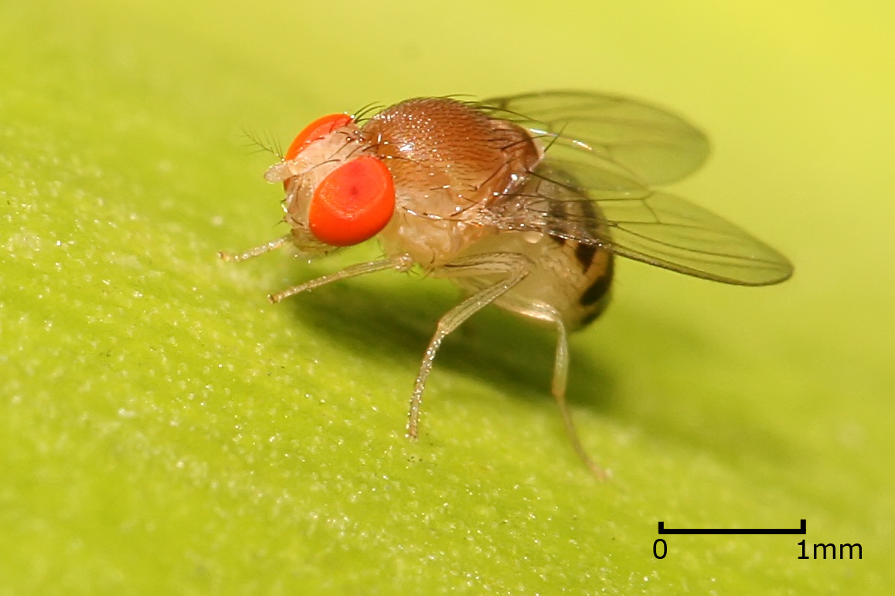
The Experiment
Effects of ethanol exposure on microbiome of D. melanogaster at different ages
Flies exposed to 50% EtOH 0, 1, or 2 times
Subjects were either young (5 days) or old (50 days)
Intestinal microbiome sequenced with Oxford Nanopore technology

Slide 3
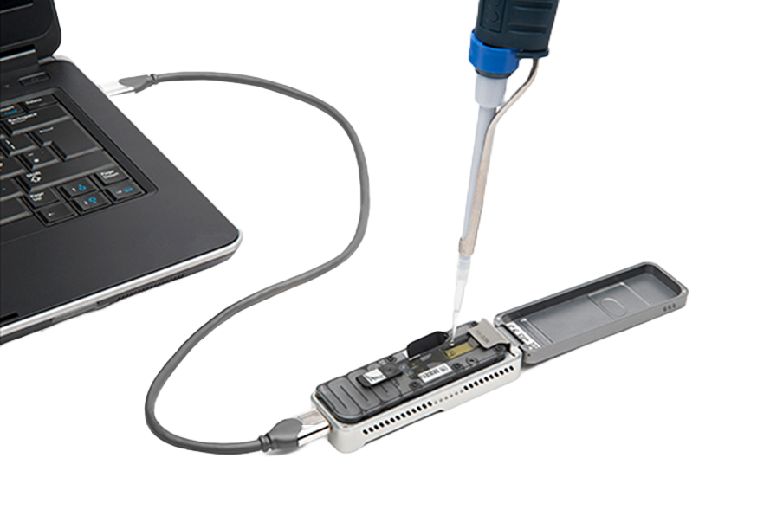
Project Goals
Oxford Nanopore sequencing allows for full-length 16s rDNA sequencing
Cheaper than others
Increased taxonomic specificity (species-level)
Rapid technological progress means few up to date pipelines for analyzing data
Pipeline useful for other experiments as well

Slide 4


NanoRTax and Epi2me
NanoRTax
Problems working with Boqueron HPCF
Dependencies (Nextflow and Kraken) and version control
Some Progress
Epi2me
Oxford Nanopore’s in-house pipeline
Does not automatically provide everything
Used R Studio to create a pipeline to for diversity and visualizations

Slide 6
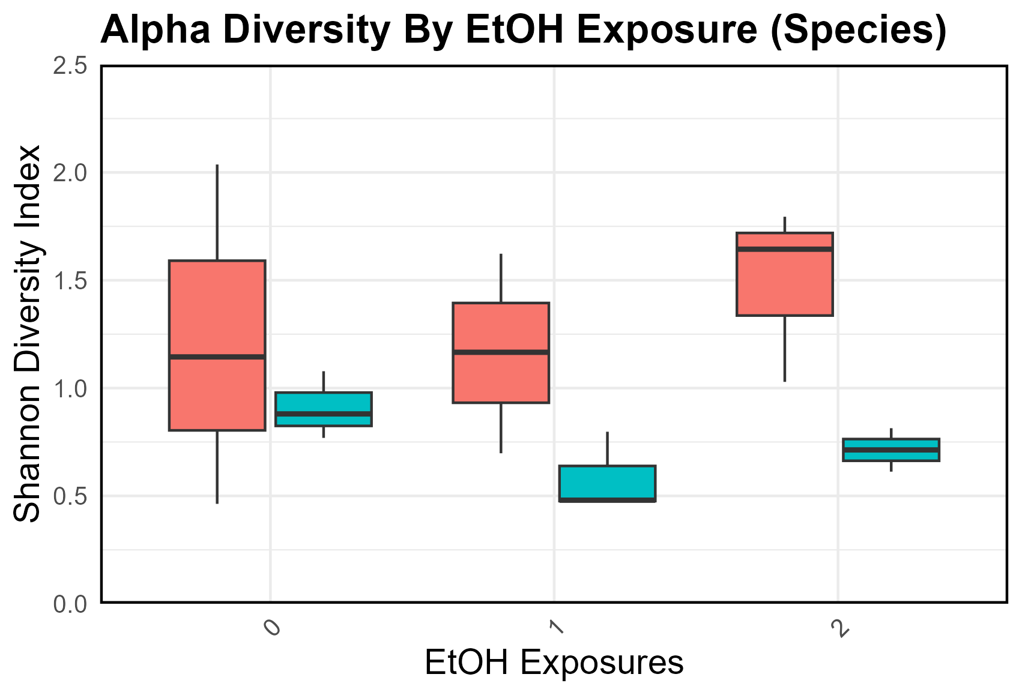
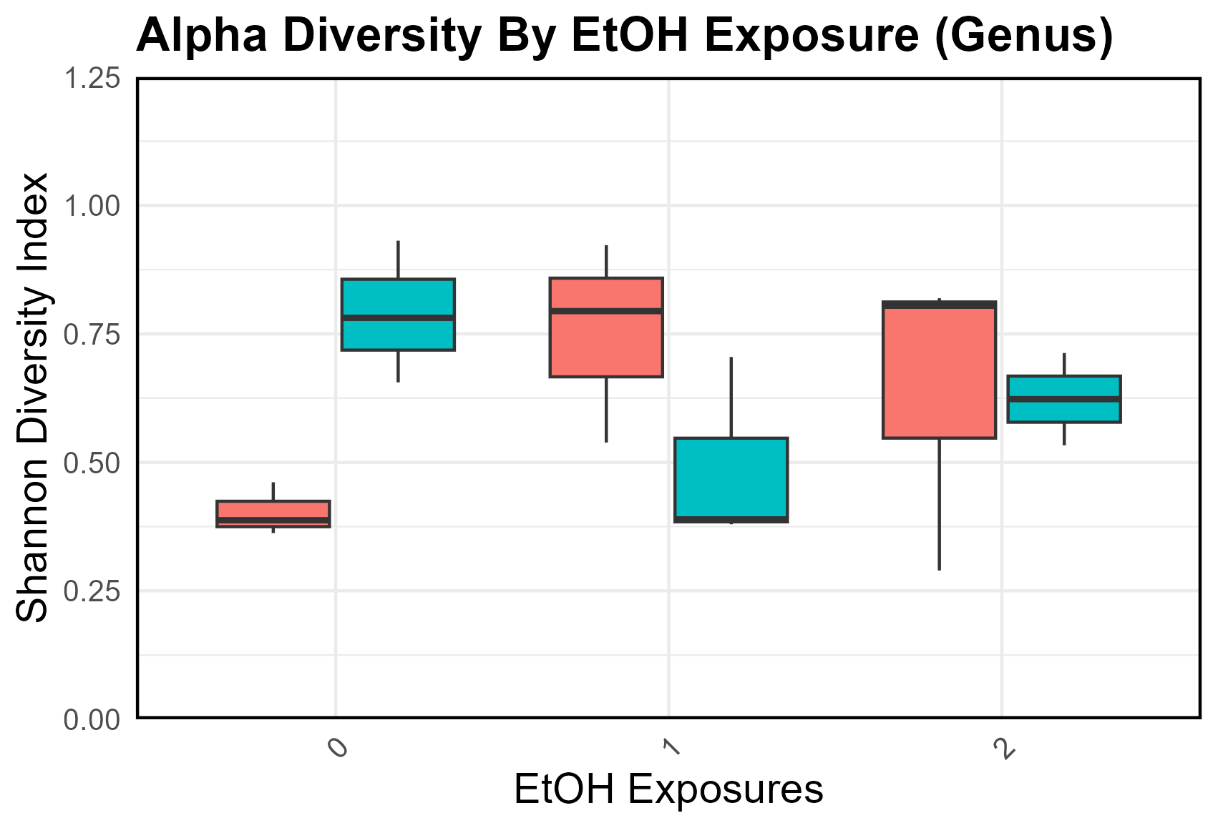

Slide 7
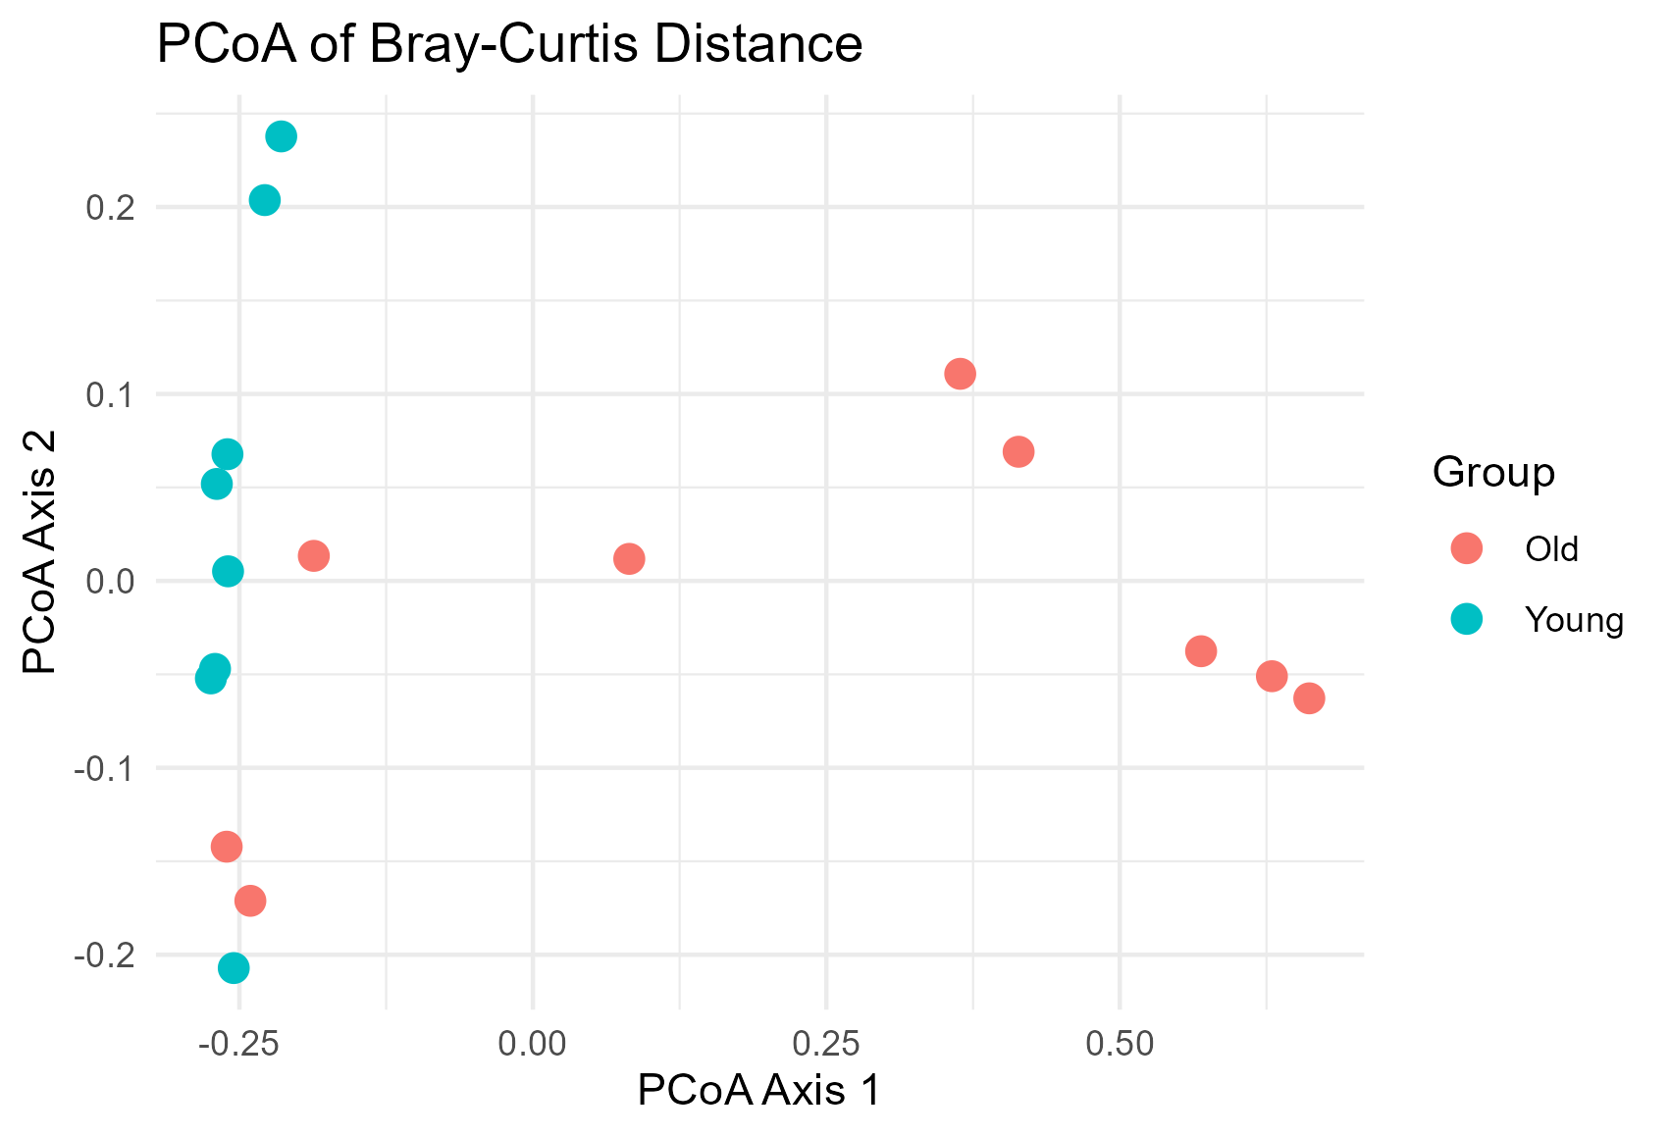
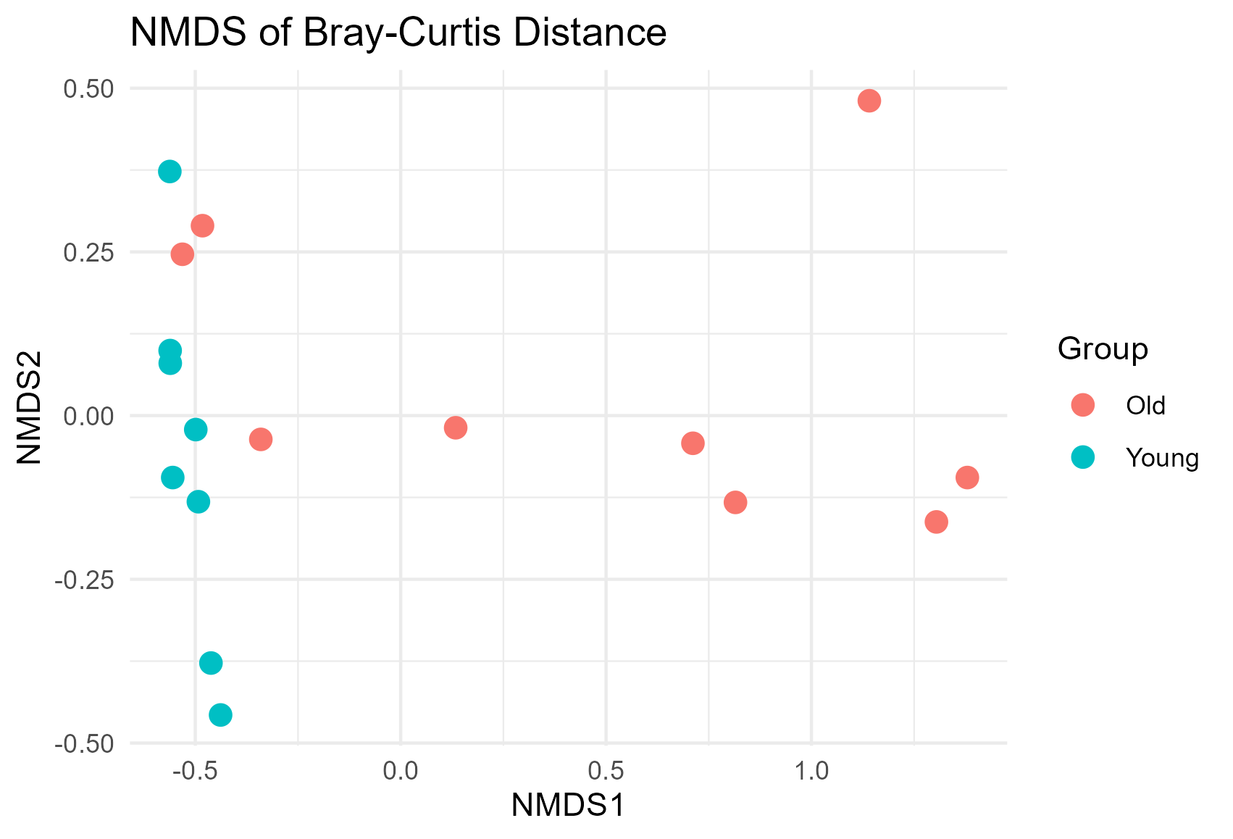
Beta Diversity

Slide 8
Conclusion

Slide 9



Acknowledgements
The lab of Dra. Imilce Rodriguez Fernandez
The University of Puerto Rico Recinto de Rio Piedras
The UPR IQ-BIO-REU: 2150326

