Slide 1
Identifying Bioinformatic Pipelines for D. melanogaster Microbiome Sequence Data
Austen Miller
Dr.Imilce A. Rodriguez-Fernandez lab
IQ BIOREU
8/1/2024

Slide 2
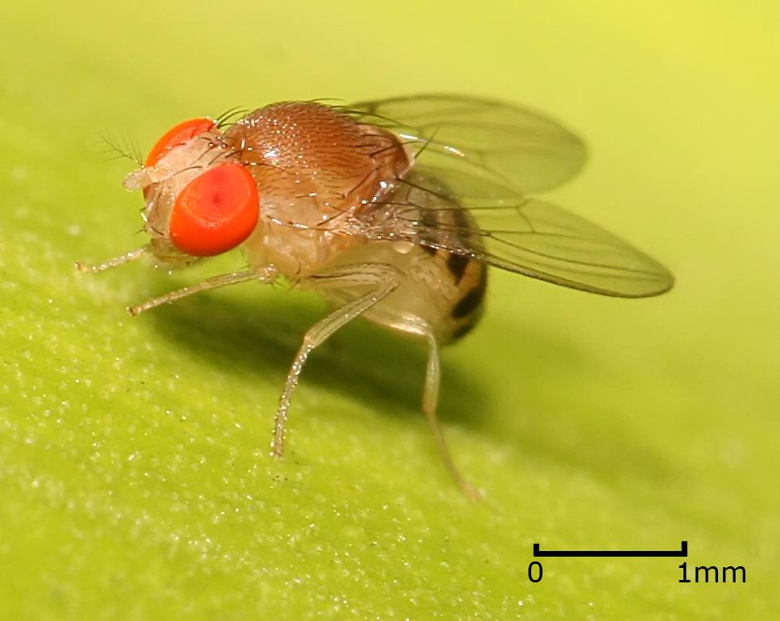

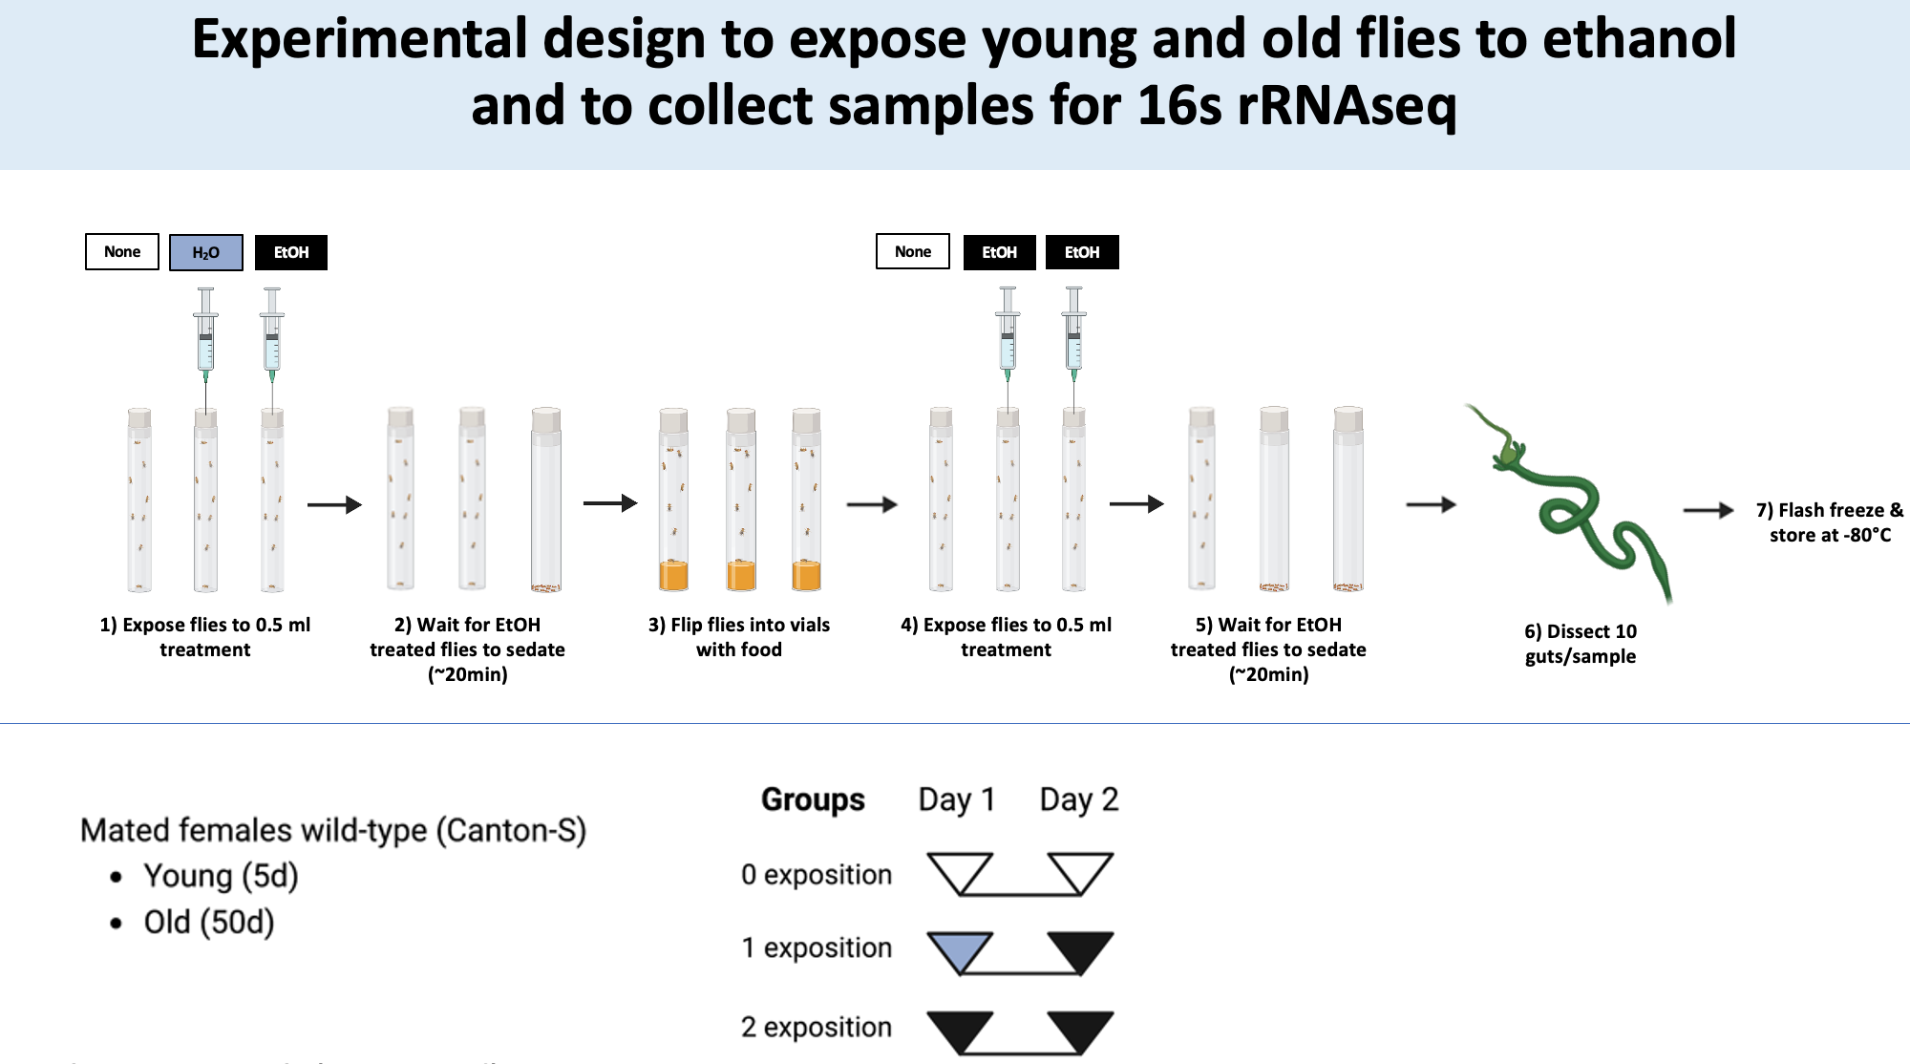
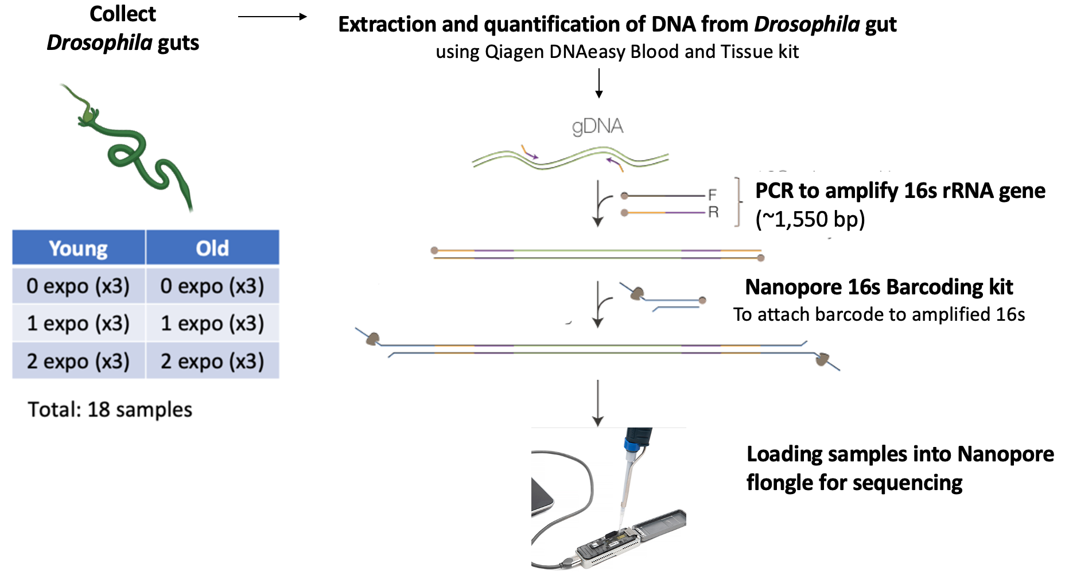
Experiment: The Effects of Ethanol Exposure and Age on D. melanogaster
10 guts per sample were collected from D. melanogaster
Bacterial DNA extracted from fly intestines and sequenced to analyze community composition
Experiment done by Jan Bilbao
Notes:
SPEAK UP

Slide 3
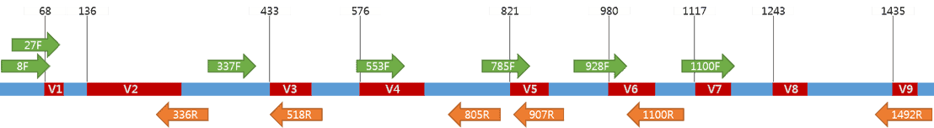

Sequencing the 16S rRNA Region with Oxford Nanopore
Explain variable regions
~300-500 bp
Limited information; genus level identification
~1500 bp sequenced using Nanopore technologies
More information, genus and species level identification
Reference: (Bioscience, Inc., 2017)
Notes:
v3 y v4 es mejor para ie=dentifiar en moscas en comparacoion con las otras variable regions
Explain variable regions, conserved regions

Slide 4
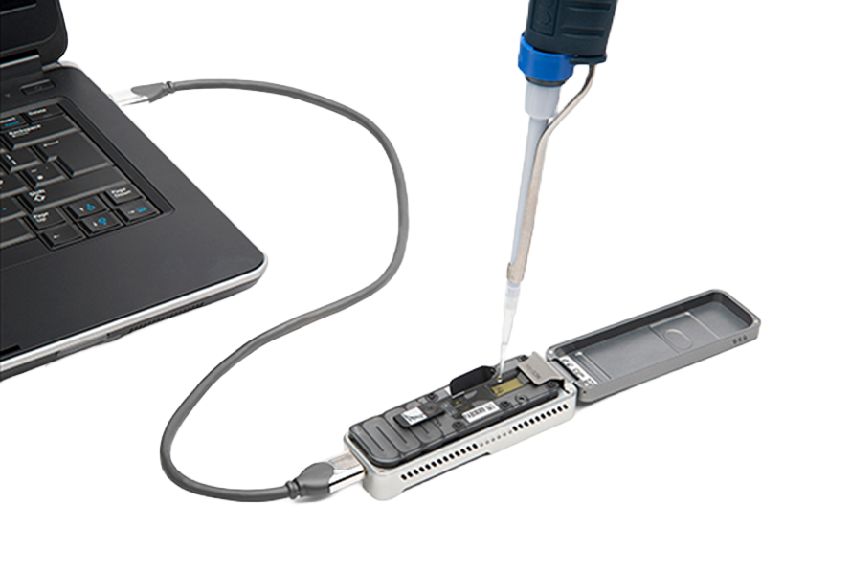
Oxford Nanopore sequencing
Pros:
Allows for full-length 16s rDNA sequencing
Cheaper than others
Increased taxonomic specificity (species-level)
Cons:
Rapid technological progress means few up-to-date pipelines for analyzing data
Current pipelines used for Illumina sequencing can not be used

Slide 5


Main goals
Implement pipelines for analysis of genomic data from D. melanogaster experiments
Epi2me
Nanopore in-house pipeline
Analyses implemented with R studio
NanoRTax
Allows for diversity analyses, visualization
Problems working with Boqueron HPCF
Add animation separating problems/explanation
NanoRTax (Rodríguez-Pérez et al., 2022), Vegan R package (Jari Oksanen et al. 2020), Tidyverse R package Hadley Wickham et al. 2021, taxize Scott Chamberlain and Eduard Szöcs. 2021.

Slide 6
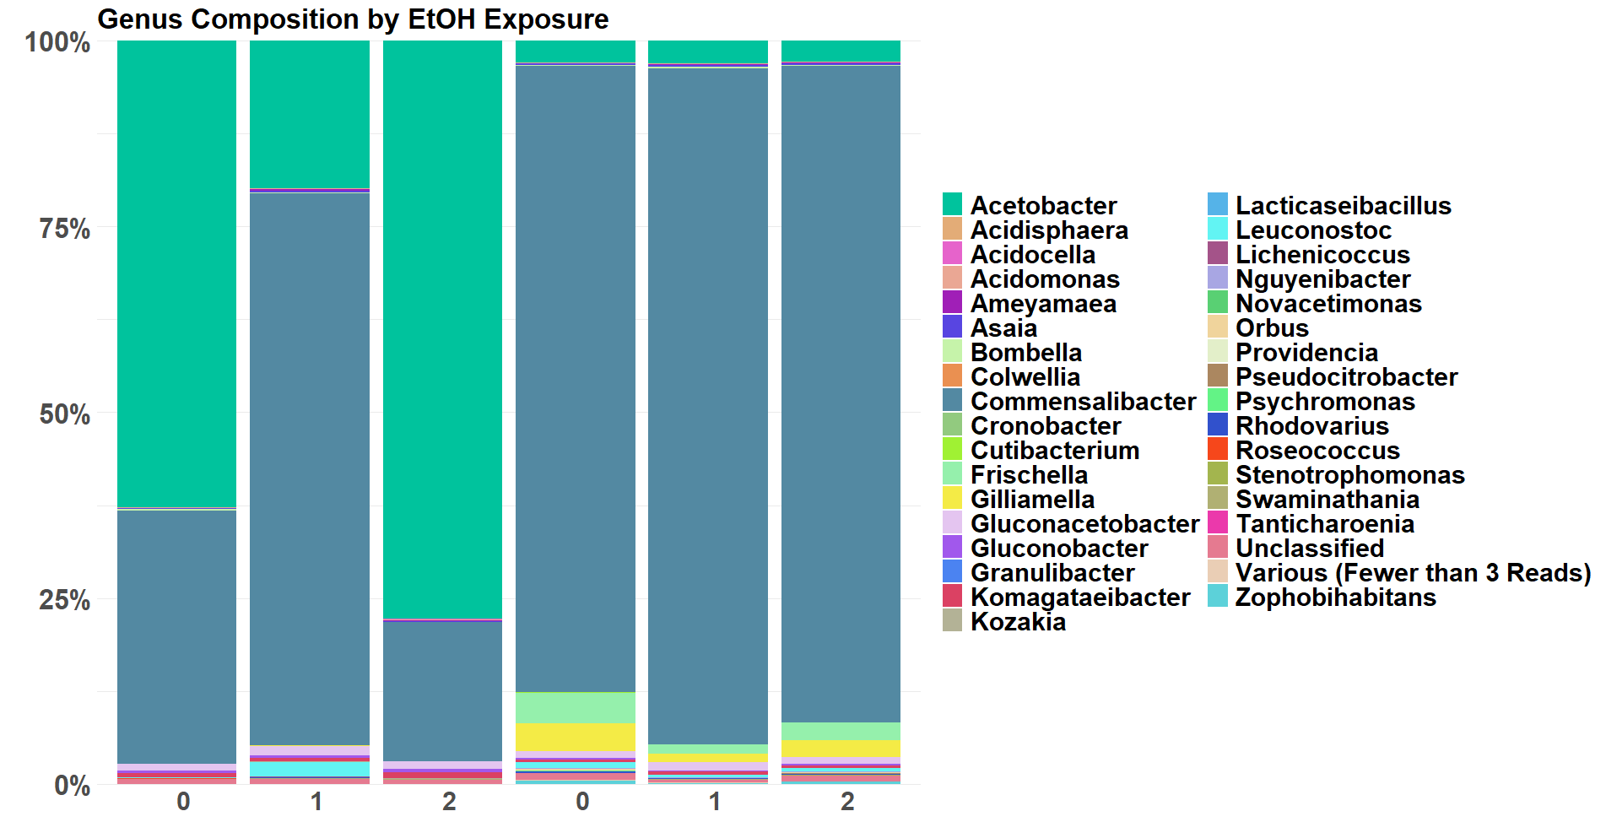
Gut bacteria genus composition by EtOH exposure and Age Group
Use just one of these?
Old
Young
Notes:
Explain the plot. Say “the colors represent genus”

Slide 7
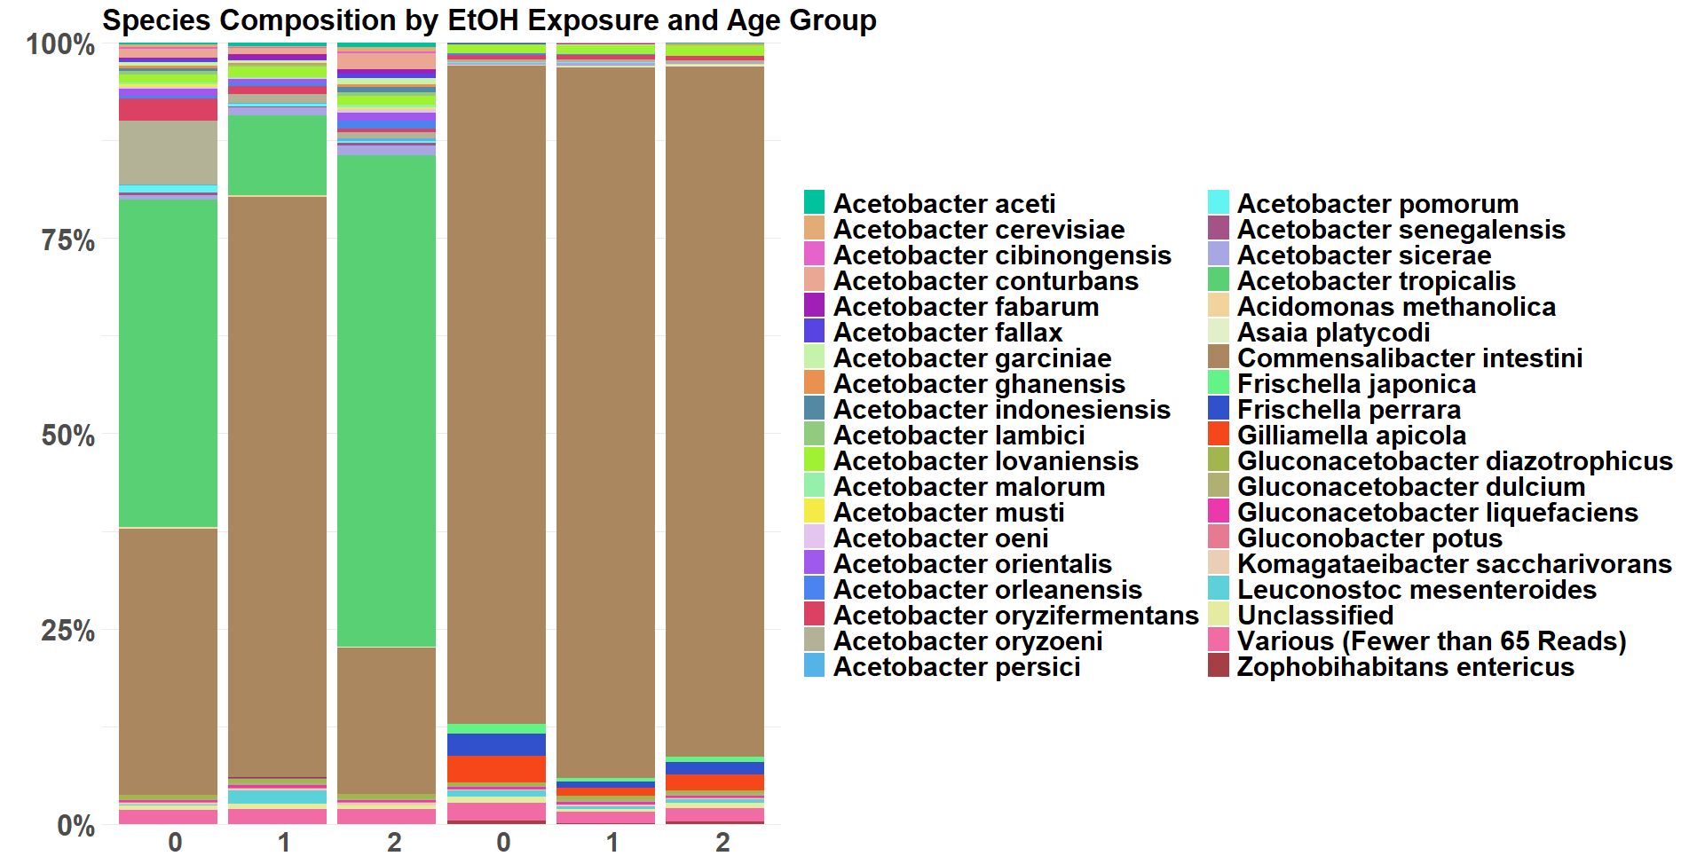
Gut Bacteria Species Composition by EtOH Exposure and Age Group
Old
Young

Slide 8
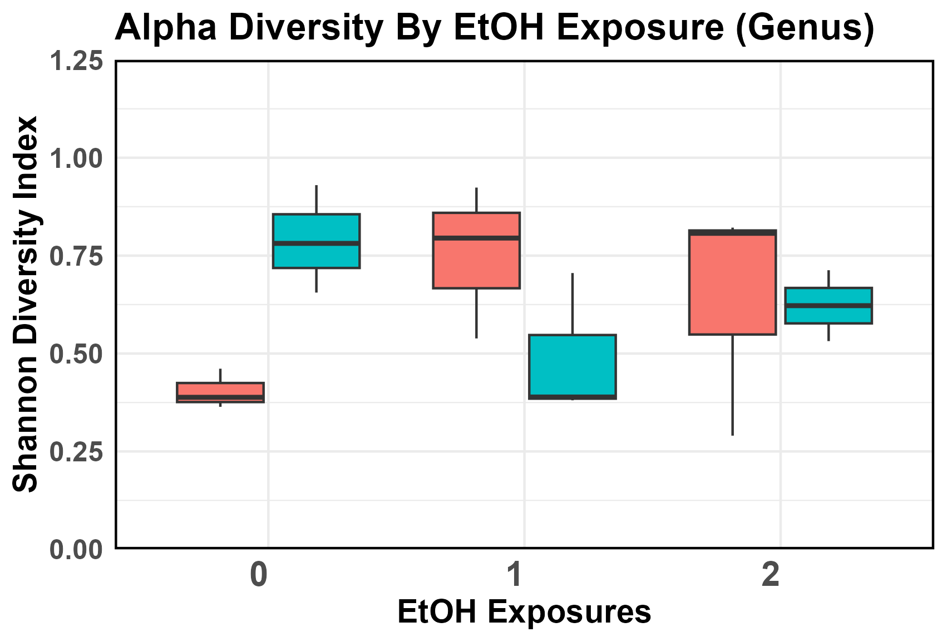
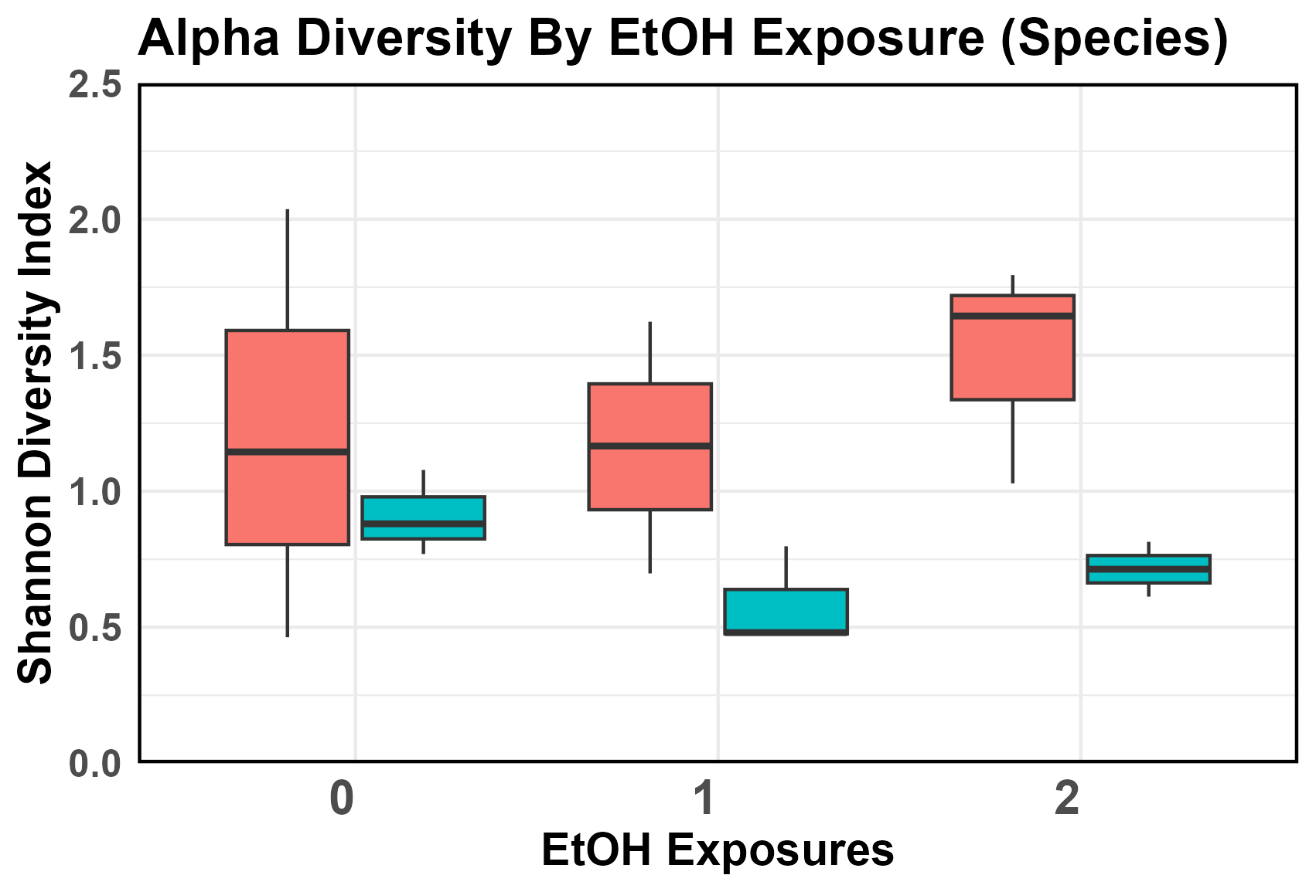
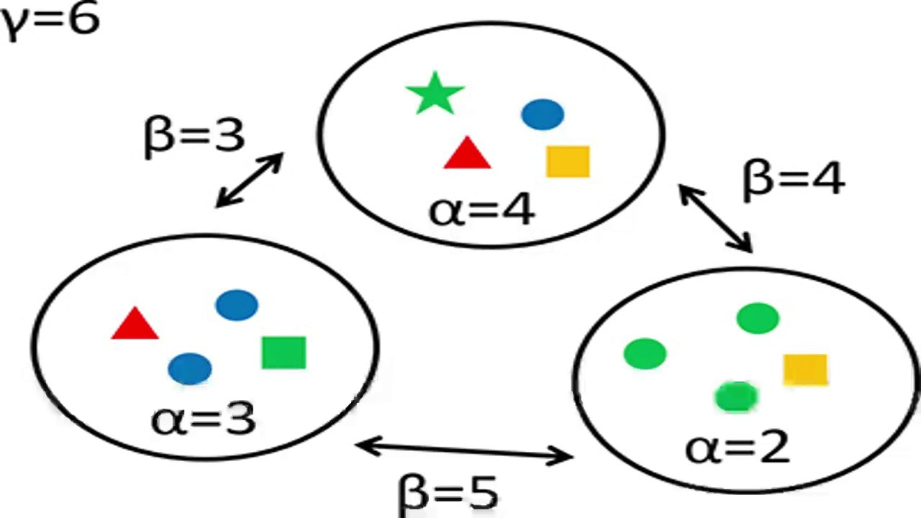


Alpha Diversity Analyses
Use just one of these
Explain alpha diversity
Notes:
Explain alpha: Alpha diversity is richness and abundance within one sample
Add simple diagram for explanation?

Slide 9
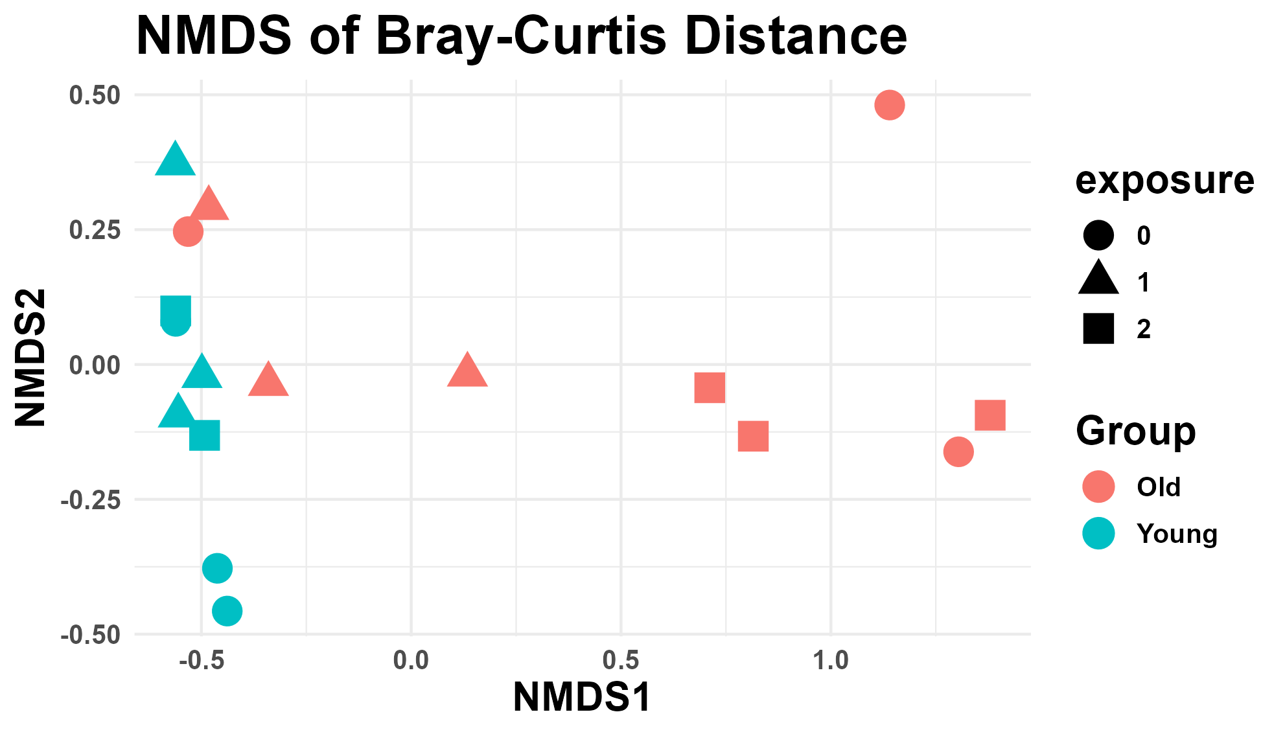
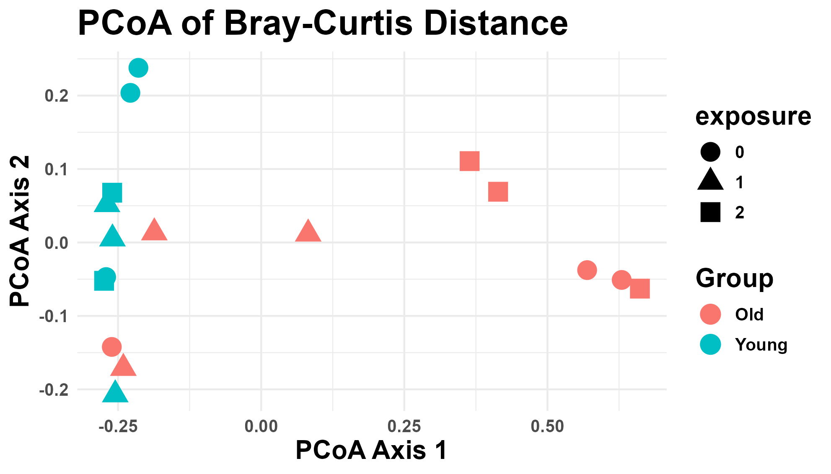
Beta Diversity Analysis
Use just one of these
Explain beta diversity
Notes:
Explain beta: “The axis on beta plots don’t matter here, what we’re interested in is the grouping of samples” Something like: "This plot shows how similar or different the species compositions are between different samples. Points that are closer together indicate similar species compositions, while points farther apart represent more distinct differences in species between those samples. Essentially, it helps visualize how the diversity of species varies across different sites or conditions.“ (ChatGPT)

Slide 10
Conclusions and future directions
NanoRTax
Problems working with Boqueron HPCF (UPR supercomputer)
Dependencies (Nextflow and Kraken) and version control
Epi2me
Does not automatically provide all analyses
Used R Studio to create a pipeline to for diversity and visualizations
Next steps: Validation by growing Acetobacter species, and sequence it using independent methods. Beta diversity with unifrac.
Add more slides with acetobacter?
NanoRTax (Rodríguez-Pérez et al., 2022)
Notes:
Add more slides with acetobacter composition?

Slide 11




Acknowledgements
The lab of Dra. Imilce Rodriguez-Fernandez, UPRRP
Kerianalee Rivera-Cruz
Jan Bilbao
The lab of Dr. Josue Perez, UPR RCM CCC
Diego Bracero
The University of Puerto Rico Recinto de Rio Piedras
NSF UPR IQ-BIO-REU: 2150326

