Slide 1
PEATCYCLE AI
Prevent the fire
before it starts.
Predictive intelligence for Malaysia's peatlands
CODEX COMMUNITY MEETUP · KUALA LUMPUR
A working MVP built with Codex
PEATCYCLE AI | PREDICTIVE PEATLAND MANAGEMENT
01

Slide 2
THE LANDSCAPE
Peatlands are a natural carbon vault — until they dry out.
A peatland is a waterlogged ecosystem built from partially decomposed organic matter.
WHAT MAKES PEATLANDS SPECIAL
WHEN THE WATER TABLE FALLS
Waterlogged soil
slows decomposition
Peat becomes dry and oxygen-rich
Organic matter becomes fuel
That stores carbon for centuries and supports unique biodiversity.
Fire can smoulder underground
Haze, emissions and lost livelihoods follow
CARBON STORED
high-value natural asset
PEATCYCLE AI | PREDICTIVE PEATLAND MANAGEMENT
02

Slide 3
THE PROBLEM
Today, many teams see the fire after the damage begins.
Monitoring data exists, but the decision loop is still too reactive.
01
02
03
Fragmented signals
Late action
Hard-to-prove impact
Sensors, weather, satellite and field notes live in separate places.
By the time smoke is visible, the intervention window is smaller and more expensive.
Teams need an evidence trail for ESG, insurance and future MRV work.
PEATCYCLE AI | PREDICTIVE PEATLAND MANAGEMENT
03

Slide 4
THE PRODUCT
PeatCycle turns raw signals into a field decision.
It is a command centre for plantation managers, agencies, conservation teams and ESG owners.
01
02
03
04
SENSE
EXPLAIN
ACT
PROVE
IoT + weather
AI reasoning
Gates + patrols
Evidence trail
The promise
Move from monitoring the peatland to managing the risk.
PEATCYCLE AI | PREDICTIVE PEATLAND MANAGEMENT
04

Slide 5
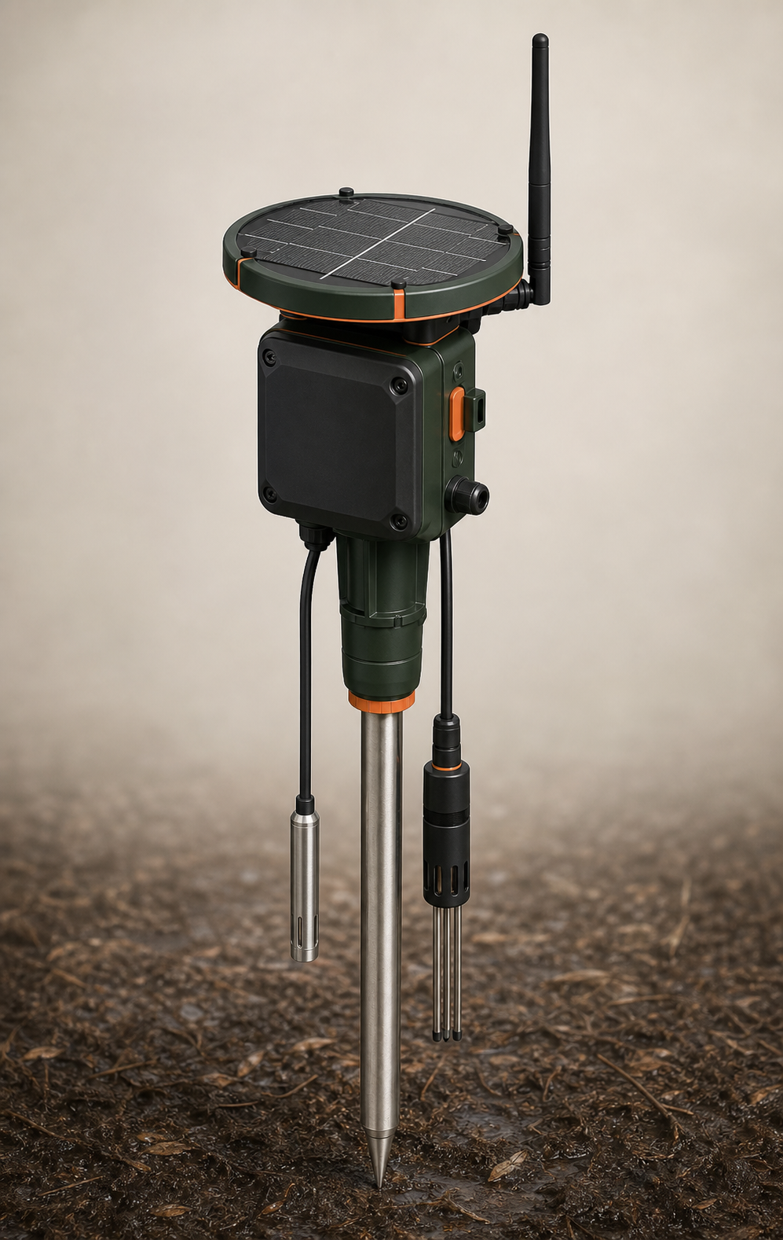
THE PHYSICAL LAYER
Yes — this can be a real product with real live sensors.
The demo uses simulated telemetry today; the same data contract can accept ESP32 / LoRaWAN field devices later.
FIELD SENSOR CONCEPT
Water-table depth probe
Soil moisture + temperature
Solar power + weatherproof enclosure
LoRa / cellular uplink to PeatCycle
Sell hardware as a deployment kit; charge software per hectare/year.
PEATCYCLE AI | PREDICTIVE PEATLAND MANAGEMENT
05

Slide 6
THE MULTI-AGENT LOOP
Three specialists reason in parallel before the dashboard gets an answer.
A lightweight orchestration pattern keeps the hackathon demo fast and deterministic.
RAW INPUT
SPECIALISTS
PREDICT
PRESCRIBE
Telemetry
Weather
Vision logs
Sensor Agent
Vision Agent
Weather Agent
Risk index
Ignition %
Carbon at risk
Water gate
Patrol
Monitoring
Promise.all
Parallel specialist execution → shared state → deterministic JSON
PEATCYCLE AI | PREDICTIVE PEATLAND MANAGEMENT
06

Slide 7
THE OPERATOR VIEW
The manager sees where the risk is — and what to do next.
The overview keeps scope, location, reasoning and action in one operational viewport.
BLOCK C · HIGH RISK
89
ignition probability
DIGITAL TWIN
Moisture 38%
Surface heat 34.2°C
Trigger water gate release
C
West wind 18 km/h
PEATCYCLE AI | PREDICTIVE PEATLAND MANAGEMENT
07

Slide 8
THE LIVE DEMO
One click runs the loop from telemetry to intervention.
The judge can watch the reasoning appear instead of trusting a static screen.
Sensor Agent
Moisture 38% · water table 42 cm
+38
79
Vision Agent
34.2°C · dry biomass detected
+27
GLOBAL RISK INDEX
3 agents coordinated
3 actions recommended
Weather Agent
18 km/h wind · 58% humidity
+18
PEATCYCLE AI | PREDICTIVE PEATLAND MANAGEMENT
08

Slide 9
THE BUSINESS
The business model follows the value of the asset and the buyer.
Commercially, PeatCycle is more than a generic SaaS subscription.
PLANTATIONS
Tiered per hectare / year
Cost scales with the estate being protected.
GOVERNMENT
Annual enterprise license
Fits budget cycles, tenders and dedicated support.
INSURERS + ESG
Readiness and evidence layer
Supports underwriting and cuts audit preparation time.
Positioning: pre-compliance and risk reduction — not an instant carbon-credit promise.
PEATCYCLE AI | PREDICTIVE PEATLAND MANAGEMENT
09

Slide 10
THE ASK
PeatCycle makes the next decision visible — before the fire does.
We are ready to move from a working MVP to a field pilot.
NEXT PILOT
WHAT SUCCESS LOOKS LIKE
Instrument one estate.
Connect the first live
water-table network.
Earlier warnings
Faster field response
Audit-ready intervention evidence
Protect the peat. Protect the people. Prove the impact.
PEATCYCLE AI | PREDICTIVE PEATLAND MANAGEMENT
10

