Slide 1
Accelerate People Ltd
Final Project – Reporting and Analysis

Slide 2





Accelerate People
Training Provider
Independent Assessment service for apprentices
https://www.instituteforapprenticeships.org/apprenticeship-standards/?routes=Digital ).
Apprentices are independently assessed by “Accelerate People” to judge their competence.
“Accelerate People” is an “End-Point Assessment Organisation“ (EPAO)
Apprentice trained 12-24 months
By “Training Provider”
&
Gains experience in a job
Accelerate People
Accelerate People
verify apprentice has
Knowledge, Skills
Behaviour
Apprentice
Apprentice awarded certificate

Slide 3
Project Outcomes
Accelerate People dashboards
Display and measure performance of multiple choice questions
End Point Assessment Dashboard
Grades by standard
Pipeline next three months by
Standard
Training Provider
Predicted/Processed Revenue
Sentiment analysis on Apprentices' feedback survey – “any other comments”

Slide 4
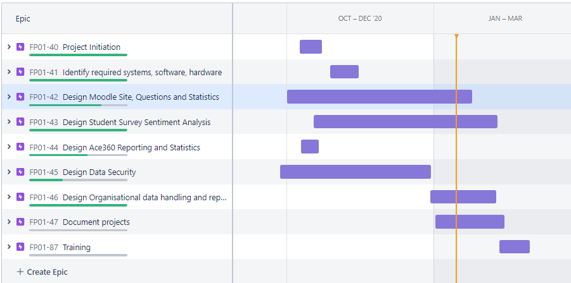
Epics – Major project areas

Slide 5
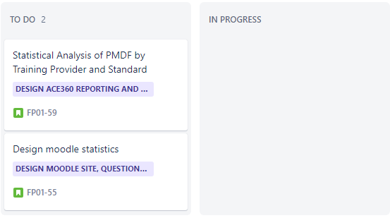
Progress this week
select qa.id,qa.questionid,qa.questionusageid,q.category,q.name,qa.questionsummary,qa.rightanswer,qa.responsesummary,qa.timemodified,qas.state,qas.fraction,qas.userid, username, from_unixtime(qa.timemodified)
from {question_attempts} qa
join {question} as q
on qa.questionid = q.id
join {question_attempt_steps} as qas
on qas.questionattemptid=qa.id
join {user} as u
on qas.userid=u.id
where qas.state in ('gradedright','gradedwrong')
order by qa.id

Slide 6
Planned next week

Slide 7
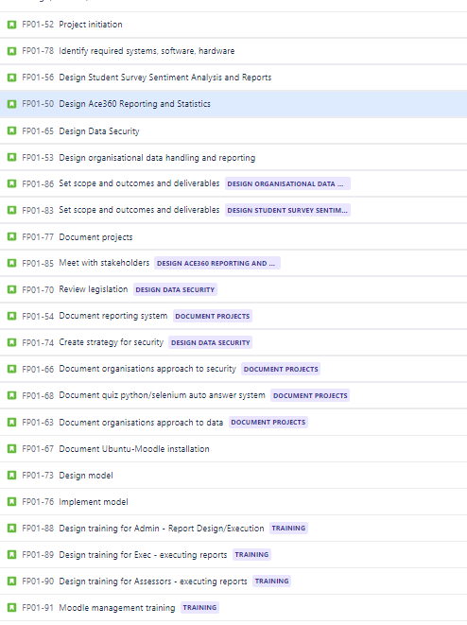
Current backlog

Slide 8
Issues
Internal teams making changes to Excel used for analysis
New company and rapid change means this will continue
Limited Moodle documentation about reporting and internal database taken a lot of time to reverse engineer

