Slide 1
Accelerate People Ltd
Final Project – Reporting and Analysis

Slide 2





Accelerate People
Training Provider
Independent Assessment service for apprentices
https://www.instituteforapprenticeships.org/apprenticeship-standards/?routes=Digital ).
Apprentices are independently assessed by “Accelerate People” to judge their competence.
“Accelerate People” is an “End-Point Assessment Organisation“ (EPAO)
Apprentice trained 12-24 months
By “Training Provider”
&
Gains experience in a job
Accelerate People
Accelerate People
verify apprentice has
Knowledge, Skills
Behaviour
Apprentice
Apprentice awarded certificate

Slide 3
Project Outcomes
Accelerate People dashboards
Display and measure performance of multiple choice questions
End Point Assessment Dashboard
Grades by standard
Pipeline next three months by
Standard
Training Provider
Predicted/Processed Revenue
Sentiment analysis on Apprentices' feedback survey – “any other comments”

Slide 4
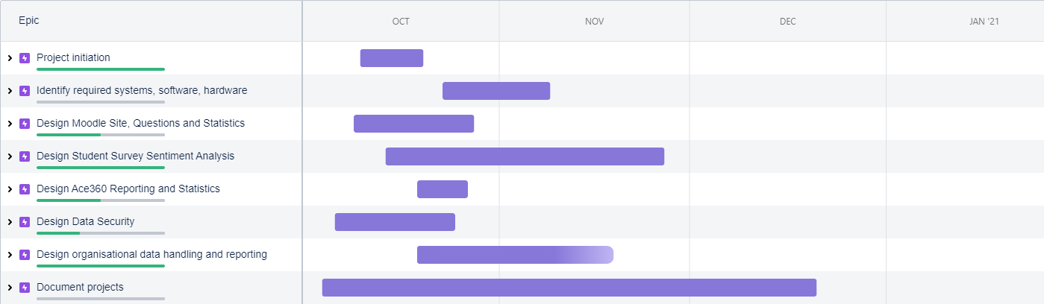
Epics – Major project areas

Slide 5
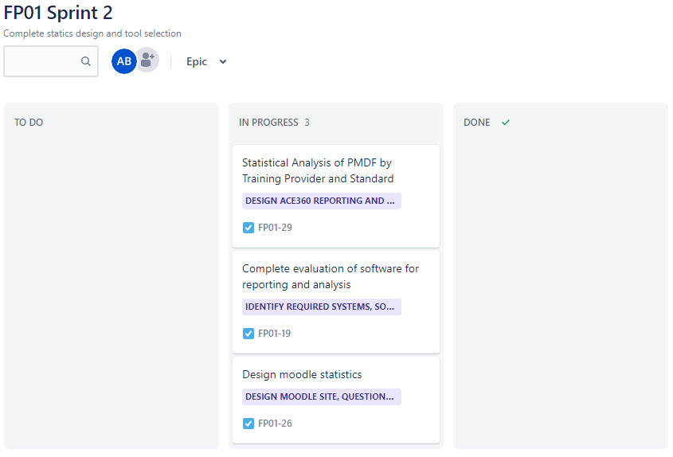
Progress this week

Slide 6
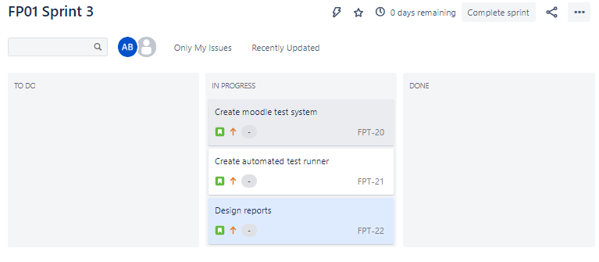
Planned next week

Slide 7
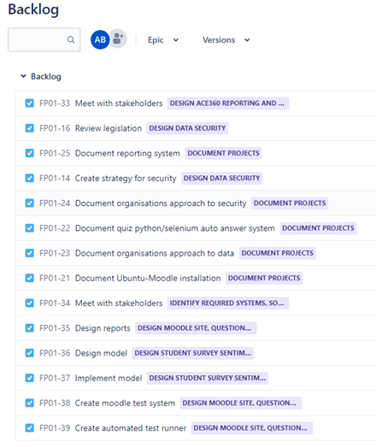
Current backlog

Slide 8
Issues
There is no relievable pipeline of assessments to allow – prediction of net 3 months
Will need alternative approach / change to project

