Slide 1
Accelerate People Ltd
DaTA ANALYST Level 4 - Synoptic Project GUIDENCE
Sale Example

Slide 2
Accelerate-People
To be completed last

Slide 3
Project with presentation and questioning (AM1)
Assessment Method One - of the End-point Assessment requires an apprentice to complete a work-based project
It must be completed by the apprentice after they go through the EPA gateway
It must be a real work project that an apprentice completes which has been designed to meet the prescribed outcomes listed in the Assessment Plan and agreed between the employer, apprentice and EPAO
An apprentice must compile and submit a 3,500 word report, then create and deliver a presentation based on the report and key findings for 20 minutes followed by questioning
An apprentice will need complete their project and submit it to the EPAO after a maximum of 8 weeks of their EPA start date.
This could be broken down to include;
6 weeks work
2 weeks write up
Please note an Employer and Apprentice are free to agree the project completion timescales, to cover any duration up to and including the 8 week maximum specified timeframe.

Slide 4
Key Responsibilities (TBC)
An Apprentices will need to
Ensure the project idea has suitable depth to meet the required project scope, is real work and has real business value
Agree a suitable project with their employer
Estimate the time required to complete the project and any resources required
Ensure that project report covers the required project structure
To complete a 3500 word project and submit an electronic report.
To submit their project to the EPAO within 8 weeks of the EPA start date.
The project should be submitted in the form of an electronic report and should comprise an explanatory narrative which sets out the tasks undertaken as well as accompanying visual infographics
An Employer will need to;
Ensure the project idea has suitable depth to meet the required project scope, is real work and has real business value
Agree a suitable project with their apprentice with delivers real business value
Will ensure the apprentice has sufficient time and the necessary resources, within this period, to plan and undertake the project.
Ensure the apprentice is subject to the supervision arrangements which exist normally within the workplace
Ensure the apprentice conducts their project and submit it to the EPAO within the maximum of 8 weeks of the EPA start date.

Slide 5
Required Project Scope
An employer and apprentice will need to decide on a suitable work based project to complete, it is important they ensure that any project ideas considered MUST have suitable scope and business value to enable the apprentice to demonstrate via their report, presentation or questioning the following criteria;
Operates data systems in compliance with all organisational and legislative requirements including principles of Privacy by Design
Outlines and applies the principles of data lifecycle to the steps of data analysis
Describe the principles of different data types, including open, public, administrative and research data and how they relate to the data used within the project
Demonstrates a reasoned application of the principles of data typography, explains where any flexibilities in application have been applied and their purpose
Identifies quality risks in data analysis and outlines methods to mitigate, escalate and/or resolve them
Outlines and applies the principles for defining customer requirements and implements findings in data analytics planning and outputs
Demonstrates how data from different sources is combined and prepared for data analysis setting out how they identified the risks and challenges inherent in combining data within the project.
Describes the tools and methods used by their organisation for data analysis and identifies which were used within the project with reasoning for the choices made.
Analyses data sets taking account of different data structures and database designs
Outlines the choice of organisational data architecture
Communicates and collaborates with all relevant stakeholders and adapts communication style to meet audience and situational requirements
Describes how they work independently and collaboratively detailing their impact on the work of others
Acts independently to establish logical and analytical solutions such as exploring new data sets or resolving issues within the data

Slide 6
Stretch Criteria
Insert Distinction

Slide 7
Formulating a Project
Identify potential project – formulate a hypothesis (what is the problem you are trying to solve or question your are trying to answer)
Discuss project with Line Manger – short list ideas
Is the data available?
Is it a real problem?
Does it have business value?
Does the project allow for coverage of the required project scope?
Review potential ideas against required project scope
Adjust idea to ensure it allows full coverage of project scope
Ensure any adjustment maintains business value
Agree timescales with line manager
Agree and identify resources required
Submit project title, start date, project mapping declaration to Accelerate People
Complete Project
Submit Project
Create Presentation
Deliver presentation

Slide 8
Project Structure
The 3,500 word report as a minimum MUST include:
Project Title (e.g Patterns / trends and predictions - Sales Data Analysis)
an introduction.
the scope of the project (including key performance indicators).
project outcomes and how the outcomes were achieved.
a project plan.
consideration of legislation, regulation, industry and organisational policies, procedures and requirements.
Analysis.
research and findings.
recommendations and conclusions.
The project must include a map, in an appendix, detailing how it evidences the relevant Knowledge Skills and Behaviours for this assessment method. (Appendix 1)
Appendices, references, diagrams etc. will not to be included in the project word count.

Slide 9

Project Topics – Example sales data analysis
There are three main suggested broad areas:
Patterns / trends and predictions
Presenting statistical analysis results to inform decisions
Optimising data models using statistical measures

Slide 10

Project Topics – Example sales data analysis
The report must include:
Patterns / trends and predictions - Sales Data Analysis
an introduction – what the organisation does what is the overall purpose of this project
GetGadget are a retail organisation selling electronic goods. Typically phones, tablet, laptops and accessories. Recently profit has dropped and the managing directory would like to analyse why.

Slide 11
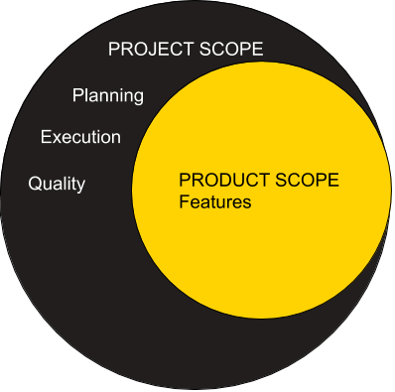
Project Topics – Example sales data analysis
The report must include:
Patterns / trends and predictions - Sales Data Analysis
the scope of the project (including key performance indicators). – What the project includes which departments, years, products are/are not included in project
The project will identify profit for the “online sales” department over the last 5 years. The profit will be use data for all products sold over this timescale and used to identify the most/least profitable products, identify trends and create recommendation to optimise future sales. Other costs such as building, services, salaries can be excluded from analysis.

Slide 12

Project Topics – Example sales data analysis
The report must include:
Patterns / trends and predictions - Sales Data Analysis
project outcomes and how the outcomes are to be achieved.
The project objects and deliverable are
Objectives
Analyse sales data to generate recommendations so that future sales can be optimised for the sales director
Create a production systems which can be used to create future recommendations automatically
Deliverable
Project Report – Summarising the project and recommendations for the Sales Director
Data Analysis Report – Identifying key analytical steps so that other analyst can recreate the analysis
A model used to optimise sales
Create an operational environment where the model can be used by non-technical staff

Slide 13
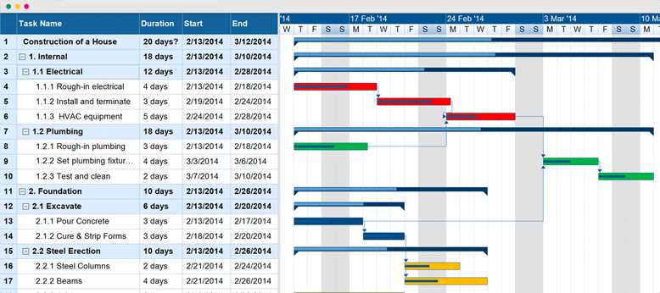
Project Topics – Example sales data analysis
The report must include in the report
Patterns / trends and predictions - Sales Data Analysis
a project plan.
How do you collect, clarify and manager customer requirements
Resources: for example costs, timescales, people, data, systems access, software
How data will be ETL
Dependencies
Risks / Issues
Data security
Data Classification
Apply you organisations analysis Lifecyle and how you will follow it
Identify the data public, administrative or research and how you apply principles of data
Plan the tools and methods needed to complete the analysis
Outline the reasons for selecting the tools and methods

Slide 14
Project Topics – Example sales data analysis
The report must include:
Patterns / trends and predictions - Sales Data Analysis
a project plan – continued
Identify how you implement “Privacy by design”
Identify relevant regulation
Identify relevant organisation policies and procedures
Identify how you will communicate with stakeholders
Show how you adapt you communication to suit the audience

Slide 15
Project Topics – Example sales data analysis
The report must include:
Patterns / trends and predictions - Sales Data Analysis
consideration of legislation, regulation, industry and organisational policies, procedures and requirements.
The UK / European / International legislation impacting this project and why – for example GDPR.
Sector regulation impacting this project – For example “PCI Payment Card Industry” regulation and what impact that has.
GetGadget policies and procedures that impact this project and why these are important

Slide 16
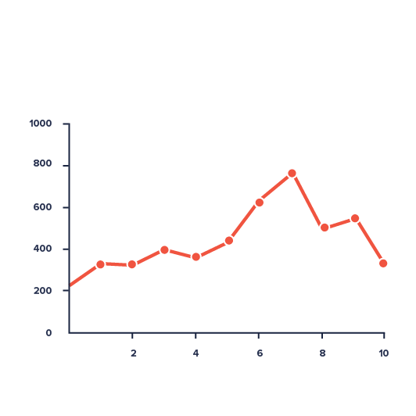
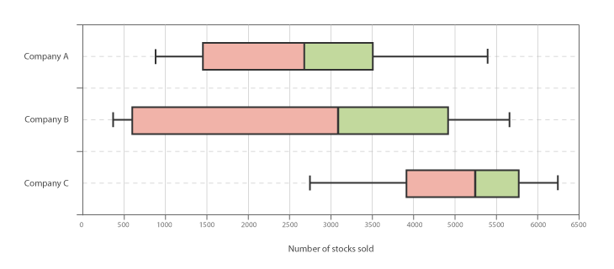
Project Topics – Example sales data analysis
The report must include:
Patterns / trends and predictions - Sales Data Analysis
Analysis.
How was data from different sources combined
What were the risks and challenges
How the data was analysed
What do the statistic show for example
What was the model you used for analysis
How does the analysis support the business questions
identify the most/least profitable products,
identify trends and create recommendation to optimise future sales.
What statistical models were applied
What graph/charts/plots were used for analysis
How can the model be applied to predict the future and answer the business questions
Did the modelling fail and show nothing – this is a successful and valid project
But explain why it fail

Slide 17
Project Topics – Example sales data analysis
The report must include:
Patterns / trends and predictions - Sales Data Analysis
Analysis. – continued
What quality risks are there
There is insufficient data
The data quality is poor – for example missing values
How can you mitigate the risks of poor data
What alternative data sources are there
How do you validate the data
What escalations are/were needed to complete the analysis
Identify how different data structures impact analysis
How did different data set / structures improve accuracy and efficiency

Slide 18

Project Topics – Example sales data analysis
The report must include:
Patterns / trends and predictions - Sales Data Analysis
research and findings – in terms of business impact
What did the analysis show and how does that relate the business question
identify the most/least profitable products,
identify trends and create recommendation to optimise future sale
For example
Sales in December are very high
Black Friday sales did not increase over previous months
January is very low sales month
Two products produced 80% of the profit
iPhone premium case & USB C universal charger
The bottom 10 selling product are making no profit

Slide 19

Project Topics – Example sales data analysis
The report must include:
Patterns / trends and predictions - Sales Data Analysis
recommendations and conclusions – in terms of business actions
Provide business recommendations
Sales in December are very high – buy bulk stock in advance at a discount
Black Friday sales did not increase over previous months – advertise Black Friday deals and measure result
January is very low sales month – design deals to encourage January sales
Two products produced 80% of the profit - Identify opportunity to get supplier discount
Stop selling the bottom 10 selling items - identifying other products to sell
Identify Risks – for example data security and outline steps to mitigate risks
Outline new methods of analysis to operationalise
Identify new tools needed and there business benefits
Did you meet the project requirements outlined at the start

Slide 20
Project Topics – Example sales data analysis
The report must include:
Patterns / trends and predictions - Sales Data Analysis
recommendations and conclusions – continues
Evaluate the outcomes of the analysis and evaluate the benefit to stakeholders of
Using alternative tools
Using alternative methods

Slide 21
Grading Slide

Slide 22
Top Tips or Checklist

Slide 23
Questions & Feedback

Slide 24
Appendix 1 - Knowledge
KSB | Description
K3 | Principles of the data analysis life cycle and the steps involved in carrying out routine data analysis tasks
K4 | Principles of data, including open and public data, administrative data, and research data
K8 | Quality risks inherent in data and how to mitigate/resolve these
K9 | principal approaches to defining customer requirements for data analysis
K11 | Approaches to organisational tools and methods for data analysis
K12 | Organisational data architecture

Slide 25
Appendix 2 - Skills
KSB | Description
S1 | Use data systems securely to meet requirements and in line with organisational procedures and legislation, including principles of Privacy by Design
S2 | Implement the stages of the data analysis lifecycle
S3 | Apply principles of data classification within data analysis activity, flexing approach as necessary
S4 | Analyse data sets taking account of different data structures and database designs
S6 | Identify and escalate quality risks in data analysis with suggested mitigation/resolutions as appropriate.
S7 | Undertake customer requirements analysis and implement findings in data analytics planning and outputs
S8 | identify data sources and the risks, challenges to combination within data analysis activity
S12 | collaborate and communicate with a range of internal and external stakeholders using appropriate styles and behaviours to suit the audience

Slide 26
Appendix 3 - Behaviours
KSB | KSB Description
B3 | Works independently and collaboratively
B4 | Logical and analytical

