Slide 1
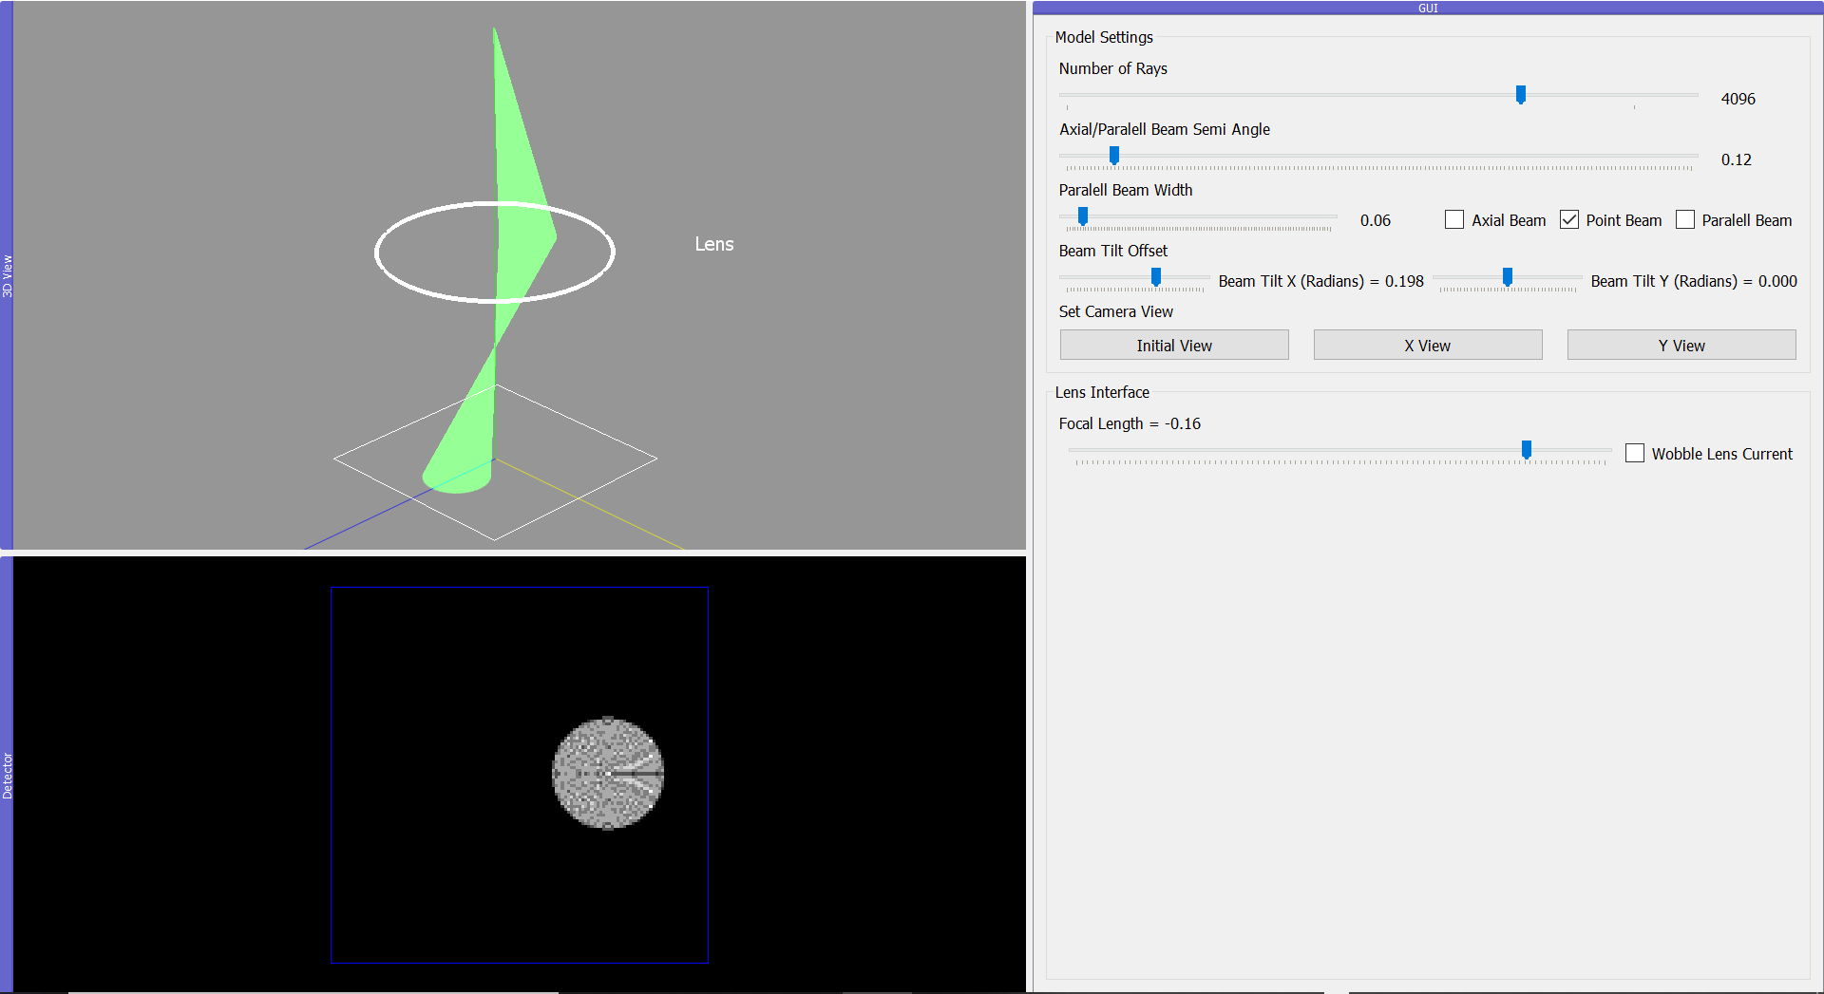
3D Ray Path Viewer
Modify Number of Rays
Tilt Beam
Wobble Focal Length of Lens
Detector Window
GUI Window

