Slide 1


Integration of multiomics
M. Davids
Bioinformatician - Microbiota center Amsterdam
Lab. Experimental Vascular Medicine
Amsterdam University Medical Centers, AMC
https://microbiotacenter.nl/

Slide 2
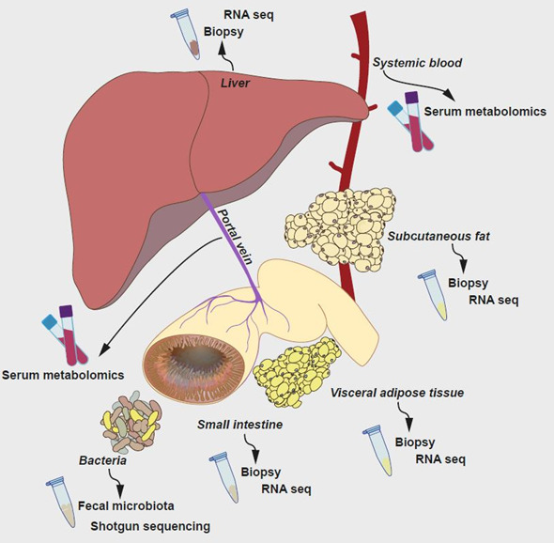
Multiomics in BARIA
Transcriptomics
180k features x 1200 samples
4 Sample Types
2 Time Points
Metabolomics
1500 features x 1200 samples
3 Sample Types
4 Time Points
Metagenomics
12000 features x 700 samples
3 Sample Types
4 Time Points
Clinical
500+ patients
100+ features
> 250M data point

Slide 3
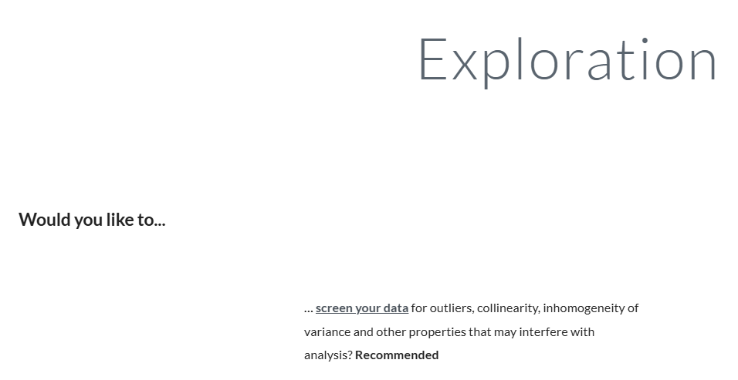
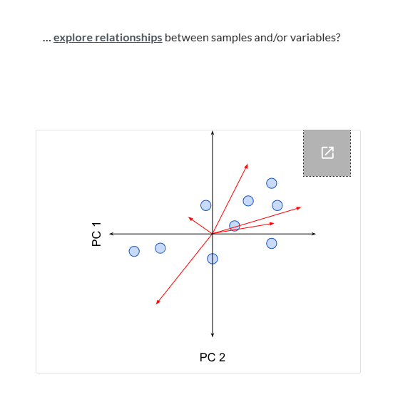
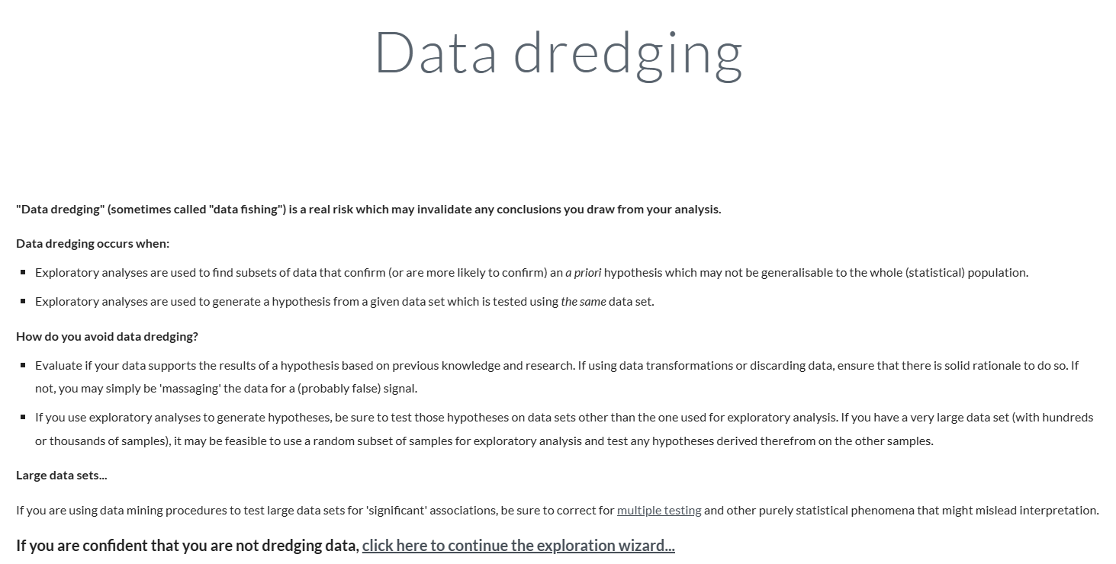
How to proceed? GUSTA ME! (GUide to STatistical Analysis in Microbial Ecology)

Slide 4
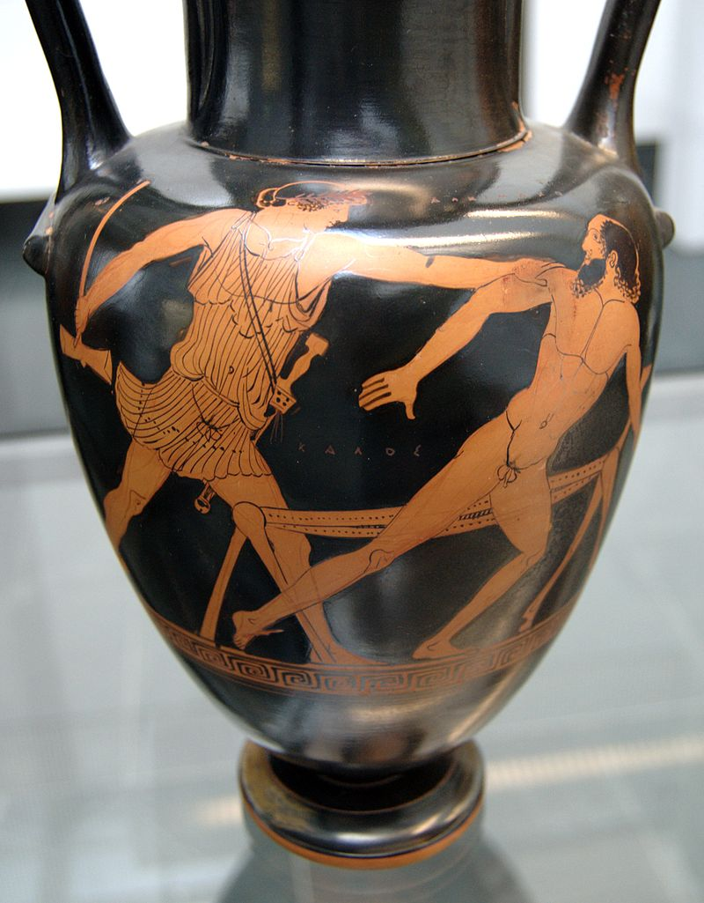
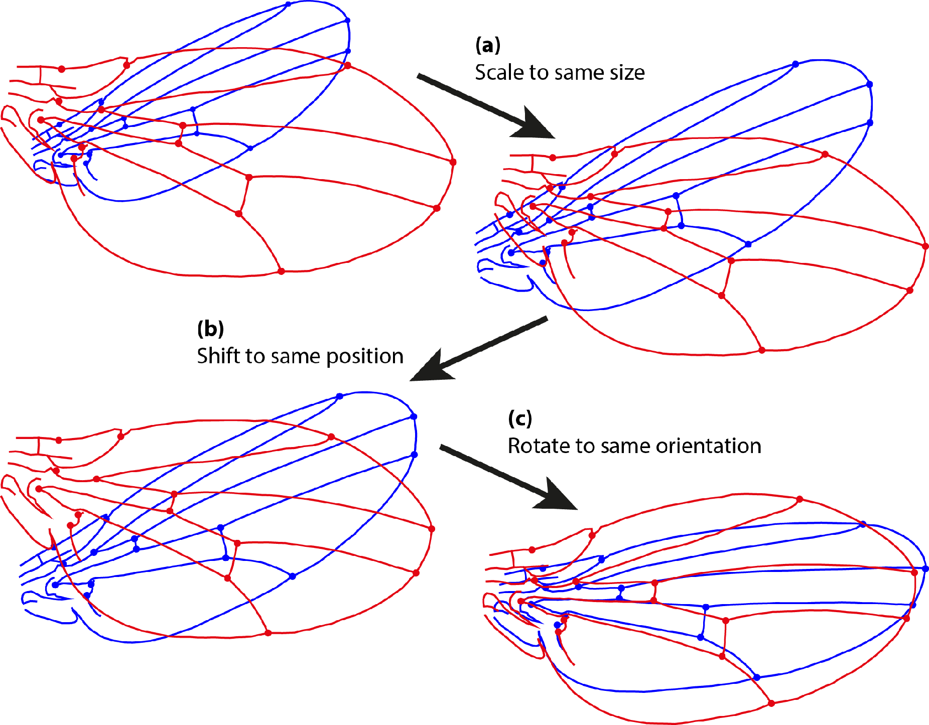
Procrustes (the stretcher)

Slide 5
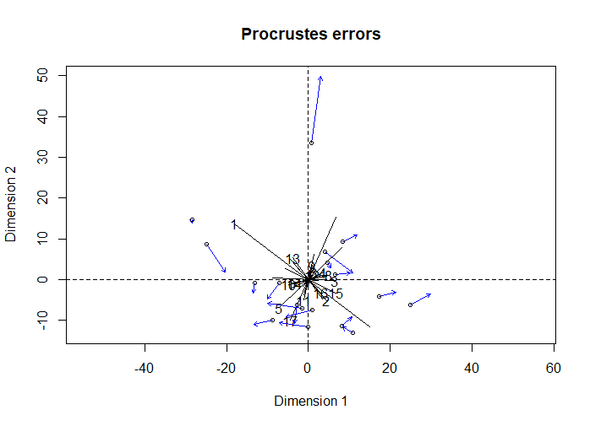
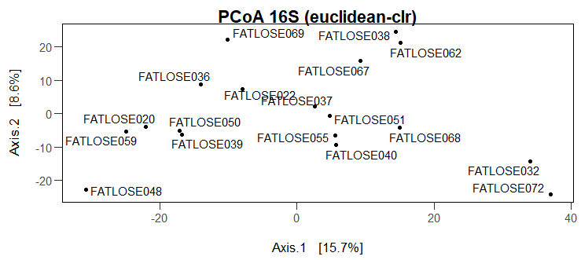
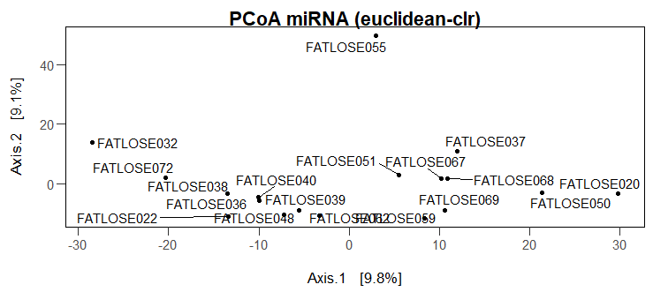
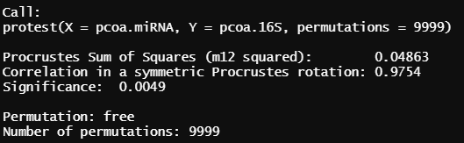
Procrustes (The stretcher)

Slide 6
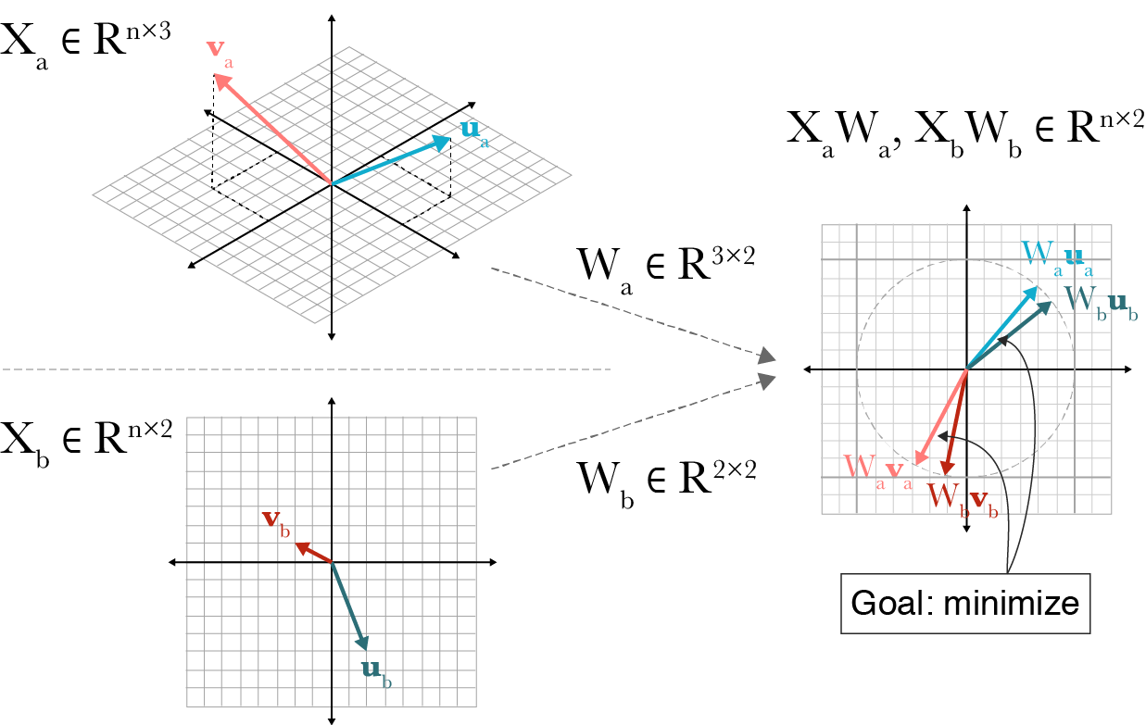
Canonical Correlation Analysis
CCA is dimensionality reduction approach by maximizing the correlation of the features between the datasets.
Variance in the data that is not coherent between both datasets is reduced.

Slide 7
Multivariate analysis resources
Gusta ME:
https://sites.google.com/site/mb3gustame/home
mixOmics:
http://mixomics.org/

