Slide 1
Build Synthetic Data Generation (SDG) Pipeline in a Digital Twin World
Background & Motivation
Synthetic Data Generation(SDG)
SmolVLA Post-Training
Evaluation in Virtual World
Summary

Slide 2
Background & Motivation
Data Scarcity in Embody AI: expensive, slow, and hard to scale
robot policy learning requires physical interaction with the real world
Data Pyramid for Robots
[Real Robot Data] ← best fidelity but most scarce and expensive
↑
[High-Quality Demonstration Data(teleop / VR)] ← human in loop, high fidelity
↑
[Synthetic/ Simulation Data] ← easy large-scale in simulation virtual world
↑
[ Weekly-Supervised Human Video Data] ← Internet-scale，no action labels

Slide 3
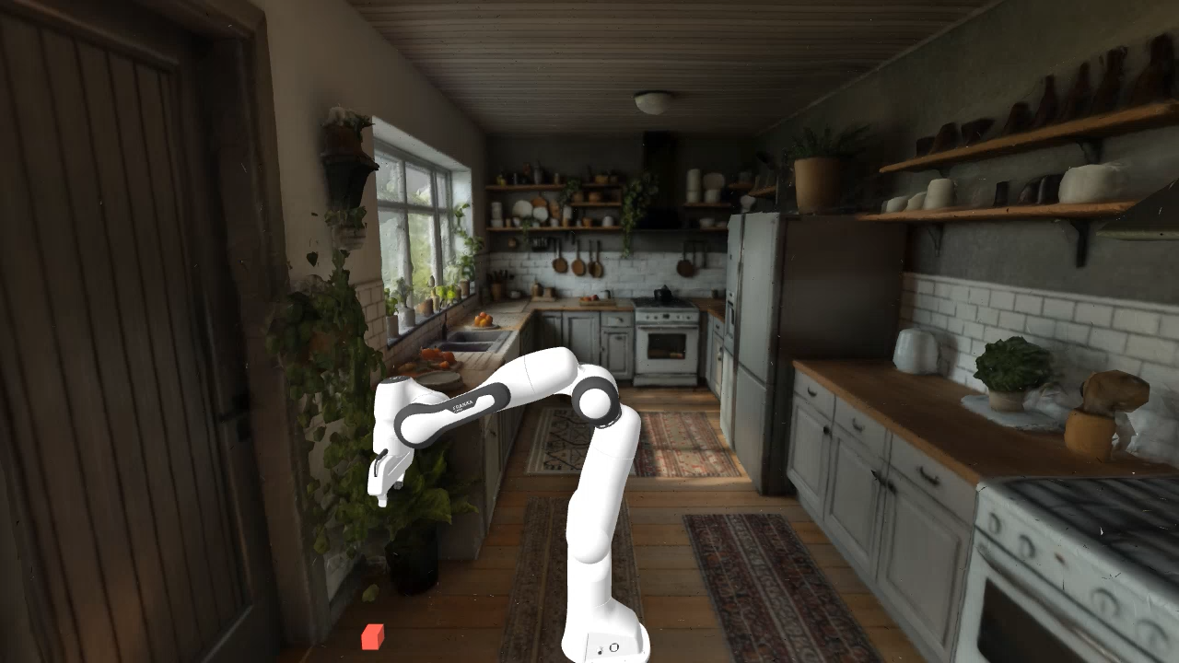
Synthetic Data Generation(SDG)
SDG is to use physical-fidelity world to generate unlimited expert demonstrations automatically
Creat Virtual Scene/World
Generate virtual world by World Lab Marble
Reconstruct/Regenerate with 3D Models
Physical Engine, e.g. Mojuco, PhysicX
Data Augmentation, e.g. Domain Randomization
In this workshop, we use World Lab Marble for scene creation + Genesis for the remaining
Data Generation
VLA Post-Train
Evaluation in Sim
Franka Arm 7-DOF
“pick red cube”
2 cameras (up/wrist)
Lerobot/smovla_base
Freeze vision encoder
Train action experts only
unseen cube poss for evaluation
Success rate as metric

Slide 4
SmolVLA Post-Training
Component | Details
Architecture | VLM (SigLIP + SmolLM2) + Action Expert
Inputs | images (up + wrst) + state (9D) + language task
Output | action chunk (50 × 9D joint targets)
Total params | ~450M
Trainable params | ~5M (expert only, vision encoder frozen)
Metrics | R9700(RDNA4) | MI300(CDNA3)
Train time(mins) | 3.6 | 5.5
Per-step(s/step) | 0.09 | 0.14
Epochs | 1.2 | 1.2
Final Loss | 0.06 | 0.012
Init Loss | 2.09 | 0.49
GPU Peak VRAM(GB) | 2.27 | 2.24

Slide 5
Evaluation in Virtual World
 | Replay(sanity check) | Closed-loop(real eval)
Action Source | Pre-recorded dataset | Model real-time inference
Perception | Not used | Render images + read joint state each step
Tests | Genesis physics + PD control + success criteria | End-to-end policy performance
Seed | RDNA4 GPU | CDNA3 CPU
99 | 10/20 = 50 % | 6/20 = 30 %
100 | 7/20 = 35 % | 6/20 = 30 %
101 | 8/20 = 40 % | 4/20 = 20 %
102 | 12/20 = 60 % | 4/20 = 20 %
103 | 11/20 = 55 % | 5/20 = 25 %
mean±std | 48/100 = 48.0 % | 25/100 = 25.0 %

Slide 6
Summary
Step | What | Key Output
Data Gen (Flat) | Franka pick-cube demo | Demo LeRobot Dataset
Data Gen(Kitchen) | 100 eps in kitchen scene | Workshop Dataset
Visualization | Offline visual (png, videos) for genesis | Debug PNG/Videos
VLA Training | Smovla fine-tune from data gen stage | Ckpts and loss curve
Evaluation | Infernece in genesis with new | Success rate
Key TakeAway: Build an end-to-end Synthetic Data Generation(SDG) pipeline, from data generation, to VLA post-training and evaluate in virtual world all on AMD GPUs
Limitations:
Genesis doesn’t yet support direct 3D Gaussian Splat Rendering, now the rendering is based-on high-quality mesh exported from WorldLab Mable, which is expensive
Rendering GPU is required for data generation and evaluation, for workshop purpose, here only evaluation on MI300

Slide 7
Reference
Frameworks
- [LeRobot](https://github.com/huggingface/lerobot) — Robot learning framework by HuggingFace (dataset format, policies, training)
- [Genesis](https://genesis-embodied-ai.github.io/) — GPU-accelerated physics simulation engine (ROCm compatible via Taichi)
AMD ROCm
- [AMD ROCm Documentation](https://rocm.docs.amd.com/)
- [PyTorch ROCm Installation](https://pytorch.org/get-started/locally/)
- [World Labs Marble](https://marble.worldlabs.ai/) — 3D scene generation for custom simulation environments
Dataset
- lidavidsh/franka-pick-100ep-genesis · Datasets at Hugging Face

