Slide 1
SignalForge
Local intelligence.
Deterministic financial truth.
A private research desk built on AMD Radeon and ROCm
No remote inference
in the accepted golden path
AMD AI DevMaster Hackathon · Track 2: Agentic AI

Slide 2
THE PRODUCT DECISION
A serious investor needs a process, not another answer
Public information is abundant.
Evidence discipline is not.
UNDERSTAND
Business model and financial quality
CONNECT
Economic variables through explicit mechanisms
SignalForge turns filings, investor-relations material, macro series, and market observations into a research case the user can inspect and challenge.
VALUE
DCF, multiples, sensitivity, and assumptions
CHALLENGE
Counterevidence and thesis invalidation
No price prediction · No trade execution · No personalized investment instruction
SignalForge · AMD AI DevMaster Hackathon · Track 2
02

Slide 3
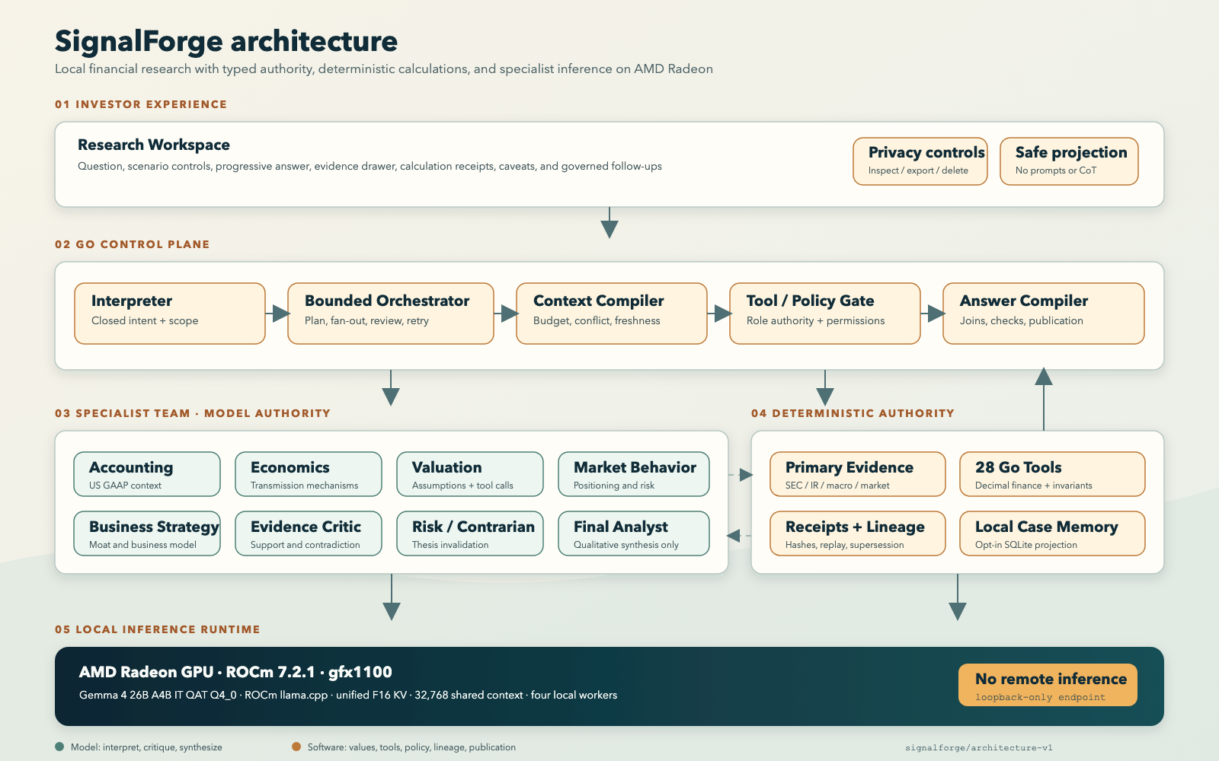
THE AUTHORITY MODEL
THE AUTHORITY MODEL
Models interpret; software owns financial truth
One local model runtime supports specialist roles; Go controls values, tools, evidence, lineage, and publication.
SignalForge · AMD AI DevMaster Hackathon · Track 2
03

Slide 4
AGENT COMPLETENESS
All five Track 2 capabilities are visible in one journey
01
Local retrieval
Point-in-time primary evidence with citations
11
28
02
Tool invocation
logical roles
deterministic tools
28 role-authorized deterministic operations
03
Multi-step planning
31/31
Typed fan-out, two critics, one synthesizer
released claims approved by both critics
04
Local memory
Governed follow-ups and opt-in case retention
05
Permission + privacy
3/3
Read-only model authority and safe projection
governed follow-ups preserved scope and lineage
SignalForge · AMD AI DevMaster Hackathon · Track 2
04

Slide 5
RADEON OPTIMIZATION
The complete journey became faster without weakening the gate
29.17%
faster end to end
44 / 44
frozen semantic checks
passed by both profiles
Unified F16 KV also restored 32,768-token request capacity: 70/80 → 80/80 contract observations.
Source: evidence/radeon-optimization.json
SignalForge · AMD AI DevMaster Hackathon · Track 2
05

Slide 6
RELEASE DISCIPLINE
Built to fail closed,
not confidently wrong
26
11
22
0
adversarial cases
executable gates
critical threats
current release blockers
Primary evidence · deterministic receipts · independent review · explicit residual risk
Bounded to Microsoft and NVIDIA. External human-ground-truth accuracy remains unscored. Novel injection and plausible upstream data errors still require review.
github.com/rvbernucci/signalforge
A private, inspectable research process on AMD Radeon and ROCm.

