Slide 1
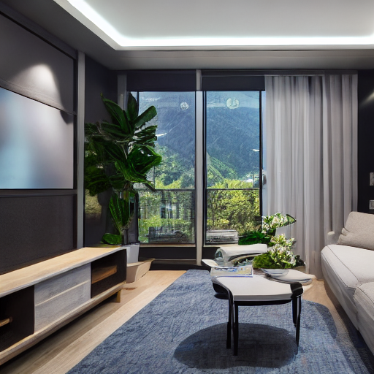

Radeon AI
Creative Studio
Local visual ideation powered by AMD Radeon GPU + ROCm
Text-to-image | Image-to-image | Batch creation | Enhancement
TRACK 1
AMD AI DevMaster Radeon GPU Hackathon 2026
Notes:
[Sources]
Project source code, curated output images in assets/, and the competition rules supplied by the participant.

Slide 2


A complete creation loop for fast visual exploration
One local workspace moves from idea to comparable, downloadable candidates.
01
02
03
04
Describe
Generate
Compare
Finish
Prompt templates turn a short idea into a structured creative brief.
Stable Diffusion creates a new image or restyles a reference.
Batch candidates use deterministic seeds for quick selection.
Enhance, enlarge, review history, and download the result.
Batch candidate
Enhanced final output
Notes:
[Sources]
Source: project source code and curated assets/batch-candidate-1.png and assets/enhanced.png. No external visual asset used.

Slide 3
The core pipeline is local and reproducible
The same seed and settings can recreate a promising candidate on the same model revision.
USER INPUT
GRADIO UI
DIFFUSERS
ROCm
OUTPUT
Prompt
or reference
Controls,
preview, history
SD 1.5
text + image
PyTorch
FP16 inference
PNG + seed
GPU + time
Reproducibility controls
Prompt + negative prompt + resolution + steps + guidance scale + seed
Notes:
[Sources]
Source: project architecture described in docs/project-profile.md and implementation in app.py, pipeline/image_generator.py, and configs/config.py.

Slide 4
Built to show the AMD GPU doing the important work
The UI makes the runtime evidence visible instead of hiding it behind a final image.
AMD Radeon + ROCm
Verified Cloud evidence
• PyTorch ROCm device check
Capture in the final demo:
• FP16 Stable Diffusion weights
• Container tag
• torch.inference_mode()
• AMD GPU name
• ROCm + PyTorch versions
• GPU name and VRAM in the UI
• Text-to-image timing
• Seed and elapsed time per request
• Image-to-image timing
• Batch timing
Key diffusion inference is local. Pillow enhancement is documented as CPU post-processing.
Notes:
[Sources]
Source: project source code and docs/benchmark.md. Exact hardware and timing values must be filled from the participant's Radeon Cloud session before final submission.

Slide 5
A practical tool for creators who need options quickly
Local execution turns one creative idea into a reviewable set of visual directions.
Why it matters
Fast ideation
Local core inference
Deterministic comparison
Simple web workflow
Social content
Design variations
Ready-to-use output
Radeon AI Creative Studio
Track 1 | AMD AI DevMaster Radeon GPU Hackathon 2026
Notes:
[Sources]
Source: curated project outputs in assets/ and application scenarios in docs/project-profile.md. Competition track wording comes from the supplied rules document.

