Slide 1
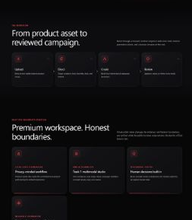
AMD AI DEVMASTER - TRACK 1
BrandPilot
Local
One product image. One campaign system. One accountable human decision.
MOCK-FIRST PRODUCT
Talal Khawaja | Aqeela Urooj
AMD Radeon + ROCm evidence, without overstating the public edge
Notes:
Open with the customer problem and the product's honest verification boundary.
[Sources]
- README.md
- docs/final-claim-audit.md
[/Sources]

Slide 2
02
PROBLEM
Campaign creation is fragmented by default.
PROMPT
A visual idea without brand context
The cost
DESIGN
Formats and composition split elsewhere
Slow iteration
Weak traceability
Unnecessary asset exposure
Review without accountability
COPY
Claims and calls-to-action drift
REVIEW
Decisions disappear into chat
BrandPilot Local
AMD AI DevMaster - Track 1
Notes:
Describe the fragmented workflow and why a campaign system is more valuable than another prompt box.
[Sources]
- README.md#the-problem
- submission/project-profile.md#problem
[/Sources]

Slide 3
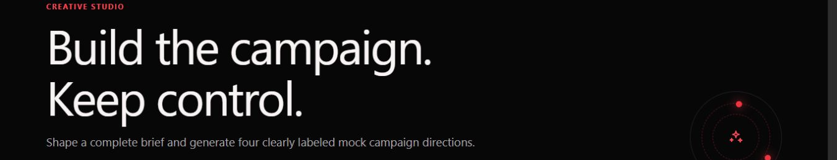
03
SOLUTION
One asset becomes an accountable campaign.
01
02
03
04
Upload
Direct
Create
Review
Validated product image
Audience, brand, formats
Four labelled concepts
Persisted human decision
LOCAL UI DEMONSTRATION
BrandPilot Local
AMD AI DevMaster - Track 1
Notes:
Walk through the four product stages. Clarify that the screenshot shows the local mock-first product.
[Sources]
- frontend/app/studio/page.tsx
- evidence/final-submission/screenshots/studio-desktop.png
[/Sources]

Slide 4
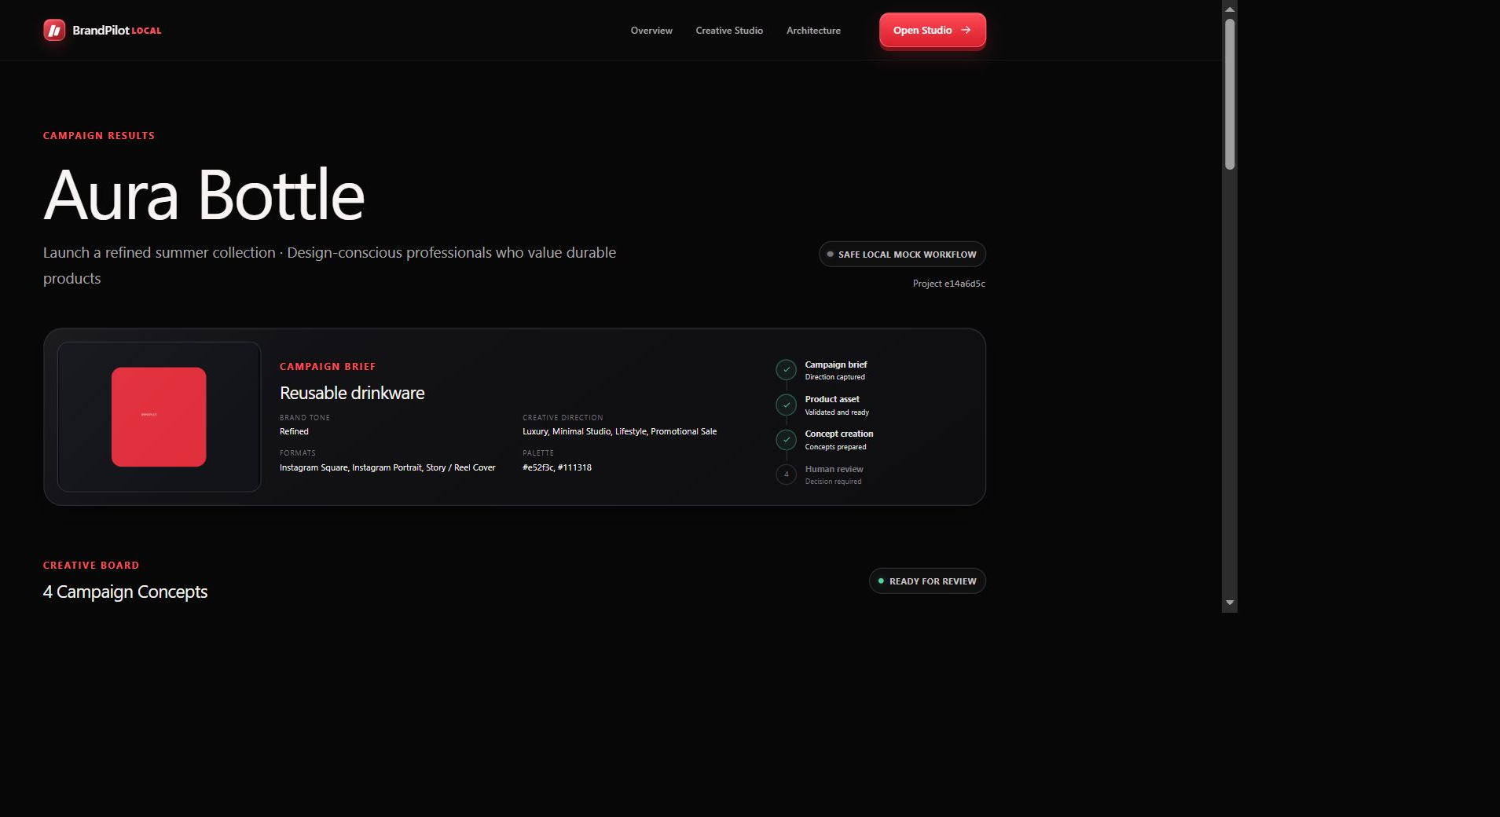
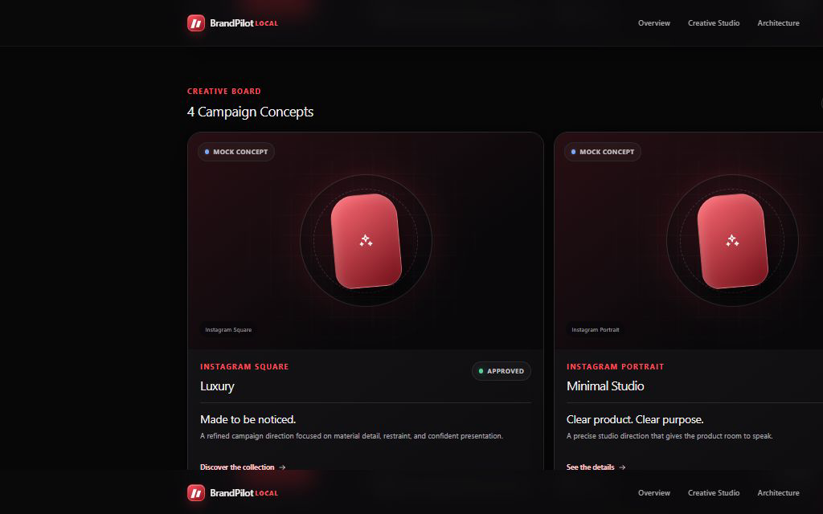
04
PRODUCT EXPERIENCE
The review board makes provenance visible.
MOCK CAMPAIGN CONCEPT
Mock stays labelled.
Approve, reject, request changes, edit copy, regenerate, and refresh without losing the decision.
BrandPilot Local
AMD AI DevMaster - Track 1
Notes:
Point out the mock disclosure and the Approved state. The local browser refresh reloaded the stored decision.
[Sources]
- evidence/final-submission/screenshots/results-desktop.png
- evidence/final-submission/screenshots/review-approved.png
- backend/tests/test_api.py
[/Sources]

Slide 5
05
ARCHITECTURE
Mock remains default. Radeon remains explicit.
PRODUCT + BRIEF
NEXT.JS
FASTAPI
ROCM WORKER
AMD RADEON
Validated input
Responsive studio
Persistence + review
Single lazy GPU job
SDXL via PyTorch/HIP
Mock path
EXPERIMENTAL OPT-IN
Always available
No GPU dependency
Bearer auth · explicit CORS · loopback bind · one job · no CPU/mock fallback
BrandPilot Local
AMD AI DevMaster - Track 1
Notes:
Explain the architecture left to right. The Radeon branch is explicit and temporary; the mock product remains useful without it.
[Sources]
- docs/architecture.md
- backend/app/core/config.py
- frontend/lib/experimental.ts
[/Sources]

Slide 6
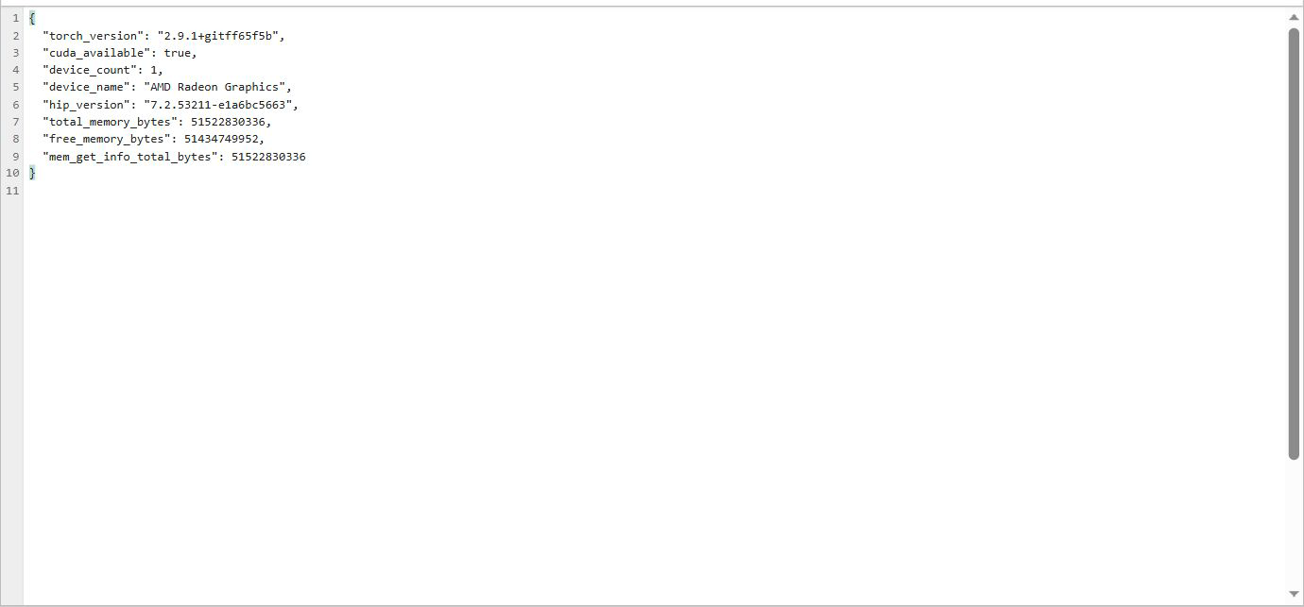
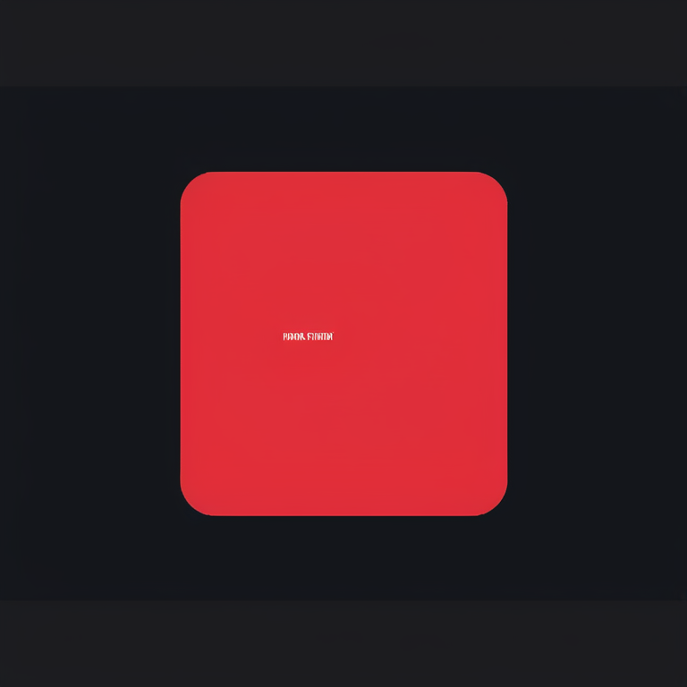
06
AMD RADEON + ROCM
Real SDXL image-to-image completed on Radeon.
RECORDED RADEON EVIDENCE
SDXL base 1.0
exact revision pinned
768 × 768
15 steps
fp16
gfx1100
48 GiB reported
HIP 7.2
The real image shown here was generated during the verified cloud session.
BrandPilot Local
AMD AI DevMaster - Track 1
Notes:
State explicitly that the output is recorded evidence, not a live generation in this presentation.
[Sources]
- docs/radeon-session-1-results.md
- evidence/radeon-session-1/generation-metadata.json
- evidence/radeon-session-1/generated-output.png
[/Sources]

Slide 7
07
MEASURED PERFORMANCE
The evidence records time, memory, and integrity.
132.295 s
222.111 s
Pinned run
cold model load
generation
768 × 768
15 steps
strength 0.35
guidance 6.5
seed 20260725
13.41 GiB
14.31 GiB
peak allocated
peak reserved
Output SHA-256
bce21d016a8179ac4ddabcbf5869a71eacf03565948d0d1f97d24e279b125452
BrandPilot Local
Session 1 measured values
Notes:
These are one controlled Session 1 run's measured values. Do not describe them as a benchmark comparison.
[Sources]
- evidence/radeon-session-1/generation-metadata.json
- docs/radeon-session-1-results.md
[/Sources]

Slide 8
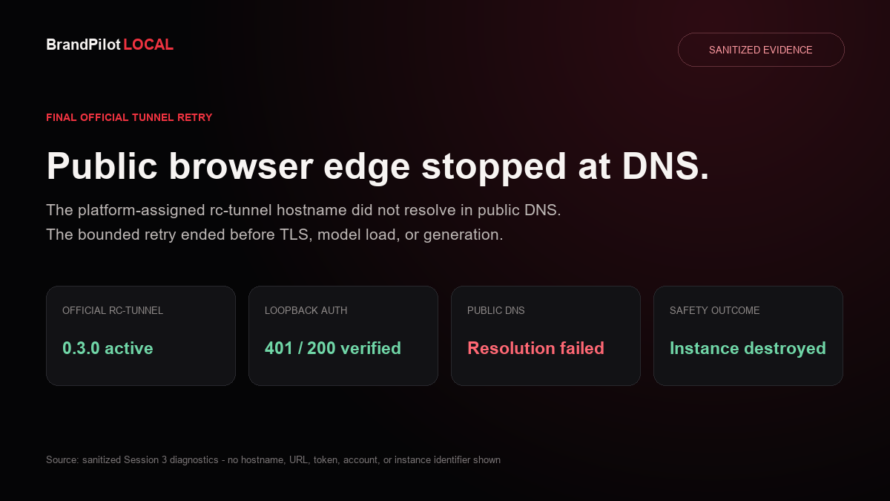
08
HONEST VALIDATION
Public browser edge stopped at DNS.
Standalone SDXL
VERIFIED
FastAPI loopback
VERIFIED
rc-tunnel 0.3.0
VERIFIED
Chrome TLS/auth/CORS/upload
VERIFIED
Protected output through edge
BLOCKED - DNS
No unofficial tunnel. No TLS bypass. No fabricated success.
BrandPilot Local
AMD AI DevMaster - Track 1
Notes:
Session 2b reached project upload through the official edge. The final retry ended earlier at DNS and loaded no model. Every instance was destroyed.
[Sources]
- docs/radeon-session-2b-results.md
- docs/radeon-session-3-results.md
- evidence/radeon-session-3/dns-python-final.json
[/Sources]

Slide 9
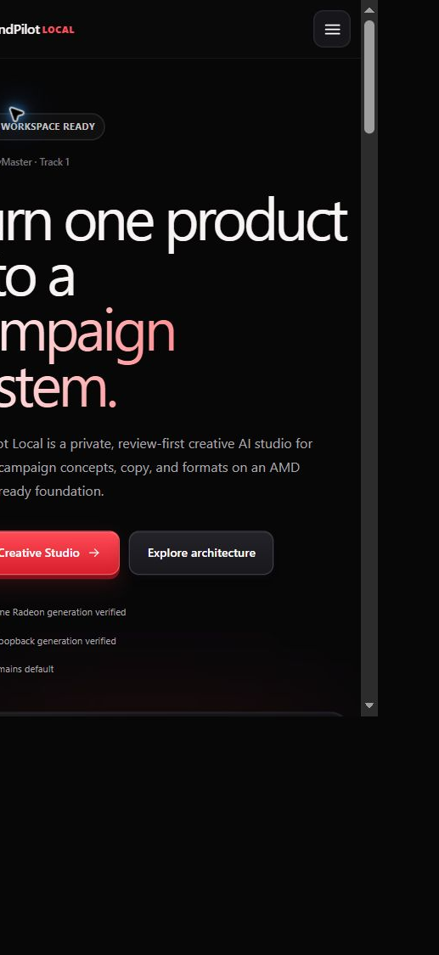
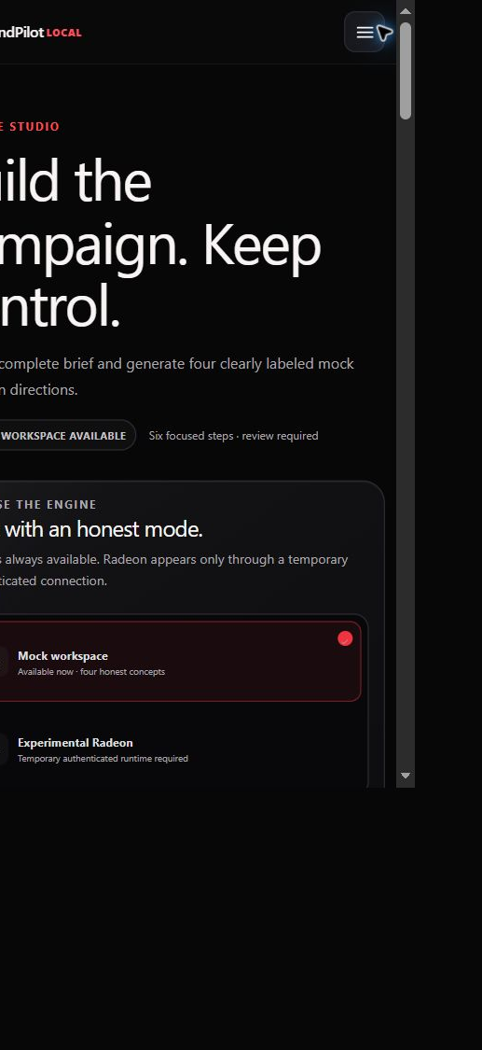
09
PRACTICAL VALUE
Generation becomes a reviewable brand workflow.
Independent brands
Launch concepts without a fragmented toolchain
In-house teams
Adapt one campaign across formats
Creative studios
Explore directions before production
Privacy-conscious teams
Keep the default workflow controlled
Responsive by design
BrandPilot Local
AMD AI DevMaster - Track 1
Notes:
Connect the product to the 80-point value/innovation criteria: complete workflow, practical scenarios, and human accountability.
[Sources]
- README.md#the-solution
- docs/judging-evidence-map.md
- evidence/final-submission/screenshots/home-mobile.png
[/Sources]

Slide 10
BRANDPILOT LOCAL
Practical today.
Disciplined about tomorrow.
Verified
Next measured phase
Real SDXL on Radeon + ROCm
Authenticated FastAPI loopback generation
Human review and responsive product workflow
Compare base SDXL with IP-Adapter plus masking/compositing for product preservation - only after submission.
Talal Khawaja | Aqeela Urooj
github.com/kmt9967/brandpilot-local
Notes:
Close on what is verified, the honest limitation, and the next measurable research question.
[Sources]
- docs/final-claim-audit.md
- docs/roadmap.md
[/Sources]

