Slide 1
AR
ACCIDENT RIGHTS AGENT
Private AI for defensible claims decisions
EVIDENCE FIRST. DEADLINES VISIBLE. HUMANS REMAIN IN CONTROL.
Reconstruct accident evidence, preserve uncertainty, and turn review windows into auditable action—entirely inside a local AMD Radeon deployment.
EVIDENCE
→
LEGAL RAG
→
VEHICLE
→
LIABILITY
→
RIGHTS
→
VERIFIER
→
HUMAN
TRACK 2 · DATALINK
AMD RADEON · ROCm · LOCAL vLLM
APACHE-2.0
Decision support—never an automatic ruling, filing, or payment.
Notes:
[Sources]
- README.md
- docs/submission/architecture.png
[/Sources]

Slide 2
WHY THIS MATTERS
A traffic accident becomes an information crisis in hours.
Evidence arrives on different clocks while review and re-appraisal windows keep moving.
01
02
03
04
VIDEO
PHOTOS
ACCOUNTS
DEADLINES
can be overwritten
lose scene context
start to conflict
continue to run
THE CREATIVE WEDGE
Preserve the person’s options before the system tries to predict the outcome.
ACCIDENT RIGHTS AGENT · DATALINK
02
Notes:
[Sources]
- docs/submission/project_description.md, Problem
- Synthetic Golden Case workflow
[/Sources]

Slide 3
PRIVATE BY DESIGN
The browser is remote. The intelligence is not.
Only Gradio port 7860 is forwarded; the model endpoint stays on Radeon loopback.
01
02
AMD RADEON CLOUD
Mac Chrome
SSH Tunnel
→
GRADIO UI
127.0.0.1:7860
Reviewer sees the UI at http://127.0.0.1:7860.
-L 7860:127.0.0.1:7860. No Cloud Proxy.
LANGGRAPH AGENT
case workflow + checkpoint
LOCAL vLLM
127.0.0.1:8000
AMD RADEON GPU
ROCm inference
LOCAL DATA + LOCAL MODEL + LOCAL AUDIT · PORT 8000 IS NEVER FORWARDED OR PUBLIC
ACCIDENT RIGHTS AGENT · DATALINK
03
Notes:
[Sources]
- README.md, Access Modes
- app/policy/local_endpoint.py
[/Sources]

Slide 4
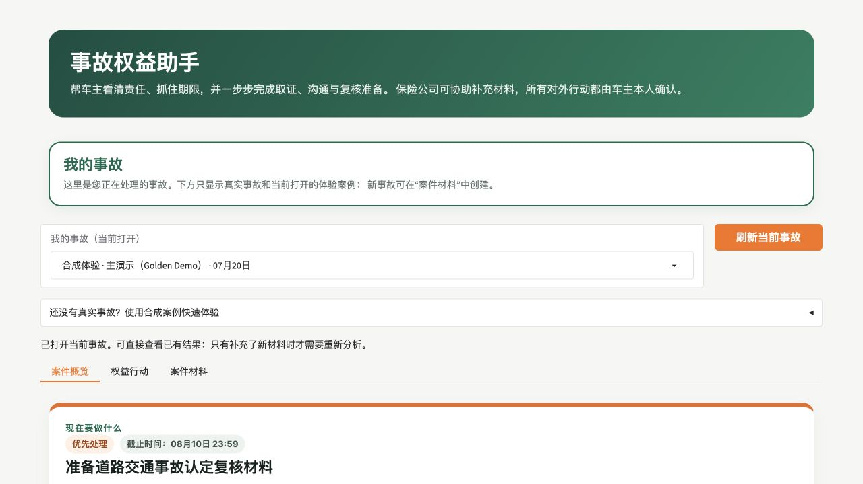
GOLDEN CASE
One live case becomes a traceable case record.
The Agent reconstructs the story before it allows a responsibility hypothesis.
IMMUTABLE SOURCE
SHA256 + source role
EVIDENCE GRAPH
facts + timeline + conflicts
PROTECTED FIELD
dates, IDs, ratios, approval
WORKFLOW STATE
SQLite checkpoint + retry
ACCIDENT RIGHTS AGENT · DATALINK
04
Notes:
[Sources]
- docs/submission/project_description.md, Multimodal Evidence Reconstruction
- app/evidence
- app/memory
[/Sources]

Slide 5
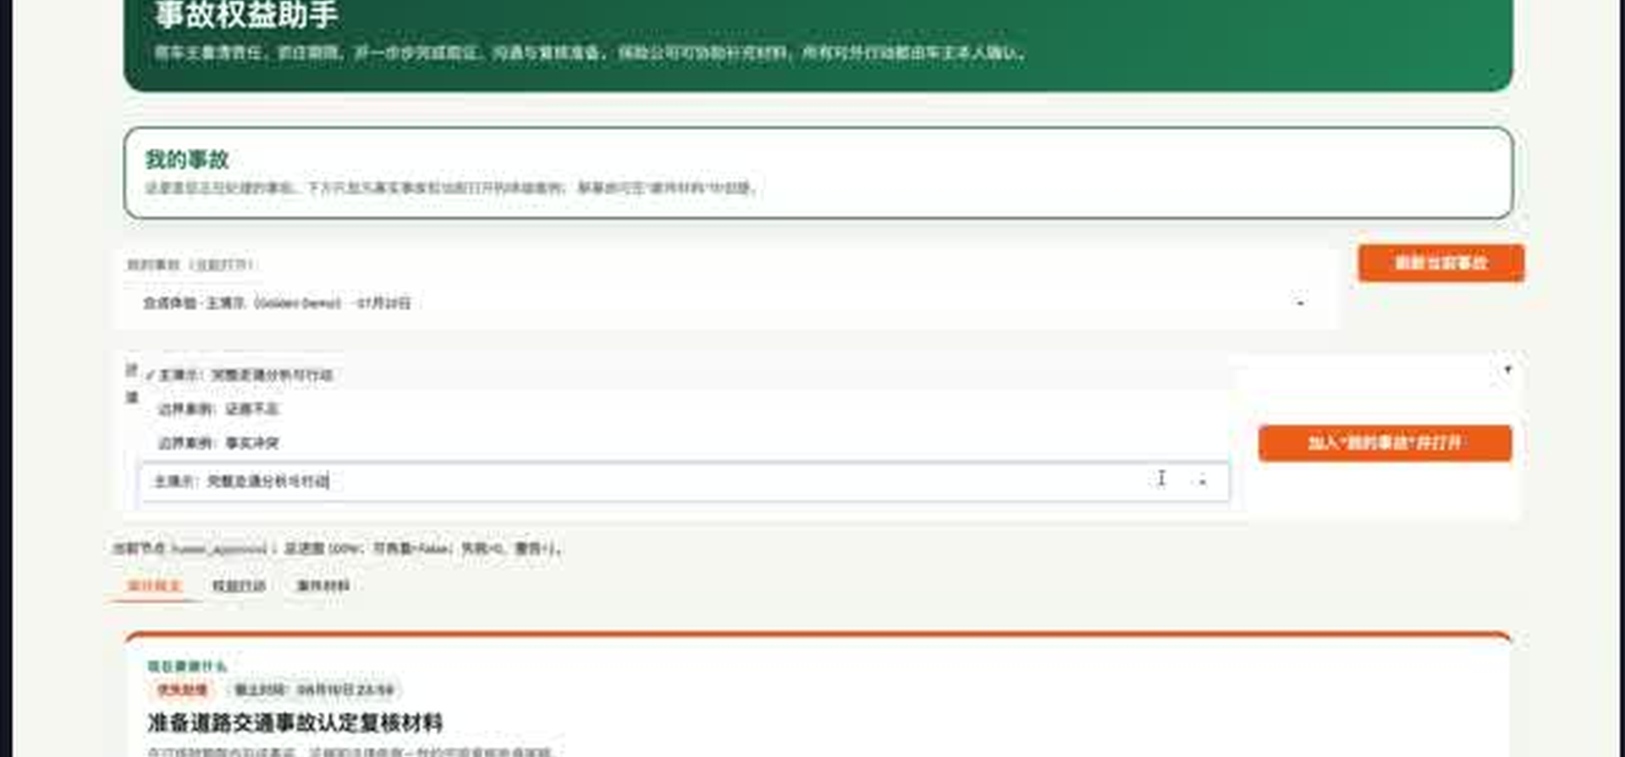
EDGE CASES
Uncertainty stays visible—and becomes actionable.
The workflow switches cases cleanly, keeps technical and legal questions separate, and routes evidence gaps.
CONFLICT CASE
Do not erase disagreement.
Conflicting facts remain linked to their sources. Vehicle parameter exceedance never becomes an automatic legal classification.
BATTERY VOLTAGE
PEDAL CAPABILITY
ANTI-TAMPER
REGISTRATION
collect original report
inspect vehicle configuration
verify limiter and controller
confirm plate / legal record
ACCIDENT RIGHTS AGENT · DATALINK
05
Notes:
[Sources]
- Demo fixture: independent conflict case
- app/agents/vehicle.py
- docs/submission/project_description.md, Innovation
[/Sources]

Slide 6
EXPLAINABLE DECISIONS
Three specialist Agents turn evidence into reviewable choices.
One coordinated workflow—never one opaque answer.
VEHICLE
LIABILITY
RIGHTS
What is it?
What caused it?
What happens next?
Parameters, classifications, and missing inspection evidence.
Violations, causal force, counterfactuals, and alternatives.
Deadlines, evidence tasks, owners, and reviewable drafts.
LIABILITY HYPOTHESES · DECISION-SUPPORT WEIGHTS
Two-wheeler primary
Equal responsibility
Motor vehicle primary
88.6%
7.9%
3.5%
Comparable scenarios—not judicial probabilities.
ACCIDENT RIGHTS AGENT · DATALINK
06
Notes:
[Sources]
- benchmarks/results Golden Case semantic output
- app/agents/vehicle.py
- app/agents/liability.py
- app/rights
[/Sources]

Slide 7
RIGHTS WORKFLOW
Analysis becomes a claims plan with owners and deadlines.
The UI moves from evidence gap to task, draft, and human-reviewed next action.
01
02
03
04
EVIDENCE TASK
→
OWNER + DUE DATE
→
DRAFT
→
HUMAN APPROVAL
What must be collected
Who acts, and by when
Versioned document output
Exact version + input hash
Earlier intervention reduces missed windows, rework, and handoff friction.
Evidence stays source-linked
Deadlines use versioned rules
Drafts stay pending
Approver keeps authority
ACCIDENT RIGHTS AGENT · DATALINK
07
Notes:
[Sources]
- app/rights
- docs/submission/project_description.md, Rights Workflow
- app/graph/verifier.py
[/Sources]

Slide 8
FAIL-CLOSED SAFETY
Three outcomes stay separate. One human stays in control.
Verifier checks the evidence, legal citations, consistency, risk language, and protected fields.
01
02
03
ACCIDENT LIABILITY
CIVIL ALLOCATION
INSURANCE PAYMENT
alternative responsibility structures
ranges, not invented certainty
insufficient_data when policy inputs are missing
POLICY GATE
EVIDENCE IDs
LEGAL IDs
CONSISTENCY
RISK LANGUAGE
PROTECTED FIELDS
PASS WITH WARNINGS → DRAFT / PENDING → MANUAL REVIEW. NO AUTOMATIC FILING OR SENDING.
ACCIDENT RIGHTS AGENT · DATALINK
08
Notes:
[Sources]
- app/graph/verifier.py
- app/policy
- docs/submission/project_description.md, Human Approval and Safety
[/Sources]

Slide 9
MEASURED OPTIMIZATION
Less context. Faster first token. Every protected field retained.
Fair baseline: same model, same Radeon hardware, temperature 0.
INPUT TOKENS
REPEATED-CASE TTFT P50
FULL HISTORY
11,808
9.003 s → 0.113 s
Automatic Prefix Caching · 98.8% improvement
CASE CAPSULE
5,795
INPUT TOKEN REDUCTION
PROTECTEDFIELD RETENTION
PEAK PREFIX CACHE HIT RATE
50.9%
100%
99.4%
11,808 → 5,795
dates · IDs · ratios · approval
Measured in the vLLM log
ACCIDENT RIGHTS AGENT · DATALINK
09
Notes:
[Sources]
- benchmarks/results/amd_baseline_vs_optimized.csv
- benchmarks/results/prefix_cache
- docs/submission/amd_optimization.md
[/Sources]

Slide 10
REAL-WORK LOAD
Concurrency scales without trading away quality.
Twenty semantic requests at each level; Prefix Cache pre-warmed; zero OOM.
C=1
25.67 tokens/s
20/20
30-MINUTE STABILITY
REQUESTS
298 / 298
C=2
49.32 tokens/s
20/20
OOM
0
vLLM
STABLE
C=4
89.48 tokens/s
20/20
CHECKPOINT
HEALTHY
CONCURRENCY 4 · 89.48 TOKENS/S · VERIFIER 100% · OOM 0 · UI/API RESPONSIVE
ACCIDENT RIGHTS AGENT · DATALINK
10
Notes:
[Sources]
- benchmarks/results/concurrency_report.csv
- benchmarks/results/stability
- docs/submission/amd_optimization.md
[/Sources]

Slide 11
AR
A CONTROLLED PILOT
Start small. Keep control. Prove value.
One claims workflow can establish measurable operational evidence before wider adoption.
01
02
03
REDACTED CASES
EXISTING APPROVAL GATES
MEASURED SAVINGS
Begin with synthetic or de-identified accident files.
Keep insurer roles, review rules, and audit controls.
Compare review time, evidence gaps, and rework.
• FASTER FIRST REVIEW
• FEWER EVIDENCE GAPS
• AUDITABLE REASONING
• CONTROLLED COMMUNICATION
EVIDENCE FIRST. DEADLINES VISIBLE. HUMANS REMAIN IN CONTROL.
TRACK 2 · DATALINK
APACHE-2.0 · DECISION SUPPORT, NOT LEGAL ADVICE
Notes:
[Sources]
- docs/submission/project_description.md, Future Commercialization
- docs/submission/privacy_security.md
[/Sources]

