Slide 1

赛道 2 | AI 智能体应用
RDK
Agent
自然语言意图转化为 RDK 开发板上经过验证的动作。
私有 RADEON 目标 / 工具调用 / 多步规划 / 有界权限
d-robotics agent
Notes:
Open with the product promise: one governed path from intent to a board action. The visual is conceptual, not hardware evidence.
[Sources]
- Project repository: README.md and submission/en/PROJECT_SPECIFICATION.md.
- Project-created AI-generated asset: submission/en/assets/rdk-agent-hero.png.
- Official Track 2 requirements: https://github.com/AMD-DEV-CONTEST/Radeon-hackathon-2026-07
[/Sources]

Slide 2

命名故事
Sophon 成为透明的设备桥梁
把文学构想映射为设备所有者控制的板端子系统。
文学隐喻
一个信使被发送到地球，用于观察与通信。
RDK-SOPHON
probe-daemon 驻留在开发板，观察遥测并向 rdk-agent 提供受治理动作。
关键区别
透明、可审计、可回滚，由设备所有者部署，绝不是隐蔽监控。
项目原创 AI 概念图，未使用小说或改编作品的官方资产。rdk-sophon 仅是板端子系统名称。
02
Notes:
Keep this as a naming explanation, then return immediately to the Track 2 product and evidence story.
[Sources]
- User-provided naming rationale in this task.
- Project-created AI-generated asset: submission/en/assets/sophon-three-body-concept.png.
- Project disclaimer: submission/en/PROJECT_SPECIFICATION.md, section 2.
[/Sources]

Slide 3
问题
一个需求要跨越五次脆弱交接
一个小动作也必须经受意图、代码、证据、部署和实体验收。
01
02
03
意图可能漂移
代码可能过度声称
部署可能破坏信任
自然语言可能丢失左右方向、作用范围或预期设备契约。
模型可能在未运行可执行检查、未保留原始行为时声称“已通过”。
一个有效文件还不是确定性软件包、原子发布、已安装 Skill 或已验证板端结果。
RDK Agent 把这些交接合并为一条具备有界重试和可执行证据的受治理路径。
03
RDK Agent | AMD Radeon AI 智能体黑客松 | 赛道 2
Notes:
Frame the problem as reproducibility and authority, not simply code generation.
[Sources]
- Project specification: submission/en/PROJECT_SPECIFICATION.md, sections 1 and 3.
- Workflow implementation: rdk-agent/config/agents.yaml.
[/Sources]

Slide 4
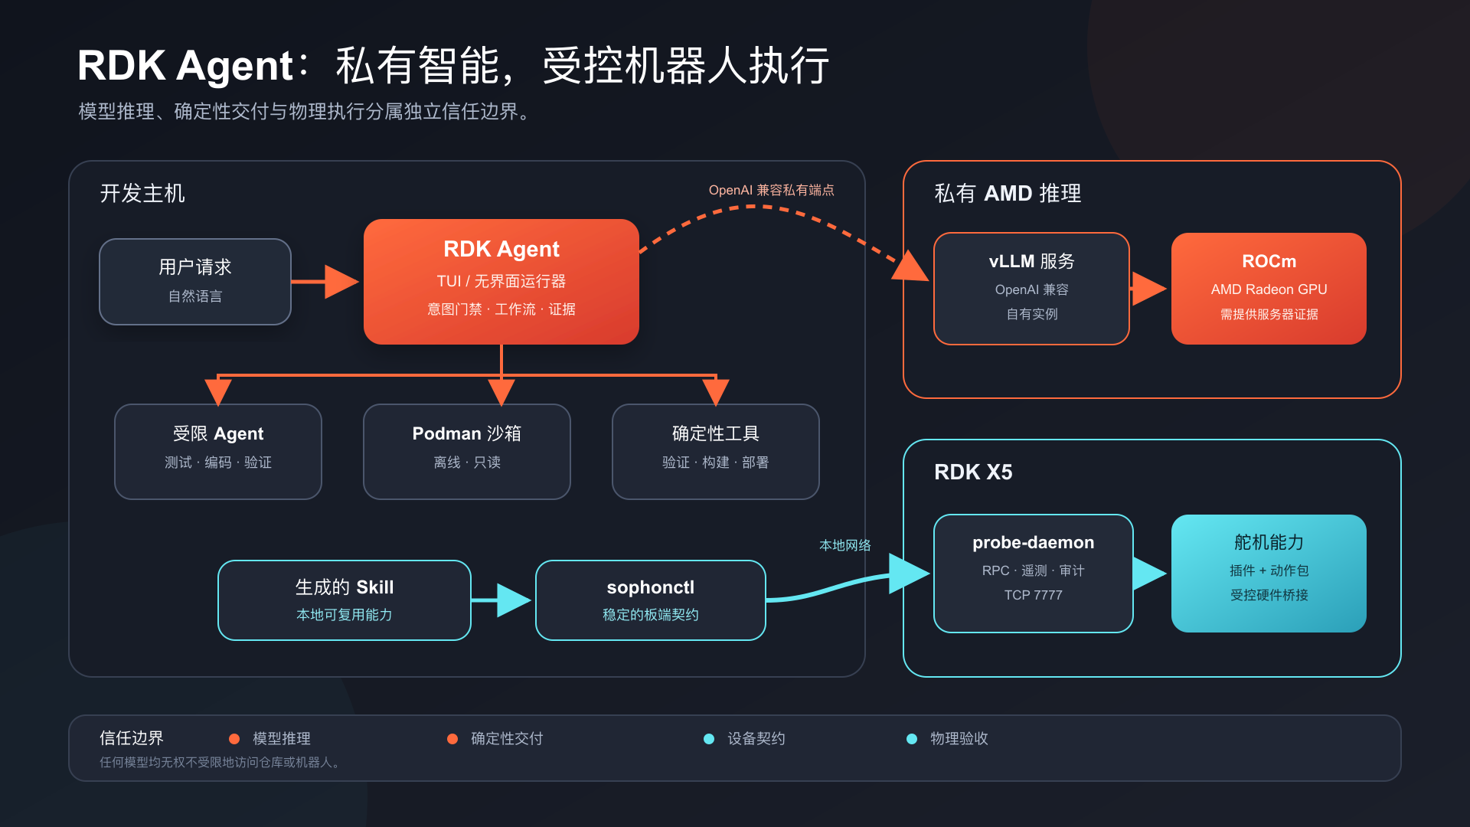
系统架构
推理保持私有，板端权限留在本地
主机负责编排，目标 Radeon 端点提供模型，rdk-sophon 守住设备契约。
04
Notes:
Call out the separation between model reasoning, deterministic delivery, the device contract and physical acceptance.
[Sources]
- Project architecture source: submission/en/assets/architecture.svg.
- Detailed specification: submission/en/PROJECT_SPECIFICATION.md, section 4.
[/Sources]

Slide 5
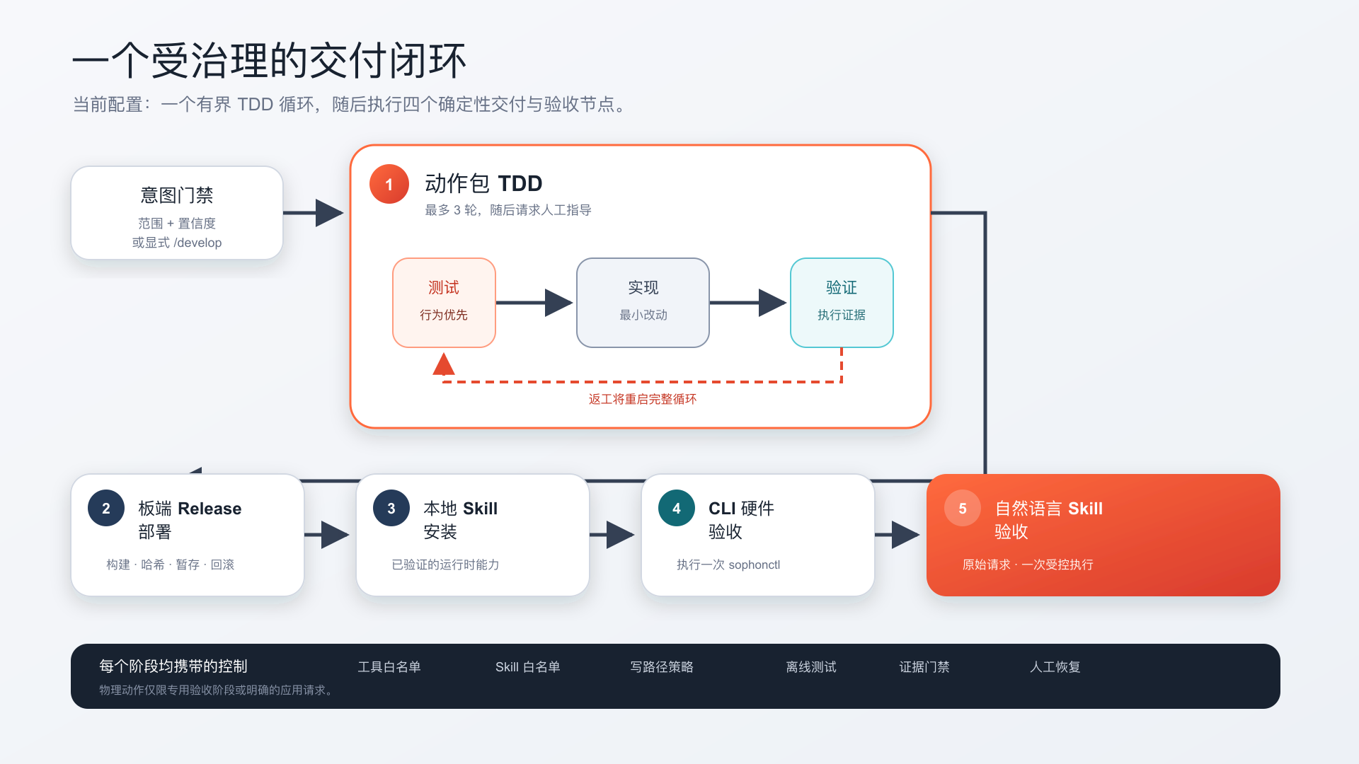
工作流
五个节点让交付可重复
一次有界动作包 TDD 循环之后，依次执行四个确定性交付与验收节点。
05
Notes:
The red loop is the only revision loop and is capped at three iterations. Every downstream node requires a successful predecessor.
[Sources]
- Project workflow source: submission/en/assets/workflow.svg.
- Workflow configuration: rdk-agent/config/agents.yaml.
[/Sources]

Slide 6
安全模型
提示词之下的控制确保权限有界
模型可以提出方案；由软件强制执行的范围、策略与证据决定能否继续。
范围
面向不同智能体的工具、Skill 与可写路径白名单
沙箱
离线、只读 Podman 验证
方向
ACTION-DIRECTION-001 阻止相反方向动作
证据
可执行检查控制软件包阶段推进
设备
probe-daemon 只提供已注册插件与动作
边界：传输认证与常规逐动作人工审批仍属于后续规划。
06
RDK Agent | AMD Radeon AI 智能体黑客松 | 赛道 2
Notes:
Describe this as agent/tool-layer permission control. Do not imply end-to-end transport security is complete.
[Sources]
- Safety design: submission/en/PROJECT_SPECIFICATION.md, sections 6-7 and 12.
- Verification tests: rdk-agent/test/security-hardening.test.ts and related suites.
[/Sources]

Slide 7
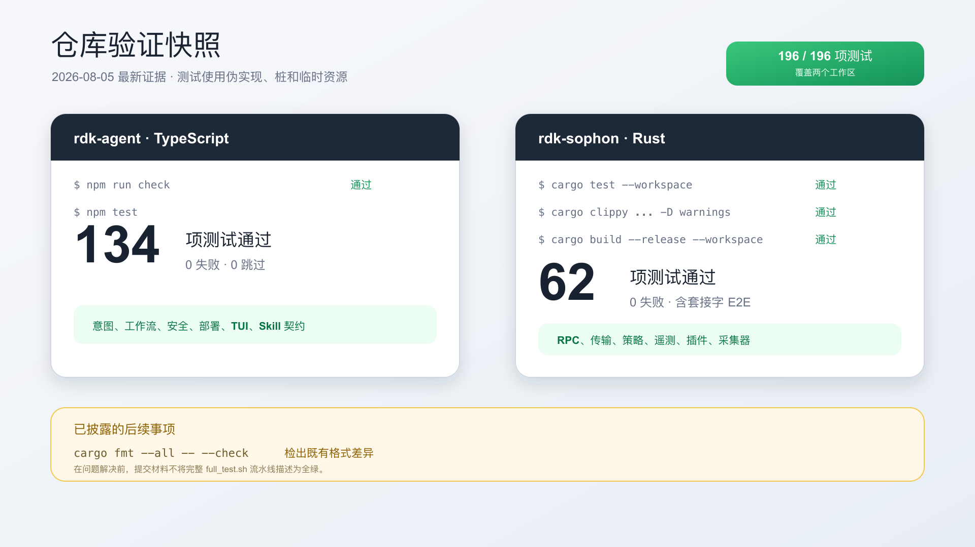
仓库证据
两个工作区共 196 项测试通过
最新验证：134 项 TypeScript 测试、62 项 Rust 测试，以及 Clippy 和 release 构建。
07
Notes:
Mention the disclosed formatting follow-up: cargo fmt --all -- --check reports existing differences, so the deck does not call the full formatting state green.
[Sources]
- Evidence log: submission/en/evidence/verification-2026-08-05.md.
- Evidence visual source: submission/en/assets/test-evidence.svg.
[/Sources]

Slide 8
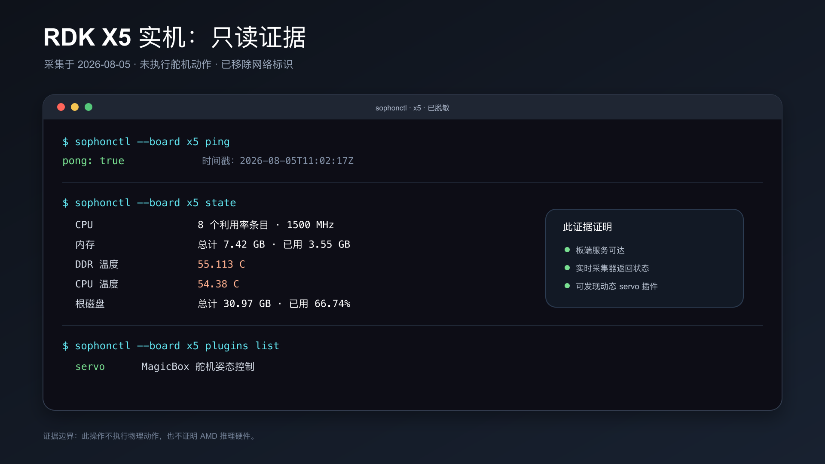
设备证据
真实 RDK X5 通过板端契约正常响应
只读 ping、state 与插件发现均成功，敏感标识已移除。
08
Notes:
This proves board reachability, live collectors and dynamic plugin discovery. It does not prove physical motion or AMD inference hardware.
[Sources]
- Evidence log: submission/en/evidence/verification-2026-08-05.md.
- Evidence visual source: submission/en/assets/board-evidence.svg.
[/Sources]

Slide 9
AMD RADEON + ROCM
两条 Qwen3 模型路径均已成功跑通
80B 单 GPU 服务与自训练 32B SFT 的 Agent 实机工作流分别具备证据。
两种模型均已跑通
RDK Agent
OpenAI API
vLLM + ROCm
Qwen3-Next-80B-
A3B-Instruct
提供方 amd
API 兼容 OpenAI
上下文 131,072
最大输出 8,192
已封存证据
80B：单张 Radeon 的 llama.cpp 指标
32B SFT：Agent 实机 5/5 节点
私有 vLLM 来源信息单独标注
09
RDK Agent | AMD Radeon AI 智能体黑客松 | 赛道 2
Notes:
Both models ran. Keep the evidence scopes distinct: the 80B figures come from the archived llama.cpp case; the 32B SFT screenshot proves the live Agent path.
[Sources]
- Sanitized config: submission/en/config/pi-models.amd-rocm.example.json.
- AMD evidence plan: submission/en/AMD_RADEON_ROCM.md.
- Current evidence boundary: submission/en/evidence/verification-2026-08-05.md.
[/Sources]

Slide 10
性能优化
两条 Radeon 路径均取得实测提升
32B SFT 改善用户可见 TTFT；80B 单 GPU 服务提升解码吞吐量。
32B TTFT
80B TOK/S
AGENT 5/5
17.41 -> 8.26 秒
37.19 -> 49.82
总计 4:04
p50，每臂 88 次试验
解码，每臂 5 次实测
RDK X5 上的 32B SFT 工作流
证据范围
32B 与 80B 运行分别保留运行时、协议与实测记录
不作跨运行时速度比较；私有 VLLM 来源信息单独标注
10
RDK Agent | AMD Radeon AI 智能体黑客松 | 赛道 2
Notes:
Both paths have measured baseline-versus-optimized results. Do not compare their absolute speeds because model sizes, servers and protocols differ.
[Sources]
- Benchmark script: submission/en/scripts/benchmark-openai-compatible.mjs.
- Optimization plan: submission/en/AMD_RADEON_ROCM.md.
[/Sources]

Slide 11
演示
视频证明完整闭环
3 分 07 秒的公开视频提供两个独立访问地址。
公开视频
B 站 BV1t3up6iEhy | 百度云备用地址
0:00
1:15
2:45
意图 + 流程图
构建 + 部署
验收 + 证明
展示需求、语义门控与有界 TDD 进度。
展示可执行检查、软件包验证、发布与 Skill 安装。
展示 CLI/自然语言验收、板端结果与脱敏 Radeon/ROCm 证据。
隐私检查：遮盖密钥、私有 URL、邮箱、MAC 地址及不必要的内网 IP。
11
RDK Agent | AMD Radeon AI 智能体黑客松 | 赛道 2
Notes:
Keep the total duration between three and five minutes. The AMD segment should show the participant-controlled Radeon/ROCm/vLLM runtime, not only the RDK board.
[Sources]
- Video shot list: submission/en/VIDEO.md.
- Official Track 2 requirement: https://github.com/AMD-DEV-CONTEST/Radeon-hackathon-2026-07
[/Sources]

Slide 12
赛道 2 | 提交材料就绪
一条受治理路径
从意图到板端动作。
私有推理。确定性交付。真实开发板证据。
01
团队：d-robotics agent
下一步
02
公开视频：主地址 + 备用地址
完成最终完整性复核，然后发起正式赛道 2 Pull Request。
03
32B SFT + 80B Radeon 证据
RDK Agent | AMD Radeon AI 智能体黑客松 | 赛道 2
Notes:
Close by resolving the opening promise and naming the only remaining owner actions. Do not end with a generic thank-you slide.
[Sources]
- Submission checklist: submission/en/SUBMISSION_CHECKLIST.md.
- PR draft: submission/en/PR_DESCRIPTION.md.
[/Sources]

