Slide 1

AMD TRACK 1 · TEAM BANYAN
ProofLaunch
Multimodal GTM Studio
Turn approved product evidence into an audited campaign pack—strategy, copy, image, audio and video—with a human release boundary.
Evidence before promise. Release only what earns trust.
TEAM BANYAN · PROOFLAUNCH · AMD RADEON HACKATHON 2026 · TRACK 1
01

Slide 2

WHY PROOFLAUNCH
Creative speed is not enough when product truth breaks
01
02
03
Unsupported claims
Identity drift
No release proof
Generated copy can outrun approved source evidence and create release risk.
Products, logos and typography can change silently across still and video outputs.
A polished asset without provenance, audit history or approval cannot be defended.
PROOFLAUNCH CHANGES THE UNIT OF WORK
Evidence
→
Campaign
→
Audit
→
Human release
→
Receipt
One inspectable workflow replaces disconnected prompts, silent retries and release-by-appearance.
TEAM BANYAN · PROOFLAUNCH · AMD RADEON HACKATHON 2026 · TRACK 1
02

Slide 3
PRODUCT WORKFLOW
One supervisor. Six visible stages. A hard release boundary.
01
02
03
04
05
06
EVIDENCE
PLAN
CREATE
AUDIT
REPAIR
DELIVER
→
→
→
→
→
Hash, rights and located claims
Claim-bound briefs and channel intent
Image, audio and video candidates
Claim, identity, type and safe zones
Maximum two recorded rounds
Human-approved export and evidence ledger
HUMAN APPROVAL GATE
Typed inputs · tenant isolation · budget limits · content-bound approvals · immutable audit events · no autonomous publish/send/spend
CODE-ENFORCED HARNESS
TEAM BANYAN · PROOFLAUNCH · AMD RADEON HACKATHON 2026 · TRACK 1
03

Slide 4
AMD RADEON / ROCM ARCHITECTURE
Radeon-targeted inference, explicit residency and observable evidence
SEQUENCED BY THE PROOFLAUNCH SUPERVISOR
01
02
03
04
05
Qwen3-VL
understand
SDXL
create
SigLIP2
audit
LTX-Video
motion
SAM2 + CLAP
verify
AMD RADEON GPU · ROCm / HIP LOCAL INFERENCE FOUNDATION
A
B
C
Single-model residency
Reproducible evidence
Fail-closed truth boundary
Only one heavy model is resident at a time. Explicit unload, garbage collection and cache controls keep the pipeline inside the available VRAM envelope.
Every real run retains hardware identity, ROCm/HIP version, model revision, input hash, seed, latency, peak VRAM and output SHA-256.
The execution path is packaged; the live Radeon receipt and Demo Video remain pending. Official guidance recommends 3–5 minutes. No Mac, mock or provider output is substituted.
TEAM BANYAN · PROOFLAUNCH · AMD RADEON HACKATHON 2026 · TRACK 1
04

Slide 5
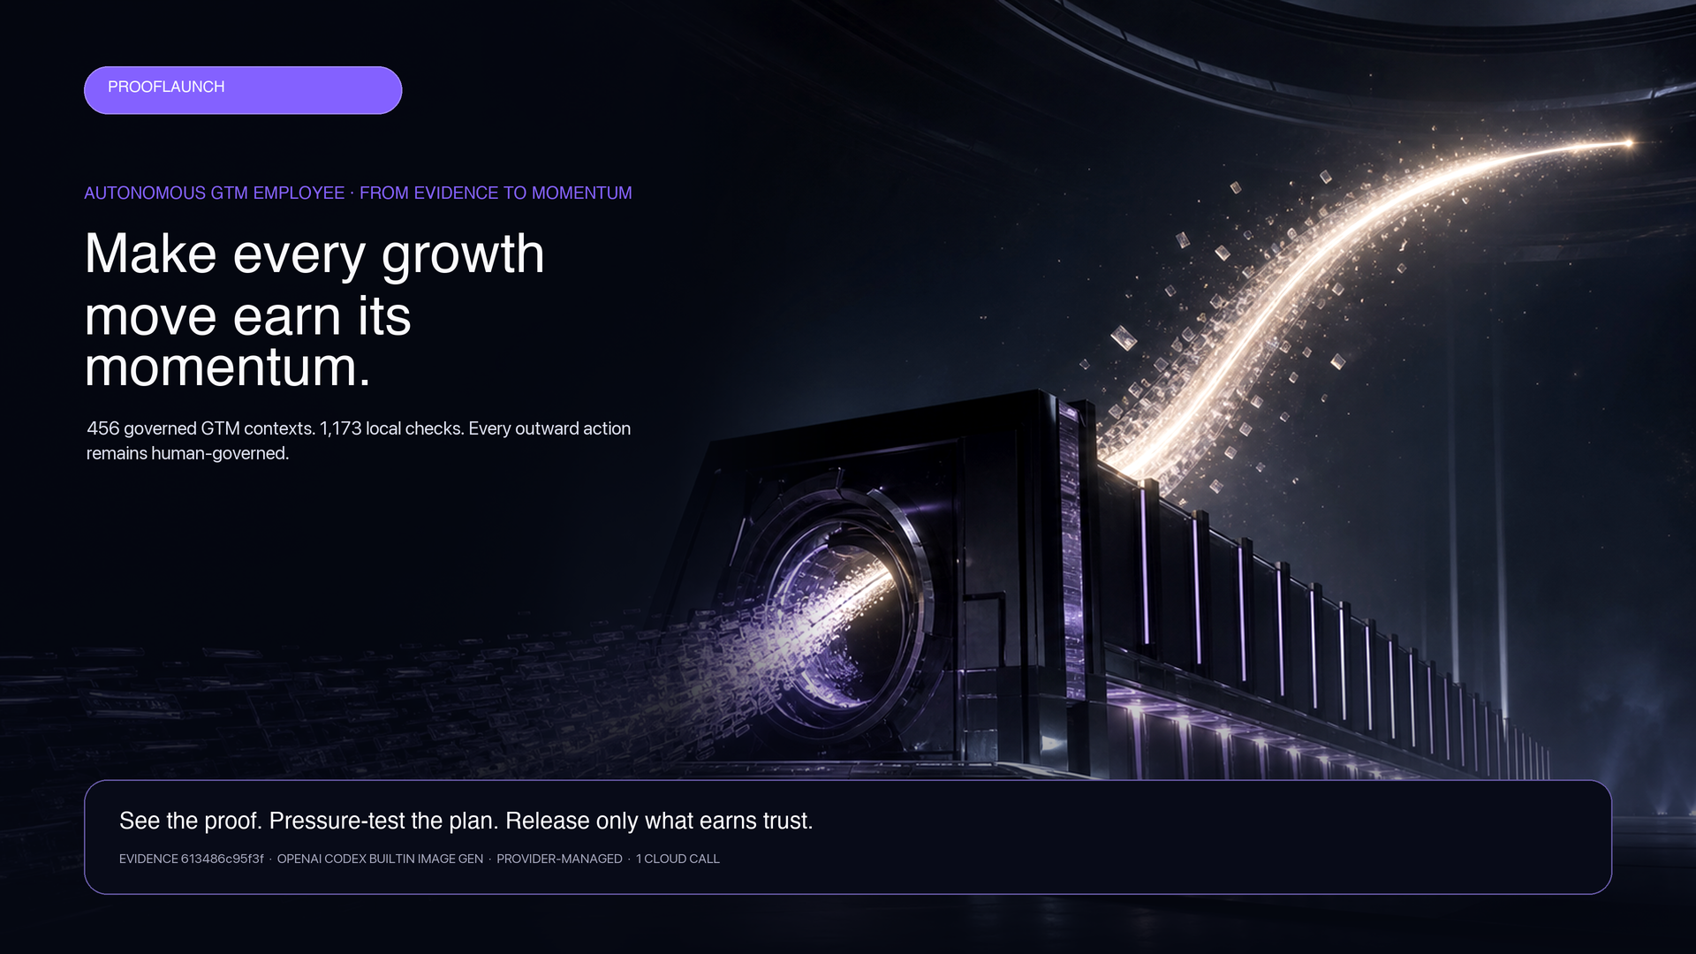

CAMPAIGN PACK
One governed run binds ten GTM deliverables
10
BOUND DELIVERABLES
Strategy · calendar · copy · analytics · GEO · SEO · execution contract · channel portfolio · audio · 4K film
SOCIAL · D9EDE8C6AE…
LANDING · sha256:9868839958…
SEALED · NOT FINAL RADEON EVIDENCE
These assets demonstrate the product package and hash-bound delivery. Their provider-managed source is disclosed and is not claimed as final Radeon evidence.
TEAM BANYAN · PROOFLAUNCH · AMD RADEON HACKATHON 2026 · TRACK 1
05

Slide 6
VERIFIED PRODUCT STATE
Measured mechanics. Unobserved claims kept separate.
827/827
17/17
10/10
46 · 60
4/4
PRODUCT-CRITICAL TESTS
UI TESTS
ROUTE VALIDATION
ROUTES · API CONTRACTS
FINAL INTEGRITY LOCKS
Observed
Not claimed
Still pending
Hash-bound replay, typed approvals, bounded repair, deterministic export and zero automatic publish / send / spend. Desktop and mobile checks report no horizontal overflow.
Named-human preference, 4A quality, Top-1 standing, production effect, causal revenue or autonomous business action.
Live Radeon model inference, final latency/VRAM receipt, Demo Video and the official pull request. Recommended video duration: 3–5 minutes.
TEAM BANYAN · PROOFLAUNCH · AMD RADEON HACKATHON 2026 · TRACK 1
06

Slide 7
TRACK 1 SUBMISSION
The package is organized. Live Radeon evidence closes the final gate.
Project Profile PDF
READY
OFFICIAL PR TITLE
Complete source + English README
Track 1, Banyan,
ProofLaunch: Multimodal GTM Studio
READY
English supplementary deck
READY
GitHub submitter: sylvanccc
Official destination: prooflaunch/
Submission language: English
Live Radeon Demo Video · 3–5 min recommended
PENDING FINAL CAPTURE
Official fork + English PR
PENDING CLEAN EXPORT + PR
FINAL STEP · Record one truthful live Radeon workflow, add the Demo Video, verify the clean export, then open the PR.
TEAM BANYAN · PROOFLAUNCH · AMD RADEON HACKATHON 2026 · TRACK 1
07

