Slide 1
NOVA
Private Local Research Assistant
A fully local AI agent — RAG, tool invocation, multi-turn memory, and
privacy-by-design permission control — running on an AMD Radeon GPU via ROCm.
AMD AI DevMaster Hackathon · Track 2: Development & Local Deployment of Private AI Agents
Submitted by DohaIsianioui

Slide 2
The Problem
Cloud AI assistants are powerful, but they require sending your documents
and questions to a third party — a non-starter for private or sensitive work.
Grounded, not
generic
Local by
default
Practical,
not a toy
Answers should come from a user's own documents — not the model's training data alone.
Nothing should leave the machine for core functionality: no document, no query, sent to a third-party API.
A real assistant needs tools, memory across turns, and explicit control over what it can access.
Nova is our answer: a private, locally-run agent built for exactly this.
Nova — Private Local Research Assistant · AMD AI DevMaster Hackathon, Track 2
2

Slide 3
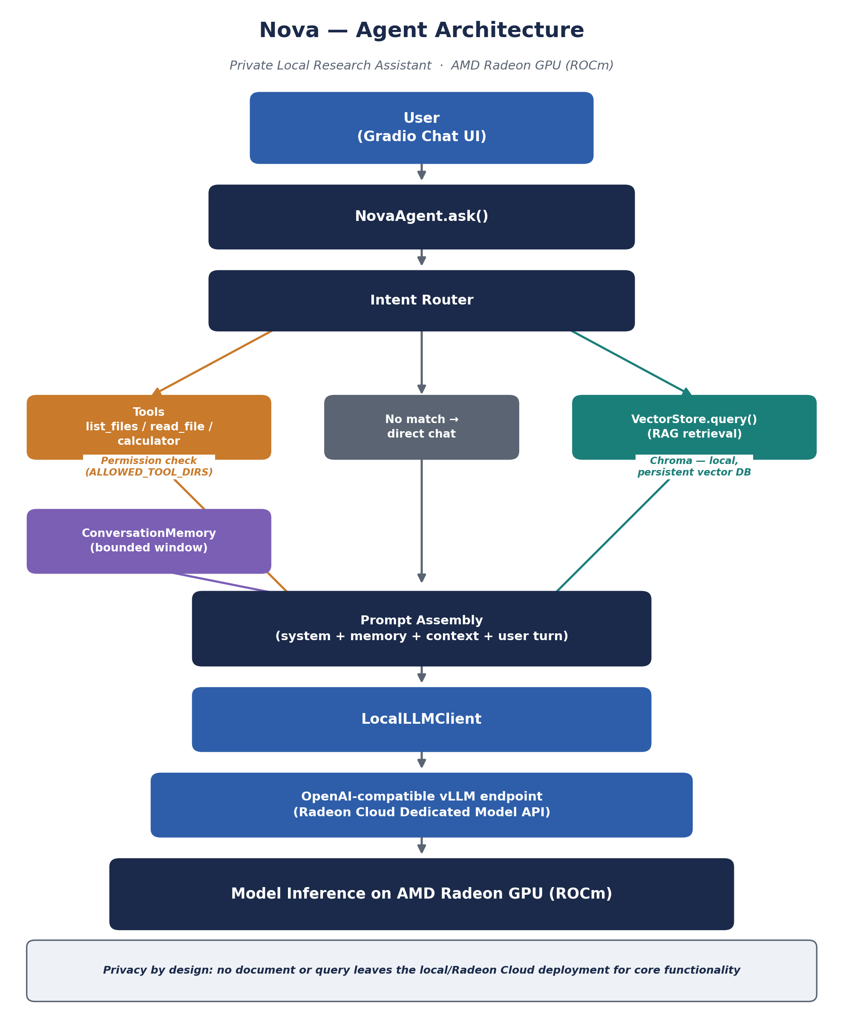
Architecture
Every turn is routed to exactly one
grounding source — auditable by design.
1 — Route
Intent router matches a tool, or falls back to RAG / direct chat.
2 — Ground
Tool executes (permission-checked) or nearest chunks are retrieved.
3 — Assemble
System prompt + memory + context + user turn.
4 — Infer
Sent to the vLLM endpoint on the AMD Radeon GPU.
Nova — Private Local Research Assistant · AMD AI DevMaster Hackathon, Track 2
3

Slide 4




Core Capabilities
4 of 5 Track 2 capabilities implemented — double the minimum required.
Local Knowledge Retrieval (RAG)
Tool Invocation
Documents chunked, embedded, and stored in a persistent local Chroma vector DB.
Router dispatches to local tools: list files, read file, calculator.
Local Multi-Turn Memory
Permission Control & Privacy
Bounded conversation window carried into every prompt for natural follow-ups.
File tools hard-restricted to an explicit allow-list — refused outside it, always.
Nova — Private Local Research Assistant · AMD AI DevMaster Hackathon, Track 2
4

Slide 5
Tech Stack & Deployment
Deployed via Radeon Cloud's vLLM Dedicated Model API — reproducible, no manual ROCm build.
LLM inference
Qwen2.5-7B-Instruct (fallback 3B) via vLLM 0.16.0 on Radeon Cloud
Embeddings
sentence-transformers · BAAI/bge-small-en-v1.5, local
Vector store
Chroma — local, persistent
Orchestration
Custom transparent intent router (src/agent.py)
UI
Gradio ChatInterface
Container image
vllm-dev:rocm7.2.1_navi_ubuntu22.04_py3.10_pytorch_2.9_vllm_0.16.0
Nova — Private Local Research Assistant · AMD AI DevMaster Hackathon, Track 2
5

Slide 6




Inference Speed Optimization
On AMD Radeon GPU (ROCm)
Continuous batching
Right-sized model
Bounded memory
Stable routing
vLLM's PagedAttention + batching used automatically by vllm serve — no manual tuning needed.
7B-parameter model fits a single GPU's VRAM comfortably; 3B fallback defined for constrained instances.
Conversation window is capped, keeping prompt length — and per-turn latency — predictable.
Required --host 0.0.0.0 --port 8000 preserved exactly, keeping the routed endpoint stable across redeploys.
Nova — Private Local Research Assistant · AMD AI DevMaster Hackathon, Track 2
6

Slide 7
Built private from the ground up
Not a cloud assistant with a privacy policy — an agent that structurally
cannot send your documents or queries anywhere outside your own
AMD Radeon GPU deployment.
RAG
Tool Invocation
Multi-Turn Memory
Permission Control
AMD Radeon · ROCm · vLLM
Nova — AMD AI DevMaster Hackathon, Track 2 · DohaIsianioui

