Slide 1
AMD AI DEVMASTER HACKATHON 2026 / TRACK 2
YIJIAN:
From superhuman Go to
human understanding.
A private, evidence-grounded AI Go coach on AMD Radeon.
Notes:
Open with the product promise: engine strength becomes a teachable reason.
[Sources]
- YIJIAN local project architecture, benchmark scripts and acceptance evidence, accessed 2026-08-03.
[/Sources]

Slide 2
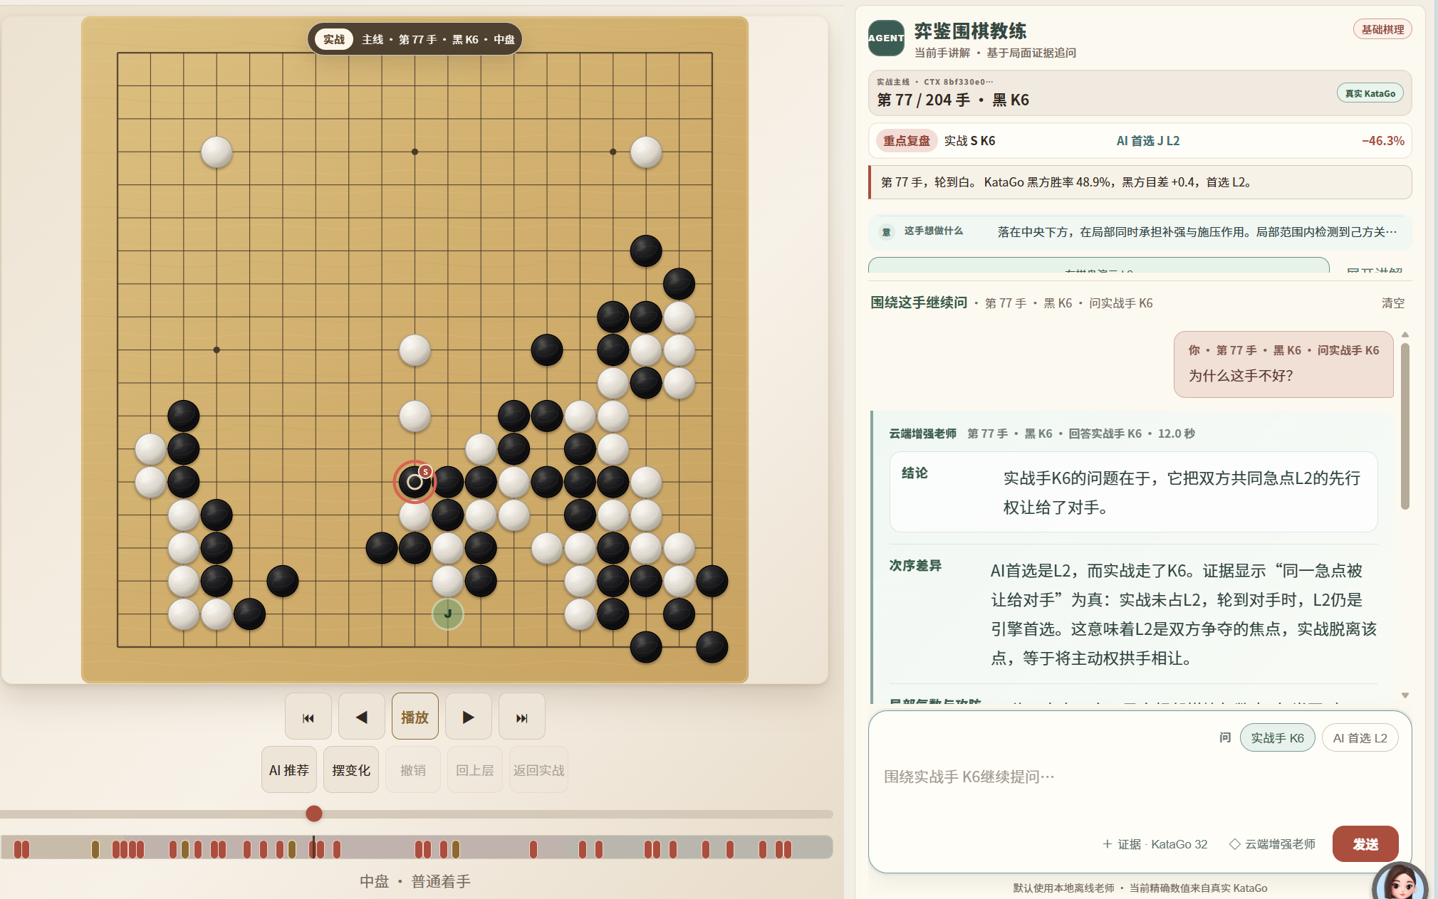
Engines need a teaching layer.
Engines rank moves. Learners need reasons.
Generic LLMs may confuse the played move with the AI move, invent a board relationship, or discuss the wrong region. YIJIAN reconstructs the position and grounds every answer in server-built evidence before the model writes a word.
2
Notes:
The board, evidence, teaching card, variation controls and dialogue share one position context.
[Sources]
- User-provided YIJIAN product screenshot, accessed 2026-08-03.
- YIJIAN local project architecture, accessed 2026-08-03.
[/Sources]

Slide 3
Three layers turn engine output into a defensible lesson.
ENGINE AUTHORITY
KataGo owns candidates, visits, win rate, score lead and variations.
TEACHING EVIDENCE
The server owns the subject, board region, Go rules and move relationships.
LANGUAGE EXPRESSION
Qwen explains the evidence; it cannot rewrite coordinates or numbers.
3
Notes:
Stress the boundary: facts, heuristics and prose are deliberately separate.
[Sources]
- YIJIAN local project architecture, benchmark scripts and acceptance evidence, accessed 2026-08-03.
[/Sources]

Slide 4
The agent gathers, explains and verifies before it answers.
ANALYZE
Replay SGF/GIB. Resolve the exact turn and variation. Ask KataGo for candidates and principal branches.
GROUND
Build a traceable teaching context: subject move, regions, local groups, rules, metrics and variation evidence.
EXPLAIN + VERIFY
Qwen adapts to the question. A validator repairs contradictions or returns a deterministic fallback.
1 / TOOL CALLS
2 / EVIDENCE
3 / VALIDATION
4
Notes:
This is the Track 2 agent loop: tool use, state, reasoning support, validation and fallback.
[Sources]
- YIJIAN local project architecture, benchmark scripts and acceptance evidence, accessed 2026-08-03.
[/Sources]

Slide 5
One W7900 runs both the superhuman engine and the local coach.
AMD RADEON PRO W7900 48 GB
KataGo v1.16.5 uses the official b40 network through OpenCL. Qwen3.6-27B Q4_K_M runs in llama.cpp through ROCm 7.2.1. GPU work is staged: scan, verify, explain, then cache in SQLite.
13.55 s
2.63 s
9.536 s
33 positions
32 visits each
128-visit
critical check
Coach P95
constructed set
5
Notes:
Do not overclaim: the six-case coach benchmark is a constructed acceptance set.
Also mention 373 automated regression tests and 6/6 acceptance cases.
[Sources]
- YIJIAN local project architecture, benchmark scripts and acceptance evidence, accessed 2026-08-03.
[/Sources]

Slide 6
YIJIAN
Every superhuman move,
made understandable.
KataGo authority
Qwen explanation
Radeon privacy
Notes:
Close by returning to the human outcome, not the benchmark.
[Sources]
- YIJIAN local project architecture, benchmark scripts and acceptance evidence, accessed 2026-08-03.
[/Sources]

