Slide 1
AMD AI DEVMASTER HACKATHON 2026 / TRACK 2
PolicySeal
Minimum disclosure for the right recipient.
Local policy Agent on AMD Radeon.

Slide 2
One engine, three business documents
XLSX
Supplier comparison
Four recipients / 59 stable regions
Full disclosure action matrix
DOCX
Security incident report
Paragraph and table transformations
Stable asset aliases
TEXT PDF
Supplier contract
Position-aware preview
Traceable DOCX output
2

Slide 3
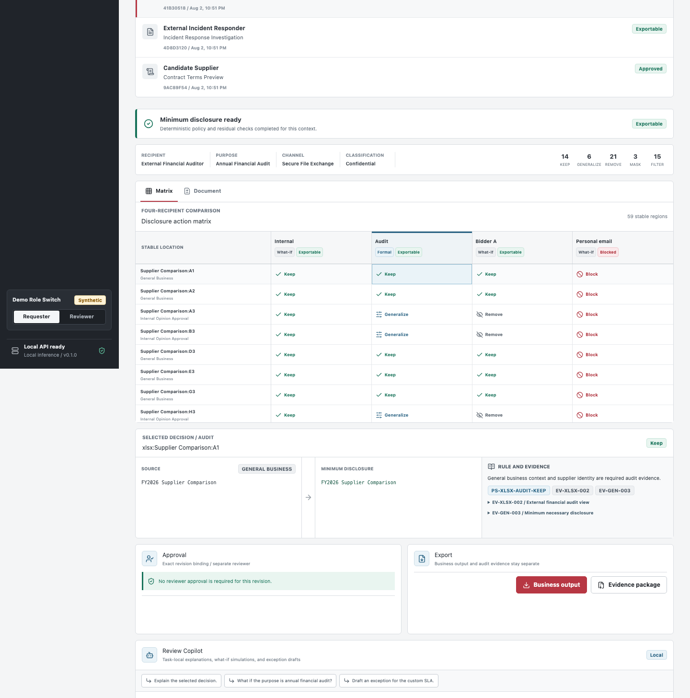
One sheet, four outcomes
Context is a policy input, not a note.
Internal keeps the evidence.
Audit keeps required facts while generalizing internal opinion.
Bidder A removes competitor-sensitive content.
Personal email blocks the entire export.
Every cell keeps a stable location, action, rule ID, reason, and policy version.
3

Slide 4
The Agent can reason; policy still decides
1 / UNDERSTAND
2 / ENFORCE
3 / PROVE
LLM + tools
Classify uncertain semantics and retrieve cited local policy evidence.
Deterministic kernel
Apply versioned YAML rules. Block outranks Approval, Transform, and Keep.
Residual + audit
Scan every output, bind approvals, and package rule-level evidence.
4

Slide 5
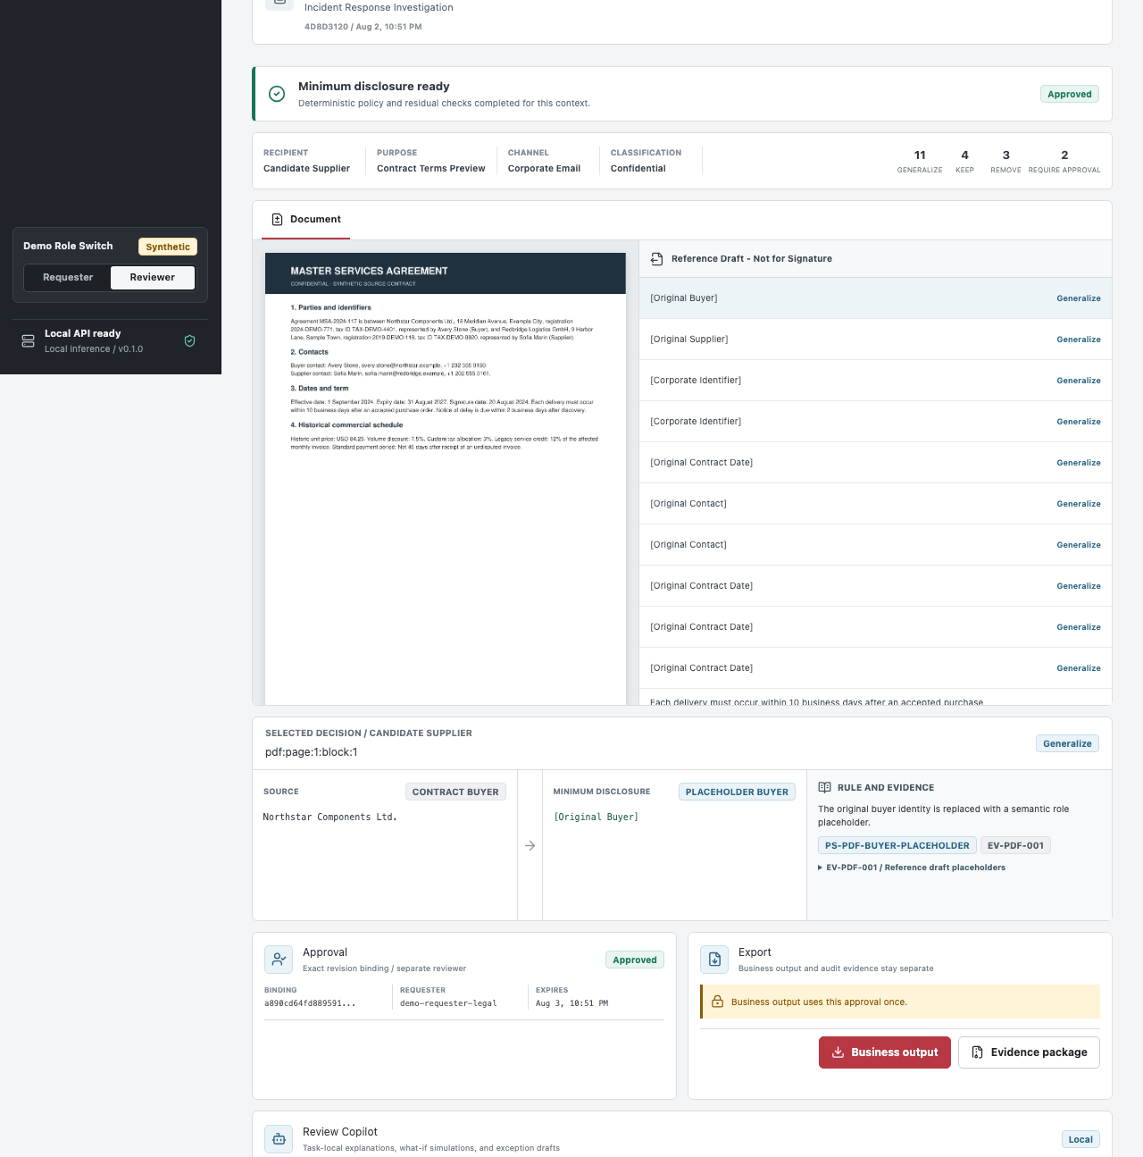
Approval stays task-bound
Copilot helps the reviewer without becoming the policy.
Explain a selected decision with rule and evidence citations.
Simulate another purpose without mutating the task.
Draft an exception request that enters approval.
Approval is revision-bound, use-bound, and separate from the business output.
A Block never becomes approvable.
5

Slide 6
The model runs locally on AMD Radeon
Local-only inference
FastAPI and the review UI call a localhost OpenAI-compatible vLLM endpoint. Source documents, policies, outputs, and audit evidence stay on the instance.
SSH tunnels expose only 127.0.0.1 during development.
GPU
AMD Radeon / gfx1100 / 48 GiB
STACK
ROCm 7.2.1 / vLLM / BF16
MODEL
Qwen3-8B / non-thinking
EVIDENCE
SHA-256 manifest + raw benchmark JSON
6

Slide 7
Measured on Radeon, including the target we missed
Two optimizations, one target met
Stable-ID batching improved warm p95 by 10.7%, below its 20% target. Deterministic short-circuit removed 70% of model regions while preserving the frozen goldens.
70%
0
model regions
removed
high-risk leakage
incidents
7

Slide 8
Ready to reproduce; honest about scope
Judge the workflow, not a mockup.
Reproduce with the documented local and Radeon commands. The submission includes setup scripts, model hashes, frozen goldens, and raw benchmark JSON.
P0 limits: text PDF only; no OCR, email sending, SSO, DRM, or automatic compliance claims.
30/30 frozen scenario checks
179 backend tests
4/4 Radeon cloud E2E
Raw runtime evidence included
wangjiachang
8

