Slide 1
IndieGen Asset Studio
Track 1 · Multimodal Content Creation Tools
From one text setting to a complete, style-consistent asset chain: concept art, depth, PBR materials, music, ambient SFX, sprite atlas and a 3D character — natively on AMD Radeon / ROCm.
AMD Radeon gfx1100 · ROCm 7.1 · ComfyUI 0.30

Slide 2
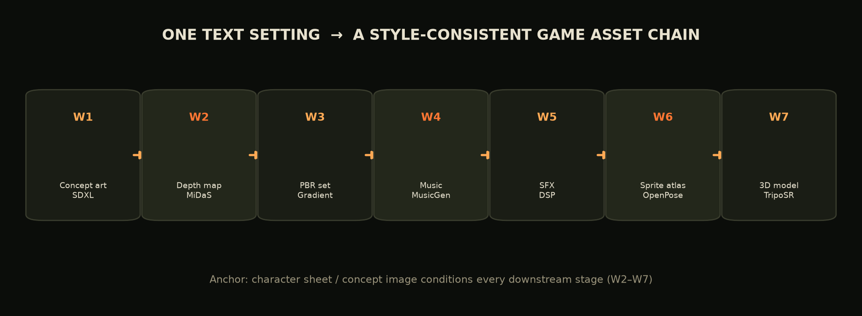
INDIEGEN ASSET STUDIO · TRACK 1
Problem & Solution
Indie teams spend 40-70% of budget on outsourced art — and style drifts between vendors.
▪ One chain instead of many vendors — every asset is conditioned on the same character sheet / setting image.
▪ One GPU instead of a cloud bill — the whole chain runs locally on a Radeon card through ROCm.
▪ Engine-ready outputs — PNG atlas + JSON, PBR maps, GLB/OBJ, MP3 loops, no post-processing.
▪ Human-in-the-loop + full reproducibility — every job stores prompt, seed, steps, CFG and model.
▪ Bilingual UX — Chinese prompts are translated offline (MarianMT) for SDXL / MusicGen.

Slide 3
INDIEGEN ASSET STUDIO · TRACK 1
The Full Asset Pipeline
W1 → W7: one text setting drives seven asset types.

Slide 4
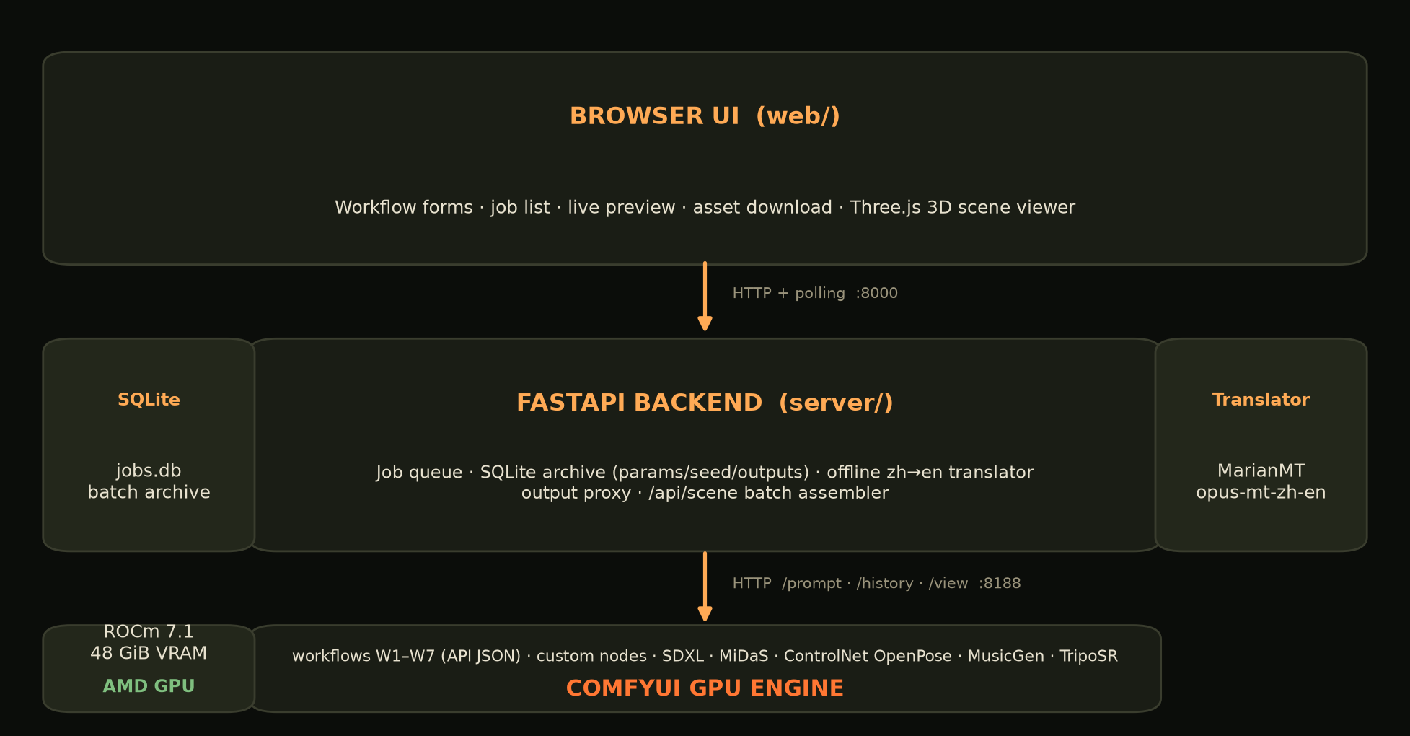
INDIEGEN ASSET STUDIO · TRACK 1
System Architecture
Browser UI · FastAPI backend · ComfyUI GPU engine.

Slide 5
INDIEGEN ASSET STUDIO · TRACK 1
Models & Algorithms
Stage | Method / model | Algorithm notes
W1 concept | SDXL base 1.0 | Text → latent → KSampler (Euler, fixed seed) → VAE decode
W2 depth | MiDaS DPT-Hybrid | Monocular depth via dense prediction transformer
W3 PBR | Custom PBRFromDepth | Depth gradients → normal/height/roughness/metalness
W4 music | MusicGen-small | Autoregressive audio conditioned on text prompt, 44.1 kHz
W5 SFX | Custom ProceduralSFX | Glass clinks, murmur, bar ambience (DSP synthesis)
W6 sprite | ActionPose + ControlNet OpenPose (SDXL) | 18-keypoint skeletons → per-frame img2img → atlas + JSON
W7 2D→3D | TripoSR | Single image → triplane → 3D mesh (GLB/OBJ)
Translate | MarianMT opus-mt-zh-en | Offline Chinese→English prompt translation

Slide 6
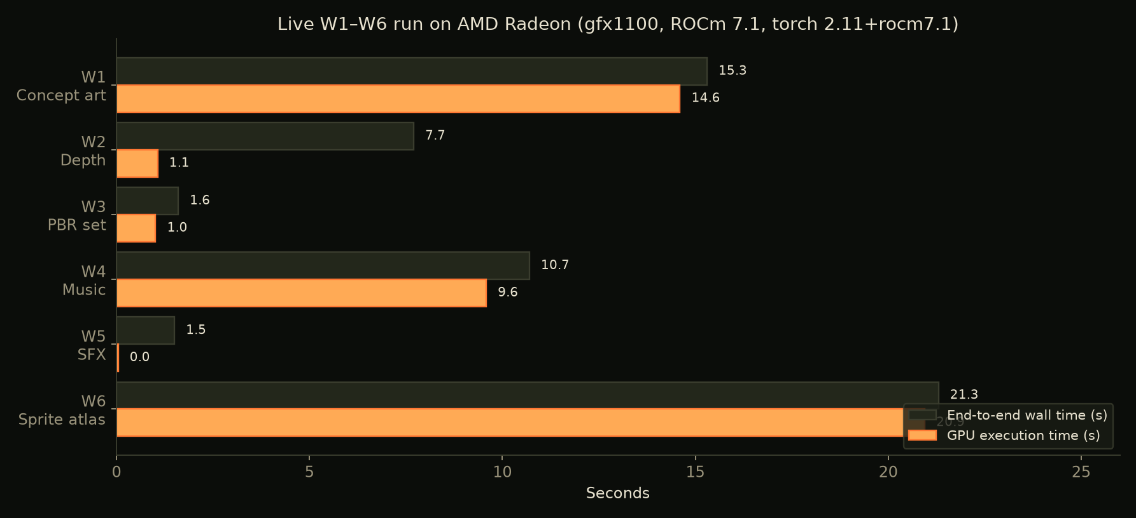
INDIEGEN ASSET STUDIO · TRACK 1
AMD Radeon GPU / ROCm Adaptation
Auto-detected ROCm wheel install · measured live on gfx1100, 48 GiB VRAM.
▪ setup_comfyui.sh auto-detects GPU: NVIDIA → CUDA 12.8, AMD (/dev/kfd) → ROCm 7.1 wheels, CPU fallback — matching torch/torchvision/torchaudio pins.
▪ PyTorch's ROCm build exposes the standard cuda API, so ComfyUI, transformers, ControlNet and all custom nodes run unchanged.
▪ rocm-smi sampled every second during the benchmark: GPU use, VRAM, temperature and power.
Full chain W1–W6: ≈57 s GPU execution · W7 TripoSR 2D→3D: 5.2 s wall on the live run

Slide 7
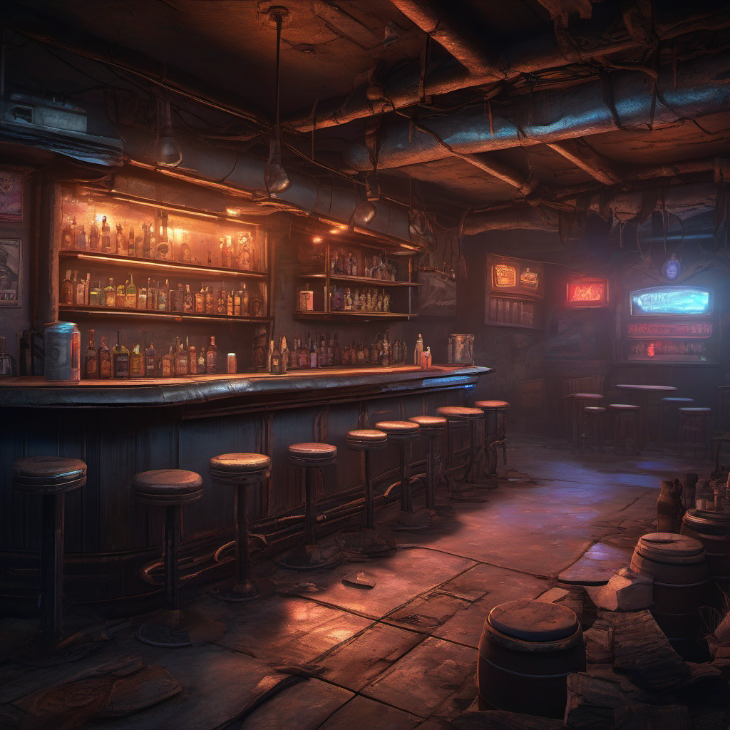
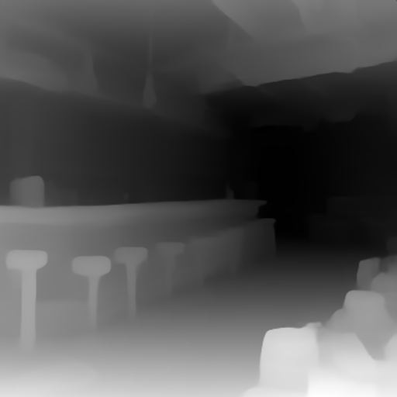
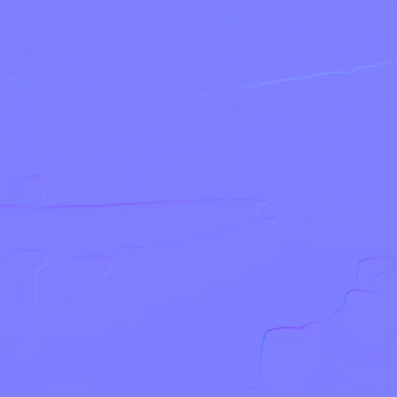
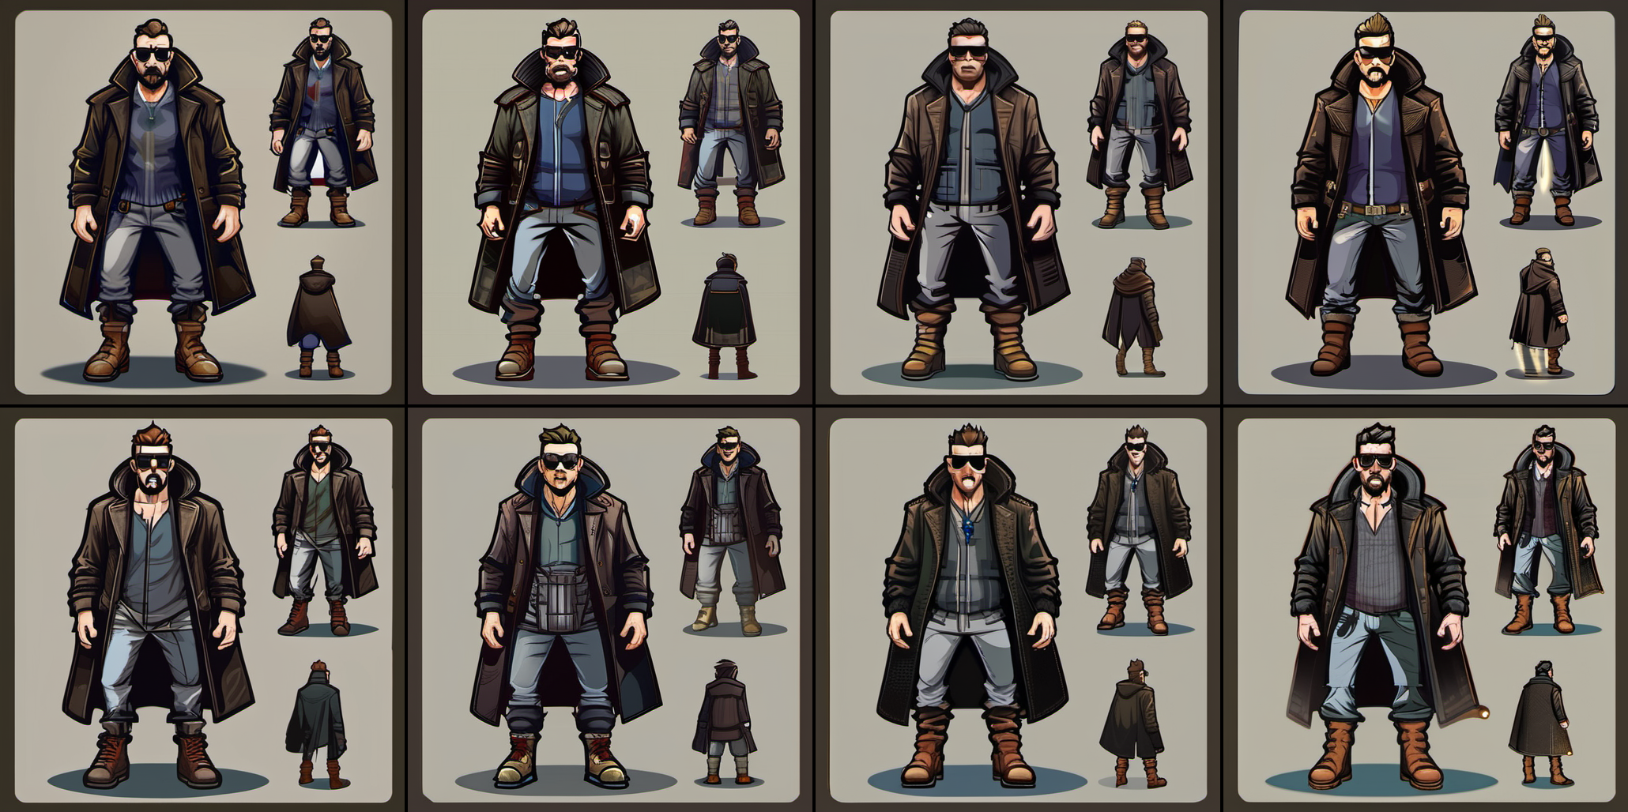
INDIEGEN ASSET STUDIO · TRACK 1
Creative Scenario — The Wasteland Bartender
One text setting → concept art (15 s) · depth + PBR maps · dark industrial music · glass-clink SFX · 8-frame run atlas + JSON (21 s) · TripoSR 3D character (5.2 s) — assembled into an auto-animated 3D bar.

Slide 8
INDIEGEN ASSET STUDIO · TRACK 1
Innovation & Practical Value
▪ Full-chain style lock: one conditioning anchor across seven asset types — no cross-vendor drift.
▪ Engine-ready outputs: PNG atlas + JSON frame config, PBR maps, GLB/OBJ — import directly.
▪ Low-cost local GPU: peak VRAM 21.7 GB on gfx1100; weight offloading supports 8–16 GB Radeon cards.
▪ Reproducible & auditable: every job stores its full parameter set; fixed seeds repeat results.
▪ Product-grade packaging: docker-compose + nginx + systemd, proxy-only networking (8188 never exposed).
▪ A living demo: the 3D scene assembles a batch into an automated bartender performance with generated music/SFX.

Slide 9
INDIEGEN ASSET STUDIO · TRACK 1
Deliverables & How to Run
▪ Project profile (PDF) · this deck · 3–5 min demo video · live benchmark data.
▪ Full source: workflows W1–W7, 5 custom ComfyUI nodes, FastAPI backend + SQLite, browser UI + Three.js scene.
▪ Run: bash scripts/setup_comfyui.sh && bash scripts/download_models.sh && bash server/run.sh
▪ W7 3D: bash scripts/setup_3d.sh && bash scripts/download_3d_model.sh
▪ Benchmark: ./ComfyUI/.venv/bin/python scripts/benchmark_amd.py
Track 1 · Multimodal Content Creation Tools
One text setting → game-ready multimodal assets, locally on AMD Radeon / ROCm.
github.com/MFWTW/create_3Dgame

