Slide 1
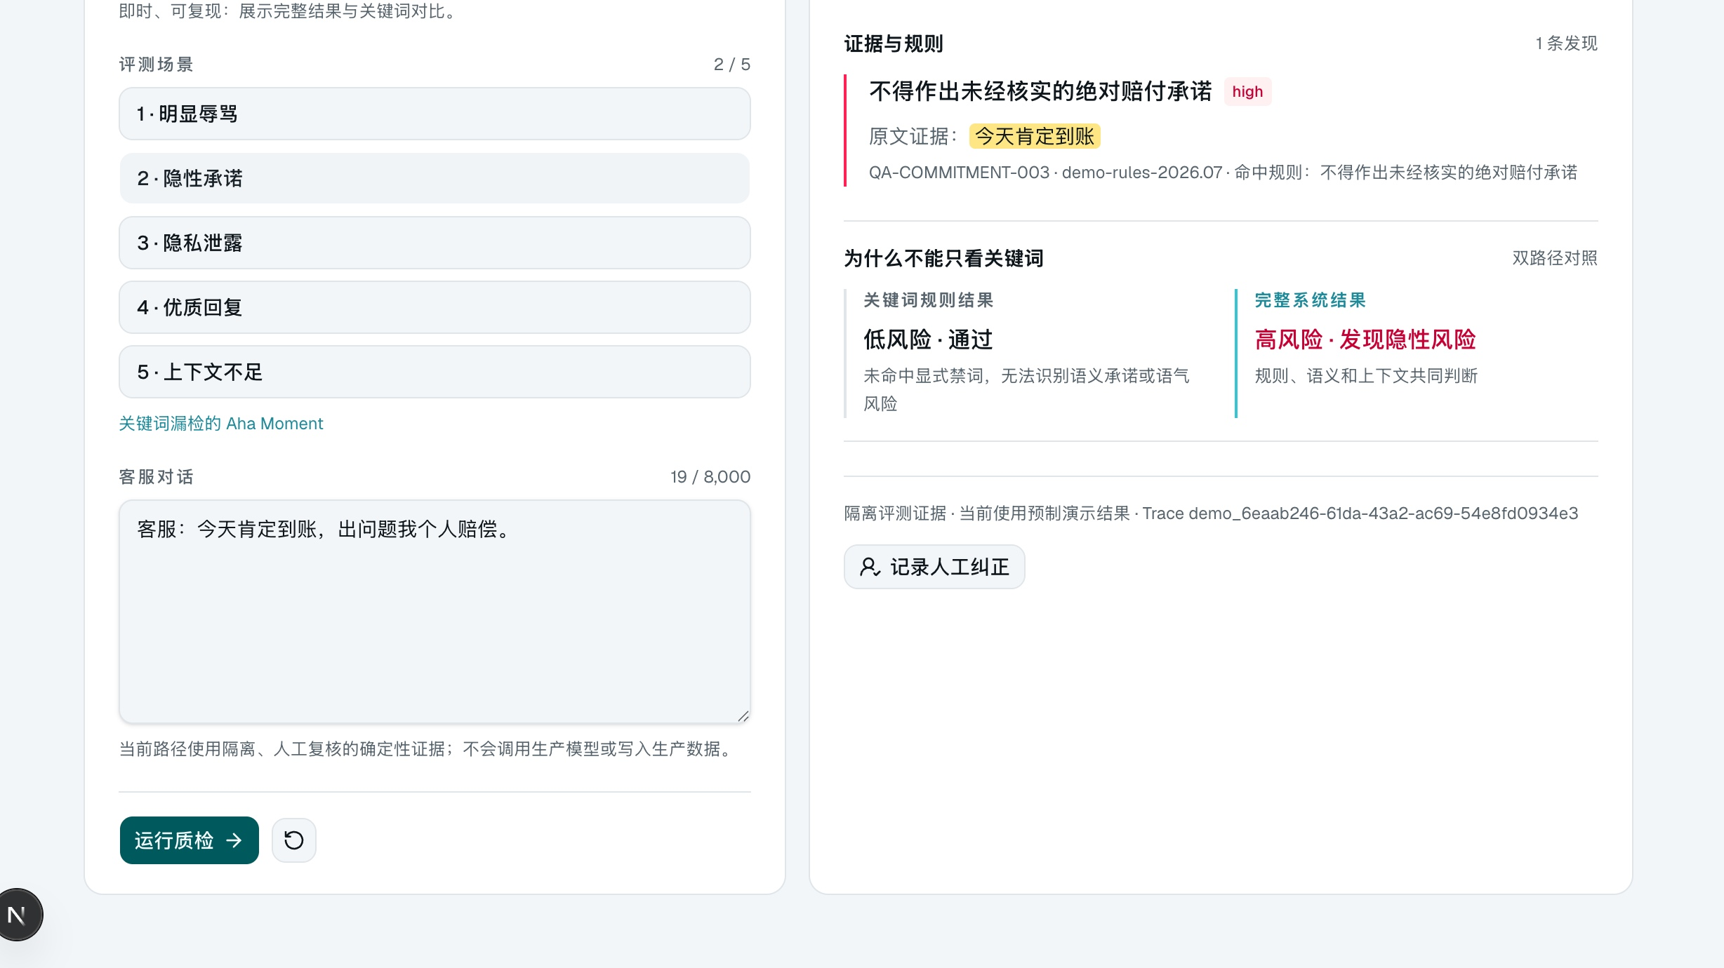
AMD AI DEVMASTER HACKATHON · TRACK 2
E-Sentinel
Private AI Quality Assurance
Agent on AMD Radeon / ROCm
An evidence-grounded QA agent that explains decisions, admits uncertainty, and turns human corrections into governed improvements.
01
Detect what keywords miss
Semantic risk, evidence-cited.
Keep data on-premise
LIVE PRODUCT VIEW
02
Inference on AMD Radeon / ROCm.
03
Turn findings into action
One case. Three controls.
QA → governed work orders.
Rule evidence · Semantic judgment · Human correction
E-Sentinel · AMD AI DevMaster Hackathon · Track 2
PRIVATE · EVIDENCE-GROUNDED · GOVERNED

Slide 2
THE CHALLENGE
01
Customer-service QA has a coverage, privacy, and trust gap
Most existing approaches solve only one of these constraints. E-Sentinel is built to solve all three together.
~20%
LOCAL
∞
MANUAL COVERAGE
PRIVATE DATA PATH
SEMANTIC VARIANTS
Spot-checking leaves the majority of conversations unreviewed.
Local AMD deployment keeps sensitive service operations inside the enterprise boundary.
Keyword rules miss implicit promises, attitude violations, and unresolved complaints.
THE DESIGN REQUIREMENT
Private coverage. Evidence-backed escalation. Governed follow-through.
Coverage · On-premise inference · Evidence before escalation · Human review when uncertain
E-Sentinel · AMD AI DevMaster Hackathon · Track 2
PRIVATE · EVIDENCE-GROUNDED · GOVERNED

Slide 3
COMMERCIAL VALUE
02
From quality assurance to an enterprise control plane
E-Sentinel turns a traditionally manual cost center into a governed operating capability: observe risk, prove it, assign it, and improve it.
COVERAGE
CONTROL
THE SHIFT
100% conversation inspection
with cited findings
Risk, evidence, owner, SLA
and audit trail in one loop
From spot
checks
to signal.
ADOPTION
THE ENTERPRISE OUTCOME
From a periodic, manual sample
to a continuous quality signal
across the service operation.
Private local inference keeps
sensitive operations in-house
A quality decision is
traceable, assignable, and reviewable.
E-Sentinel · AMD AI DevMaster Hackathon · Track 2
PRIVATE · EVIDENCE-GROUNDED · GOVERNED

Slide 4
THE PRODUCT
03
From a conversation to a governed action
E-Sentinel connects detection, evidence verification, and operational follow-through.
Detect
1 CUSTOMER CONVERSATION
01
Deterministic hard rules catch non-negotiable red lines.
Verify
02
The agent retrieves policy sources and cites the original quote.
Govern
03
A validated finding becomes a work order with owner and SLA.
The system does not stop at a score.
E-Sentinel · AMD AI DevMaster Hackathon · Track 2
PRIVATE · EVIDENCE-GROUNDED · GOVERNED

Slide 5
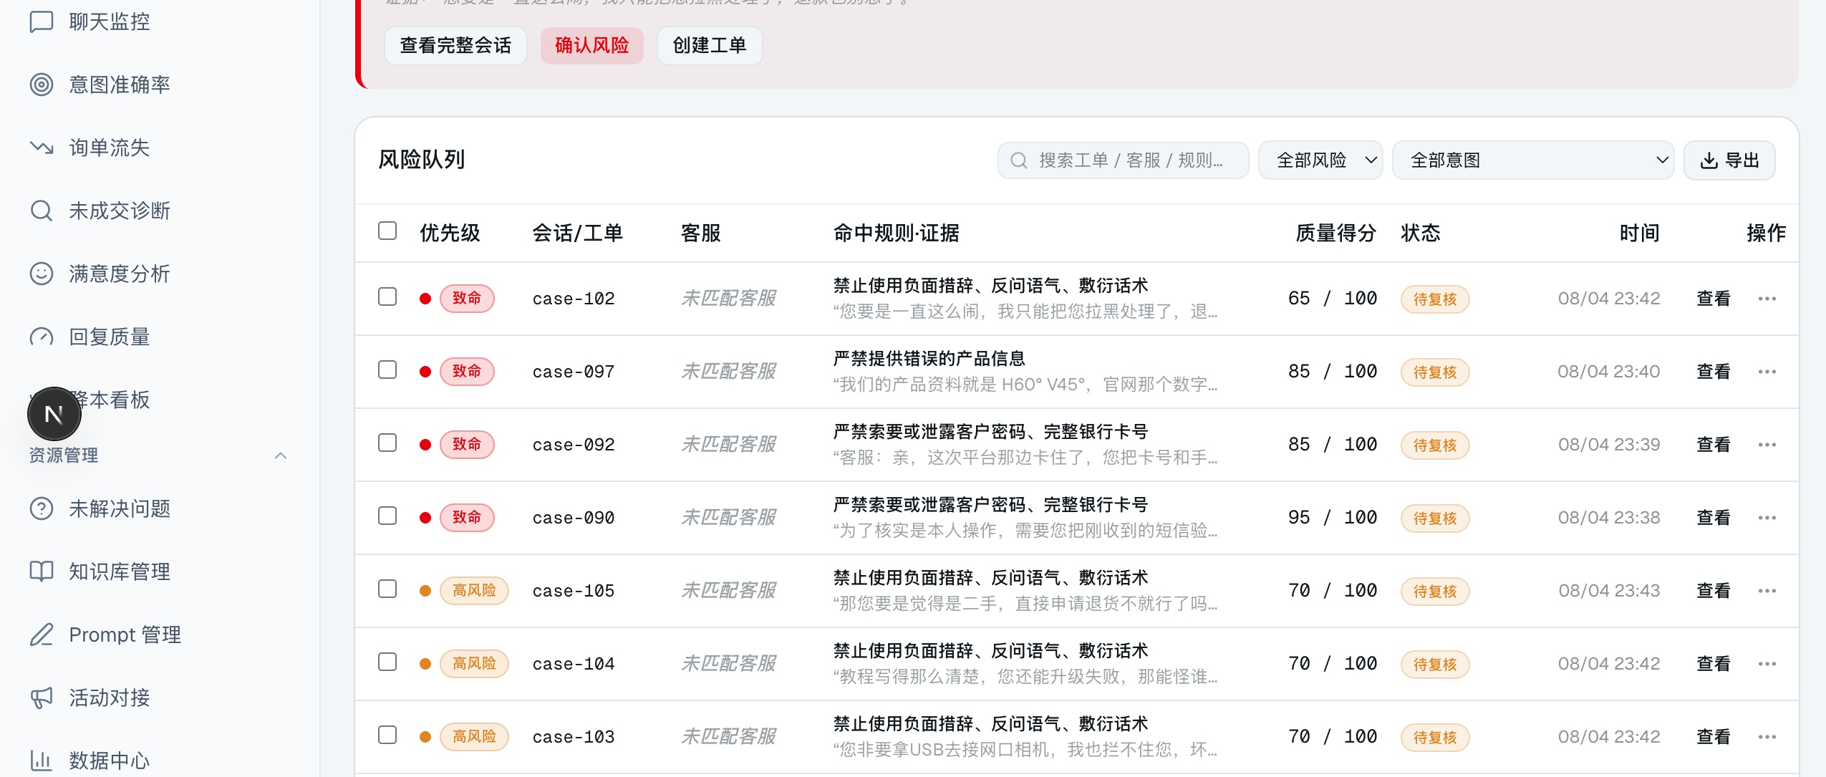
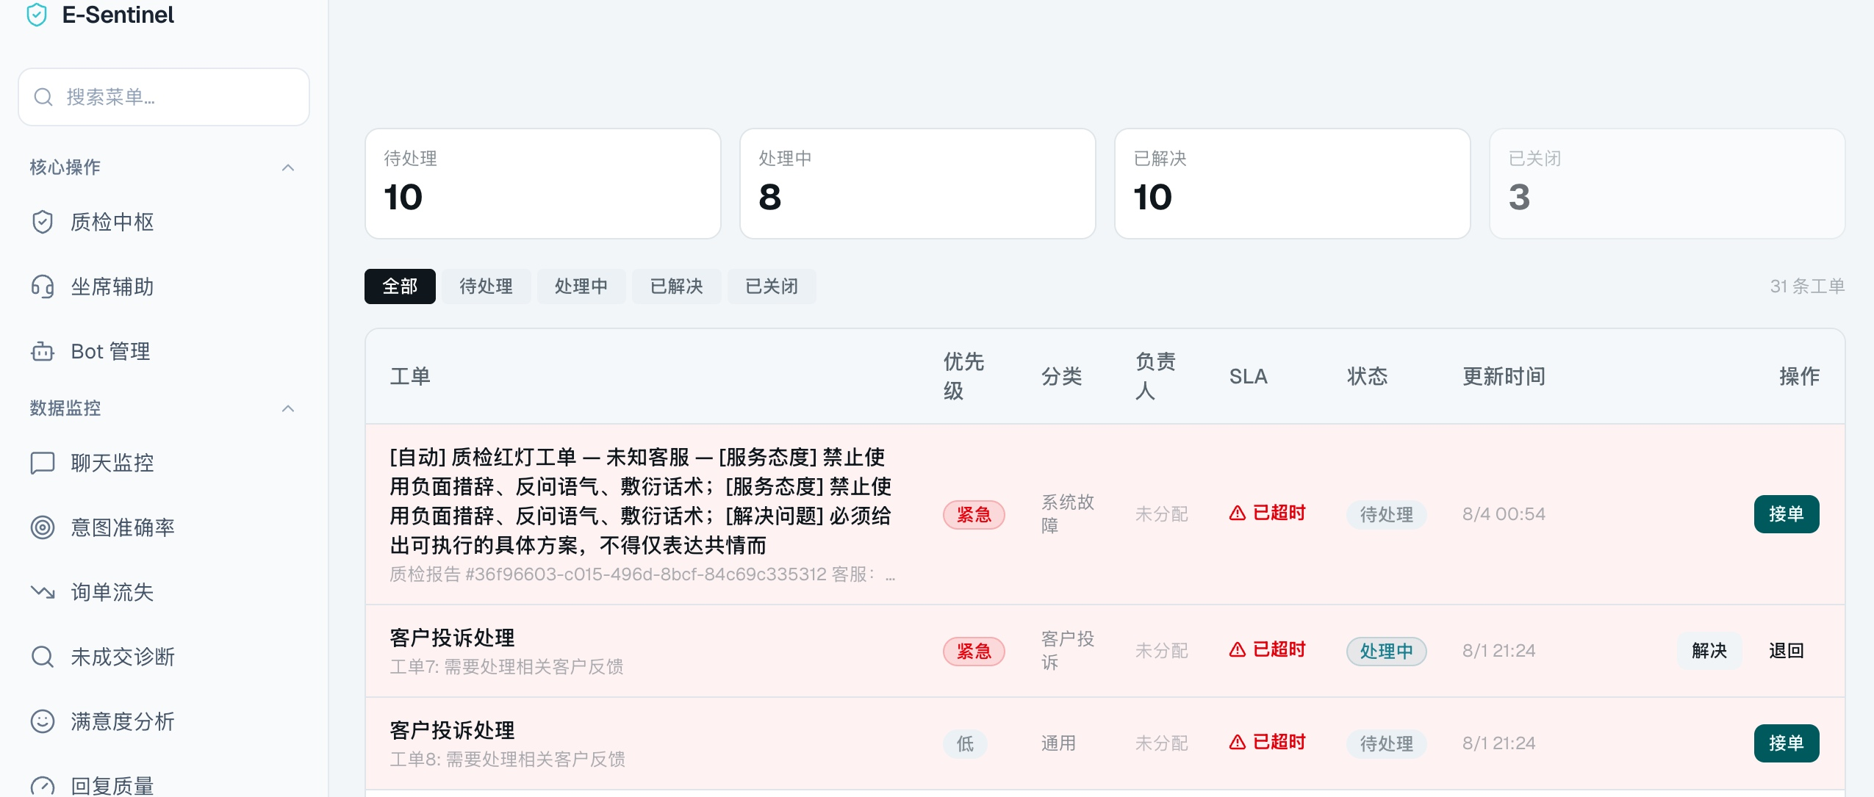
THE FULL PRODUCT
04
A complete, governed QA operating system
27 workbench panels connect daily quality work across four operational groups.
CORE OPS · 4
DATA MONITORING · 7
Overview · QA hub
Agent assist · Bot config
Monitoring · diagnosis
Satisfaction · quality · cost
RESOURCE MGMT · 5
SYSTEM OPS · 11
Issues · knowledge · prompts
Campaigns · data center
Governance · compliance
Work orders · models · audit
QA HUB · LIVE RISK OVERVIEW
“A detected violation becomes a governed, assignable action item.”
Complete audit report: score · risk · source quotes · SLA · priority · owner
WORK ORDERS · QA → ACTION
E-Sentinel · AMD AI DevMaster Hackathon · Track 2
PRIVATE · EVIDENCE-GROUNDED · GOVERNED

Slide 6
AGENT CAPABILITIES
05
Four capabilities. One accountable decision.
Each capability has a distinct role; the agent coordinates evidence, but cannot directly lower a risk decision.
01
02
03
04
Observe
Investigate
Ground
Improve
→
→
→
5-dimension LLM-as-a-Judge
Deterministic compliance rules
Risk grading: pass → block
ReAct tool calling
scan_compliance
retrieve_knowledge
Original conversation quote
Cited policy / product knowledge
No source → human review
Human correction precedent
Few-shot case memory
Audit trail + work order
Live tool contract on AMD Qwen
scan_compliance → retrieve_knowledge → check_corrections → evidence summary → deterministic resolver
E-Sentinel · AMD AI DevMaster Hackathon · Track 2
PRIVATE · EVIDENCE-GROUNDED · GOVERNED

Slide 7
SAFETY BY DESIGN
06
Five layers. One non-negotiable: risk never goes down.
The agent investigates with evidence; a deterministic resolver retains final safety control.
finalRisk = max(hardRules, semanticBaseline, validatedAgentEscalation)
1
2
3
4
5
Hard rules
→
LLM judge
→
Soft signals
→
Agent investigator
→
Resolver
Critical floor
never downgraded
Scored, cited
semantic baseline
Review hints
not auto-locks
Tools collect evidence
no risk-write authority
Same input
same output
Hard red lines cannot be downgraded
No source → human review (fail-closed)
Human corrections are auditable
E-Sentinel · AMD AI DevMaster Hackathon · Track 2
PRIVATE · EVIDENCE-GROUNDED · GOVERNED

Slide 8
AMD LOCAL DEPLOYMENT
07
A local runtime sized for the Radeon PRO W7900D
The core agent runs on a 48GB gfx1100 card; the larger cloud model is an optional control, not a dependency.
MODEL FIT ON 48GB GFX1100
VALIDATED AMD ENVIRONMENT
NO CODE FORK
Qwen3-8B
~16GB FP16
LOCAL CORE · FITS
Same agent.
Local endpoint.
gfx1100
Radeon PRO W7900D
48GB VRAM · 96 CUs
ROCm 7.2.1 · vLLM ROCm
Qwen3-14B
~28GB FP16
LOCAL OPTION · FITS
Point AMD_API_URL to local vLLM. The provider stays OpenAI-compatible.
Qwen3.6-35B-A3B
~70GB FP16
AMD CLOUD CONTROL
The local service exposes an
OpenAI-compatible endpoint.
AMD_API_URL → vLLM
E-Sentinel · AMD AI DevMaster Hackathon · Track 2
PRIVATE · EVIDENCE-GROUNDED · GOVERNED

Slide 9
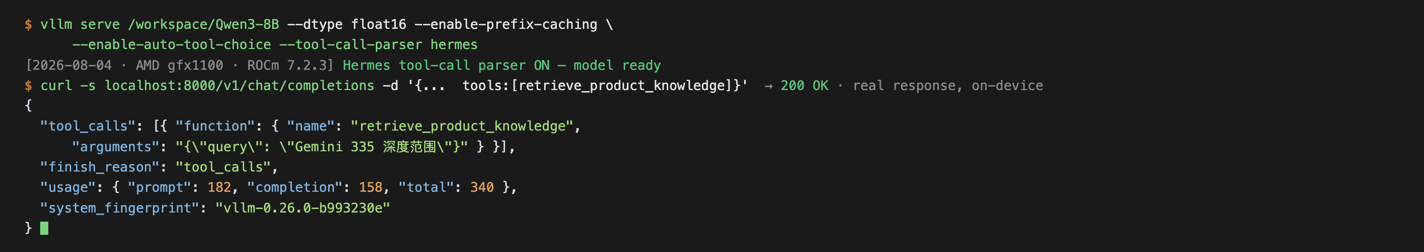
AMD EXECUTION
08
Private inference on AMD, measured under ROCm
Qwen3-8B served locally on AMD gfx1100 (Radeon PRO W7900D) · ROCm 7.2.1 · vLLM 0.26.0+rocm723.
87%
3.20×
1.49×
~170
VRAM used
for Qwen3-8B
E2E speedup
thinking off
Shared-prefix
cache speedup
tok/s aggregate
concurrency 1→8
Why it matters
Customer conversations can be evaluated locally — with real tool calling, not a mocked integration.
LIVE HERMES TOOL-CALL TRACE
Controlled measurements: thinking-off P50 5.01s → 1.57s · cached prefix 3.14s → 2.11s · concurrency-8: 170.4 tok/s, 0 failures.
E-Sentinel · AMD AI DevMaster Hackathon · Track 2
PRIVATE · EVIDENCE-GROUNDED · GOVERNED

Slide 10
OPTIMIZATION DECISION MATRIX
09
Every optimization is gated by performance and quality
The local Agent path adopts only optimizations that improve deployment economics without violating the frozen quality gate.
3.20×
THINKING-OFF E2E
1.49×
PREFIX CACHE
P50 5.01s → 1.57s
200 → 22 completion tokens
Same shared prefix
3.14s → 2.11s
−64%
GPTQ MODEL WEIGHTS
+62–79%
GPTQ OUTPUT TOK/S
FP16 16GB → GPTQ 5.7GB
Weight size, not peak VRAM
Concurrency 1: 34 → 55
Concurrency 8: 133 → 238
QUALITY GATE
Agent GPTQ passes: Recall 0.921 → 0.905 (−0.016) · F1 0.823 → 0.844 · FPR 0.476 → 0.357
Dual GPTQ degrades: Recall 0.508 → 0.254 — therefore Dual stays FP16.
Same script, same prompt; one observation per concurrency, no warm-up. Benefits are reported as controlled deployment evidence, not universal GPU claims.
E-Sentinel · AMD AI DevMaster Hackathon · Track 2
PRIVATE · EVIDENCE-GROUNDED · GOVERNED

Slide 11
EVALUATION PROTOCOL
10
Hard to game by design
The evaluation set, labels, comparison path, and quality boundaries are explicit and reproducible.
105 CONVERSATIONS
DOUBLE-BLIND LABELING
PAIRED COMPARISON
40 human-annotated
65 synthetic-near-real
13 scenario types
→
Two independent channels
Human arbitration
Cohen’s κ = 0.805
→
Dual and Agent reuse the
same judge baseline snapshot
0 failed predictions
WHAT WE CLAIM — AND WHAT WE DO NOT
✓ Local 8B and cloud 35B results are reported separately
✓ Human-gold is never used as training examples or generation seeds
✓ No source means human review — not invented certainty
✓ Quality gates can reject worse fine-tuned models
E-Sentinel · AMD AI DevMaster Hackathon · Track 2
PRIVATE · EVIDENCE-GROUNDED · GOVERNED

Slide 12
EVIDENCE
11
Paired ablation: the agent path recovers semantic misses
Human-gold 105 cases · double-blind annotation + arbitration · Cohen’s κ = 0.805.
SEVERE-VIOLATION RECALL
Variant
Recall
Precision
F1
FPR
κ
Keyword rules
27.0%
rule_only
0.270
0.486
0.347
0.429
0.012
LLM judge
60.3%
dual (AMD 35B)
0.603
0.974
0.745
0.024
0.332
Agent + tools
63.5%
agent (ReAct+tools)
0.635
0.952
0.762
0.048
0.350
The key comparison is paired: Dual and Agent reuse the same judge baseline snapshot.
Local Qwen3-8B results are reported separately; never merged with cloud 35B.
E-Sentinel · AMD AI DevMaster Hackathon · Track 2
PRIVATE · EVIDENCE-GROUNDED · GOVERNED

Slide 13
ENGINEERING INTEGRITY
12
The quality gate is allowed to say no
The project retains the stock model when experiments regress — results are disclosed rather than cherry-picked.
274
0 / 50
2
PASSING JEST TESTS
CROSS-TENANT LEAKS
LORA RUNS REJECTED
Coverage includes AMD integration and contract tests.
Observed in the 50-row pgvector isolation test.
Both fine-tuning experiments regressed the frozen quality gate.
TRUSTWORTHY AI IS NOT THE MODEL THAT ALWAYS SAYS “YES.”
Stock Qwen3-8B remains in production because the evidence gate rejected weaker alternatives.
E-Sentinel · AMD AI DevMaster Hackathon · Track 2
PRIVATE · EVIDENCE-GROUNDED · GOVERNED

Slide 14
WHY E-SENTINEL
E
A private AI agent
that earns the right
to make quality decisions.
E-Sentinel · Track 2
Thank you
Not a chat widget. Not a keyword filter. A complete quality operating system that combines evidence, safety controls, human review, and AMD local inference.
PRIVATE BY DESIGN
EVIDENCE BEFORE ESCALATION
OPERATIONS YOU CAN ACT ON
AMD Radeon / ROCm local runtime
Sensitive content stays on-premise.
Every claim has an original quote
and retrieved policy context.
27 panels connect QA findings to
owners, SLAs, and work orders.
Reproducible evidence · 105-case human-gold · κ 0.805 · 274 passing Jest tests · Local and cloud results kept separate
E-Sentinel · AMD AI DevMaster Hackathon · Track 2 · Submission deck
PRIVATE · EVIDENCE-GROUNDED · GOVERNED

