Slide 1
AMD AI DEVMASTER 2026 · TRACK 2
XiangLens
A private, cross-context profile-image Agent
Goal-relative · Source-backed · User-controlled
Da Le
llama.cpp · LangGraph · Milvus Lite · AMD Radeon / ROCm
github.com/ld0574/Radeon-hackathon-2026-07
Notes:
XiangLens cover — AMD AI DevMaster 2026, Track 2. Goal-relative, source-backed, user-controlled profile-image review, running fully on AMD Radeon / ROCm.

Slide 2
THE PROBLEM
Profile images are small. Their risks are not.
One avatar is reused across professional, open-source, social, and cross-cultural contexts
Clarity
Small-size legibility and crop resilience
The XiangLens answer
Goal-relative review — measured against your stated goal and audience, never personality or identity inference.
Local by default — inspection and inference run on your own GPU.
Evidence-backed — every recommendation links the sources used.
Privacy
Embedded metadata, visible QR codes, identifiers
Provenance
Copyright, ownership, and licensing uncertainty
Context
The same image reads differently to each audience
XiangLens · AMD AI DevMaster 2026 · Track 2
02
Notes:
The problem — profile-image choice carries privacy, provenance, clarity, and context risks. XiangLens is goal-relative review, not personality or identity inference.

Slide 3
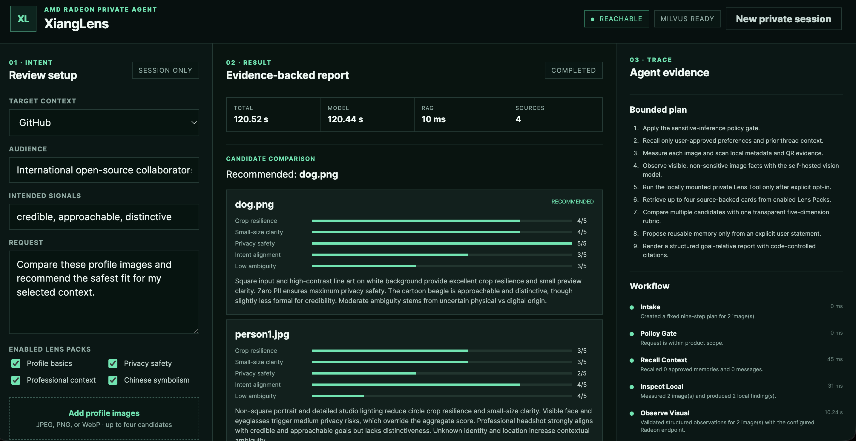
THE PRODUCT
The interface makes the Agent workflow inspectable
01 · Intent context, audience, signals 02 · Result five-dimension rubric 03 · Trace bounded plan + node timings
Notes:
The real product UI — three inspectable zones. 01 Intent — review setup with target context, audience, intended signals, Lens Packs. 02 Result — evidence-backed report with a transparent five-dimension candidate rubric. 03 Trace — bounded nine-step plan and per-node workflow timings.

Slide 4
WHY AN AGENT
One workflow owns every decision around the model
A single model call cannot safely own all of these decisions — so the graph does
Policy routing
Sensitive inference blocked at the gate
Deterministic inspection
EXIF, QR, crop and size before the VLM
Bounded observation
Visible facts and uncertainty only
Filtered retrieval
Top-K cards from enabled Lens Packs
Transparent comparison
One five-dimension rubric for 2–4 images
Consent + citations in code
Model proposes; the application writes and renders
The bounded path — every node emits a timed SSE trace
Policy
Recall
Inspect
Observe
Private Lens
RAG
Compare
Consent
Report
Sensitive branch: policy gate → blocked report, no inference performed.
Follow-up branch: recall → reuse analysis → answer — vision, retrieval, and comparison are not repeated.
XiangLens · AMD AI DevMaster 2026 · Track 2
04
Notes:
Why an Agent — the result requires policy routing, state restoration, deterministic inspection, multimodal observation, filtered retrieval, comparison, consent, and code-controlled citation rendering. The bounded path runs as a fixed visible plan; every node emits an SSE trace; sensitive requests branch to a blocked report; follow-ups reuse verified analysis instead of repeating vision.

Slide 5
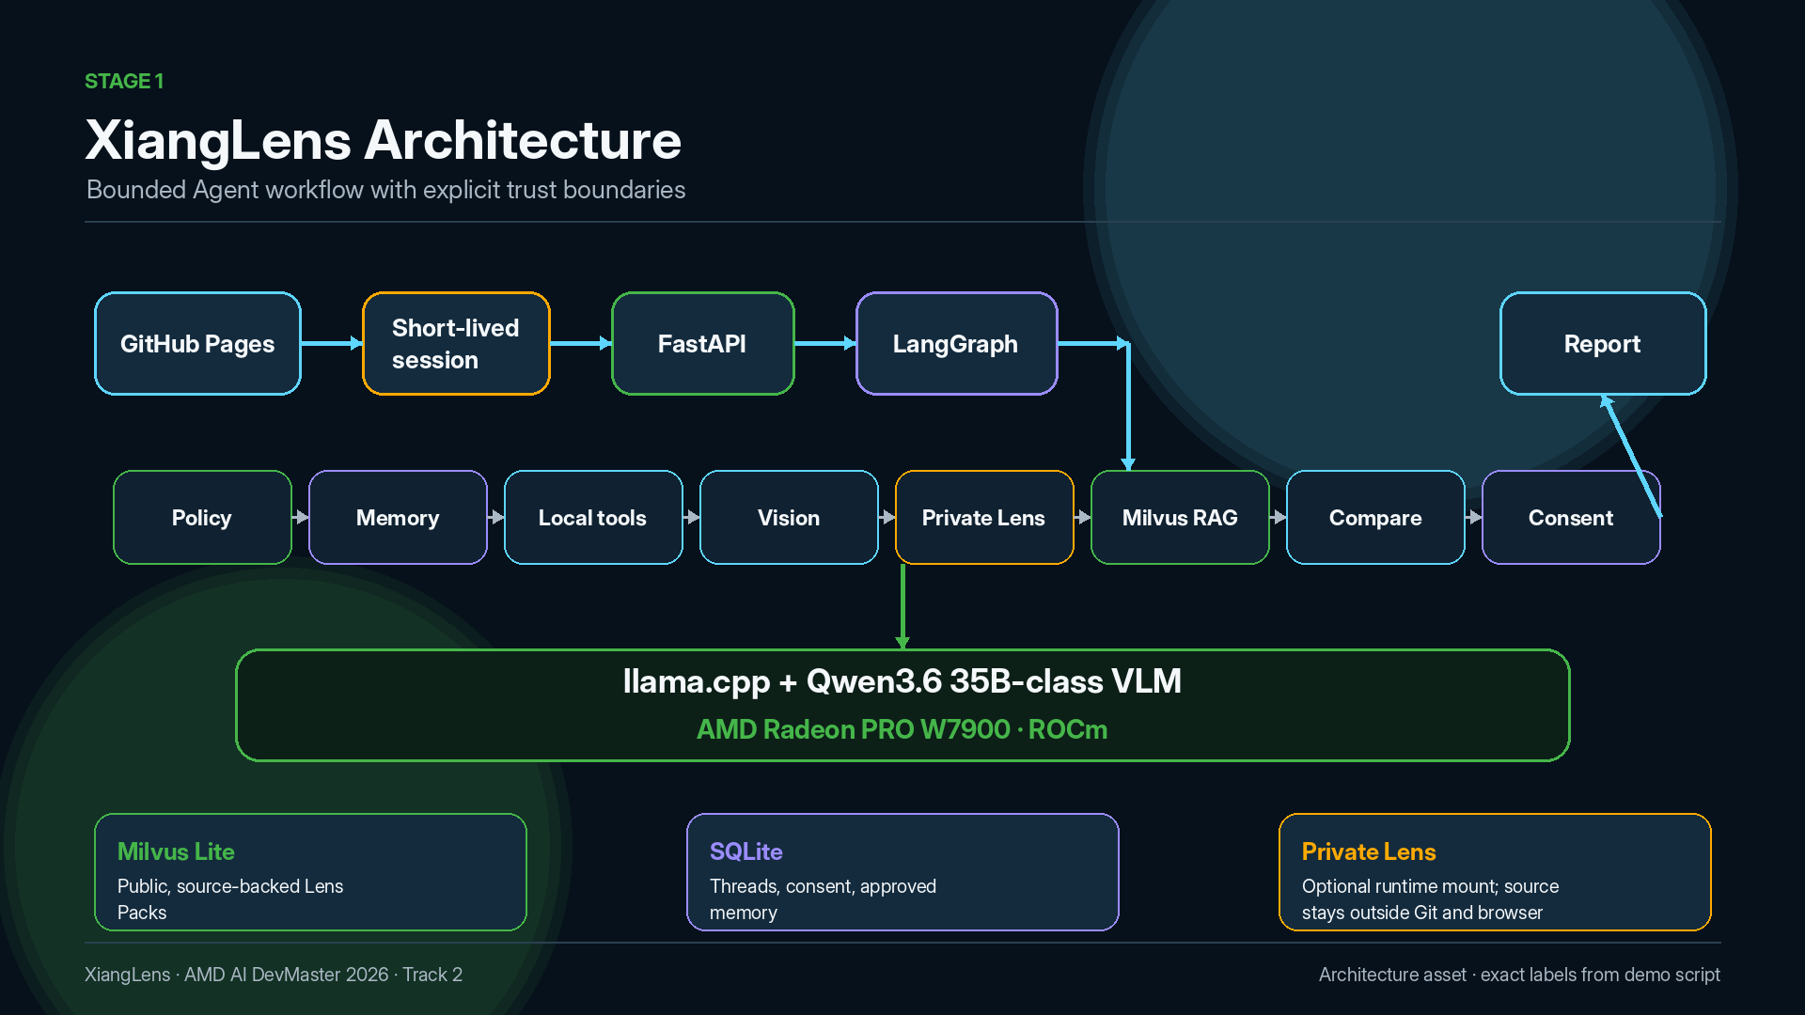
Notes:
Architecture — bounded Agent workflow with explicit trust boundaries. GitHub Pages frontend, short-lived session, FastAPI, LangGraph nodes, Milvus Lite public Lens Packs, SQLite approved memory, Private Lens mounted only at runtime. Inference via llama.cpp + Qwen3.6 35B-class VLM on AMD Radeon PRO W7900 / ROCm.

Slide 6
TRACK 2 REQUIREMENTS
All five required capabilities, reviewable in one run
Each capability maps to a visible UI trace or a reproducible repository artifact
CAPABILITY | XIANGLENS IMPLEMENTATION | REVIEWER EVIDENCE
Multi-step planning | Fixed nine-step plan with conditional policy routing | Plan and node trace in the UI
Tool calling | EXIF / QR / crop metrics, safe copy, private Lens mount | Public trace lists each bounded tool
Local RAG | Milvus Lite · four Lens Packs · Top-K with visible sources | Retrieved Sources panel + smoke queries
Local multi-turn memory | SQLite threads, recent-turn context, approved preferences | Recall trace, approve / delete controls
Permission & privacy | Policy gate, short-lived token, consent-first writes, Forget Me | Blocked request, pending proposal, deletion API
XiangLens · AMD AI DevMaster 2026 · Track 2
06
Notes:
Track 2 requirements mapping — all five required capabilities implemented and reviewable in the UI or the repository.

Slide 7





THE DEMO
Four cases, one controlled Agent
Each case isolates one control property — privacy, consent, recall, and opt-in extension
1
2
3
4
LinkedInPrivacy Review
GitHub Rights +Memory Consent
Cross-ReviewRecall
Opt-InPrivate Lens
Deterministic QR detection before model interpretation.
Proves: local privacy inspection + source-backed report
Provenance warning without legal claims; memory stored only after Approve.
Proves: rights awareness + consent-first memory
A new thread recalls exactly one approved preference — as a goal, not a fact.
Proves: memory portability with full visibility
Private knowledge mounted only at runtime; filtered, bounded output.
Proves: extensibility without leakage
ACTUAL TEST INPUTS
ACTUAL TEST INPUTS
ACTUAL TEST INPUTS
ACTUAL TEST INPUTS
person1.jpg · qr.jpg
person2.jpg · dog.png
dog.png · yinyang.jpg
yinyang.jpg
XiangLens · AMD AI DevMaster 2026 · Track 2
07
Notes:
Demo roadmap — four cases, each proving a distinct control property of the Agent.

Slide 8
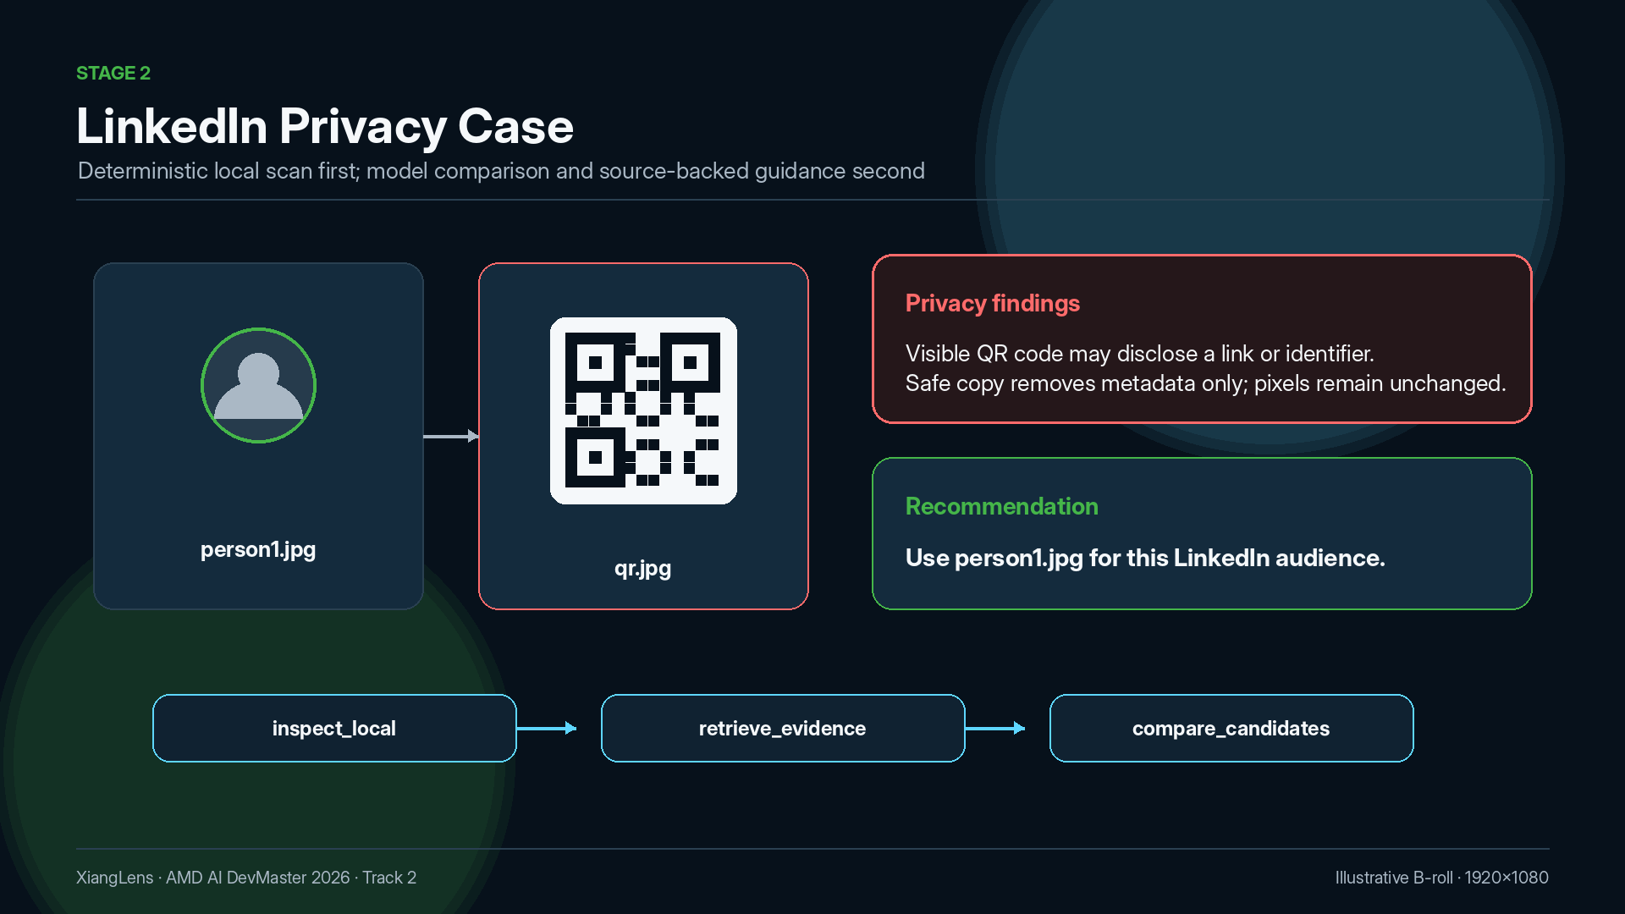
Notes:
Case 1 — LinkedIn privacy review. person1.jpg vs qr.jpg; deterministic local scan detects the visible QR code before model interpretation; Safe copy removes metadata only. Recommendation: person1.jpg, with linked sources.

Slide 9
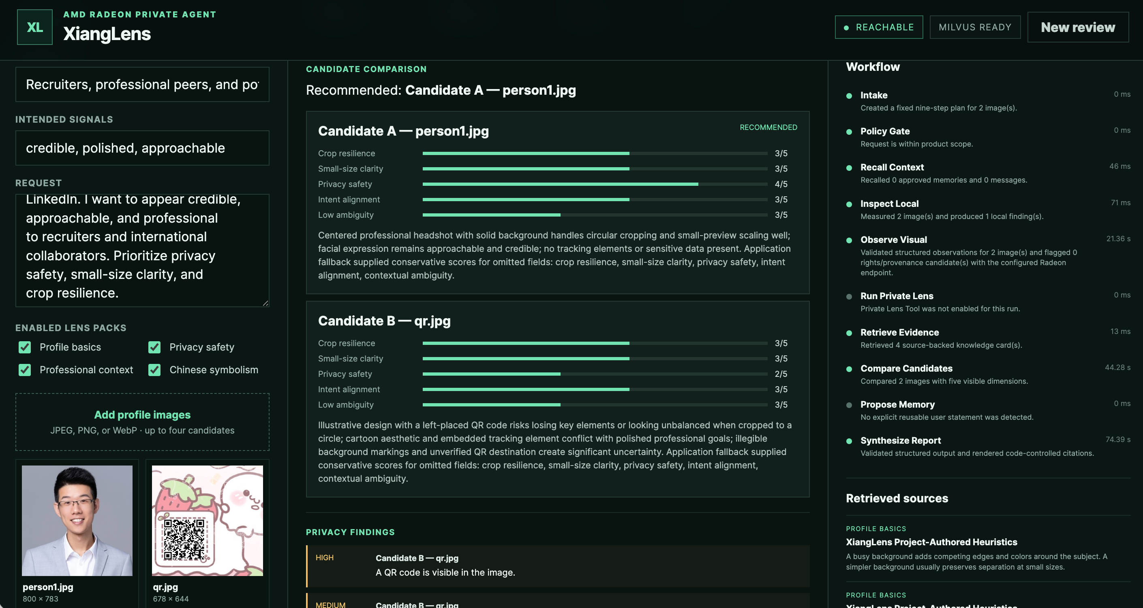
CASE 1 · IN THE UI
The QR risk is caught before the model interprets
Real test inputs: person1.jpg vs qr.jpg QR visible — HIGH privacy finding Recommended: person1.jpg, scored on 5 dimensions Per-node latency visible
09
Notes:
Real UI evidence for Case 1 — the review runs on the actual test avatars (person1.jpg vs qr.jpg). The deterministic Inspect Local step flags the QR code as a HIGH privacy finding before any model interpretation, person1.jpg is recommended with five-dimension scores, and every node reports its latency in the workflow rail.

Slide 10
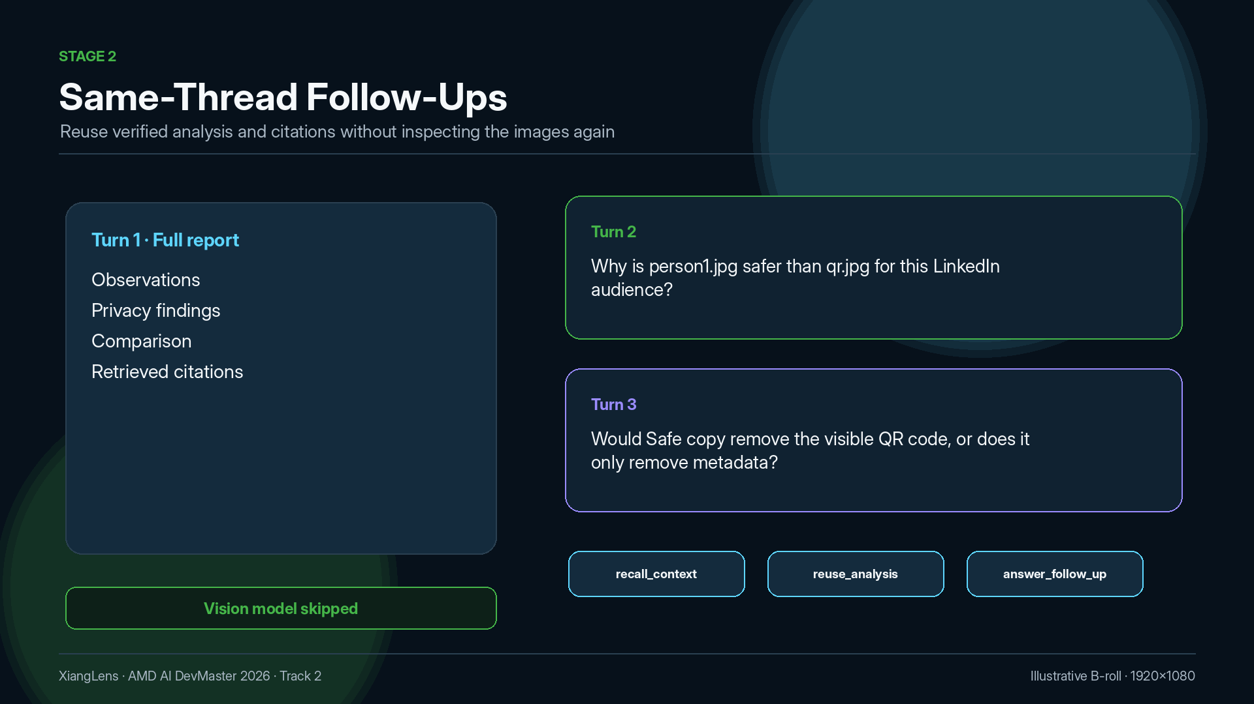
Notes:
Case 1 follow-ups — two follow-up questions in the same thread are answered from the verified report via recall_context, reuse_analysis, answer_follow_up; the vision model is skipped, so follow-ups are faster with a visible reasoning trace.

Slide 11
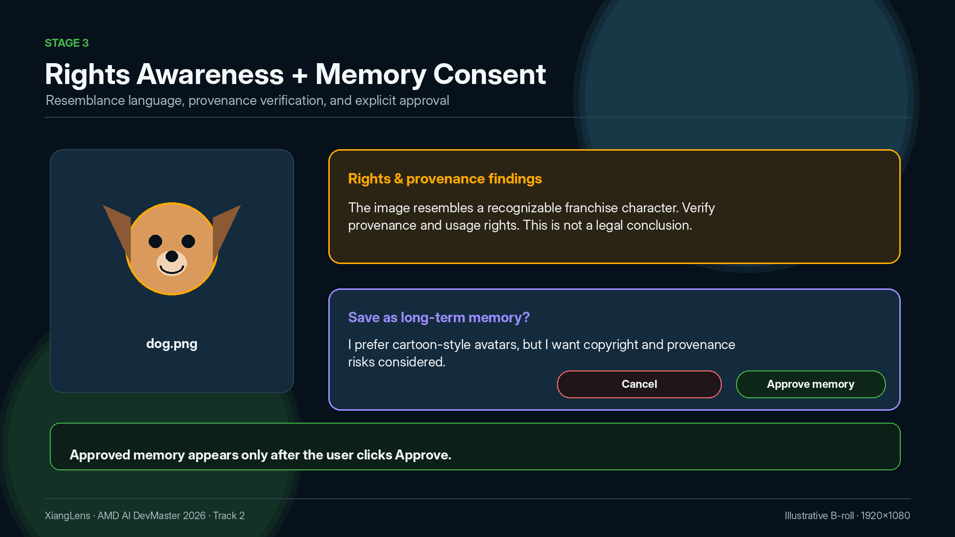
Notes:
Case 2 — GitHub context. The cartoon dog avatar is flagged as resembling a recognizable franchise character; XiangLens identifies provenance uncertainty without declaring infringement. The stated preference becomes a pending memory proposal and is stored only after the user clicks Approve memory.

Slide 12
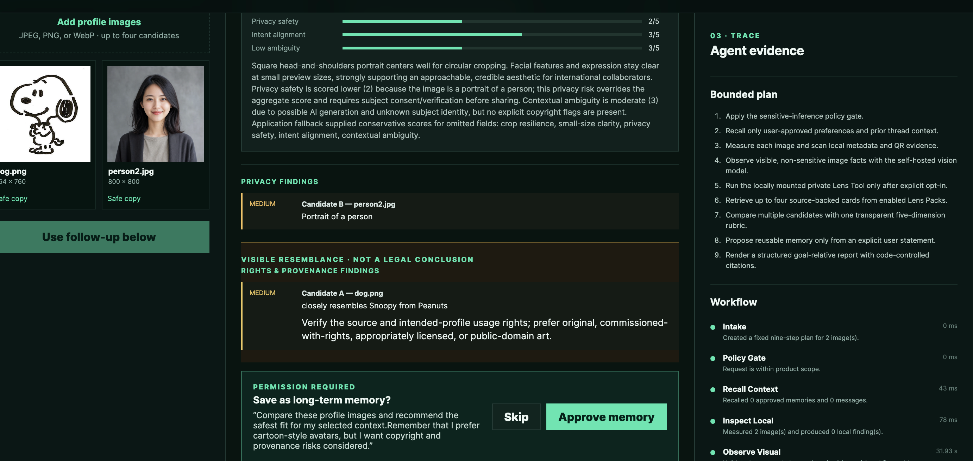
CASE 2 · IN THE UI
Resemblance without verdicts, memory only after Approve
Real test inputs: dog.png · person2.jpg Resembles Snoopy — MEDIUM, not a legal conclusion Approve memory gate
12
Notes:
Real UI evidence for Case 2 — the review runs on the actual test avatars (dog.png vs person2.jpg). The rights finding says dog.png closely resembles Snoopy from Peanuts, flagged MEDIUM with resemblance language and explicitly not a legal conclusion; person2.jpg gets a MEDIUM privacy finding as a portrait of a person. The preference is stored only through the PERMISSION REQUIRED gate — Skip or Approve memory.

Slide 13
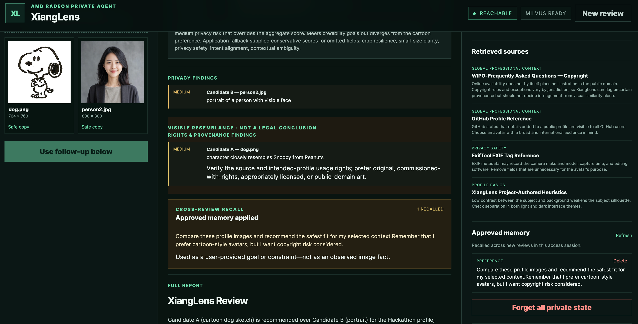
CASES 2–3 · IN THE UI
Rights warnings, recalled memory, cited sources — all visible
Resemblance, not verdict 1 approved memory recalled WIPO + GitHub sources Forget all private state
Notes:
Real UI evidence for Cases 2–3 — the rights finding uses resemblance language (not a legal conclusion), the approved memory is recalled in a new review and shown verbatim, retrieved sources include WIPO and GitHub references, and Forget all private state removes everything.

Slide 14
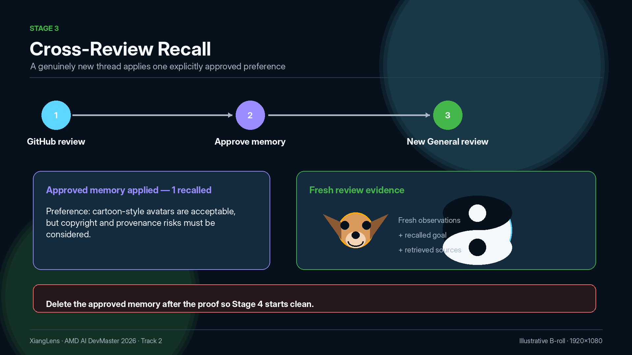
Fresh observations
+ recalled goal
+ retrieved sources
Notes:
Case 3 — a brand-new General review recalls exactly one approved memory and treats it as a user goal, combined with fresh visual analysis and new source-backed evidence. The memory is deleted after the proof. The avatars shown are the actual test inputs dog.png and yinyang.jpg from the case folder.

Slide 15
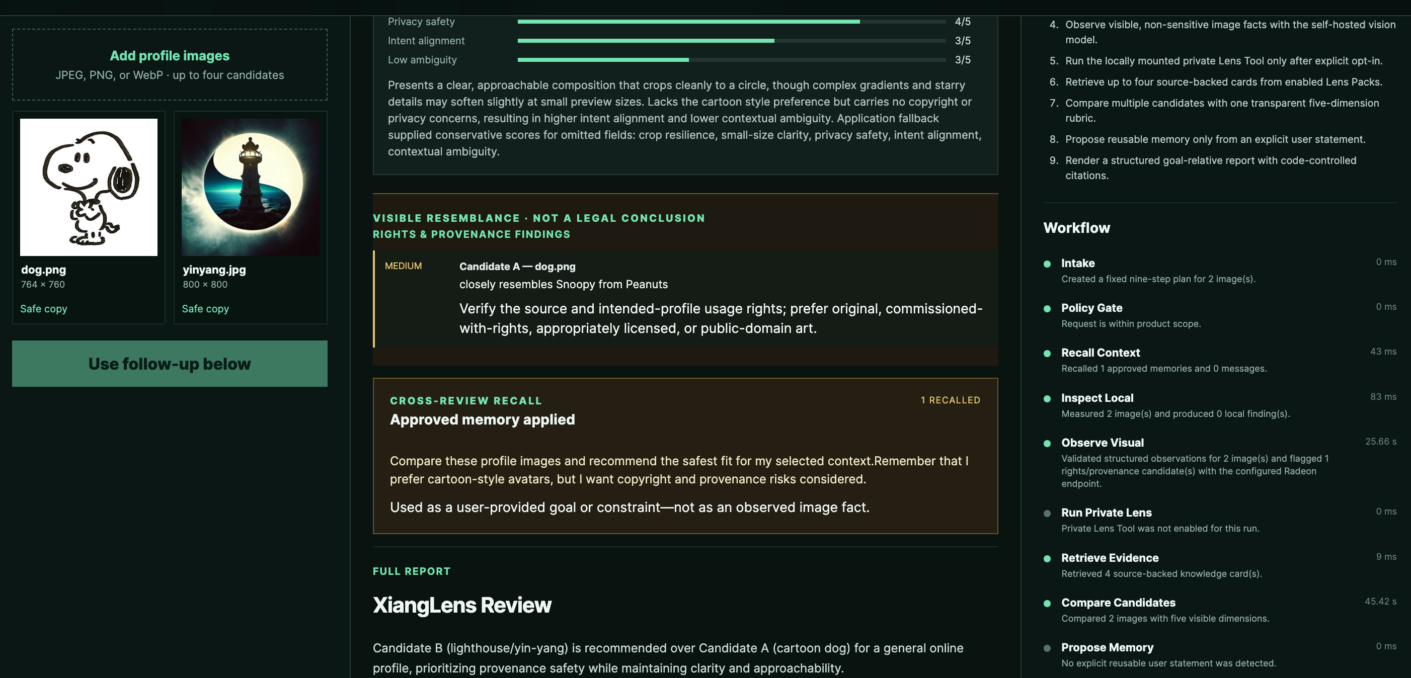
CASE 3 · IN THE UI
One approved memory recalled — as a goal, not a fact
Real test inputs: dog.png · yinyang.jpg 1 RECALLED — shown verbatim, labeled as a goal Candidate B recommended on provenance safety
15
Notes:
Real UI evidence for Case 3 — a new General review on dog.png vs yinyang.jpg shows CROSS-REVIEW RECALL with 1 RECALLED. The approved preference is shown verbatim and explicitly labeled as a user-provided goal or constraint, not an observed image fact. The final report recommends Candidate B (lighthouse/yin-yang) over the cartoon dog, prioritizing provenance safety.

Slide 16
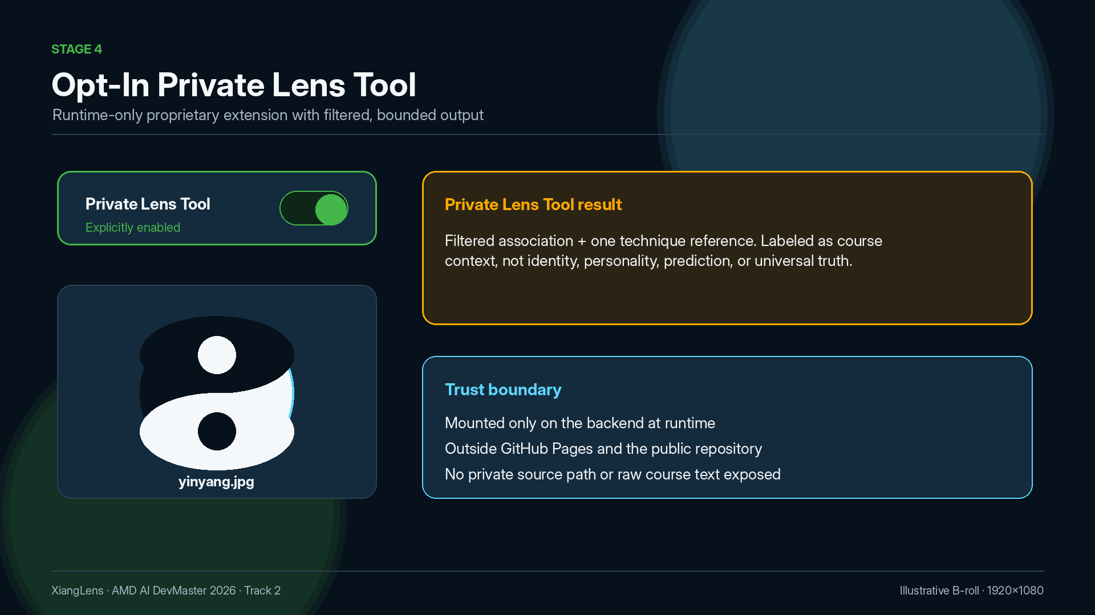
Notes:
Case 4 — the Private Lens Tool is disabled by default and runs only when explicitly enabled. Private knowledge is mounted only on the backend at runtime; output is a filtered symbolic association plus one technique reference, labeled as course context — no identity, personality, destiny, or universal-truth inference. The avatar shown is the actual test input yinyang.jpg from the case folder.

Slide 17
MEASURED ON W7900 · 2026-08-05
83.42 tok/s median, 100% valid structured output
Qwen3.6-35B-A3B · Q6_K GGUF · llama.cpp · ROCm · AMD Radeon PRO W7900
87.09 ms
9.96 s
11.92 s
83.42
first generated delta, median
first final-content delta, median
end-to-end model latency, median
decode throughput, median tok/s
100% valid JSON (5/5) · identical final-content SHA-256 across all six captured runs
Capture configuration
Cold reference
Full GPU layer offload · flash attention · Q8_0 KV cache
2,048-token reasoning budget · 384-token final budget
Batch-size-1 multimodal · 1 warmup + 5 measured runs
825.58 ms to first generated delta
12.69 s total latency · 83.16 tok/s decode
Model-workload benchmark — not the complete multi-node Agent workflow duration.
XiangLens · AMD AI DevMaster 2026 · Track 2
17
Notes:
Measured W7900 result, 2026-08-05 — Q6_K GGUF, full GPU layer offload, flash attention, Q8_0 KV cache, 2048-token reasoning budget, 384-token final budget. One warmup plus five measured batch-size-1 multimodal requests. Median 87.09 ms first delta, 9.96 s first final-content delta, 11.92 s end-to-end, 83.42 tok/s decode, 100% valid JSON (5/5). Cold reference 825.58 ms / 12.69 s / 83.16 tok/s; identical final-content SHA-256 across all six runs. Model-workload benchmark, not the complete Agent workflow duration.

Slide 18
SUMMARY
What the four cases prove
Every claim above is backed by a visible workflow step in the recorded run
Local privacy inspection
Deterministic QR detection before the model — Case 1
Consent-first memory
Nothing stored until the user clicks Approve — Case 2
Source-backed retrieval
Reports link the exact evidence used — Case 1
Cross-review recall
Approved goals apply in brand-new threads — Case 3
Same-thread follow-ups
Verified analysis reused; vision skipped — Case 1
Opt-in private extension
Runtime-only knowledge, bounded output — Case 4
One principle underneath: the user stays in control — of images, evidence, memory, and private knowledge.
XiangLens · AMD AI DevMaster 2026 · Track 2
18
Notes:
Summary — the six control properties demonstrated across the four cases, each verified in the live demo recording.

Slide 19
XiangLens
Private · Evidence-backed · User-controlled
llama.cpp · LangGraph · Milvus Lite · AMD Radeon / ROCm
120 deterministic image fixtures · 32 inspectable public knowledge cards · reproduce via docs/REPRODUCE.md
github.com/ld0574/Radeon-hackathon-2026-07
XiangLens · AMD AI DevMaster 2026 · Track 2
Notes:
Closing — XiangLens keeps the user in control. Stack and repository.

