Slide 1
AgentOS
Next-Generation AI Research Assistant
AMD AI DevMaster Hackathon 2026
Vidwat Srivastava & Shivam Raj

Slide 2
Problem Statement
• Knowledge is scattered across documents and images
• Manual search is slow
• Existing assistants lack private document understanding

Slide 3
Solution
AgentOS combines:
• Multi-document RAG
• OCR
• Conversation Memory
• Hybrid Web Search
• Groq Llama 3.3

Slide 4
Architecture
User → Streamlit UI → RAG Engine → ChromaDB → Groq Llama 3.3
Images → EasyOCR
Current events → Tavily Web Search

Slide 5
Technology
Python
Streamlit
ChromaDB
Groq Llama 3.3
EasyOCR
Tavily API

Slide 6
AMD Deployment
Successfully deployed and tested on AMD Radeon Cloud.
Public deployment using rc-tunnel.
Validated end-to-end on AMD cloud environment.

Slide 7
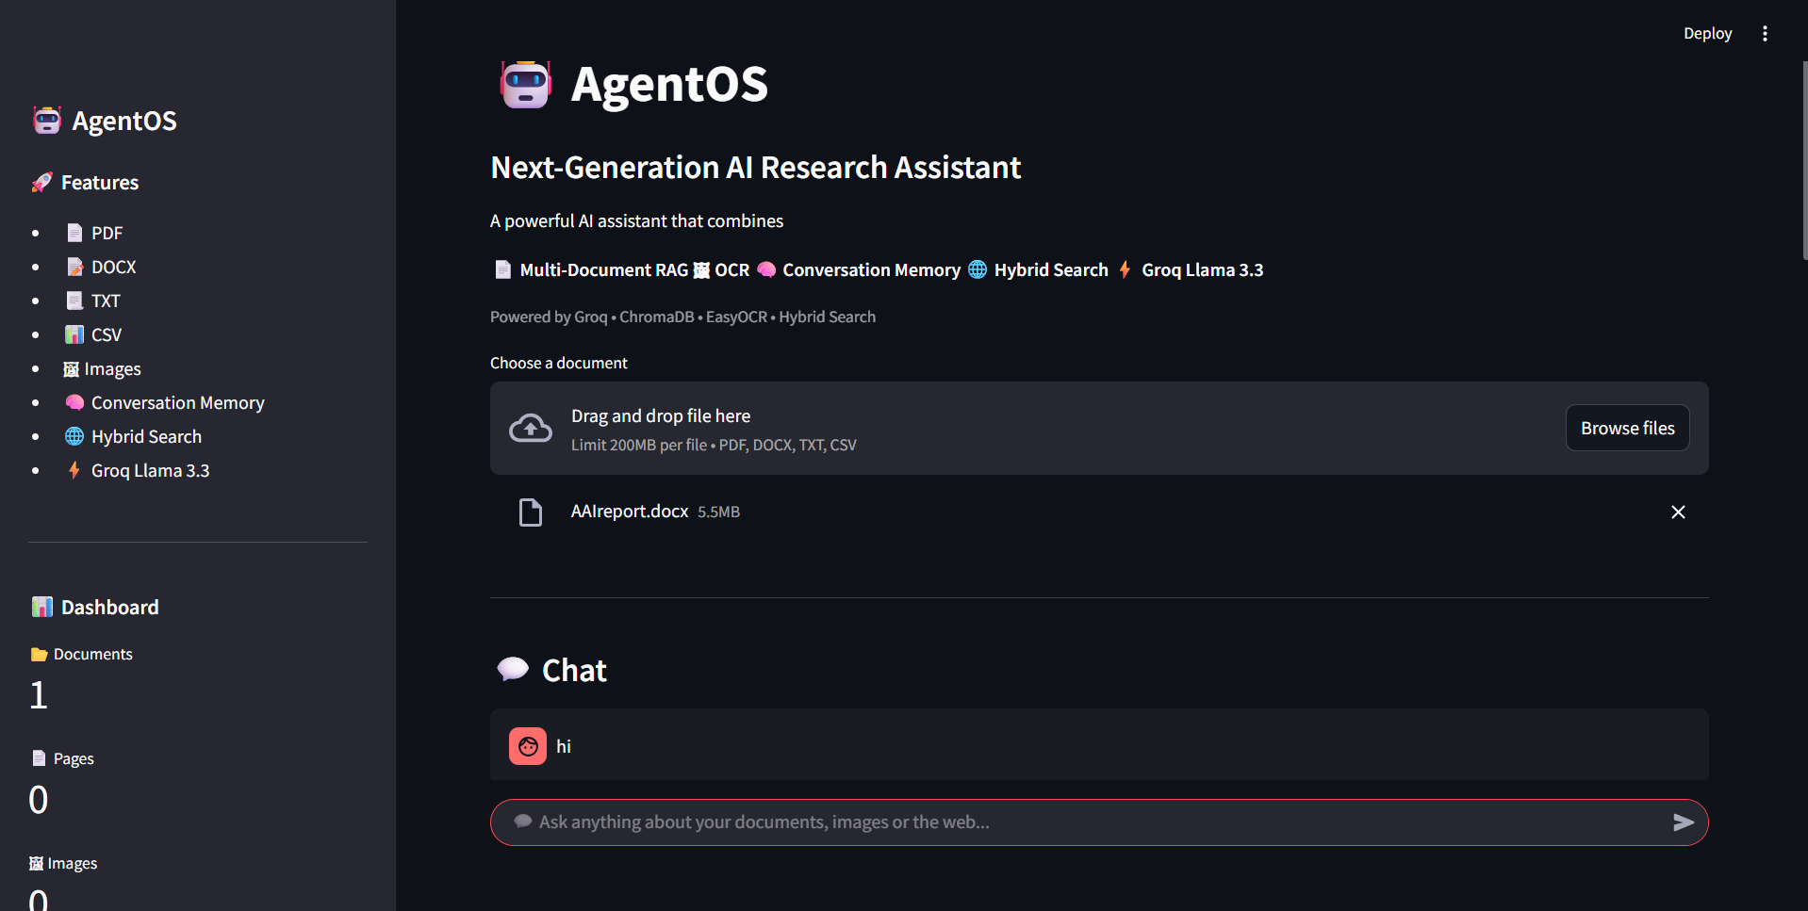
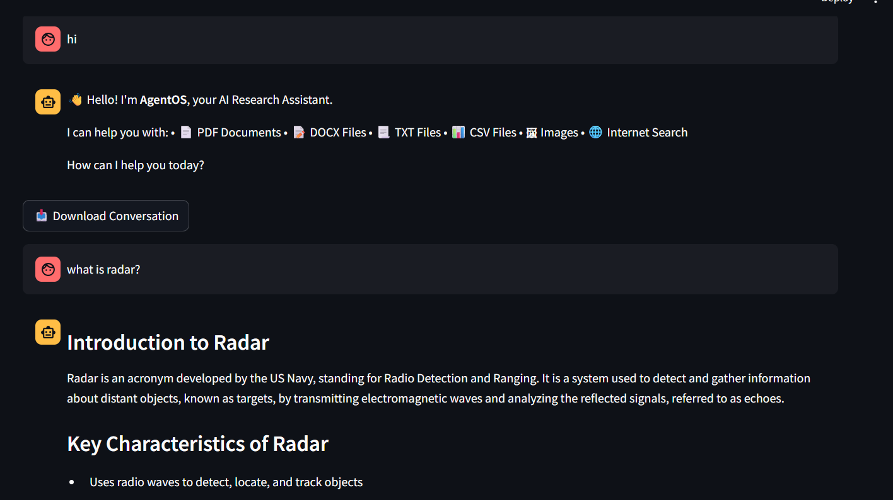
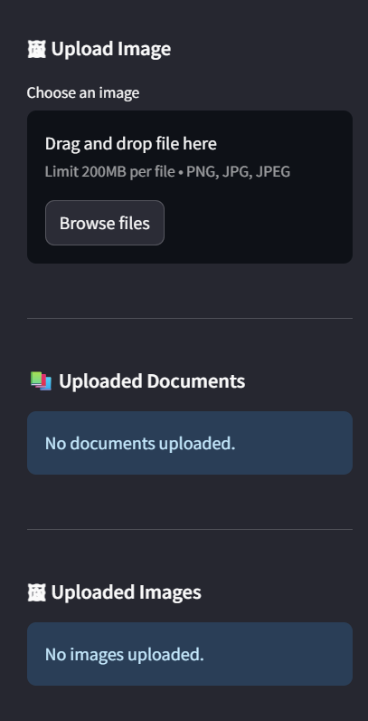
Application Screenshots

Slide 8
Thank You
GitHub: https://github.com/v1dwt/AgentOS
Questions?

