Slide 1

Qingxi Rift Character Workshop
Local Multimodal OC Creation on AMD Radeon + ROCm
App:Qingxi Rift Character Workshop •Mission:"Turn one brief into an original character card — fully local on AMD Radeon."
Tech Stack:Track 1 Multimodal • ROCm • PyTorch • SDXL • Qwen2.5
Notes:
Hello everyone, today I'm excited to introduce "Qingxi Rift Character Workshop," a project that brings the power of multimodal AI directly to your local AMD Radeon GPU. Our goal is simple: to turn a simple text brief into a fully realized original character card, all without relying on cloud APIs. This workshop leverages the ROCm stack, PyTorch, SDXL, and Qwen2.5 to create a seamless, private, and powerful character creation experience.

Slide 2






The Problem: Fragmented & Restrictive Workflow
01 / Disjointed Creation Process
02 / Cloud-API Limitations
Lore & Worldbuilding
Brainstorming backstories and universes in isolated docs, disconnected from visual design.
Latency & Slow Iteration
Network delays and strict API rate limits break the flow, making real-time creation impossible.
Visual Generation Silos
Jumping between AI art tools to create portraits, with no link to character stats.
Prohibitive Cost Structure
Pay-per-use fees add up quickly, making it expensive for hobbyists and small indie studios.
Mechanical Design in Silos
Designing attributes and game mechanics in spreadsheets, separate from the core narrative.
Critical Privacy Risks
Sending sensitive IP and creative drafts to third-party servers risks leaks and security breaches.
Notes:
So, what problem are we solving? Currently, creating an original anime character is a cumbersome process. You might write the lore in a document, generate the portrait using a web service, and design the stats in a spreadsheet. This fragmentation breaks the creative flow. Worse, using cloud APIs means you're often paying for each generation, waiting for network responses, and sacrificing the privacy of your unique ideas. This is where our solution comes in.

Slide 3







The Solution: A Unified Local Workbench
A single, integrated local application that streamlines the entire OC creation pipeline—combining AI-powered lore generation, anime art creation, and automated composition into a seamless, private workflow.
01. Input
02. Lore Crafting
03. Art Generation
04. Poster Compilation
Start with a simple text brief or upload a reference image to define your character’s core identity and style.
AI processes your input to generate a structured backstory, personality traits, and attributes in a clean JSON format.
A high-quality anime-style portrait is rendered to perfectly match the character’s lore, features, and aesthetic.
All elements auto-assemble into a shareable character card, complete with portrait, lore, and a six-affinity radar chart.
All-in-One Tool
Local & Private
Structured Output
Eliminates the hassle of switching between apps by combining lore writing, art generation, and design into one seamless experience.
Runs entirely on your AMD GPU for maximum speed and privacy—no cloud costs, no data uploads, and full creative control.
Exports machine-readable JSON data alongside visual art, making it perfect for game developers and automated pipelines.
Notes:
Our solution is the "Qingxi Rift Character Workshop," a unified local workbench. Here's how it works: you start with a text brief, maybe even a reference image. The workshop then takes over, generating a detailed character lore in JSON format, creating a matching anime portrait, and finally composing everything into a beautiful character card with a unique six-affinity radar chart. The entire process is local, meaning it's fast, private, and free from cloud constraints.

Slide 4


How It Works: The Local Pipeline
01 / INPUT
02 / PROCESSING
03 / OUTPUT
Character Brief & Reference
Dual LLM + GenAI Inference
Pillow Asset Composition
Define your character with a detailed textual prompt, optionally including a reference image to guide visual style and key features.
Qwen2.5-7B generates a structured JSON profile; SDXL Anime creates a bespoke portrait—both models run locally and are accelerated by ROCm on AMD hardware.
Automatically composites the generated portrait, six-affinity radar chart (from JSON), and lore text into a final, high-resolution character card image.
CORE DIFFERENTIATOR: 100% LOCAL EXECUTION
No cloud APIs, no data leaving your machine. The entire pipeline runs on AMD Radeon GPUs using the ROCm software stack, ensuring maximum privacy, ultra-low latency, and full creative control over the generation process.
Notes:
Let's dive into the technical pipeline. It all starts with your input: a text brief and an optional reference image. This is fed into a local instance of the Qwen2.5-7B large language model, running on ROCm, which generates a detailed JSON file. Simultaneously, the same input is used by a fine-tuned SDXL anime model, also on ROCm, to create the character's portrait. Finally, the Pillow library composes the portrait, the JSON data (visualized as a radar chart), and the lore into the final character card image. The key takeaway is that every single step happens locally on your AMD GPU.

Slide 5
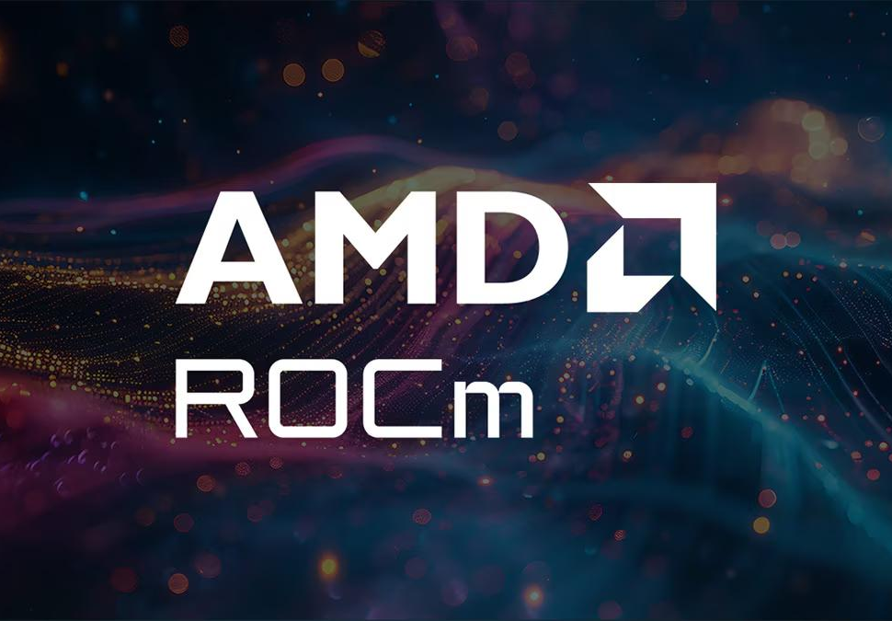

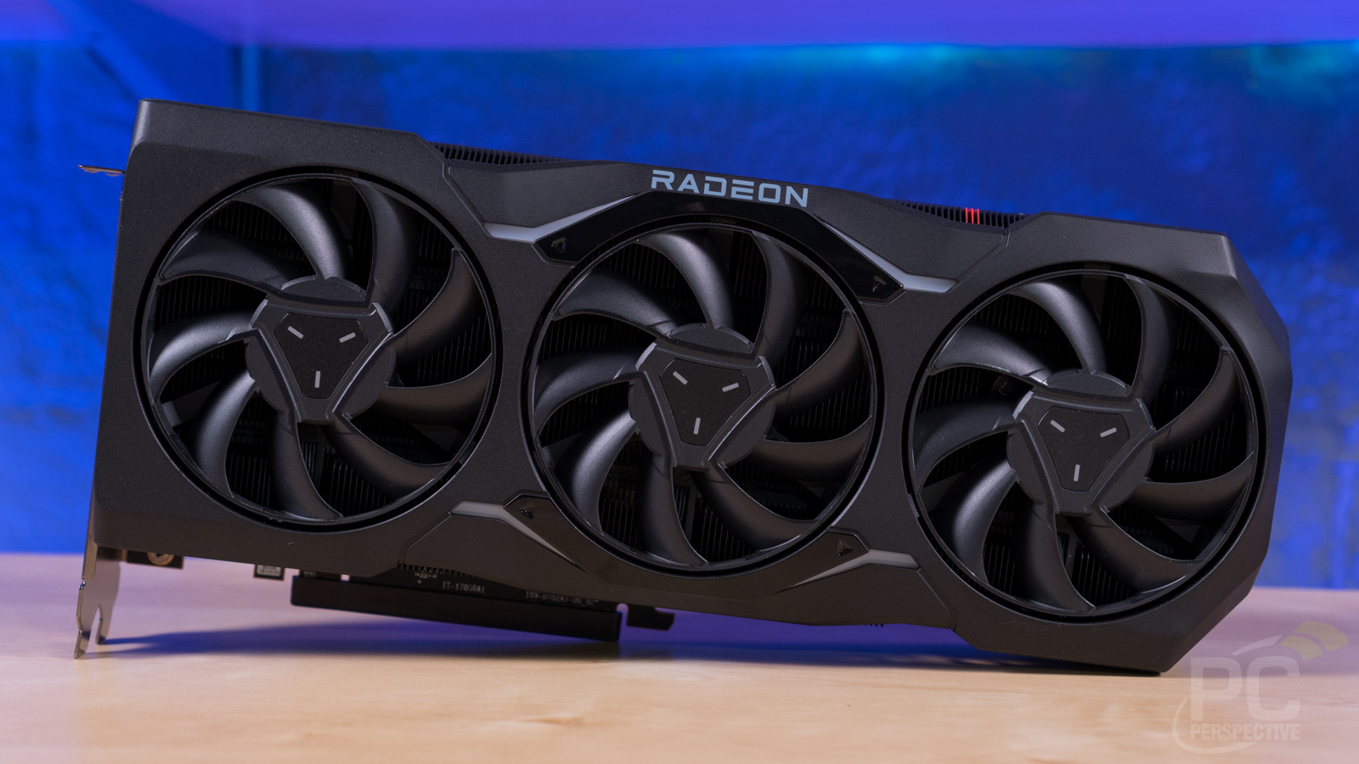

AMD Radeon / ROCm Highlights
This project is a showcase of what's possible with the AMD Radeon ecosystem and the ROCm software stack, demonstrating seamless integration, efficient resource utilization, and easy reproducibility for AI workloads.
01. Verified Compatibility
02. Efficient VRAM Management
03. Reproducible Offline Setup
Asetup_env.shscript automates dependency installation for instant environment creation.
Fully validated withrocm-smiandPyTorch-for-ROCm, ensuring a stable and reliable foundation for live AI demonstrations and production deployments.
Sequential unloading optimizes memory use, fitting a7B-parameter LLMand SDXL on a single24GB GPU—making powerful AI accessible on consumer-grade hardware.
All wheels and model weights are hosted on PVC, enabling easy restoration of the development environment—even without an internet connection.
Notes:
Now, let's talk about the hardware and software that makes this possible. We've fully verified the compatibility with ROCm and PyTorch, ensuring everything runs smoothly. A key technical highlight is our efficient VRAM management. By sequentially unloading the LLM before loading SDXL, we've made it possible to run both a 7B model and SDXL on a single 24GB GPU. Additionally, we've provided a setup script and hosted all dependencies on PVC, making the entire environment easily reproducible offline.

Slide 6
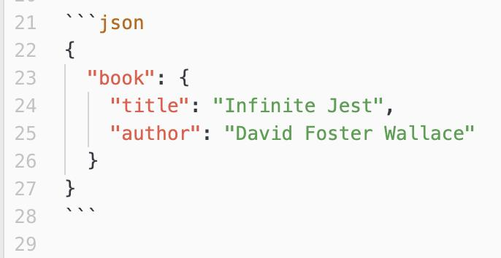



Reliability Engineering
Robust Data Handling
3-attempt JSON decoding and tolerant schema coercion recover from malformed outputs. The system intelligently extracts valid fields even with minor errors, preventing crashes.
Graceful Degradation
If affinity scores return all zeros, an auto-fallback generates a balanced spread. This ensures character cards remain visually complete and meaningful, avoiding broken UI.
This JSON validation example illustrates our system’s ability to handle structured data. We implement strict yet flexible parsing to ensure resilience against minor formatting inconsistencies from LLMs.
Flexible Dev Workflow
MOCK mode skips GPU inference, enabling full laptop-based development without specialized hardware. This drastically speeds up iteration and testing cycles.
Notes:
AI outputs aren't always perfect, so we've built in several layers of reliability. Our system can handle imperfect JSON output from the LLM with multiple decoding attempts and tolerant data extraction. For example, if the affinity scores come out as all zeros, we have a fallback that creates a balanced spread. We also have a MOCK mode for developers, allowing them to work on the app without needing an AMD GPU, which is a huge productivity boost.

Slide 7
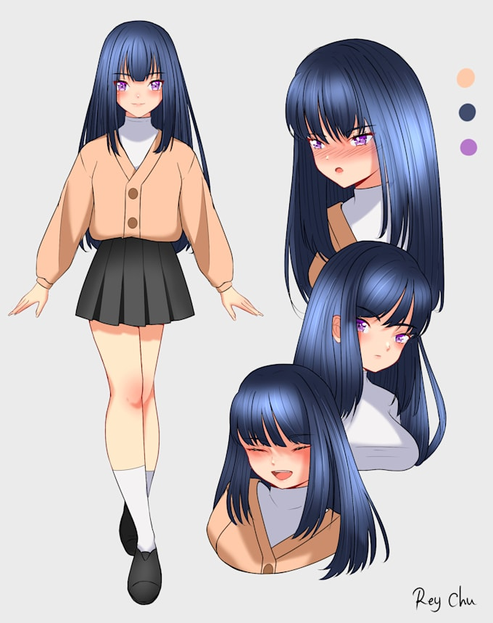
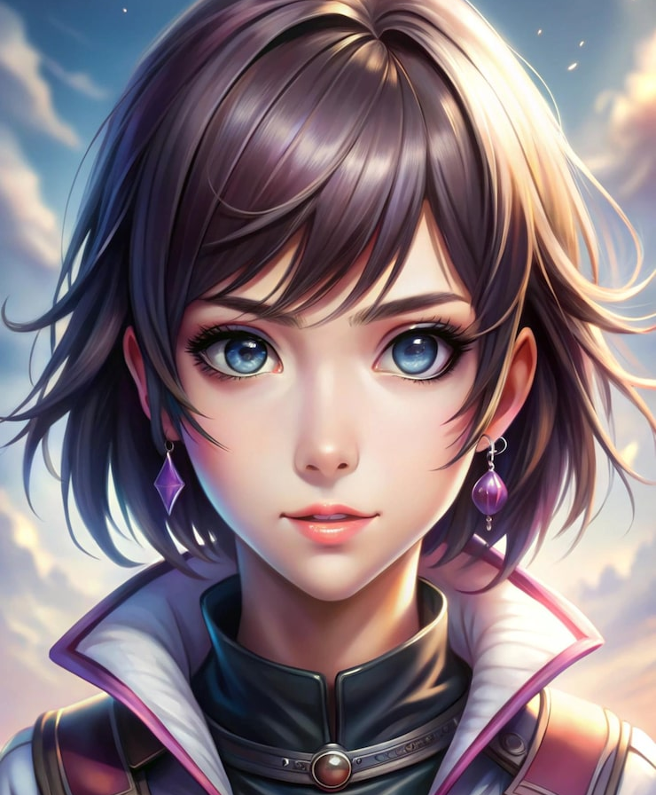
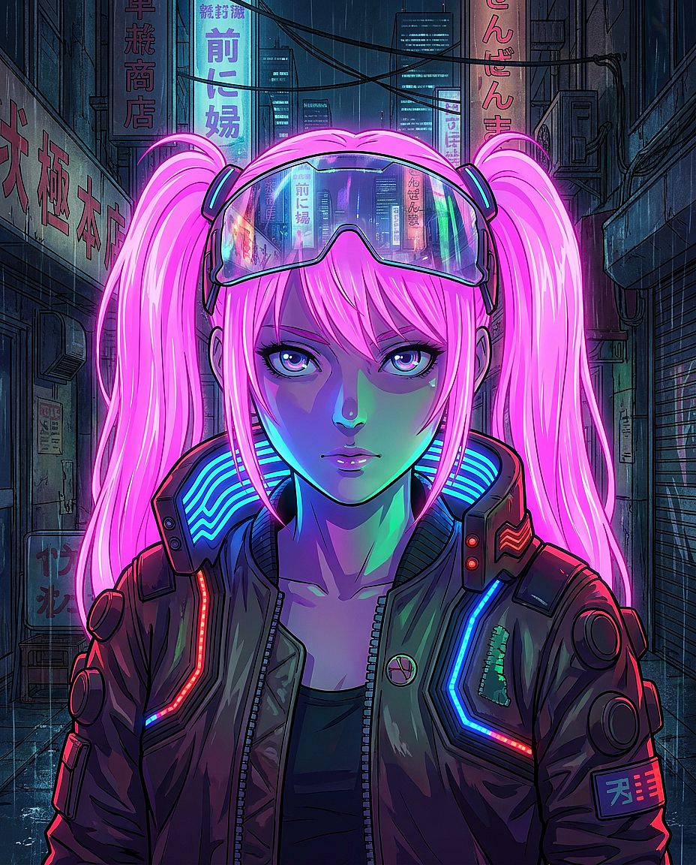
Demo Stills: Characters from the Radeon Cloud Run
Discover the versatility of AI-generated character art on the Radeon Cloud platform. These examples highlight the fusion of dynamic design, rich AI-crafted lore, and visual depth—ranging from expressive anime model sheets to atmospheric fantasy portraits and vivid cyberpunk aesthetics, all built for the immersive "Qingxi Rift" world.
Design Sheet
Multi-angle expressions & model breakdown
Heroic Portrait
Detailed fantasy art with scenic depth
Cyberpunk Aesthetic
Neon-lit futuristic anime styling
Notes:
Seeing is believing. These are some examples of the character cards generated by our workshop running on the Radeon Cloud. As you can see, the system produces a variety of styles, from classic anime designs to more futuristic cyberpunk looks. Each card is a complete package, with a unique portrait, a detailed backstory, and a visual representation of the character's affinities. These are just placeholders; the real magic happens when we generate characters for our original "Qingxi Rift" world.

Slide 8




Impact & Originality
01 / Original World Building
02 / Empowering Creators
Qingxi Rift Universe
Repeatable Creation Loop
A standardized, AI-driven workflow for generating high-quality OCs consistently, significantly lowering the barrier to entry for creators of all skill levels.
A bespoke cosmology rooted in six elemental affinities—Form, Mind, Life, Matter, Void, and Time—crafting a rich, self-contained narrative foundation for endless storytelling.
Local & Private Generation
Processing runs entirely on local hardware, ensuring your creative ideas, character designs, and IP remain secure, confidential, and offline.
IP-Clean Originality
100% original lore and characters eliminate third-party IP conflicts, offering a blank slate for creators to build, own, and monetize their work without legal constraints.
Zero Marginal Cost
After the initial hardware setup, create unlimited characters at no extra cost—an economical solution for indie developers, artists, and writers.
Notes:
The impact of this project goes beyond just a cool tool. We've built it around an original world, "Qingxi Rift," with its own unique six-affinity system, ensuring that all creations are truly original and free from IP concerns. More importantly, we're empowering creators by giving them a repeatable, private, and essentially free way to generate unlimited original characters. This opens up new possibilities for artists, writers, and game developers to explore their creativity without constraints.

Slide 9




Thank You
GitHub Repo: The repository will be made publicly accessible before the official pull request submission.
Live Demo: Experience the interactive showcase running on Radeon Cloud, available at Track 1 for hands-on exploration.
— Let’s build the future of digital character creation together —
Notes:
Thank you for your time. The GitHub repository will be made public before the pull request, so stay tuned for that. If you're at the event, feel free to check out our live demo running on the Radeon Cloud in Track 1. We're excited to see what you'll create with the Qingxi Rift Character Workshop.

