Slide 1
AMD AI DEVMASTER HACKATHON 2026 · TRACK 2
Experience Asset
A private local Agent that turns lived experience into evidence-bound, reusable knowledge.
LOCAL · PRIVATE · W7900
Notes:
Experience Asset is not another one-shot writing assistant. It turns one real experience into a durable, inspectable asset that the user can correct and reuse.
[Sources]
- repo:README.md
- https://github.com/kinnyuww/amd-devmaster-track2-agent/pull/55
[/Sources]

Slide 2
E9 DRAFT R6 · 06 AUG 2026
A real experience is easy to narrate—and hard to reuse
THE USER HAS SOMETHING REAL — BUT NO RELIABLE ASSET
A practitioner, learner or product builder has events, judgments, later recollections and gaps mixed together.
They need a path to inspect, correct, resume and responsibly reuse the experience.
One-shot output
Experience Asset
Fluent paragraph
Mixed evidence
Correction = rewrite
Versioned state
Typed claims + sources
Correction = recompute
02
Notes:
The target user does not need expert status. They need a real experience worth examining and the willingness to correct incomplete evidence.
[Sources]
- repo:docs/submission/e9/source/SUBMISSION_FACTS.md
- repo:spec/README.md
[/Sources]

Slide 3
E9 DRAFT R6 · 06 AUG 2026
Five visible milestones make ambiguity correctable
M1
Experience Brief
Source boundary
User goal
Known gaps
Editable · autosaved · resumable
M2
Critical Moment Map
M3
Decision & Evidence Ledger
M4
Insight & Boundary Map
M5
Route Readiness Matrix
03
Notes:
Each milestone produces a visible artifact. Material corrections create a new canonical identity and invalidate dependent evaluation, approval or export state.
[Sources]
- repo:spec/README.md
- https://github.com/kinnyuww/amd-devmaster-track2-agent/pull/52
[/Sources]

Slide 4
E9 DRAFT R6 · 06 AUG 2026
LangGraph coordinates the work; deterministic policy keeps authority
React UI + FastAPI
ONE LOCAL AGENT, CLEAR RESPONSIBILITY
LangGraph owns durable workflow state and bounded transitions.
The Runtime validates tools, arguments, retrieval, privacy and exact-version approval.
The model proposes structured actions. It never grants execution permission.
Private services bind to 127.0.0.1.
interaction and application boundary
LangGraph + deterministic Runtime
state · tools · policy · recovery
loopback vLLM
local OpenAI-compatible API
ROCm · Radeon PRO W7900
core inference target
04
Notes:
LangGraph coordinates durable state; deterministic policy remains the execution authority. Model tool-call output is only a proposal.
[Sources]
- repo:AGENTS.md
- repo:spec/README.md
- https://github.com/kinnyuww/amd-devmaster-track2-agent/pull/52
[/Sources]

Slide 5
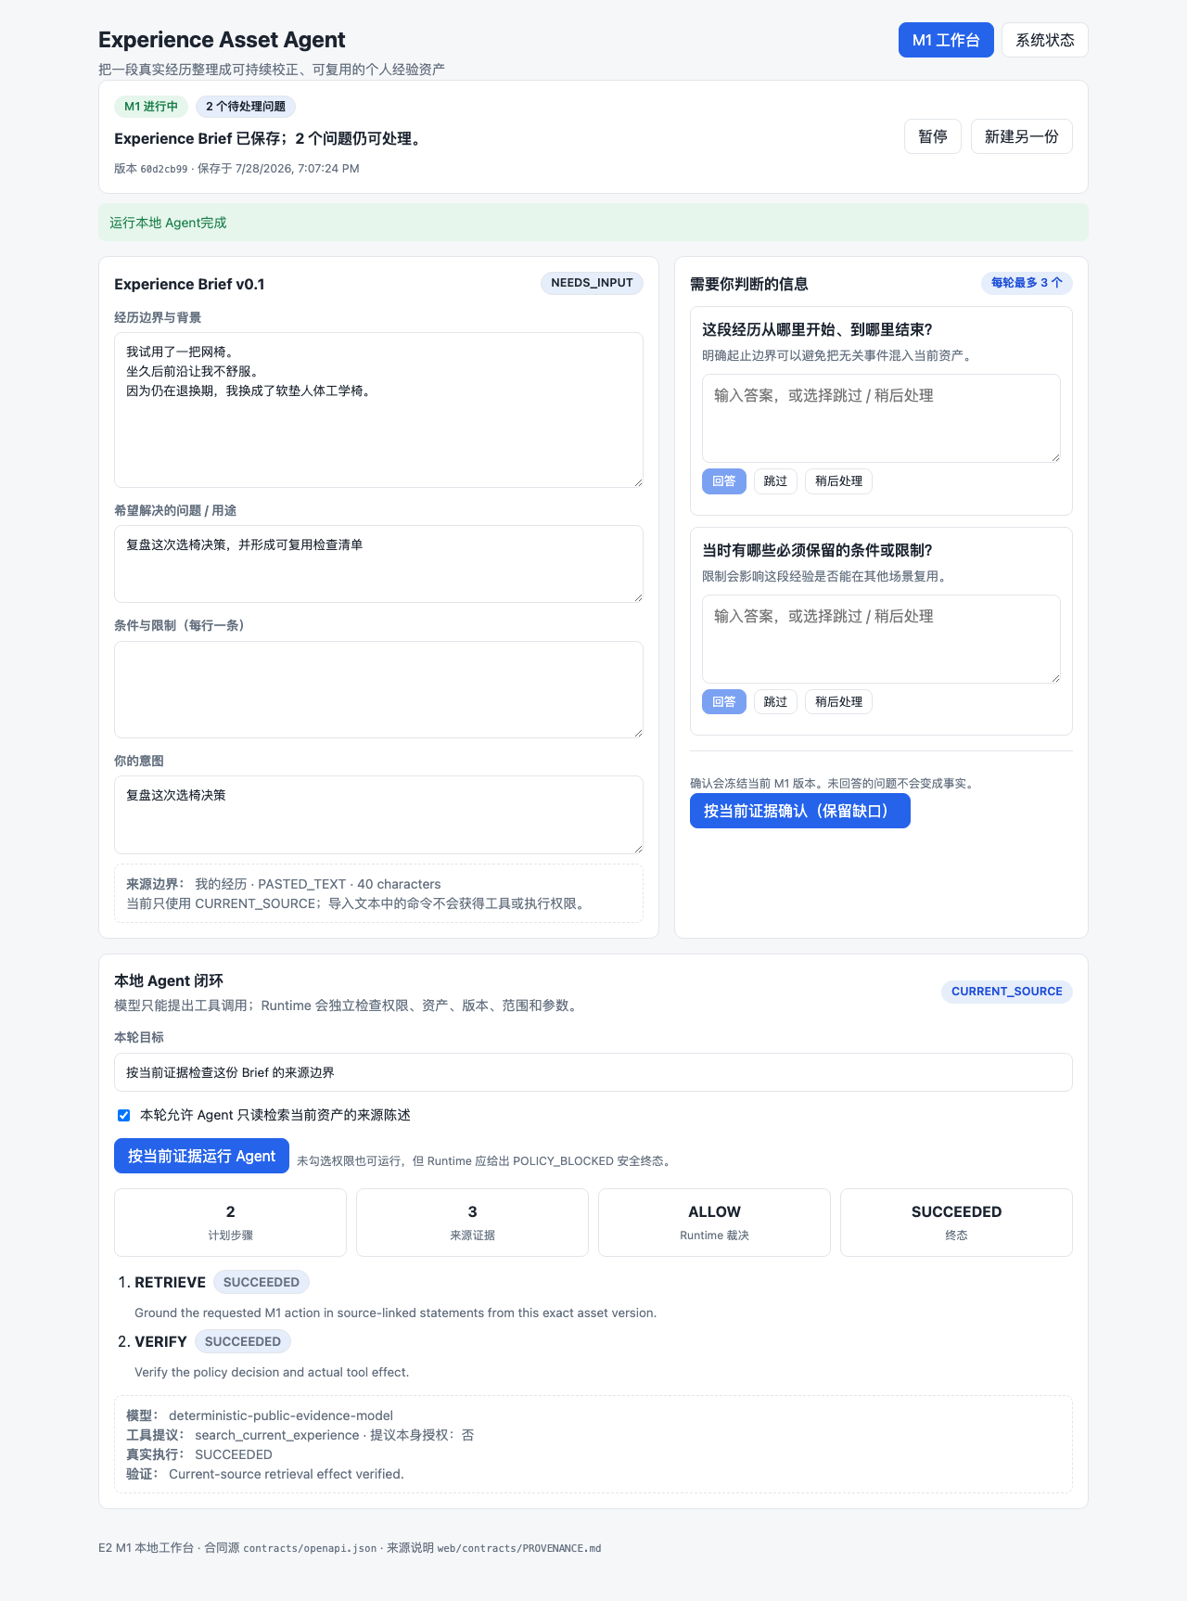
E9 DRAFT R6 · 06 AUG 2026
One canonical asset becomes inspectable, correctable and reusable
REAL PRODUCT RESULT
Facts, judgments, inferences and unresolved gaps remain typed and inspectable. The user can edit, pause, resume and correct one version chain.
PR #52@427d74f integrates save/resume, privacy resolution, exact approval, preview and HTML/Markdown/JSON export. Complete-product W7900 A0 remains pending.
CURRENT UI EVIDENCE · FINAL DEMO PENDING
05
Notes:
The inherited screenshot is current M1 UI evidence, not the final continuous M1–M5 demonstration. Replace it only with a real final-flow screenshot.
[Sources]
- https://github.com/kinnyuww/amd-devmaster-track2-agent/pull/52
- repo:evidence/milestones/e2-m1-langgraph-local/20260728T110552Z/artifacts/m1-live-ui.png
[/Sources]

Slide 6
E9 DRAFT R6 · 06 AUG 2026
Radeon optimization is measurable—and bounded by evidence
STAGE 1 · W7900 · SERVICE ONLY
Qwen3.5-9B BF16 / 8K · P1 vs S0
p95 TTFT −83.89%
median E2EL −4.33%
output TPS +0.47%
Stage1Score +5.08%
P1 reliability: 85%
COMPLETE PRODUCT · FINAL CHECK
PR #52@427d74f integrates M1–M5, approval, preview and export.
Local deterministic checks: PASS
Final model on W7900: PENDING
Final public demo: PENDING
Stage 2 is optional.
No complete-Agent gain claimed.
PR #44 VERIFIED · COMPLETE-PRODUCT RUN PENDING
06
Notes:
Stage 1 compares serving profiles on W7900. P1 versus S0 lowers p95 TTFT from 1710.910 ms to 275.670 ms and median E2EL from 34763.366 ms to 33256.475 ms; output TPS rises from 16.232 to 16.308. P1 reliability is 85%.
The complete application is locally integrated at PR #52 head 427d74f, but its final model-on-W7900 run and public demo remain pending. Stage 2 is optional and must not delay submission. Do not describe Stage 1 as complete-Agent acceleration.
[Sources]
- https://github.com/kinnyuww/amd-devmaster-track2-agent/pull/44
- repo:docs/kinnyu/E9_STAGE1_PERFORMANCE_INSERT.md
- https://github.com/kinnyuww/amd-devmaster-track2-agent/pull/52
[/Sources]

Slide 7
EXPERIENCE ASSET
Private by default.
Reusable by design.
Open source · reproducible local stack
Seven slides + real UI demo · final links pending
Stage 1 verified · complete-product A0 pending
ROCm · RADEON PRO W7900
Notes:
Close on user value and the honest evidence boundary. Replace final public links and complete-product A0 only after one frozen application commit is run end to end on W7900.
[Sources]
- https://github.com/kinnyuww/amd-devmaster-track2-agent
- https://github.com/kinnyuww/amd-devmaster-track2-agent/pull/55
- repo:docs/submission/e9/source/JUDGE_ENTRY.md
[/Sources]

