Slide 1
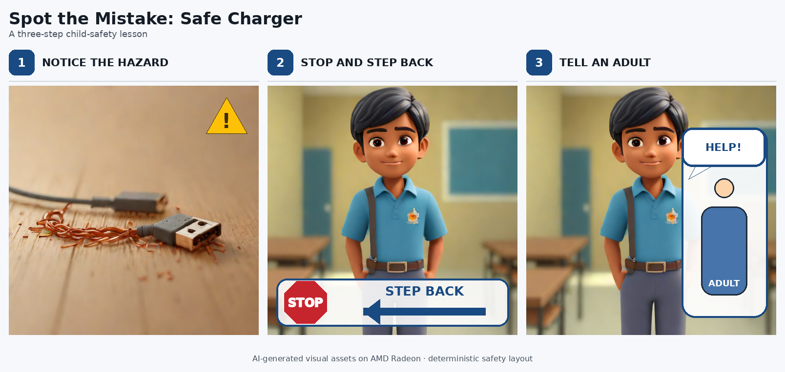
AMD AI DevMaster Hackathon · Track 1
Agar Aisa Ho Jai
Radeon Story Studio
Local Radeon/ROCm workflows for evidence-backed child-safety storyboards and visual lessons.
Participant: Ankur Sawhney
Public source snapshot: eba2f154

Slide 2
AMD AI DevMaster Hackathon · Track 1
The problem: pretty output can still be wrong
Ambiguous action
A child may stand near a hazard instead of stepping back.
Unsafe framing
The image may show the danger clearly but not the safe response.
Identity drift
A multi-panel story can lose continuity across scenes.
Radeon Story Studio separates generation from acceptance.
Evidence-backed acceptance
Candidates must pass technical, safety, semantic and continuity checks before they become public output.
Agar Aisa Ho Jai — Radeon Story Studio
2

Slide 3
AMD AI DevMaster Hackathon · Track 1
Product: manifest to reviewed lesson card
1. Sealed input
Transcript or scene manifest defines allowed characters, actions and safety intent.
2. Local planning
Qwen through vLLM produces a constrained storyboard and textual safety review.
3. Local generation
SDXL Turbo on Radeon creates candidate story panels and runtime evidence.
Accepted safe-charger lesson card
Agar Aisa Ho Jai — Radeon Story Studio
3

Slide 4
AMD AI DevMaster Hackathon · Track 1
Architecture: two local Radeon workflows
Qwen + vLLM
Storyboard JSON + textual safety review
Input contract
Short lesson idea or sealed scene manifest
Validation
Hashes, timings, semantic checks and human review
Accepted output
Lesson card or storyboard package
SDXL Turbo
Candidate images + GPU runtime evidence
Core inference stays local; deterministic assembly and FFmpeg are supporting stages.
Agar Aisa Ho Jai — Radeon Story Studio
4

Slide 5
AMD AI DevMaster Hackathon · Track 1
Radeon/ROCm proof captured as evidence
gfx1100
7.2
2.9.1
vLLM
HIP 7.2.53211
+rocm7.2.1
Qwen on Radeon
GPU architecture
HIP runtime
PyTorch build
Local serving
Preflight does not trust configuration alone
The runner verifies a non-empty HIP version, an AMD Radeon device, and a real tensor operation on PyTorch’s ROCm-backed cuda:0 device API.
Evidence is content-addressed
Returned run reports include timings, memory, component dtypes, artifact hashes and rejection reasons.
Agar Aisa Ho Jai — Radeon Story Studio
5

Slide 6
AMD AI DevMaster Hackathon · Track 1
Measured results: image + text workloads
10.50
0.368
45.69
10.45
seconds / 8 candidates
seconds
candidates/minute
GB allocated
SDXL candidate phase
Median candidate latency
Image throughput
Peak GPU memory
Qwen planning throughput
1,259 completion tokens in 14.941 seconds — 84.264 completion tokens/second.
Qwen safety review
315 completion tokens in 5.395 seconds — 58.389 completion tokens/second.
Performance evidence is presented with model/runtime versions and hashes, not just screenshots.
Agar Aisa Ho Jai — Radeon Story Studio
6

Slide 7
AMD AI DevMaster Hackathon · Track 1
Safety-by-design and publication boundary
Fail closed
A generated candidate is not accepted just because inference succeeded.
Four review dimensions
Technical pass, child-safety fit, semantic action, and continuity.
Publish only accepted output
Rejected raw media remains private; hashes and reasons preserve evidence.
Excluded from public snapshot
Private corpora, real-person context, children’s material, nested repos, local sessions, credentials, model weights, rejected raw media, historical campaigns, unrelated provider adapters, and uncommitted work.
The contest folder is a deliberate allowlisted snapshot, not a dump of the private working repository.
Agar Aisa Ho Jai — Radeon Story Studio
7

Slide 8
AMD AI DevMaster Hackathon · Track 1
Submission package status
Ready now
Privacy-reviewed source snapshot, README, setup commands, tests, evidence, profile PDF, and this presentation.
Manual before PR
Record 3–5 minute demo, test video link signed out, review final asset rights, inspect official-fork diff.
PR title
Track 1, Ankur Sawhney, Agar Aisa Ho Jai — Radeon Story Studio
Commit message
feat(track1): add Agar Aisa Ho Jai Radeon Story Studio submission
Agar Aisa Ho Jai — Radeon Story Studio
8

