Slide 1


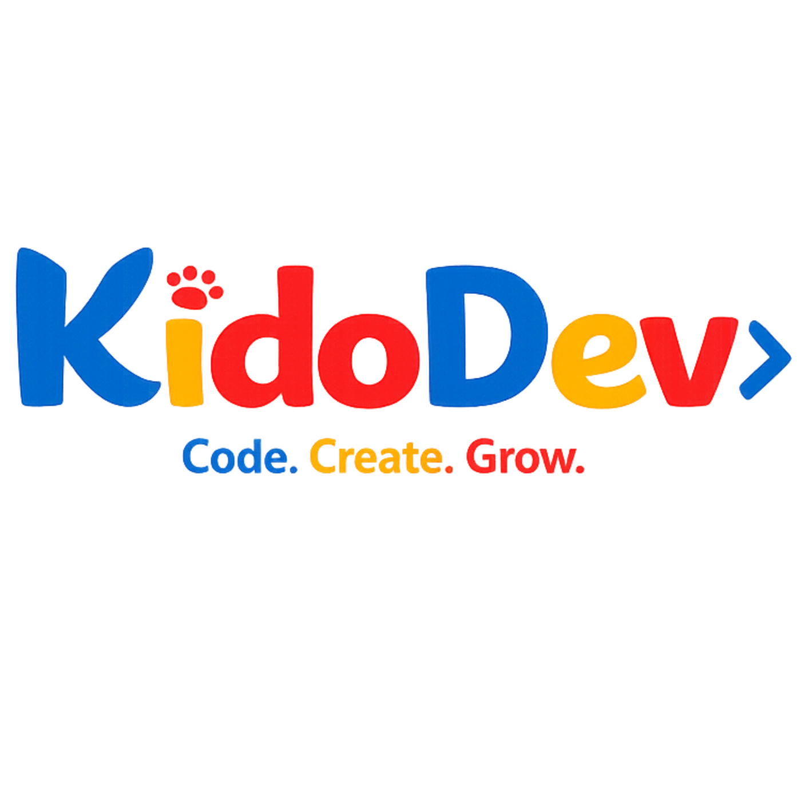

KidoDev: AI-Powered Coding Education for Kids
Teaching Kids to Code with Locally-Deployed AI Agents on AMD ROCm
AMD HACKATHON TRACK 2: AGENTIC AI / LOCAL AI AGENT DEVELOPMENT ON AMD RADEON GPU + ROCM
Notes:
1

Slide 2



The Problem: Kids Need Patient, Always-On Tutors
Logic Gaps in Block Coding
Scratch-style block coding is intuitive — but learners consistently get stuck on loops, conditionals, and event handling. There's no one there to help at 9pm.
Human Tutors Don't Scale
Qualified tutors are expensive, unavailable 24/7, and simply cannot reach the millions of children who need personalized support.
Cloud AI = Privacy Risk
Cloud-based AI tutoring exposes children's learning data to third-party APIs — a serious concern for schools and parents under COPPA.
Latency Kills Engagement
Kids expect instant feedback. A 2–3 second API round-trip shatters focus and breaks the learning flow mid-lesson.
Notes:
2

Slide 3



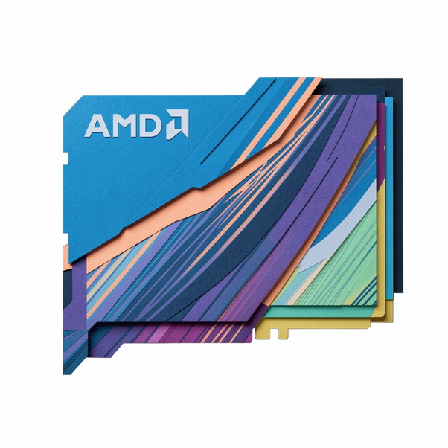

Why Local AMD GPU Deployment Changes Everything
Privacy First
No API Fees
Offline Ready
Zero data leaves the device — children's workspace, interactions, and progress stay entirely on-premise.
Amortized GPU hardware cost enables unlimited tutoring at scale — no per-inference billing ever.
Works without internet — critical for schools in low-bandwidth or rural regions.
Sub-Second Latency
Real-time, conversational tutoring with response times that keep kids in the zone.
Notes:
3

Slide 4

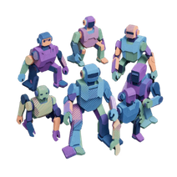


KidoDev Executive Overview
Native AMD Inference
Multi-Agent Orchestrator
Qwen 2.5 1.5B (int8)
Full-Stack Platform
End-to-end AI reasoning pipeline runs natively on AMD GPU via ROCm — zero external inference APIs in the loop.
Quantized model deployed on AMD Radeon GPU via PyTorch + ROCm inference stack — fast, efficient, local.
React frontend + FastAPI backend; Supabase for persistence; ngrok for secure HTTPS tunneling.
Routes student requests to three specialist agents: Socratic Tutor, Curriculum Planner, and Business Insights.
Notes:
4

Slide 5
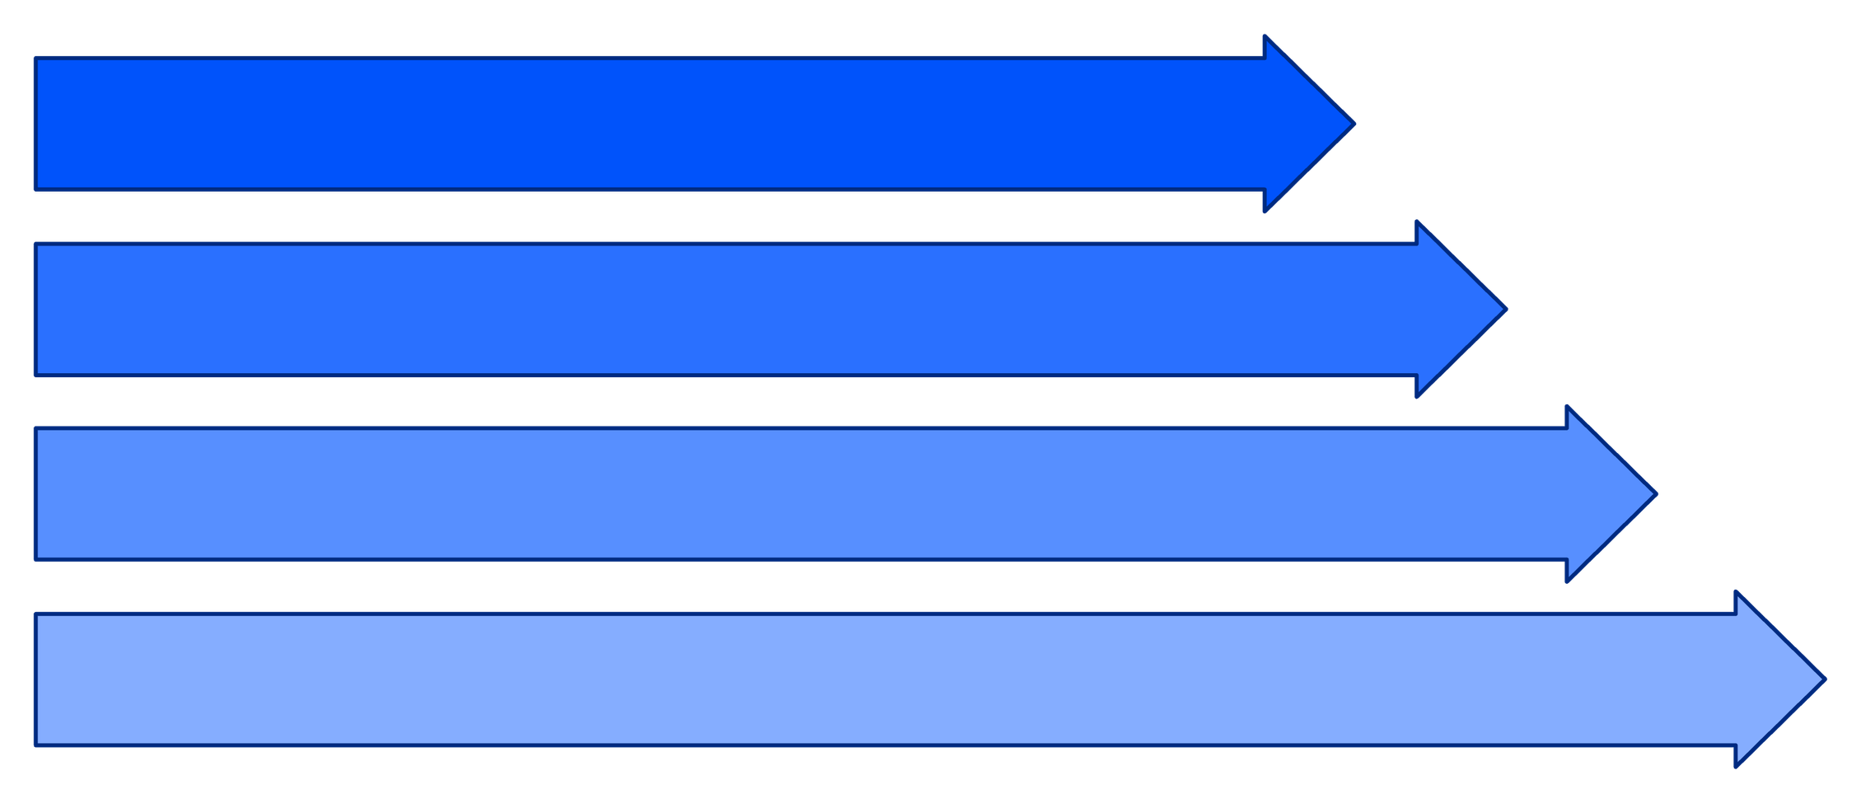
System Architecture: End-to-End Flow
React Frontend
ngrok Tunnel
FastAPI Backend
Agent Orchestrator
All AI reasoning stays on AMD hardware — no external LLM APIs are ever called.
Notes:
5

Slide 6




AMD GPU & ROCm Technical Stack
1
2
PyTorch ROCm
HuggingFace Transformers
HIP 7.2 backend; model weights loaded and executed on cuda:0 device interface via ROCm runtime.
Qwen 2.5 1.5B quantized int8 loaded via Transformers → dispatched to AMD GPU for inference.
3
4
GPU Telemetry
Optimization Layer
rocm-smi monitoring; VRAM utilization ~2.8 GB; inference latency 150–300ms per token.
Flash Attention 2, KV-cache reuse, and batch inference for efficient multi-turn conversation handling.
Notes:
6

Slide 7
Request Pipeline: From Student Click to AI Response
Student Submits Request
"Why won't my sprite move?" — entered via React Blockly workspace.
Capture Context
Frontend captures Blockly AST + lesson metadata + full conversation history.
FastAPI + Supabase Log
Endpoint receives request via ngrok; validates payload and persists to Supabase.
Agent Routing
Orchestrator routes to the correct specialist: Socratic Tutor, Curriculum, or Business Insights.
Local Qwen Inference
Prompt with AST diff + XP + context → ReAct reasoning on AMD GPU via ROCm.
Response + Persist
JSON (hint, block suggestion, SVG transform) → rendered in frontend + saved to Supabase.
Notes:
7

Slide 8

Agent 1: Socratic Visual Tutor (KidoBot) 🧠
Multi-turn ReAct Reasoning
Example Scenario
KidoBot thinks through the student's Blockly workspace step-by-step before responding — no shallow pattern matching.
Student's sprite doesn't move → KidoBot detects missing move 10 steps block → diffs AST against target → hints:
"What should happen when the arrow key is pressed? Look at your Events blocks — is there something that tells the sprite what to do?"
XML AST Gap Diffing
Compares student blocks to the target lesson structure; pinpoints exactly which logic piece is missing.
Student figures it out. No answer given. Reasoning built.
Socratic Hints Only
Asks guiding questions without spoiling answers — "What should happen when the arrow key is pressed?"
Autonomous Visual Co-Pilot
Suggests block drag-drop operations via SVG screen matrix transforms — visually guides the child's next move.
Notes:
8

Slide 9
Agent 2: Curriculum Agent 📚 Agent 3: Business Insights Agent 📊
CURRICULUM AGENT
BUSINESS INSIGHTS AGENT
Progress Analysis
Platform KPI Engine
Tracks lesson completions, XP earned, and accuracy per block type to build a real picture of each learner.
Computes ARPU, LTV:CAC ratio, MRR, and platform health score — all derived from local Supabase data.
Weak Area Detection
Churn Risk Analysis
Flags struggling categories: loops, conditionals, event handlers — surfaced automatically from interaction logs.
Identifies at-risk students via low engagement signals and high error rates before they drop off.
Dynamic Learning Paths
Growth Recommendations
Generates personalized homework with difficulty tiers: Easy → Medium → Hard, scaffolded to each child's level.
Suggests feature rollouts, pricing tiers, and retention campaigns — admin-ready, AI-generated insights.
{"next_lesson": "loops_02",
"difficulty": 3,
"blocks": ["repeat", "change_y"],
"est_time_min": 8}
{"arpu": 4.50,
"ltv_cac": 3.2,
"mrr": 12500,
"churn_risk": 0.18}
Notes:
9

Slide 10
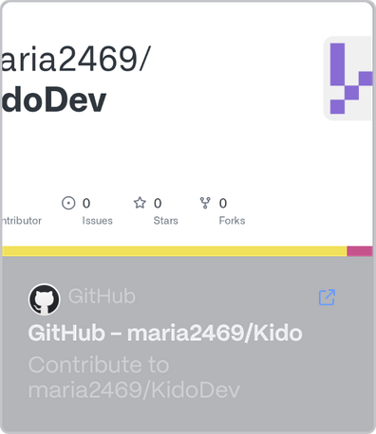
Build with KidoDev
Every child deserves a patient, brilliant, always-on tutor — running locally, privately, and at scale on AMD hardware.
🔗 GitHub Repo
👥 Team
KidoDev
⚙️ Stack
Qwen 2.5 · ROCm · FastAPI · React · Supabase
AMD Hackathon Track 2: Agentic AI — 100% local inference. No cloud APIs. No compromises. KidoDev runs where kids are.
Notes:
10

