Slide 1
Candy Sticker
Anime Sticker Generator on AMD Radeon GPU (ROCm)
Track 1 · Development of Multimodal Content Creation Tools
Text / image → 8 consistent anime expressions → transparent, print-ready stickers
100% local inference on ROCm · no closed-source cloud API

Slide 2
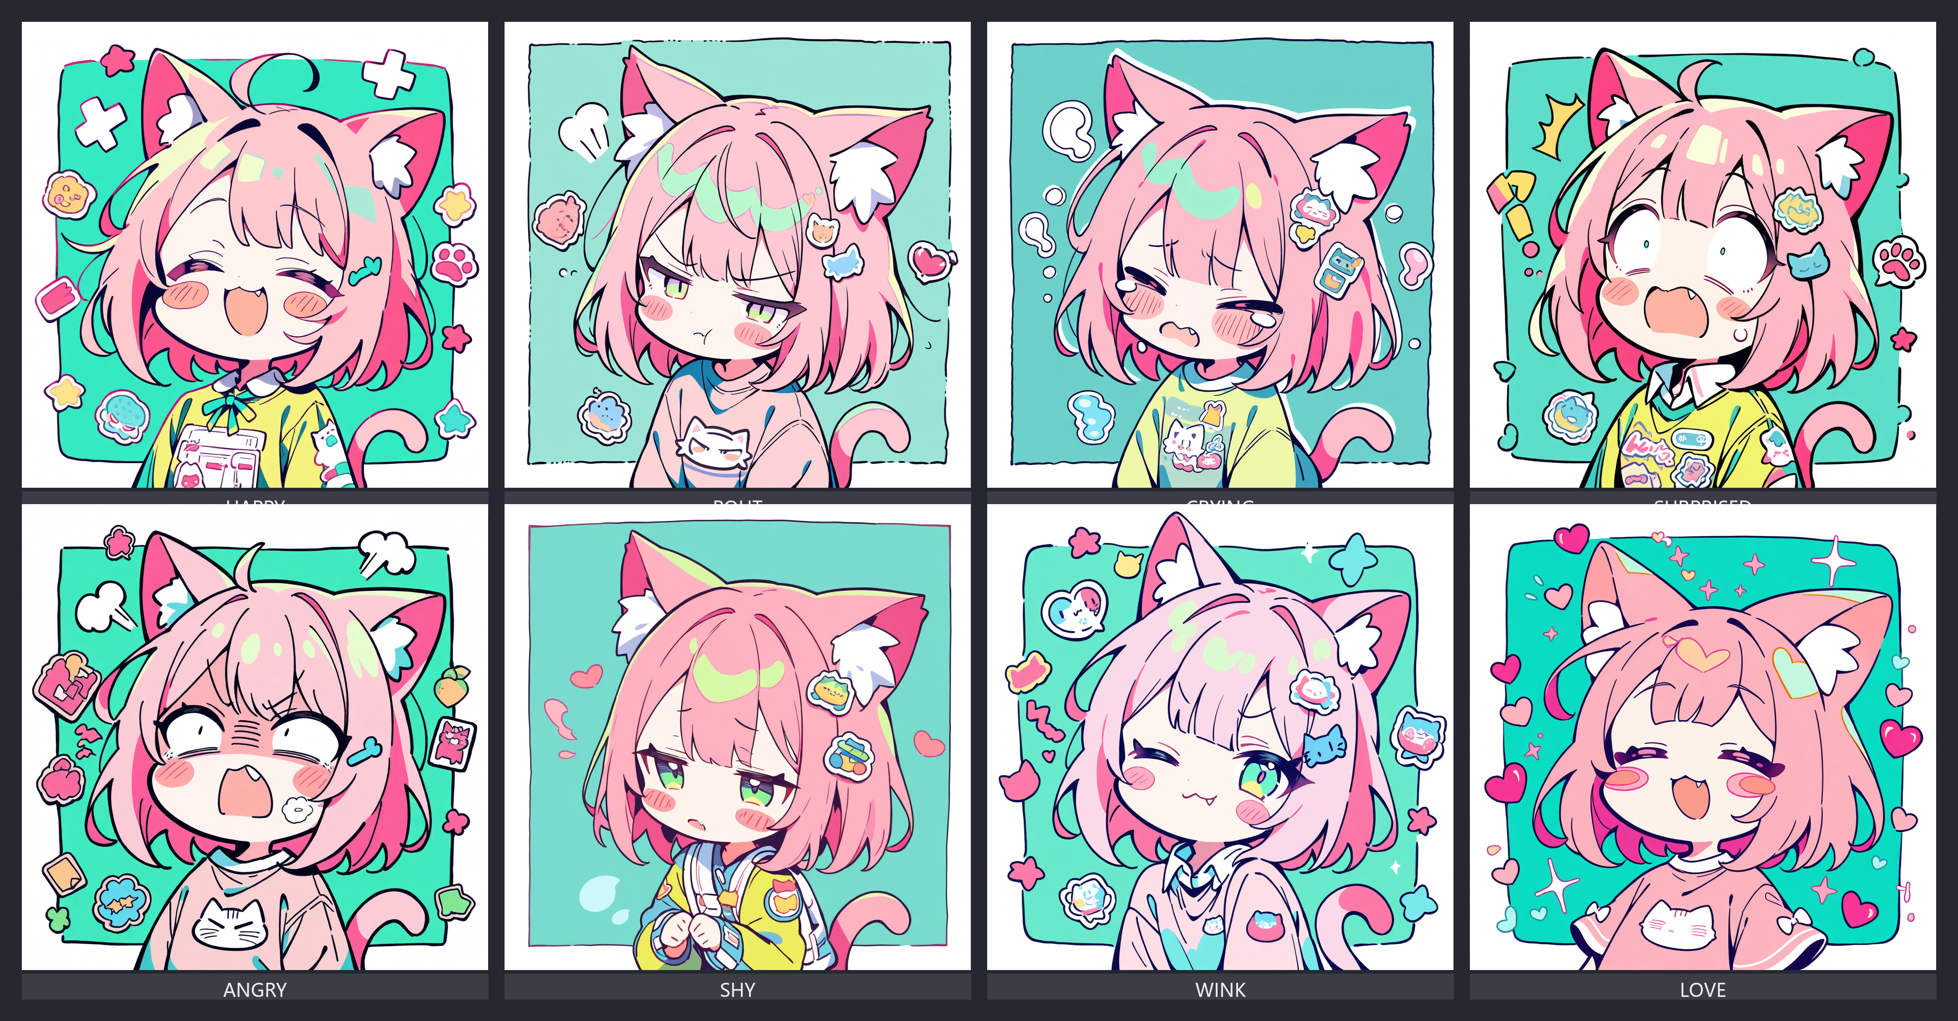
What Candy Sticker does
One idea → a complete, consistent sticker pack in seconds
1
8 expressions, one family
happy / shy / angry / crying / wink / surprised / love / sleepy from a single seed pool
2
Transparent & print-ready
offline flood-fill + Euclidean die-cut border; 2×4 sheet + ZIP (WeChat 500 / TG 512 / print)
3
Multimodal loop
upload a reference → Qwen2.5-VL understands it → SDXL redraws the same character (image→text→image)
4
Signature style lock
optional self-trained SDXL LoRA (stkstyle) to keep a recognizable art style
5
Runs on AMD Radeon
all core inference on ROCm — no CUDA, no cloud API, deployable offline
Candy Sticker · AMD AI DevMaster Hackathon · Track 1
2

Slide 3
System Architecture
Forward (text) and reverse (image) multimodal paths
INPUT
Text prompt
Reference image
AMD Radeon GPU · ROCm 7.2 · Navi 31 · 48 GB
OUTPUT
• 8 transparent stickers
• 2×4 sheet PNG
• ZIP export
• WeChat/TG/print
▶
Qwen2.5-VL-3B
image → text (multimodal leg)
SDXL Animagine XL 4.0
text → image (FP16, 28 steps)
Post-process
flood-fill + EDT die-cut border
Sticker sheet 2×4 + ZIP
transparent, platform specs
Multimodal: image → Qwen-VL → text → SDXL → image (≥2 modalities linked, closed loop)
Candy Sticker · AMD AI DevMaster Hackathon · Track 1
3

Slide 4








Signature Art Style & 8 Expressions
Candy-neon Q-version · 2-head tall · original, zero-training + self-trained LoRA
Happy
Shy
Angry
Crying
Wink
Surprised
Love
Pout
Candy Sticker · AMD AI DevMaster Hackathon · Track 1
4

Slide 5
Multimodal Linkage
A genuine image → text → image loop, not just text expansion
1 · IMAGE IN
Upload a reference sketch or artwork
2 · TEXT (Qwen-VL)
Qwen2.5-VL-3B describes character, palette, mood
3 · IMAGE OUT (SDXL)
SDXL generates the same-style sticker pack
▶ ▶
Why it matters for the contest
The judging requires ≥2 modalities linked. A pure text→image tool only touches one modality;
our image→text→image closed loop satisfies the multimodal requirement with real local ROCm inference.
Candy Sticker · AMD AI DevMaster Hackathon · Track 1
5

Slide 6
Commercial Value
From a creator's idea to sellable, printable merch
Sticker / Emoji stores
Batch-produce WeChat / Telegram / Discord packs; direct ZIP export at platform specs (500×500 / 512×512).
Print-on-Demand
Transparent + die-cut output ready for acrylic stands, badges, T-shirts.
Candy Sticker · AMD AI DevMaster Hackathon · Track 1
6
Brand / IP mascots
Rapid, consistent expression sets; lock style with self-trained LoRA.
Creator productivity
10–50× faster than manual drawing; reproducible offline on commodity AMD HW.

Slide 7
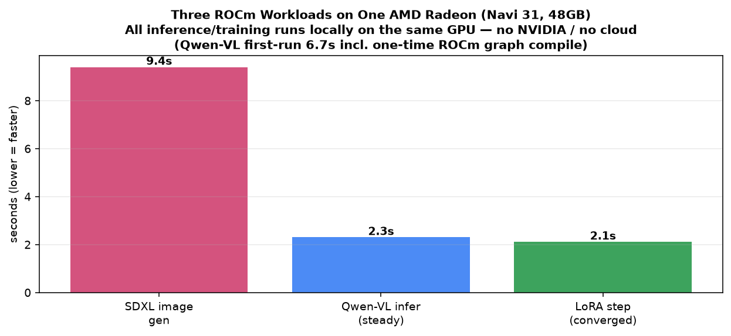
AMD Radeon GPU + ROCm Adaptation
Every key inference step runs locally on Radeon — no CUDA, no cloud API
GPU
AMD Radeon (Navi 31, gfx1100), 48 GB VRAM
Platform
ROCm 7.2 (runtime 7.2.26015), PyTorch 2.11.0+rocm7.2
Image gen
SDXL Animagine XL 4.0 — ROCm PyTorch, FP16, ~7 GB VRAM
Vision LM
Qwen2.5-VL-3B — ROCm PyTorch, FP16, ~6 GB VRAM
Offline
HF_HUB_OFFLINE=1 → pure-local, air-gapped reproducible
Portable
env-var paths; runs on any ROCm 7.x Radeon (Navi 2x/3x)
Perf (honest): ~9.5 s/img GPU-exclusive. ROCm ≈ 70–80% same-bandwidth CUDA; value = price/perf (AMD ~50–60% cheaper at same VRAM).
Candy Sticker · AMD AI DevMaster Hackathon · Track 1
7

Slide 8
Self-trained Style LoRA - on AMD ROCm
The whole pipeline runs on Radeon, not just inference
What
stkstyle LoRA locks the signature candy-neon Q-version art style
Why it scores
A 2nd, independent proof that the AMD ROCm stack runs the FULL creative
pipeline - training + inference - not just inference on a prebuilt model.
Reproducible on any ROCm 7.x Radeon (Navi 2x/3x).
Base
Animagine XL 4.0 (SDXL); LoRA on UNet only, text encoders frozen
Config
r=32 / a=16, 2000 steps, lr 1e-4, 1024, bf16, caption dropout 0.15
Data
34 image-caption pairs (lora/training_data), trigger word stkstyle
ROCm train
same Radeon Navi 31 - 2000 steps in ~70 min (see lora/train.log)
Output
~178 MB Diffusers adapter, toggle in WebUI (weight 0.8)
Candy Sticker · AMD AI DevMaster Hackathon · Track 1
8

Slide 9
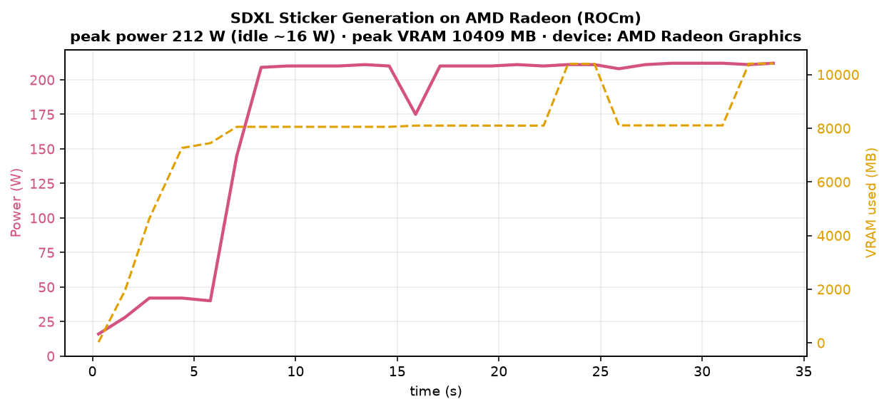
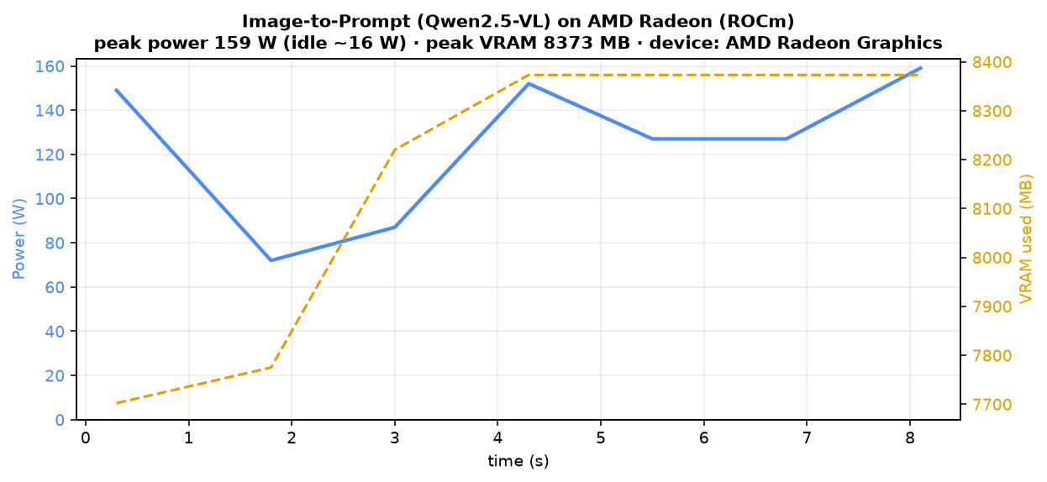
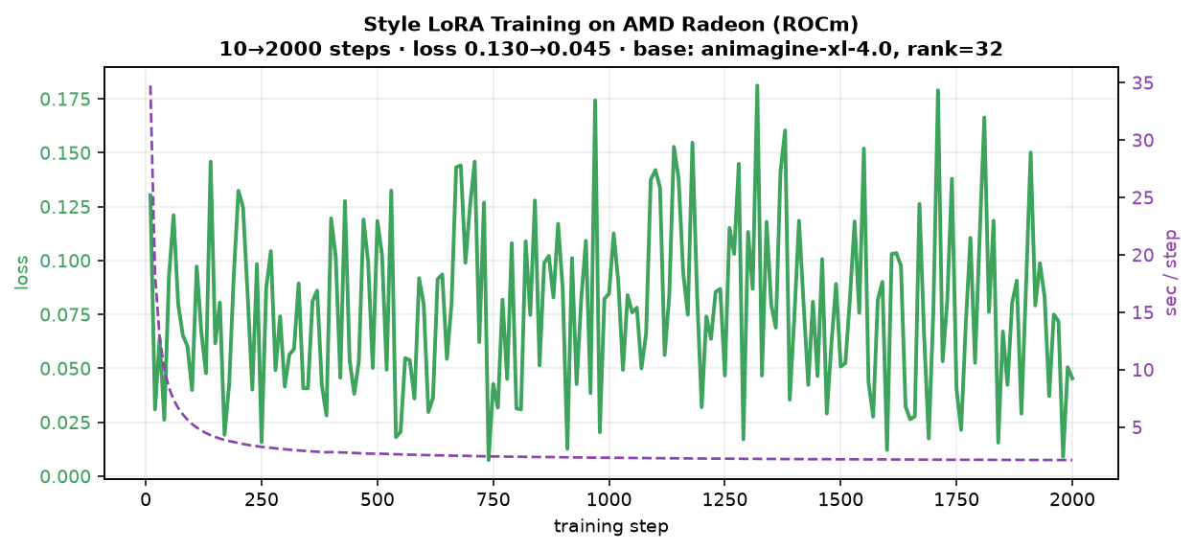
ROCm GPU Evidence — Three Local Workloads
rocm-smi --showpower proves the Radeon GPU (not CPU) does the work
SDXL generation
board power ~200–300 W · VRAM ~10 GB
Qwen-VL image→text (图生图)
board power ~150–200 W · VRAM ~8.4 GB
LoRA training (train.log)
loss 0.13→0.08 · s/it 34→3
Note: rocm-smi --showuse / gpu_busy_percent read 0% on RDNA3 Navi 31, so board power draw (W) is the proof metric; device_info.txt confirms AMD Radeon / Navi 31 / 48 GB.
Candy Sticker · AMD AI DevMaster Hackathon · Track 1
9

Slide 10
Summary
• Local multimodal sticker generator: text / image → 8 consistent anime expressions → transparent, print-ready
• Real image→text→image loop (Qwen-VL + SDXL) on AMD Radeon ROCm
• 100% offline ROCm inference — compliant, deployable, no cloud API
• Deliverables: WebUI + README + Project Profile PDF + this deck + ROCm power-draw evidence + PR
License: MIT (code) · OpenRAIL++-M (Animagine) · Qwen license (VL) · original art style

