Slide 1
FOUNDRY
an autonomous model-distillation agent on a single AMD Radeon
AMD AI DevMaster Hackathon — Track 2 (Agentic AI) · Solo entry

Slide 2
▪ THE PROBLEM
“
01 dataset design
Everyone wants small private models; the pipeline between ‘I need X’ and a model file is expert work.
02 synthetic generation
03 fine-tuning
04 evaluation
05 error analysis
06 quantization
the wall of steps a human must do today
02 / 12

Slide 3
▪ THE PRODUCT IN ONE SENTENCE
screenshot: chat + tool chips
user message · agent plan · tool chips
Conversation in → model file out.
the output is a model file, not chat answers
03 / 12

Slide 4
▪ WHY IT CAN’T BE AN API WRAPPER
01
Training needs local weights
fine-tuning cannot happen over an inference API — producing new weights requires local training
02
Datagen is where iteration cost lives
a single 1,000-example build passes roughly two million tokens through the teacher, and iteration scales that linearly — on the Radeon the marginal cost is zero
03
Seed docs never leave
privacy is structural — the seed documents that ground the labels never leave the machine, and neither does the data derived from them
▪ Track 2’s rule that “core inference processes shall be executed locally on AMD Radeon GPU” is, for Foundry, simply a description of the product.
04 / 12

Slide 5
▪ HOW IT WORKS
SPEC
GENERATE
TRAIN
EVAL
DIAGNOSE
REGENERATE
EXPORT
RAG on seed docs
retrain
▪ Task decomposition
▪ Tool invocation
▪ Retrieval-grounded generation
▪ Memory management
agent capabilities — in Track 2’s own words
05 / 12

Slide 6
▪ IT RUNS ON ONE RADEON
3
screenshot: GPU telemetry card
rocm-smi / UI telemetry during a build
GPU workloads timesharing one card
gfx1100 · 48 GB · ROCm 7.2.4
▪ 30B teacher serving
▪ LoRA training
▪ student serving
06 / 12

Slide 7
▪ HEADLINE RESULT
base 0.15 →
0.97
0.97
0.15
exact match · n=100
granted Radeon — gfx1100 48 GB · ROCm 7.2.4
base Qwen3-0.6B
Foundry student
07 / 12

Slide 8
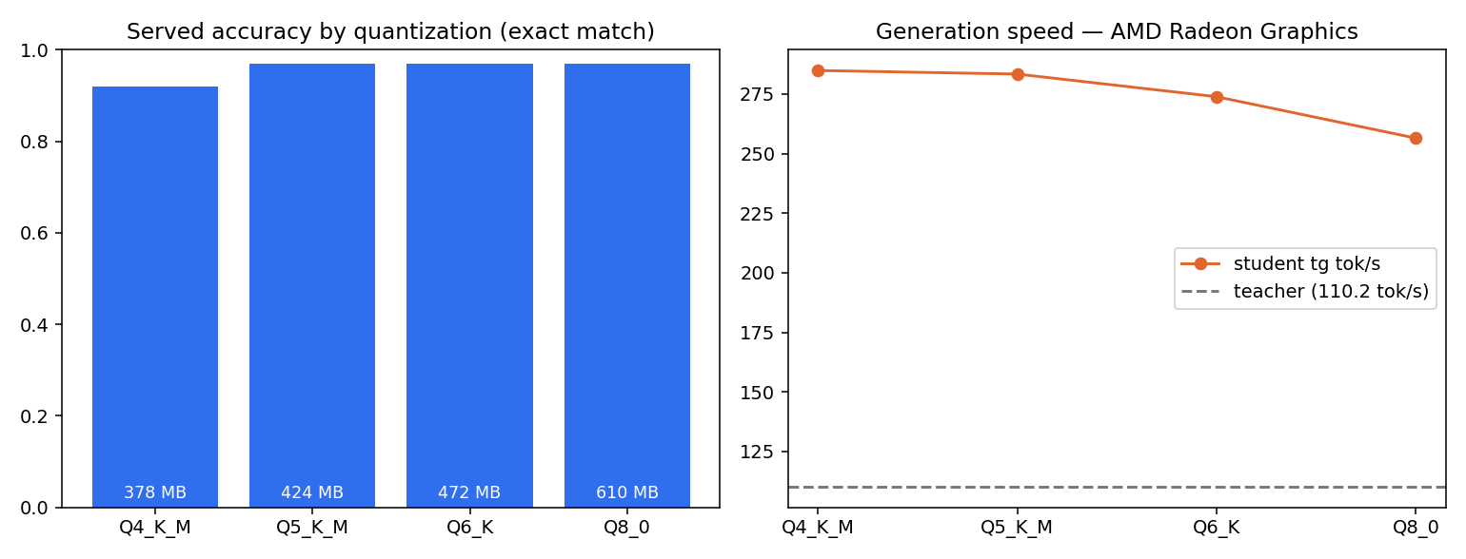
▪ THE QUANT LADDER
bench_chart.png · Radeon run · accuracy measured through llama-server
Q4 costs 5 points; Q5 costs nothing.
from Q5_K_M up, served accuracy equals the full-precision checkpoint’s on this task
08 / 12

Slide 9
▪ STUDENT VS TEACHER
SIZE
GENERATION SPEED
AGREEMENT
Foundry student · 283.4 tok/s
teacher 30B · 110.2 tok/s
held-out examples · n=100
teacher 30B Q4_K_M
17,697 MB
student Q5_K_M
424 MB
1/42 the size
2.6× faster generation
97% agreement
424 MB vs 17,697 MB
tg tok/s · single-stream llama-bench
exact match with the teacher
09 / 12

Slide 10
▪ THE IMPROVEMENT LOOP
0.667 → 0.833
exact match · same frozen holdout
DIAGNOSE
TARGETED REGENERATION
RETRAIN + RE-EVALUATE
feature_request
recall 0.667
train set 59 → 141
category 0.917 → 1.00
confusion with technical_issue
focused on the weak class · holdout frozen
exact match 0.667 → 0.833
in a rehearsal round that produced no gain, the agent reported “no measurable gain” — rather than inflating
10 / 12

Slide 11
▪ GENERALITY + MEMORY
0 code changes
screenshot: registry rail — both tasks
resumable builds · triage + expense routing
second domain — expense routing — from a new policy doc, one conversation
routing_decision × spending_category
▪ the registry resumes builds across sessions — “continue yesterday’s model”
11 / 12

Slide 12
Small models, made to order, on your Radeon.
ROCm 7.2.4 · llama.cpp · PyTorch-ROCm · peft
repo: [ placeholder — add link ]
Thank you.
12 / 12

