Slide 1

TRACK 2 | AI AGENT APPLICATION
RDK
Agent
Natural-language intent becomes a verified action on an RDK board.
PRIVATE RADEON TARGET / TOOL CALLING / MULTI-STEP PLANNING / BOUNDED AUTHORITY
d-robotics agent
Notes:
Open with the product promise: one governed path from intent to a board action. The visual is conceptual, not hardware evidence.
[Sources]
- Project repository: README.md and submission/en/PROJECT_SPECIFICATION.md.
- Project-created AI-generated asset: submission/en/assets/rdk-agent-hero.png.
- Official Track 2 requirements: https://github.com/AMD-DEV-CONTEST/Radeon-hackathon-2026-07
[/Sources]

Slide 2

NAMING STORY
Sophon becomes a transparent device bridge
A memorable literary idea maps to an owner-controlled board-side subsystem.
FICTIONAL METAPHOR
A messenger is sent toward Earth to observe and communicate.
RDK-SOPHON
probe-daemon lives on the board, observes telemetry and exposes governed actions to rdk-agent.
The crucial difference
Transparent, auditable, reversible and deployed by the device owner - never covert surveillance.
Project-created AI image; no official novel or adaptation assets are used. rdk-sophon is a board-side subsystem name, not an AI accelerator brand.
02
Notes:
Keep this as a naming explanation, then return immediately to the Track 2 product and evidence story.
[Sources]
- User-provided naming rationale in this task.
- Project-created AI-generated asset: submission/en/assets/sophon-three-body-concept.png.
- Project disclaimer: submission/en/PROJECT_SPECIFICATION.md, section 2.
[/Sources]

Slide 3
PROBLEM
One request crosses five fragile handoffs
A small behavior must survive intent, code, evidence, deployment and physical acceptance.
01
02
03
Intent drifts
Code can overclaim
Deployment breaks trust
Natural language can lose left/right direction, scope or the expected device contract.
A model can say 'passed' without running an executable check or preserving the requested behavior.
A valid file is not yet a deterministic package, atomic release, installed Skill or verified board result.
RDK Agent turns those handoffs into one governed path with bounded retries and executable evidence.
03
RDK Agent | AMD Radeon AI Agent Hackathon | Track 2
Notes:
Frame the problem as reproducibility and authority, not simply code generation.
[Sources]
- Project specification: submission/en/PROJECT_SPECIFICATION.md, sections 1 and 3.
- Workflow implementation: rdk-agent/config/agents.yaml.
[/Sources]

Slide 4
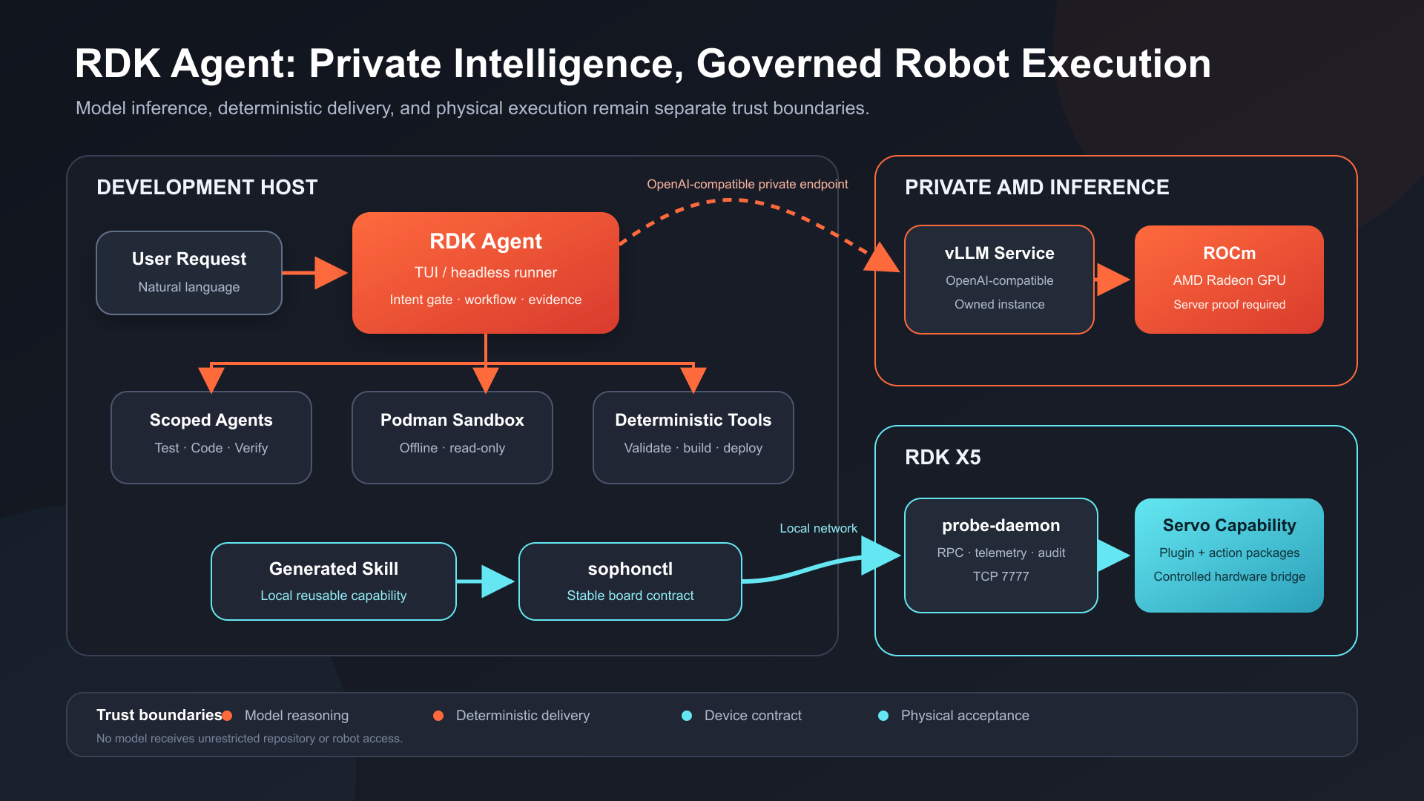
ARCHITECTURE
Reasoning stays private; board authority stays local
The host orchestrates, the target Radeon endpoint serves the model, and rdk-sophon owns the device contract.
04
Notes:
Call out the separation between model reasoning, deterministic delivery, the device contract and physical acceptance.
[Sources]
- Project architecture source: submission/en/assets/architecture.svg.
- Detailed specification: submission/en/PROJECT_SPECIFICATION.md, section 4.
[/Sources]

Slide 5
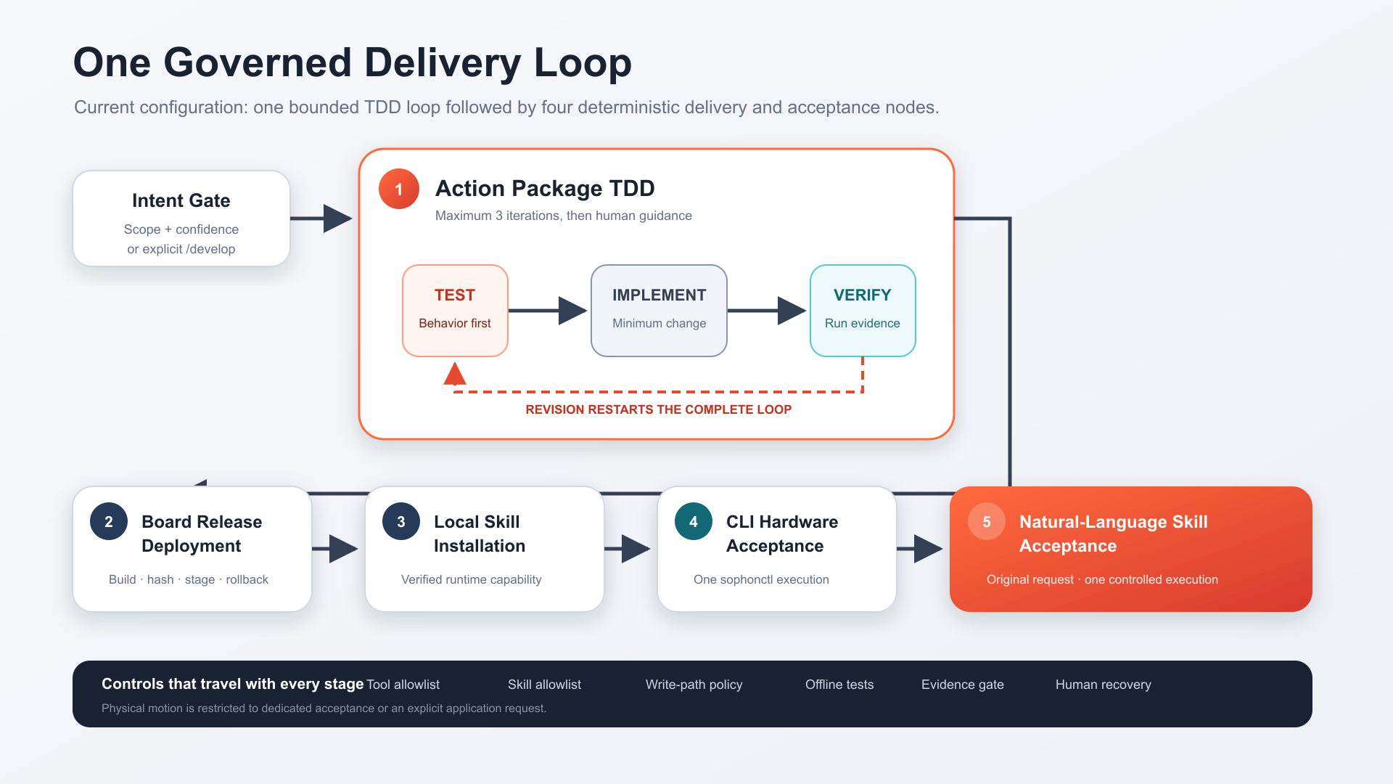
WORKFLOW
Five nodes make delivery repeatable
One bounded Action Package TDD loop is followed by four deterministic delivery and acceptance nodes.
05
Notes:
The red loop is the only revision loop and is capped at three iterations. Every downstream node requires a successful predecessor.
[Sources]
- Project workflow source: submission/en/assets/workflow.svg.
- Workflow configuration: rdk-agent/config/agents.yaml.
[/Sources]

Slide 6
SAFETY MODEL
Controls below the prompt keep authority bounded
The model can propose; software-enforced scope, policy and evidence decide what can progress.
SCOPE
Agent-specific tool, Skill and write-path allowlists
SANDBOX
Offline, read-only Podman verification
DIRECTION
ACTION-DIRECTION-001 blocks opposite-side actions
EVIDENCE
Executable checks gate package progression
DEVICE
probe-daemon exposes only registered plugins and actions
Boundary: transport authentication and routine per-action human approval remain roadmap items.
06
RDK Agent | AMD Radeon AI Agent Hackathon | Track 2
Notes:
Describe this as agent/tool-layer permission control. Do not imply end-to-end transport security is complete.
[Sources]
- Safety design: submission/en/PROJECT_SPECIFICATION.md, sections 6-7 and 12.
- Verification tests: rdk-agent/test/security-hardening.test.ts and related suites.
[/Sources]

Slide 7
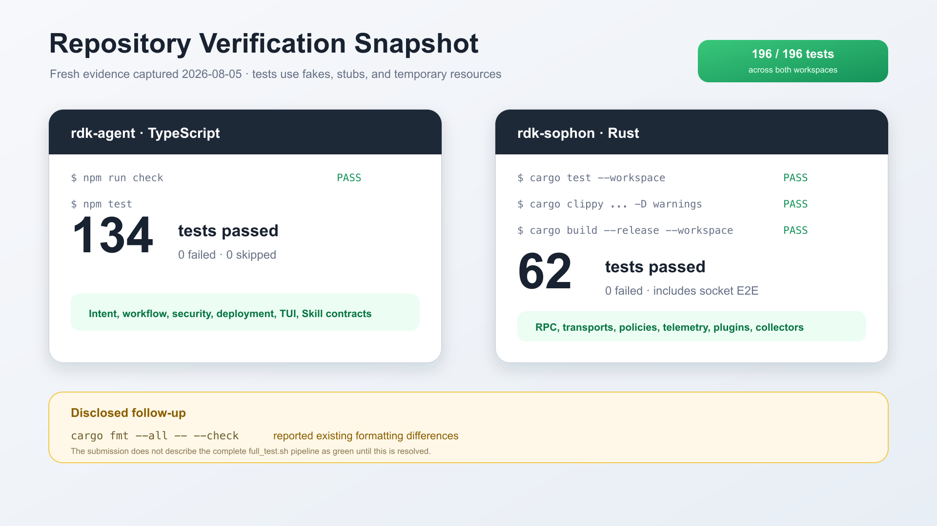
REPOSITORY EVIDENCE
196 tests pass across both workspaces
Fresh verification: 134 TypeScript tests and 62 Rust tests, plus Clippy and a release build.
07
Notes:
Mention the disclosed formatting follow-up: cargo fmt --all -- --check reports existing differences, so the deck does not call the full formatting state green.
[Sources]
- Evidence log: submission/en/evidence/verification-2026-08-05.md.
- Evidence visual source: submission/en/assets/test-evidence.svg.
[/Sources]

Slide 8
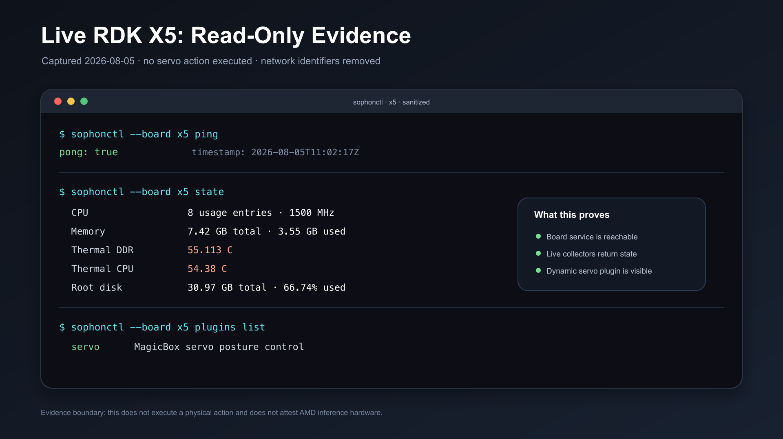
DEVICE EVIDENCE
A live RDK X5 answers through the board contract
Read-only ping, state and plugin discovery succeeded; sensitive identifiers were removed.
08
Notes:
This proves board reachability, live collectors and dynamic plugin discovery. It does not prove physical motion or AMD inference hardware.
[Sources]
- Evidence log: submission/en/evidence/verification-2026-08-05.md.
- Evidence visual source: submission/en/assets/board-evidence.svg.
[/Sources]

Slide 9
AMD RADEON + ROCM
Both Qwen3 model paths ran successfully
80B single-GPU serving and the trained 32B SFT live Agent workflow are evidenced separately.
BOTH MODELS RUN
RDK Agent
OpenAI API
vLLM + ROCm
Qwen3-Next-80B-
A3B-Instruct
Provider amd
API OpenAI-compatible
Context 131,072
Max out 8,192
Archived evidence
80B: single-Radeon llama.cpp metrics
32B SFT: 5/5 live Agent nodes
Private vLLM provenance remains separate
09
RDK Agent | AMD Radeon AI Agent Hackathon | Track 2
Notes:
Both models ran. Keep the evidence scopes distinct: the 80B figures come from the archived llama.cpp case; the 32B SFT screenshot proves the live Agent path.
[Sources]
- Sanitized config: submission/en/config/pi-models.amd-rocm.example.json.
- AMD evidence plan: submission/en/AMD_RADEON_ROCM.md.
- Current evidence boundary: submission/en/evidence/verification-2026-08-05.md.
[/Sources]

Slide 10
OPTIMIZATION
Measured gains on two Radeon paths
32B SFT improves user-visible TTFT; 80B single-GPU serving improves decode throughput.
32B TTFT
80B TOK/S
AGENT 5/5
17.41 -> 8.26 s
37.19 -> 49.82
4:04 total
p50, 88 trials per arm
decode, five measured runs per arm
32B SFT workflow on RDK X5
Evidence scope
32B and 80B runs keep separate runtimes, protocols and archived measurements
NO CROSS-RUNTIME SPEED CLAIM; PRIVATE VLLM PROVENANCE REMAINS SEPARATE
10
RDK Agent | AMD Radeon AI Agent Hackathon | Track 2
Notes:
Both paths have measured baseline-versus-optimized results. Do not compare their absolute speeds because model sizes, servers and protocols differ.
[Sources]
- Benchmark script: submission/en/scripts/benchmark-openai-compatible.mjs.
- Optimization plan: submission/en/AMD_RADEON_ROCM.md.
[/Sources]

Slide 11
DEMO
The video proves the entire closed loop
The 3:07 public recording is available from two independent links.
PUBLIC VIDEO
Bilibili BV1t3up6iEhy | Baidu Cloud backup
0:00
1:15
2:45
Intent + graph
Build + deploy
Accept + prove
Show the request, semantic gate and bounded TDD progress.
Show executable checks, package validation, release and Skill installation.
Show CLI/NL acceptance, the board result and redacted Radeon/ROCm evidence.
Privacy check: blur keys, private URLs, emails, MAC addresses and unnecessary internal IPs.
11
RDK Agent | AMD Radeon AI Agent Hackathon | Track 2
Notes:
Keep the total duration between three and five minutes. The AMD segment should show the participant-controlled Radeon/ROCm/vLLM runtime, not only the RDK board.
[Sources]
- Video shot list: submission/en/VIDEO.md.
- Official Track 2 requirement: https://github.com/AMD-DEV-CONTEST/Radeon-hackathon-2026-07
[/Sources]

Slide 12
TRACK 2 | SUBMISSION READY
One governed path
from intent to a board action.
Private reasoning. Deterministic delivery. Live board evidence.
01
Team: d-robotics agent
Next action
02
Public video: primary + backup
Run the final integrity review, then open the official Track 2 pull request.
03
32B SFT + 80B Radeon evidence
RDK Agent | AMD Radeon AI Agent Hackathon | Track 2
Notes:
Close by resolving the opening promise and naming the only remaining owner actions. Do not end with a generic thank-you slide.
[Sources]
- Submission checklist: submission/en/SUBMISSION_CHECKLIST.md.
- PR draft: submission/en/PR_DESCRIPTION.md.
[/Sources]

