Slide 1
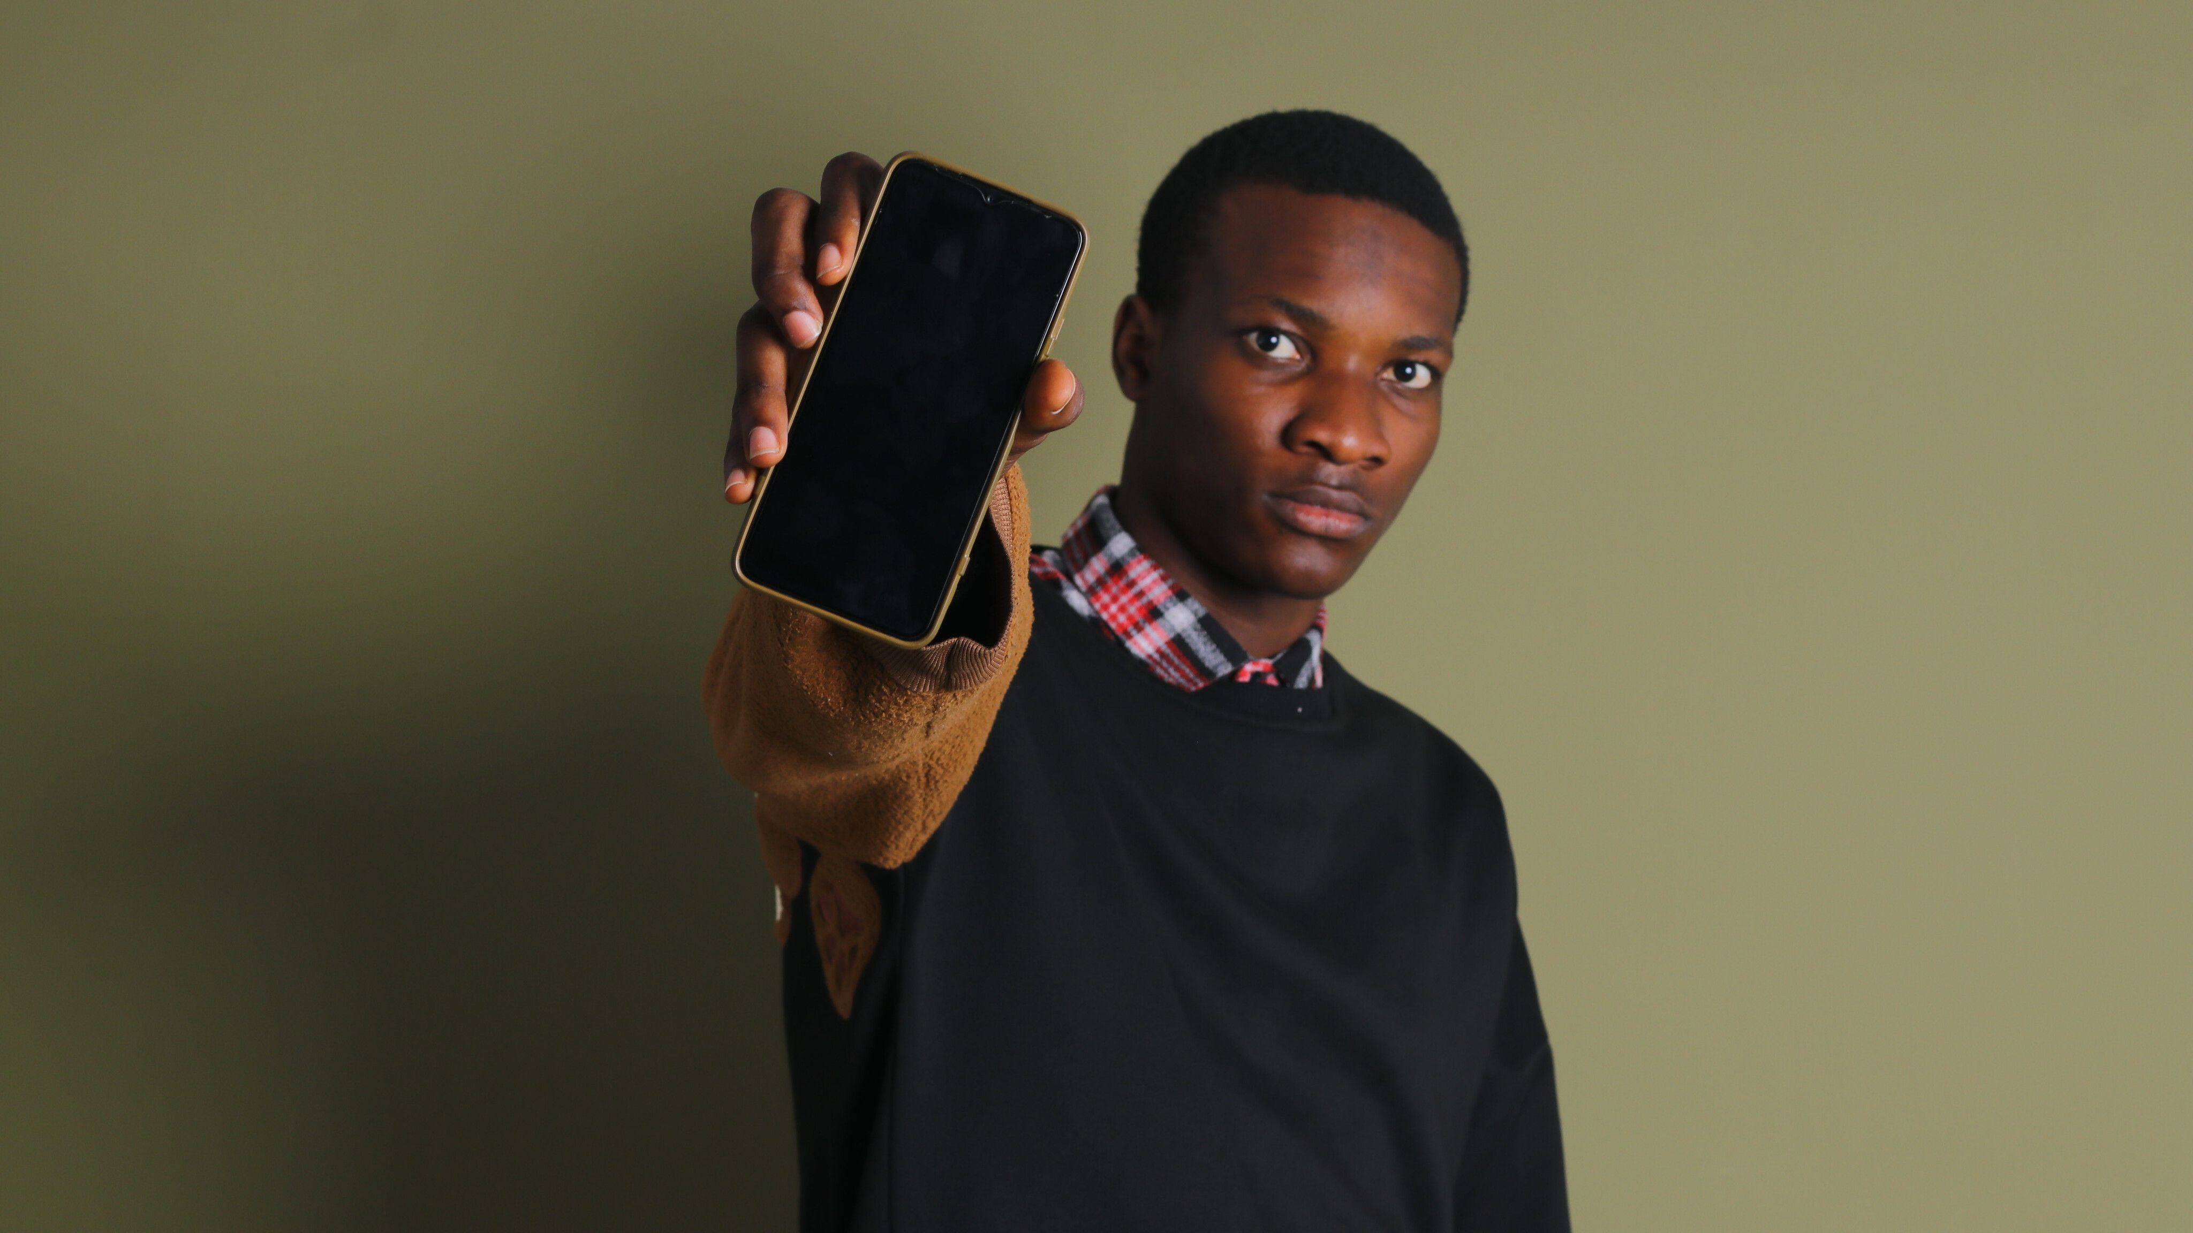
TRACK 2 · PRIVATE AI AGENT
Aperture
AI Photographer Agent
Turns a private reference photo into an executable on-location shooting plan—fully local on AMD Radeon + ROCm.
Aperture Intelligence
AMD AI DevMaster Hackathon · 2026
Notes:
Open with the product promise: this is an Agent that converts photographic intent into actions, not an image-captioning demo.
[Sources]
- https://github.com/yang13926151198-ai/AI-Photographer-Agent-ROCm
- https://github.com/AMD-DEV-CONTEST/Radeon-hackathon-2026-07
- https://www.pexels.com/photo/portrait-of-man-with-smartphone-19518383/
[/Sources]

Slide 2
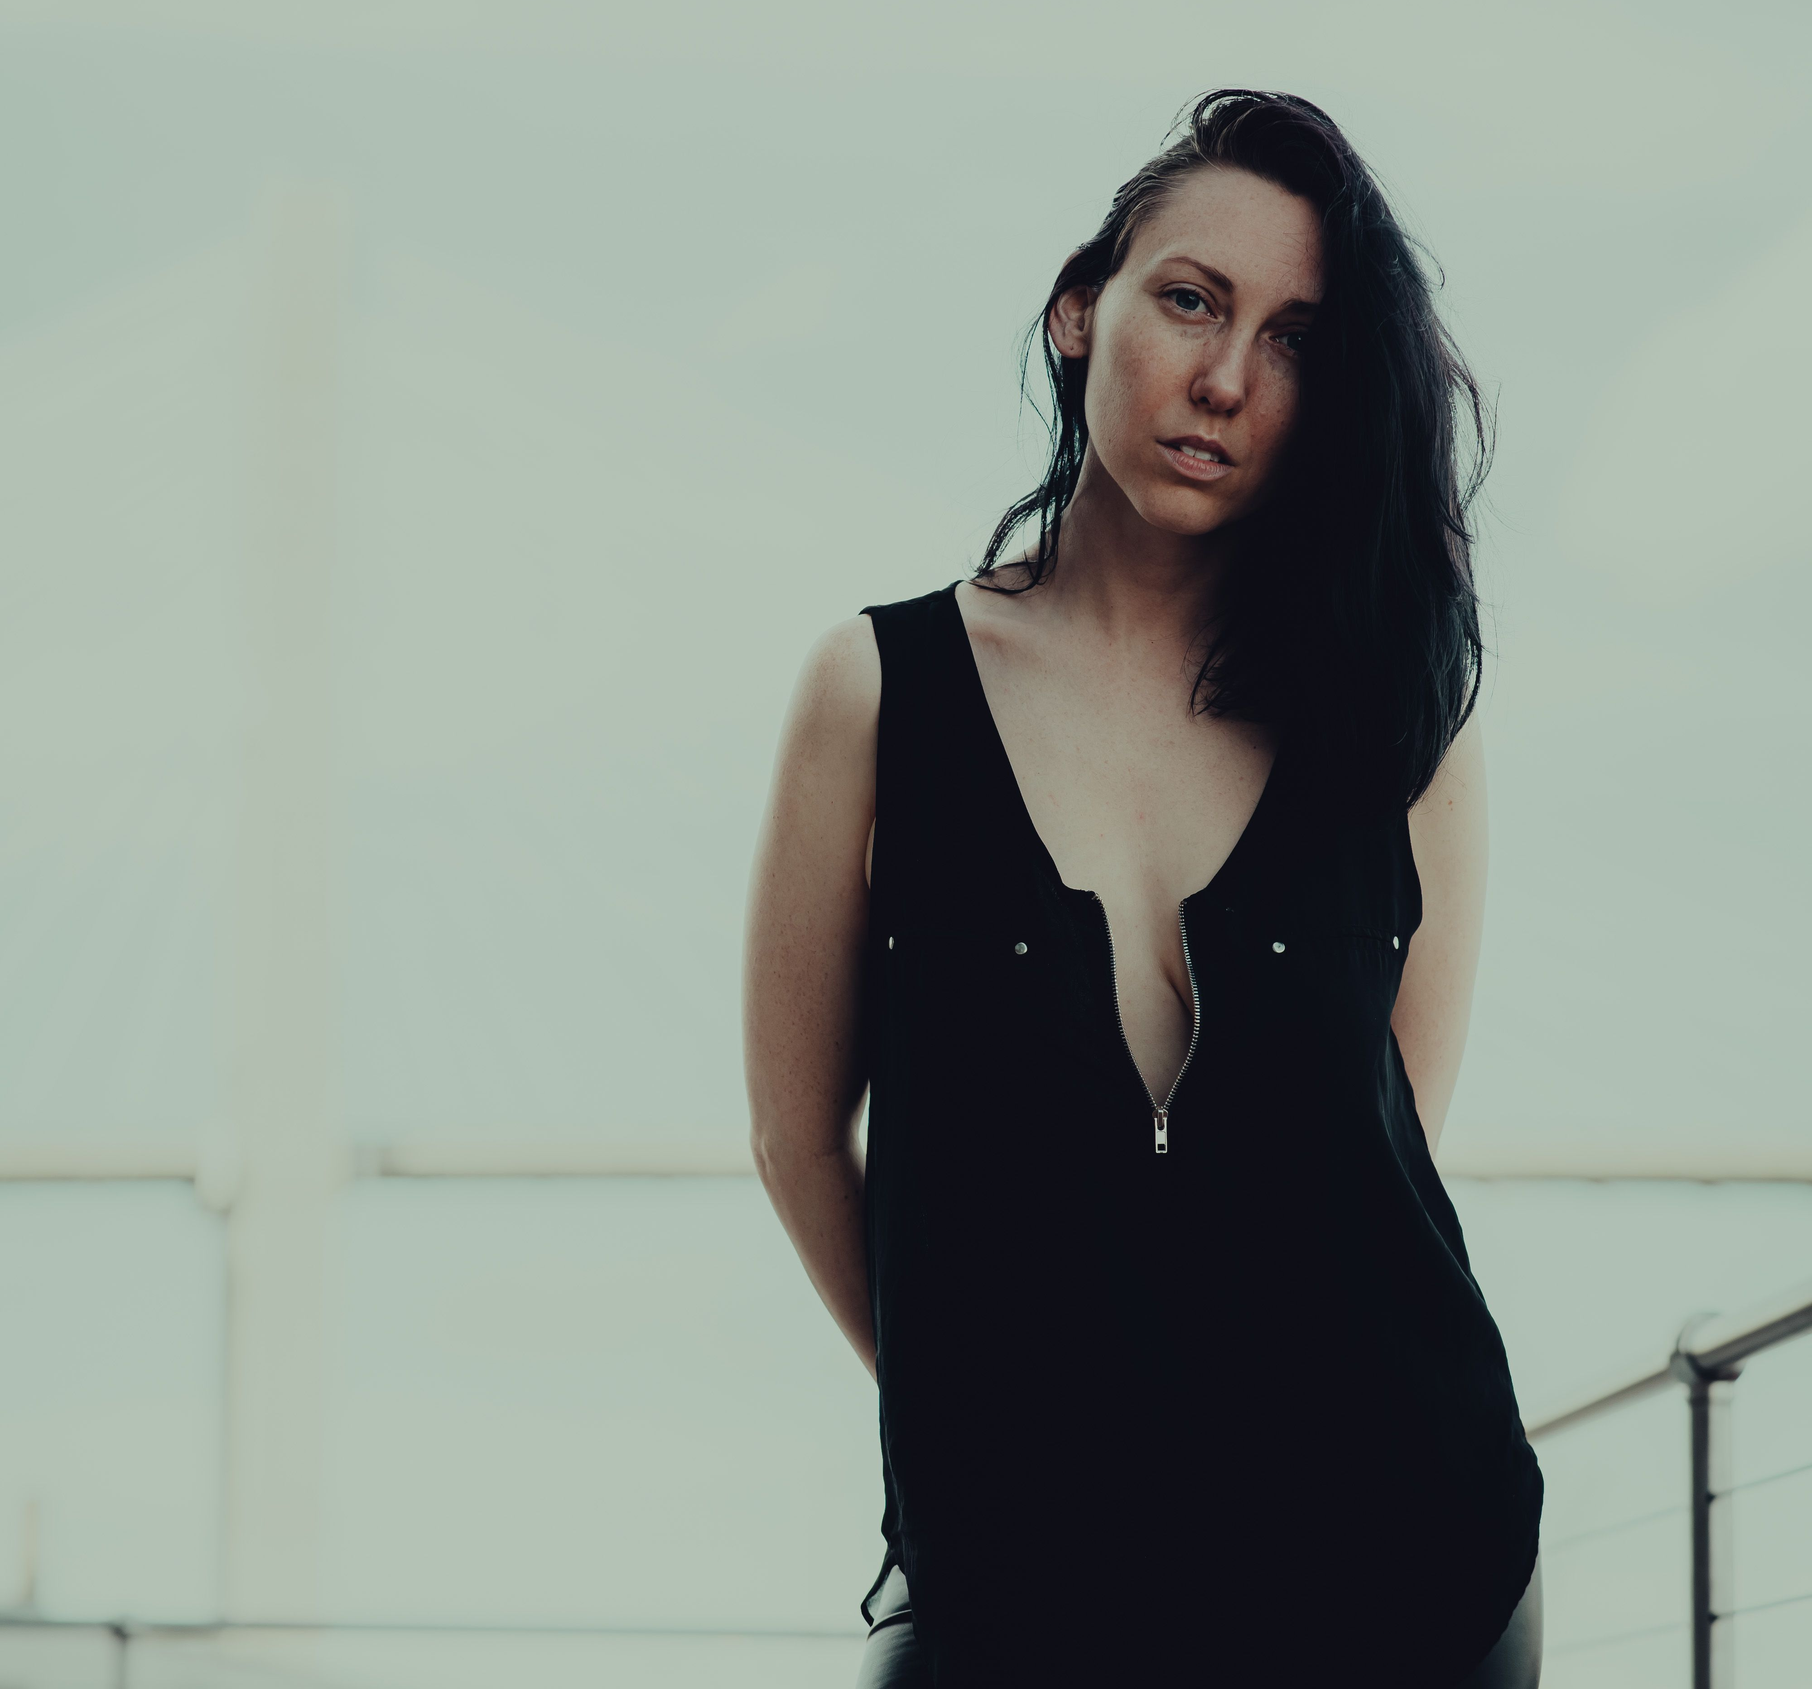
THE USER PROBLEM
02
Liking a photo is easy. Recreating it is not.
Most tools explain what is visible; photographers need to know what to do next.
A reference photo hides decisions
WHERE
Where should the photographer place the camera?
HOW
How should the person stand, look, and interact?
WHY
Why does this subject–environment relationship work?
AVOID
What will make the recreation fail?
APERTURE / AMD AI DEVMASTER HACKATHON / TRACK 2
2 / 10
Notes:
Frame the gap between visual recognition and real-world execution. The product is designed for ordinary users, so actions take priority over technical parameters.
[Sources]
- https://github.com/yang13926151198-ai/AI-Photographer-Agent-ROCm
- https://www.pexels.com/photo/portrait-of-a-woman-standing-12182660/
[/Sources]

Slide 3
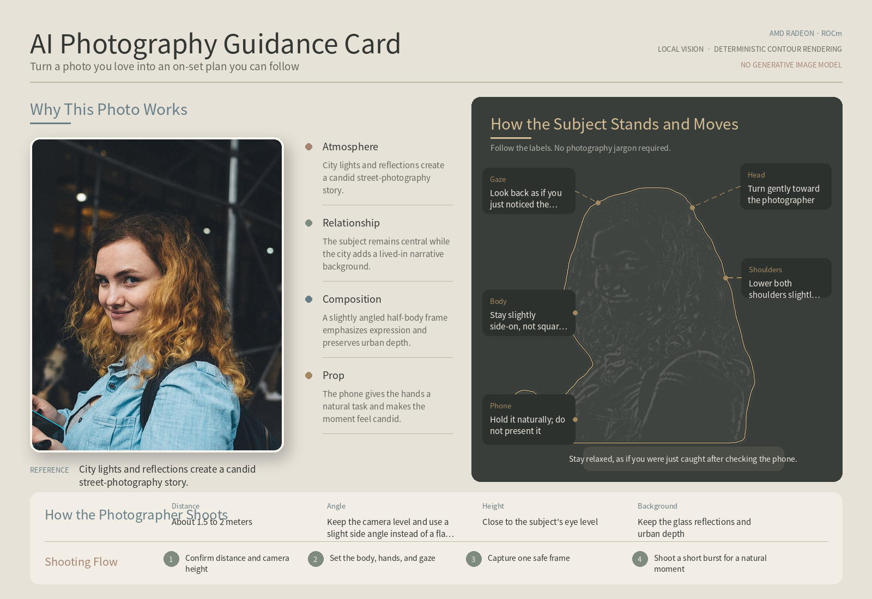
THE PRODUCT
03
One private photo becomes one executable guidance card.
No text prompt is required in the current demo.
INPUT
OUTPUT
LOCAL
AGENT
Private reference photo
Why it works · Photographer actions · Subject actions · Shooting sequence
APERTURE / AMD AI DEVMASTER HACKATHON / TRACK 2
3 / 10
Notes:
Explain the product in one breath: upload a photo, wait for local analysis, then use or download a stable guidance card. The reference thumbnail and real subject contour are preserved.
[Sources]
- https://github.com/yang13926151198-ai/AI-Photographer-Agent-ROCm
- https://www.pexels.com/photo/portrait-of-man-with-smartphone-19518383/
[/Sources]

Slide 4
THE EXPERIENCE
04
The interface is simple; the Agent does the complex work.
A photo-only interface keeps the interaction focused and repeatable.
01
02
03
04
05
Upload
Understand
Plan
Check
Render
Add one portrait or group photo.
Ground scene, people, composition, and props.
Translate evidence into concrete shooting actions.
Critic rejects vague, contradictory, or unsupported advice.
Draw a stable card from the real person mask.
The result is not a photography lesson. It is a set of actions that two people can execute on location.
APERTURE / AMD AI DEVMASTER HACKATHON / TRACK 2
4 / 10
Notes:
This is the user-facing sequence. Avoid technical detail here; the next slide reveals the Agent architecture behind it.
[Sources]
- https://github.com/yang13926151198-ai/AI-Photographer-Agent-ROCm
[/Sources]

Slide 5
AGENT ARCHITECTURE
05
Eight audited tools turn evidence into a guidance card.
Core vision and segmentation run locally through PyTorch ROCm.
Intent
Router
Vision
Analyzer
Composition
Checker
Photography
Planner
Plan
Critic
AMD RADEON + ROCm
Qwen2.5-VL-3B
Plan Refiner
(optional)
Pose
Analyzer
Pose Card
Renderer
+ Torchvision Mask R-CNN
Local vision + person segmentation
One bounded repair pass; no unbounded loop
The renderer receives validated JSON and a real person mask.
APERTURE / AMD AI DEVMASTER HACKATHON / TRACK 2
5 / 10
Notes:
Walk left to right. Every tool is registered, permission-checked, timed, and recorded. The Critic can request at most one bounded refinement and cannot invent new visual evidence.
[Sources]
- https://github.com/yang13926151198-ai/AI-Photographer-Agent-ROCm
- https://github.com/AMD-DEV-CONTEST/Radeon-hackathon-2026-07
[/Sources]

Slide 6
TRACK 2 COMPLIANCE
06
Aperture demonstrates three Track 2 Agent capabilities.
The official minimum is two; Aperture proves three with inspectable runtime evidence.
01
02
03
Tool invocation
Multi-step planning
Permission & privacy
Eight registered tools with ordered calls, timing, device, safe summaries, and status.
Grounded analysis → planning → criticism → bounded repair → deterministic output.
Local image read and GPU inference allowed; network and persistent storage denied.
AUDITABLE RESULT
tool_manifest · tool_calls · permission_audit · privacy · agent_trace · GPU & latency metrics
APERTURE / AMD AI DEVMASTER HACKATHON / TRACK 2
6 / 10
Notes:
Map the product directly to the official Track 2 capability list. The visible audit fields are returned with every result, so these are product behaviors rather than presentation-only claims.
[Sources]
- https://github.com/AMD-DEV-CONTEST/Radeon-hackathon-2026-07
- https://github.com/yang13926151198-ai/AI-Photographer-Agent-ROCm
[/Sources]

Slide 7
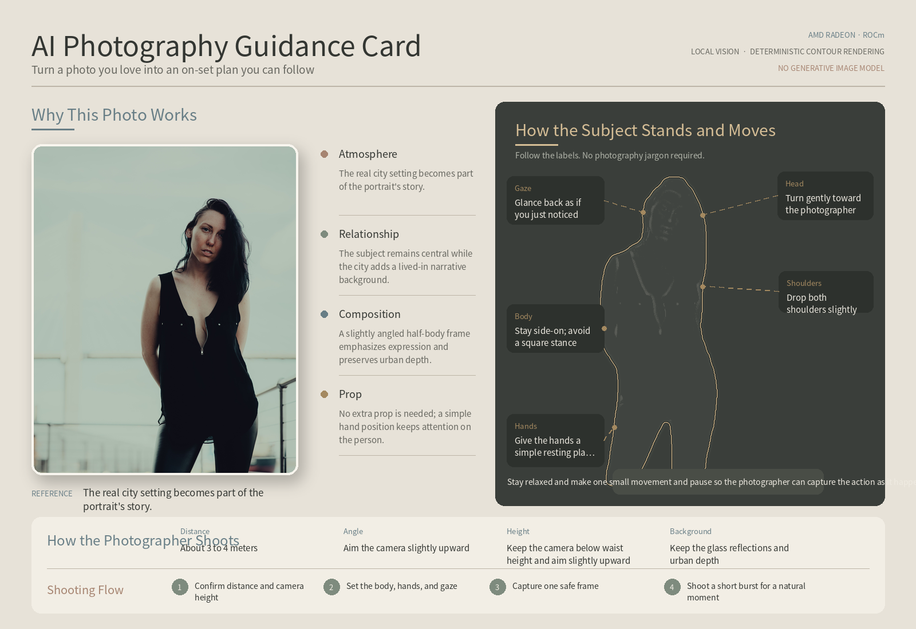
PRODUCT CHOICE
07
The final image is rendered, not generated.
AI decides the actions; deterministic code decides every pixel of the card.
REAL CONTOUR
Mask R-CNN extracts the subject from the uploaded photo.
STRUCTURED LABELS
Qwen returns body, head, gaze, hands, interaction, and camera guidance as JSON.
STABLE OUTPUT
PIL/SVG-style drawing keeps the layout consistent across photos.
NO REPLACEMENT IMAGE
No image-generation model is called; the system teaches rather than imitates.
APERTURE / AMD AI DEVMASTER HACKATHON / TRACK 2
7 / 10
Notes:
This is a deliberate safety and product decision. The system uses AI for interpretation and planning, then uses deterministic rendering for a stable, inspectable teaching artifact.
[Sources]
- https://github.com/yang13926151198-ai/AI-Photographer-Agent-ROCm
- https://www.pexels.com/photo/portrait-of-a-woman-standing-12182660/
[/Sources]

Slide 8
VERIFIED ON RADEON CLOUD
Local runtime evidence, not synthetic estimates.
AMD Radeon Graphics · ROCm/HIP 7.2.53211 · PyTorch 2.13.0+rocm7.2
47.98 GiB
10.403 GiB
76 / 76
3 / 3
GPU memory
Peak allocated VRAM
Automated tests passed
Fresh English demo cases
MEASURED END-TO-END PATHS
82.376 s
Single portrait with JSON repair
57.867 s
Single portrait without a prop
59.569 s
Three-person graduation group
Longer paths expose real JSON repair and multi-person grounding costs instead of hiding them in an average.
08 / 10
Notes:
Emphasize that the GPU remains local and the measurements are retained as observed. The slower group path includes malformed-output repair, grounding, and a second completion pass.
[Sources]
- https://github.com/yang13926151198-ai/AI-Photographer-Agent-ROCm
[/Sources]

Slide 9
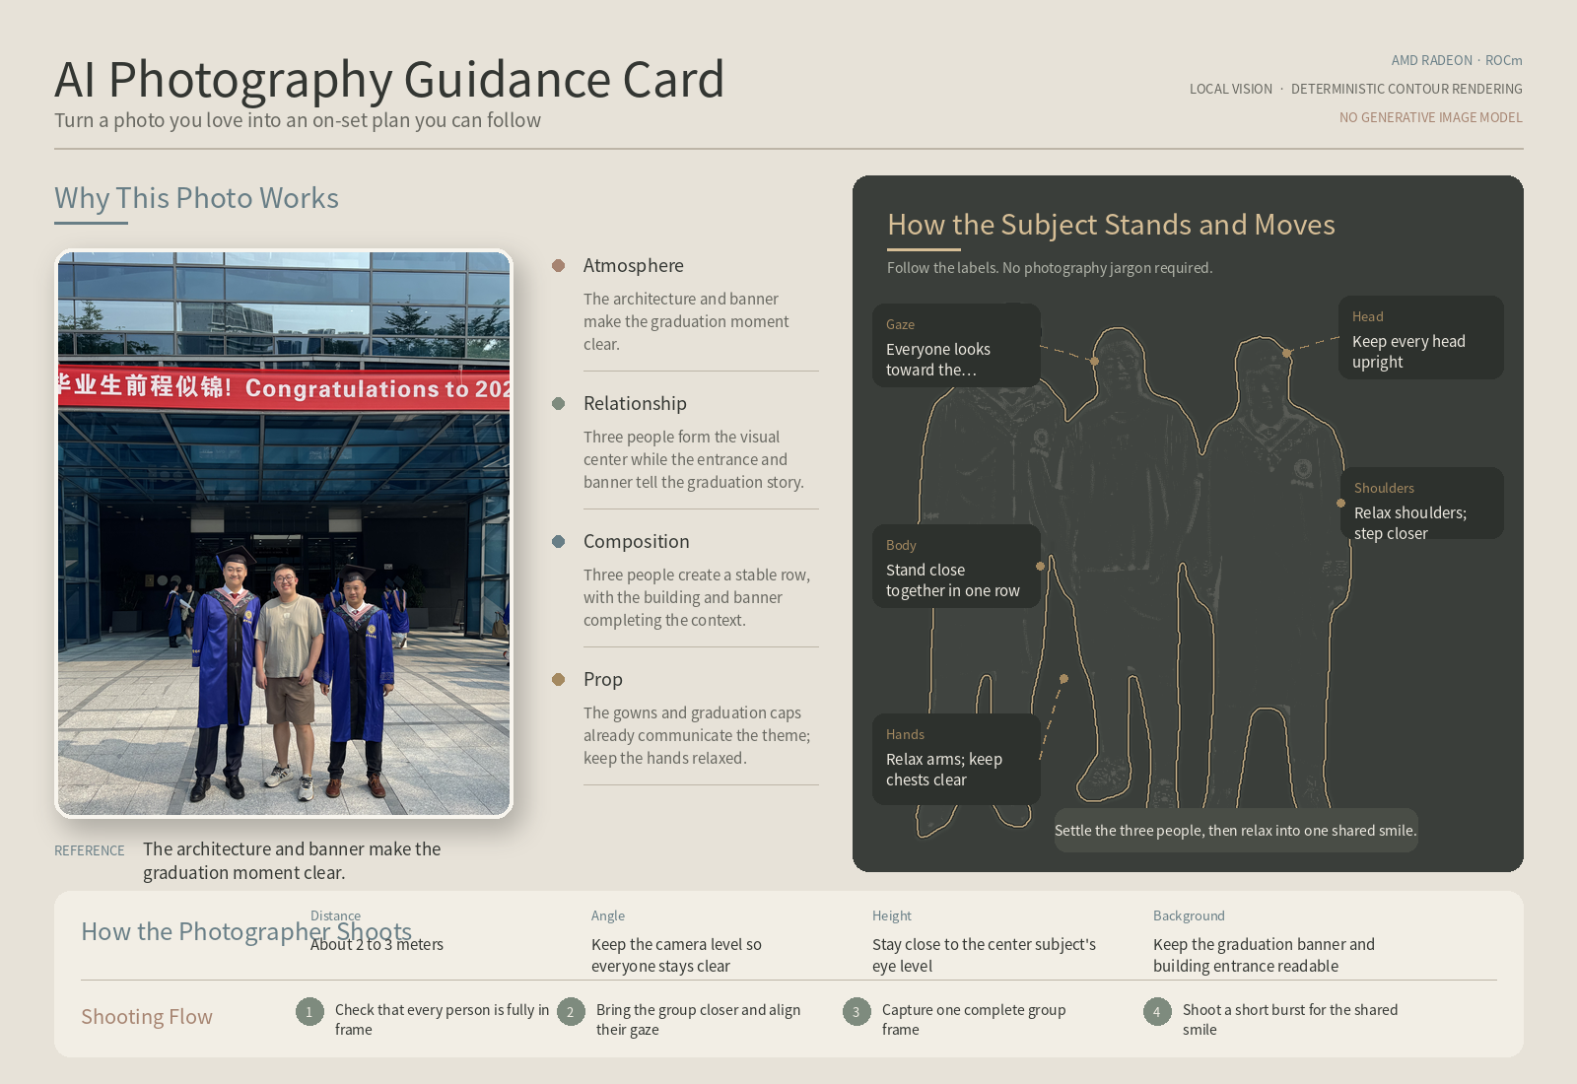
REAL OUTPUTS
09
The guidance changes with every photo.
Three licensed inputs; three distinct local plans; one consistent interface.
Single portrait · phone
Single portrait · no prop
Three-person group
Prop-specific hand action
No invented object guidance
Three matched contours
1 / 1
1 / 1
3 / 3
people detected / matched
people detected / matched
people detected / matched
APERTURE / AMD AI DEVMASTER HACKATHON / TRACK 2
9 / 10
Notes:
Use the three cases to show image-specific behavior: a real phone changes the hand instruction, the no-prop image does not invent an object, and the group path matches all three foreground people.
[Sources]
- https://github.com/yang13926151198-ai/AI-Photographer-Agent-ROCm
- https://www.pexels.com/photo/portrait-of-man-with-smartphone-19518383/
- https://www.pexels.com/photo/portrait-of-a-woman-standing-12182660/
- https://www.pexels.com/photo/group-portrait-of-three-friends-outdoors-35054544/
[/Sources]

Slide 10
THE PRODUCT THESIS
Make the photographer’s hidden decisions visible—and executable.
Submission proof
Complete public source code
English README & architecture
Official local checkpoints supported
Aperture combines local multimodal understanding, audited tool orchestration, bounded criticism, real-person segmentation, and deterministic rendering on AMD Radeon + ROCm.
76/76 automated tests
3/3 fresh English demo cases
No remote AI API for core functions
PUBLIC & REPRODUCIBLE
No image-generation model
github.com/yang13926151198-ai/AI-Photographer-Agent-ROCm
10 / 10
Notes:
Resolve the opening tension: the value is not describing a photo; it is exposing the decisions that let ordinary people recreate the result. End on reproducibility and the public repository.
[Sources]
- https://github.com/yang13926151198-ai/AI-Photographer-Agent-ROCm
- https://github.com/AMD-DEV-CONTEST/Radeon-hackathon-2026-07
[/Sources]

