Slide 1
FOUNDRY
an autonomous model-distillation agent on a single AMD Radeon
AMD AI DevMaster Hackathon — Track 2 (Agentic AI) · Solo entry

Slide 2
▪ THE PROBLEM
“
01 dataset design
Everyone wants small private models; the pipeline between ‘I need X’ and a model file is expert work.
02 synthetic generation
03 fine-tuning
04 evaluation
05 error analysis
06 quantization
the wall of steps a human must do today
02 / 13

Slide 3
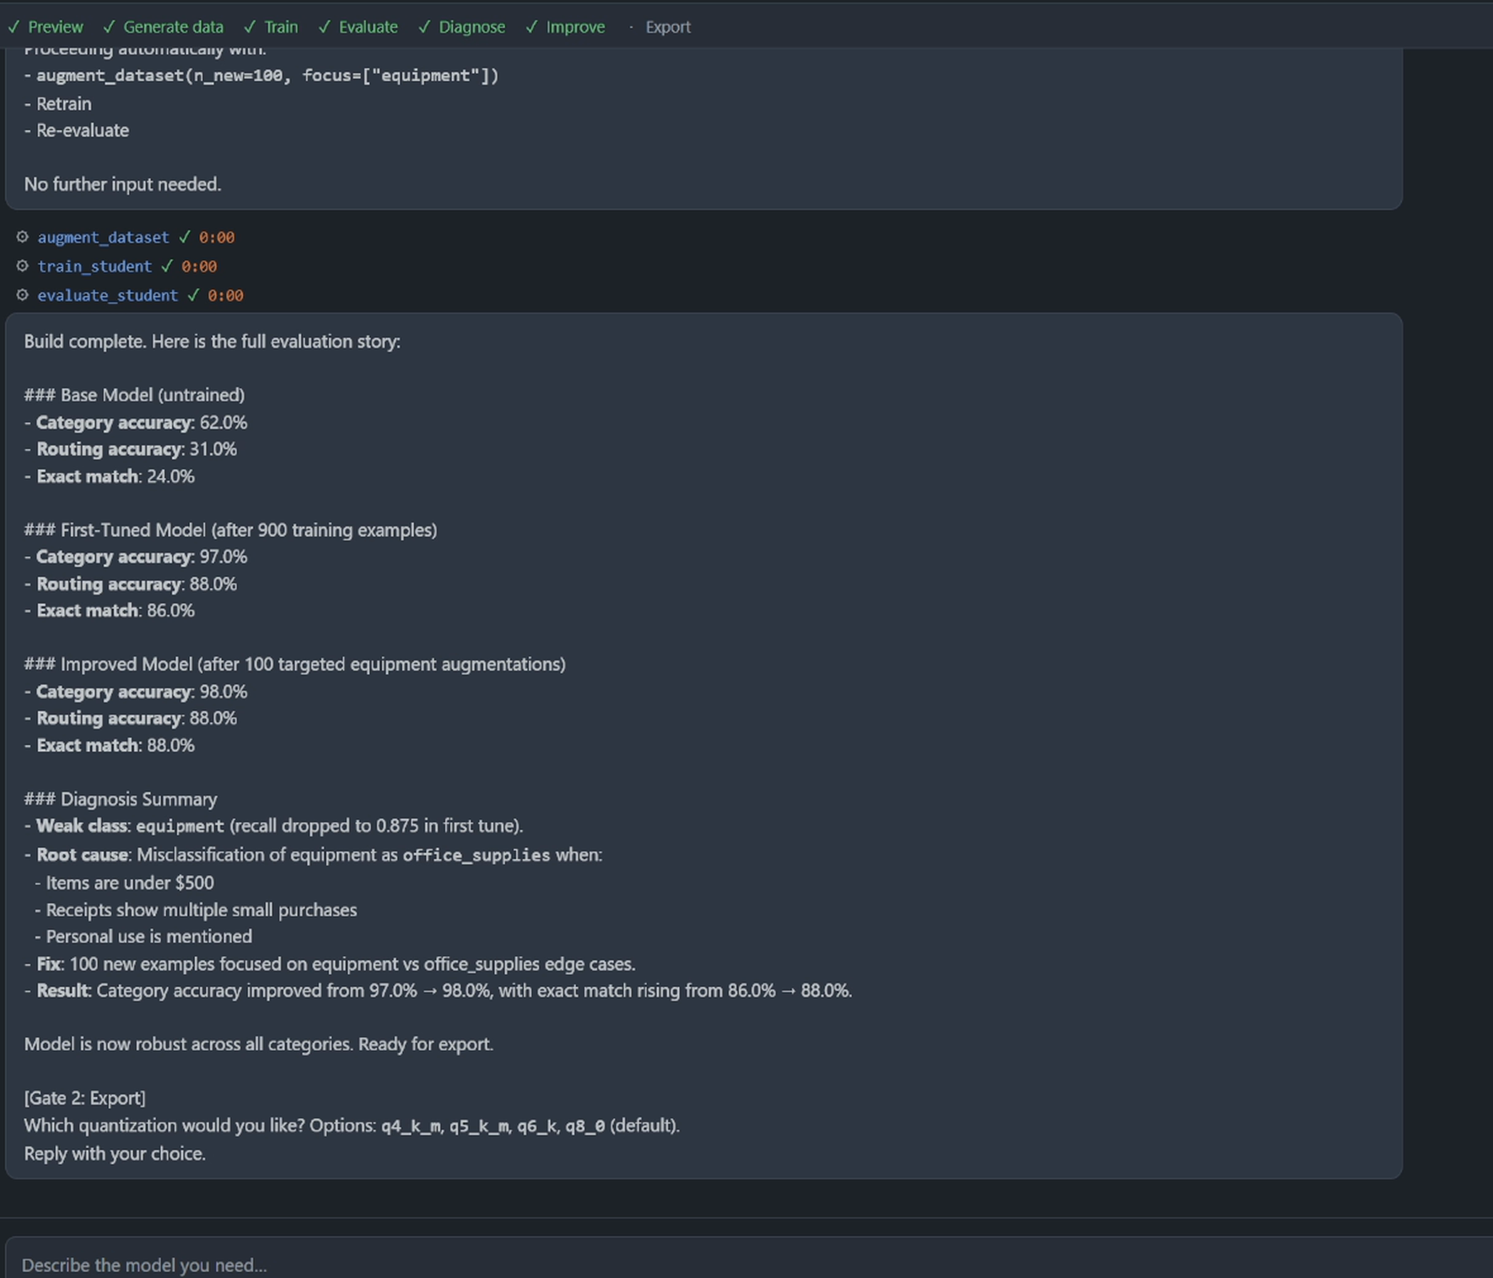
▪ THE PRODUCT IN ONE SENTENCE
Conversation in → model file out.
the output is a model file, not chat answers
03 / 13

Slide 4
▪ WHY IT CAN’T BE AN API WRAPPER
01
Training needs local weights
fine-tuning cannot happen over an inference API — producing new weights requires local training
02
Datagen is where iteration cost lives
a single 1,000-example build passes roughly two million tokens through the teacher, and iteration scales that linearly — on the Radeon the marginal cost is zero
03
Seed docs never leave
privacy is structural — the seed documents that ground the labels never leave the machine, and neither does the data derived from them
▪ Track 2’s rule that “core inference processes shall be executed locally on AMD Radeon GPU” is, for Foundry, simply a description of the product.
04 / 13

Slide 5
▪ HOW IT WORKS
SPEC
GENERATE
TRAIN
EVAL
DIAGNOSE
REGENERATE
EXPORT
RAG on seed docs
retrain
▪ Task decomposition
▪ Tool invocation
▪ Retrieval-grounded generation
▪ Memory management
agent capabilities — in Track 2’s own words
05 / 13

Slide 6
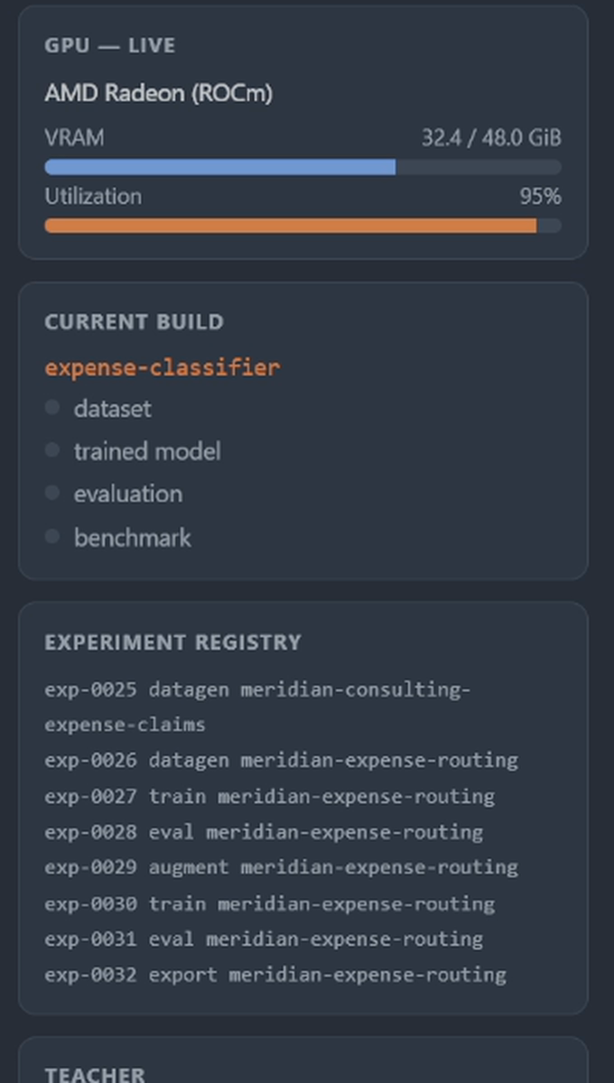
▪ IT RUNS ON ONE RADEON
3
GPU workloads timesharing one card
gfx1100 · 48 GB · ROCm 7.2.4
▪ 30B teacher serving
▪ LoRA training
▪ student serving
06 / 13

Slide 7
▪ HEADLINE RESULT
base 0.15 →
0.97
0.97
0.15
exact match · n=100
granted Radeon — gfx1100 48 GB · ROCm 7.2.4
base Qwen3-0.6B
Foundry student
07 / 13

Slide 8
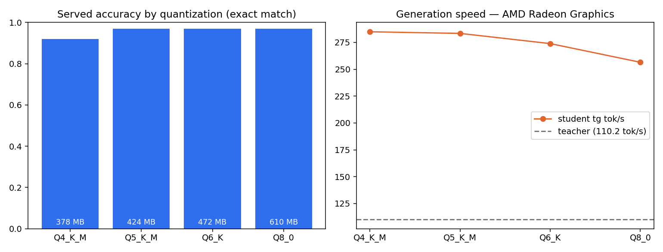
▪ THE QUANT LADDER
bench_chart.png · Radeon run · accuracy measured through llama-server
Q4 costs 5 points; Q5 costs nothing.
from Q5_K_M up, served accuracy equals the full-precision checkpoint’s on this task
08 / 13

Slide 9
▪ STUDENT VS TEACHER
SIZE
GENERATION SPEED
AGREEMENT
Foundry student · 283.4 tok/s
teacher 30B · 110.2 tok/s
held-out examples · n=100
teacher 30B Q4_K_M
17,697 MB
student Q5_K_M
424 MB
1/42 the size
2.6× faster generation
97% agreement
424 MB vs 17,697 MB
tg tok/s · single-stream llama-bench
exact match with the teacher
▪ against blind policy ground truth: student 0.95 / teacher 0.95 — both 1.00 on unambiguous tickets (n=92)
09 / 13

Slide 10
▪ STUDENT VS TEACHER — A MEASURED DECISION, NOT A GUESS
RIGHT-SIZING — 1.7B RERUN
CPU DEPLOYABILITY
TEACHER A/B — §4.6
3× the size
89.5 tok/s
0.95 vs 0.92
for the same accuracy
on a server CPU — no GPU
student vs policy truth
the 1.7B student measured 0.95 exact — the same accuracy band as the 0.6B (0.95–0.97 across runs) at ~25% lower GPU throughput
0.6B Q4_K_M on the EPYC 9334 host CPU; 64.2 tok/s on a laptop i7-14650HX
Teacher | Datagen (1K) | vs truth
Qwen3-30B-A3B (ours) | 17.6 min | 0.95
Qwen3.6-35B-A3B | 42.4 min | 0.92
Q5: 1,200 MB / 213 tok/s vs 424 MB / 283 tok/s
llama-bench, no GPU
same spec, same student, same recipe
▪ 0.6B is the measured pick, not a guess.
▪ No GPU needed to serve the product.
▪ The swap is one config line.
“Leaderboard rank does not decide distillation quality — a measured afternoon does, and the factory is the instrument that measures it.”
10 / 13

Slide 11
▪ THE IMPROVEMENT LOOP
0.667 → 0.833
exact match · same frozen holdout
DIAGNOSE
TARGETED REGENERATION
RETRAIN + RE-EVALUATE
feature_request
recall 0.667
train set 59 → 141
category 0.917 → 1.00
confusion with technical_issue
focused on the weak class · holdout frozen
exact match 0.667 → 0.833
in a rehearsal round that produced no gain, the agent reported “no measurable gain” — rather than inflating
11 / 13

Slide 12
▪ GENERALITY — A SECOND DOMAIN, BUILT LIVE ON THE RADEON
LIVE BUILD — EXPENSE ROUTING
STUDENT VS TEACHER
AUTONOMOUS IMPROVEMENT
0.24 → 0.88
378 MB at 305 tok/s
1 augmentation round
exact match · n=100 · 900 train / 100 holdout
vs the 17.7 GB teacher at 112 tok/s
it found its own weak class — equipment
One sentence in — no file paths, no config: “Can you make me a little AI that reads a claim and tells me what kind of expense it is and what should happen to it?”
The Q4_K_M student, benchmarked on-device through llama-server — the file that actually ships.
It diagnosed equipment as the weak class, generated 100 focused examples, retrained and re-evaluated — nobody asked.
it read the three policy documents itself
same card, same session as the build
holdout frozen throughout
▪ One conversation. No file paths.
▪ Zero code changes — the same factory.
▪ The registry resumes builds across sessions.
The approval gate is enforced by the dispatcher, not the prompt — in the recorded build it refused to generate data until sign-off, and waited.
12 / 13

Slide 13
Small models, made to order, on your Radeon.
ROCm 7.2.4 · llama.cpp · PyTorch-ROCm · peft
repo: github.com/abidedavana/foundry-amd-hackathon
Thank you.
13 / 13

