Slide 1
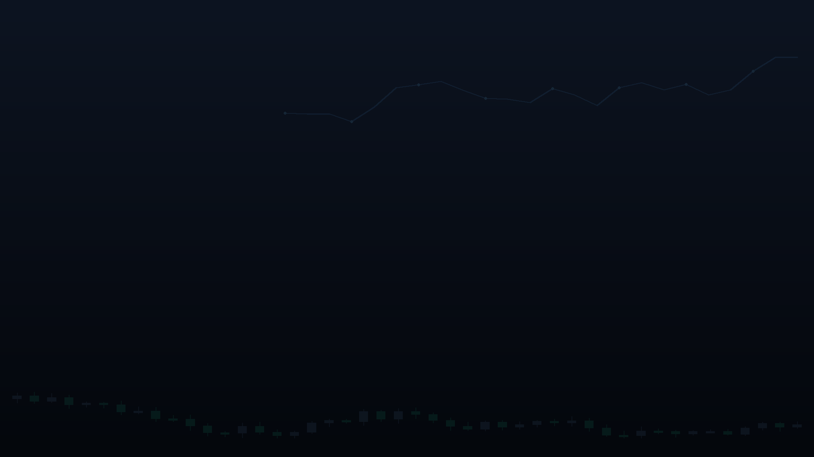




Aegis Analytics AI
An intelligent stock market assistant
Real-time insight. Less noise. Smarter trades.
⚡
◎
▶
Real-time market data
AI-driven news sentiment
Audio-visual smart alerts
Team Infinitix
Team lead: Udit Rajput
Democratizing financial intelligence

Slide 2

Introduction
Why this problem, why now
◈
⚡
◎
Highly dynamic markets
AI-powered speed
Our goal
NSE handles ~93% of cash trades & ~99% of derivatives turnover in India.
Turn machine-speed data into forecasts traders can act on instantly.
Algo trading now drives 50%+ of NSE cash turnover, up from 17% in FY11.
Source: NSE Market Pulse, FY26
Aegis Analytics AI · Team Infinitix
02

Slide 3

Problem
The gaps retail investors face
1
Information paradox
2
Latency gap
13.6 crore Indian investors often trade on delayed data vs. institutions' millisecond feeds.
50%+ of NSE volume is now algo-driven in milliseconds retail reacts to stale prices.
3
Data silos
4
No risk quantification
Price feeds miss breaking news, leaving investors blindsided by sudden swings.
91% of F&O traders lost money in FY24-25 avg loss ₹1.1 lakh (SEBI).
MarketPulse AI turns noise into real-time, actionable intelligence.
Aegis Analytics AI · Team Infinitix
03

Slide 4

Proposed solution
A real-time AI co-pilot for traders
◈
Live prediction
◎
Sentiment analysis
LSTM/Transformer models hit up to 94% directional accuracy in backtests.
News & social sentiment fused with price data flags moves early.
✦
Personalized strategy
☁
Cloud-based
Real-time sync keeps every device updated in under a second.
Tailored to each trader's risk profile — not one-size-fits-all signals.
Aegis Analytics AI · Team Infinitix
04

Slide 5


Technology stack
Built on proven, scalable tools
Data & streaming
AI & ML
Backend & sync
Experience
WebSockets
LSTM
Firebase
Assistant Hub
Redis
Transformer
Python
React
ScyllaDB
Fast API
Pandas
Push alerts
Aegis Analytics AI · Team Infinitix
05

Slide 6

System architecture
From live data to actionable forecasts
01
02
03
04
Data ingestion layer
Stream processing layer
Storage layer
AI inference engine
Real-time cleaning adds only single-digit ms overhead.
→
→
→
WebSockets stream NSE/BSE prices in sub-millisecond time.
Redis/ScyllaDB: ms-level latency at 1M+ requests.
Feeds AI models for live, actionable forecasts.
Aegis Analytics AI · Team Infinitix
06

Slide 7
Under the Hood: Full-Stack Implementation
Modules, services, and data stores that power the platform
ML PIPELINE · ml/train.py
DATA LAYER
ml/train.py
feature_builder
LightGBM
reg + clf
Isotonic
calibration
Conformal
intervals
Yahoo Finance (yfinance)
▸
▸
▸
▸
▸
▸
▸
▸
▸
▸
data/app.db · SQLite
STREAMLIT DASHBOARD · :8501
FASTAPI BACKEND · :8000
▸
dashboard/theme.py
api/routes.py
models/*.joblib
▸
▸
▸
assistant overlay
+ assistant.py
risk_engine.py
predictor.py
▸
data/dashboard_users.db · SQLite
▸
dashboard/app.py
dashboard/
user_store.py
▸
▸

Slide 8



A price prediction system
Roadmap to implementation
Phase 1
Phase 2
Phase 3
Phase 4
Data pipeline
Model training
Real-time inference
Alerts & rollout
Connect live + historical feeds (4–6 wks).
Train & validate models on price + sentiment data (6–8 wks).
Deploy sub-second inference engine (3–4 wks).
Ship alerts & onboard early users (2–3 wks).
Aegis Analytics AI · Team Infinitix
07

Slide 9

Conclusion
The future of intelligent trading
24/7 AI co-pilot always on, unlike human traders.
Adapts instantly to shifting price & sentiment data.
✓
✓
Milliseconds, not minutes, for faster decisions.
Tackles India's 91% F&O retail loss problem head-on.
✓
✓
Up to 94% directional accuracy from real-time AI.
Cuts the data lag holding back 13.6 crore investors.
✓
✓
Aegis Analytics AI · Team Infinitix
08

Slide 10
Thank you
Aegis Analytics AI · An intelligent stock market assistant
Team Infinitix
Team lead: Udit Rajput
Democratizing financial intelligence

