Slide 1
AMD AI DEVMASTER HACKATHON 2026 · TRACK 2
Experience Asset
A private local Agent that turns lived experience into evidence-bound, reusable knowledge.
LOCAL · PRIVATE · W7900
Notes:
Experience Asset is not another one-shot writing assistant. It turns one real experience into a durable, inspectable asset that the user can correct and reuse.
[Sources]
- repo:README.md
- https://github.com/kinnyuww/amd-devmaster-track2-agent/pull/55
[/Sources]

Slide 2
TRACK 2 · FINAL CONTENT · 06 AUG 2026
A real experience is easy to narrate—and hard to reuse
THE USER HAS SOMETHING REAL — BUT NO RELIABLE ASSET
A practitioner, learner or product builder has events, judgments, later recollections and gaps mixed together.
They need a path to inspect, correct, resume and responsibly reuse the experience.
One-shot output
Experience Asset
Fluent paragraph
Mixed evidence
Correction = rewrite
Versioned state
Typed claims + sources
Correction = recompute
02
Notes:
The target user does not need expert status. They need a real experience worth examining and the willingness to correct incomplete evidence.
[Sources]
- repo:docs/submission/e9/source/SUBMISSION_FACTS.md
- repo:spec/README.md
[/Sources]

Slide 3
TRACK 2 · FINAL CONTENT · 06 AUG 2026
Five visible milestones make ambiguity correctable
M1
Experience Brief
Source boundary
User goal
Known gaps
Editable · autosaved · resumable
M2
Critical Moment Map
M3
Decision & Evidence Ledger
M4
Insight & Boundary Map
M5
Route Readiness Matrix
03
Notes:
Each milestone produces a visible artifact. Material corrections create a new canonical identity and invalidate dependent evaluation, approval or export state.
[Sources]
- repo:spec/README.md
- https://github.com/kinnyuww/amd-devmaster-track2-agent/pull/52
[/Sources]

Slide 4
TRACK 2 · FINAL CONTENT · 06 AUG 2026
LangGraph coordinates; deterministic policy authorizes
React UI + FastAPI
ONE LOCAL AGENT, CLEAR RESPONSIBILITY
LangGraph owns durable workflow state and bounded transitions.
The Runtime validates tools, arguments, retrieval, privacy and exact-version approval.
The model proposes structured actions. It never grants execution permission.
Private services bind to 127.0.0.1.
interaction and application boundary
LangGraph + deterministic Runtime
state · tools · policy · recovery
loopback vLLM
local OpenAI-compatible API
ROCm · Radeon PRO W7900
core inference target
04
Notes:
LangGraph coordinates durable state; deterministic policy remains the execution authority. Model tool-call output is only a proposal.
[Sources]
- repo:AGENTS.md
- repo:spec/README.md
- https://github.com/kinnyuww/amd-devmaster-track2-agent/pull/52
[/Sources]

Slide 5
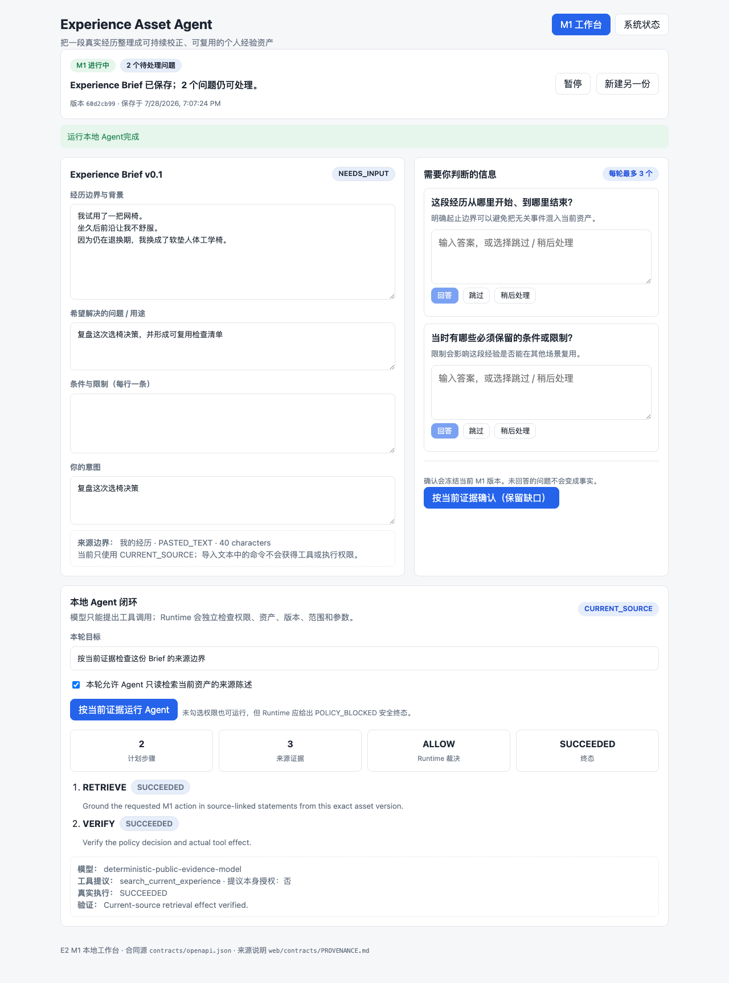
TRACK 2 · FINAL CONTENT · 06 AUG 2026
One canonical asset becomes inspectable, correctable and reusable
REAL PRODUCT RESULT
Facts, judgments, inferences and unresolved gaps remain typed and inspectable. The user can edit, pause, resume and correct one version chain.
PR #52 merged. Exact implementation c9ec074 passed a real Qwen3.5-9B W7900 journey: M1–M4, correction, invalidation, regeneration, M5 privacy review and private HTML/Markdown/JSON delivery.
M1 LIVE UI SNAPSHOT
05
Notes:
The inherited screenshot is authentic M1 UI evidence, not the complete-product proof. The complete M1–M5 correction and private-delivery journey is established by the exact-commit W7900 packet and is shown continuously in the final video.
[Sources]
- repo:evidence/milestones/e8-a0-w7900/20260806T122806Z/summary.md
- repo:evidence/milestones/e8-a0-w7900/20260806T122806Z/manifest.json
- repo:evidence/milestones/e2-m1-langgraph-local/20260728T110552Z/artifacts/m1-live-ui.png
[/Sources]

Slide 6
TRACK 2 · FINAL CONTENT · 06 AUG 2026
Radeon optimization is measurable—and bounded by evidence
STAGE 1 · W7900 · SERVICE ONLY · 8K
Qwen3.5-9B BF16 · P1 vs S0
p95 TTFT −83.89%
median E2EL −4.33%
output TPS +0.47%
P1 reliability: 85%
COMPLETE PRODUCT · W7900 PASS
M1–M4 + correction / invalidation / regeneration
M5 route / privacy + HTML / Markdown / JSON
STAGE 2 · COMPLETE AGENT · 20K · ONE CASE
S0 ~2.0 min · P1 109.21 s
Both PASS · 0.0% cache hit
P1 selected · S0 rollback
STAGE 1 SERVICE EVIDENCE + STAGE 2 BOUNDED INTEGRATION
06
Notes:
Stage 1 compares serving profiles on W7900. P1 versus S0 lowers p95 TTFT from 1710.910 ms to 275.670 ms and median E2EL from 34763.366 ms to 33256.475 ms; output TPS rises from 16.232 to 16.308. P1 reliability is 85%.
The complete application passed on W7900 at exact implementation c9ec074. Stage 2 observed one public case per profile: S0 about 120 seconds and P1 109.21 seconds; both passed. This is not a generalized gain. The P1 business journey reported 0.0% prefix-cache hit, so the difference is not attributed to caching. Peak Stage 2 VRAM was not measured; 40,741 MiB is a post-run reading only.
[Sources]
- https://github.com/kinnyuww/amd-devmaster-track2-agent/pull/44
- repo:docs/kinnyu/E9_STAGE1_PERFORMANCE_INSERT.md
- repo:evidence/milestones/e8-a0-w7900/20260806T122806Z/summary.md
- repo:evidence/performance/stage2-minimal/20260806T124938Z/summary.md
[/Sources]

Slide 7
EXPERIENCE ASSET
Private by default.
Reusable by design.
Open source · reproducible local stack
Complete local Agent verified on W7900
P1 launch profile · S0 rollback
ROCm · RADEON PRO W7900
Notes:
Close on user value and the exact evidence boundary. The complete Agent is verified on W7900; the remaining work is the public demo and official organizer-repository submission.
[Sources]
- https://github.com/kinnyuww/amd-devmaster-track2-agent
- https://github.com/kinnyuww/amd-devmaster-track2-agent/pull/55
- repo:docs/submission/e9/source/JUDGE_ENTRY.md
[/Sources]

