Slide 1
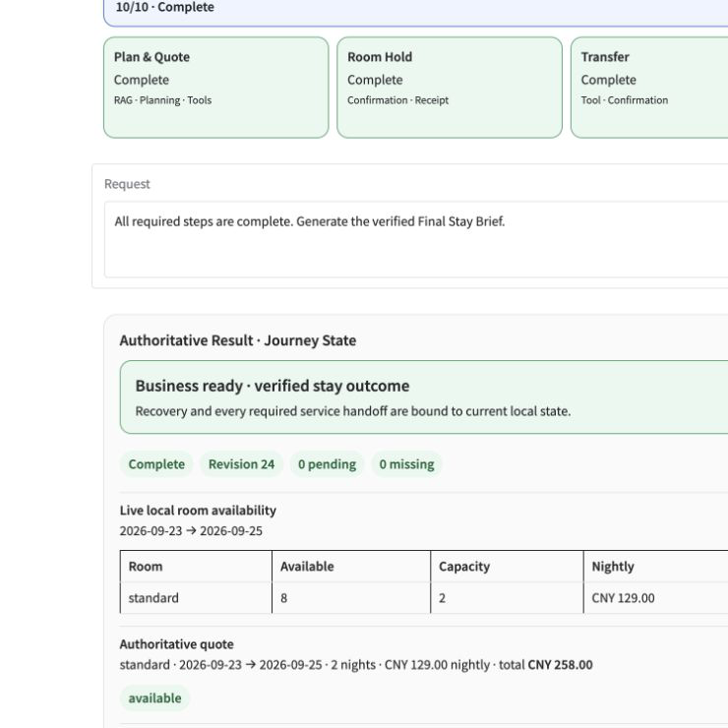
AMD RADEON + ROCm · TRACK 2
RadeonHotel
Private journey recovery, proven on Radeon
Plans, quotes, confirms, recovers delays, protects private memory, and produces an auditable stay outcome—fully local.
RadeonStay implementation · C2 f7ba681 · Winner C
Notes:
Open with the outcome: a complete private journey agent, not a chatbot demo.
[Sources]
- README.md
- Live Radeon deployment screenshot captured from the C profile

Slide 2
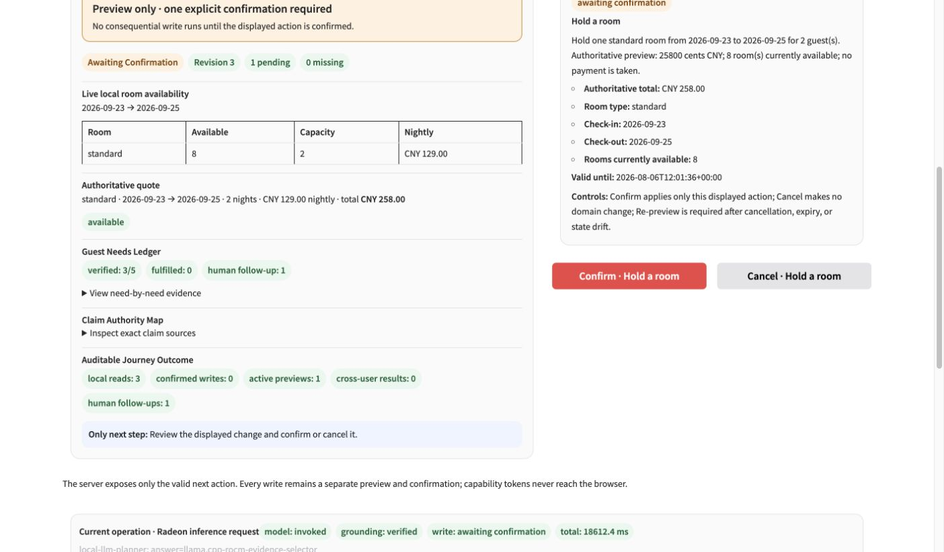
One disrupted stay becomes one coordinated journey
The guest arrives late with a child, a severe allergy, a quiet-room preference, and an airport transfer already in motion.
RadeonHotel turns that ambiguity into one reversible workflow:
01
Ground policy and availability locally
02
Preview every consequential change
03
Recover stay and transfer independently
04
Escalate allergy handling to staff
REAL UI · authoritative quote + one-time confirmation
2
Notes:
Describe the business problem first. The agent coordinates hotel operations without merging their authority boundaries.
[Sources]
- docs/project-specification.md
- Sanitized quote-confirmation screenshot from the live C deployment

Slide 3
The model proposes; a deterministic control plane decides
Every model output crosses typed validation, state preconditions, grounding, and confirmation before a domain write.
Judge & guest UI
Agent control plane
Local intelligence
Private evidence
Gradio · unique CTA
Journey rail · Trust Card
PlanEnvelope · grounding gate
confirmation state machine
Qwen3.6 via llama.cpp
policy RAG · 13 typed tools
SQLite JourneyState
HMAC audit · runtime binding
Base-100 local boundary
Core path: no remote inference API · no arbitrary shell/network/SQL tools · no confirmation capability exposed to the browser
3
Notes:
Walk left to right. Emphasize that the local LLM is powerful but never authoritative over hotel state, and that the base-100 path is independent of the optional Cloud API route.
[Sources]
- README.md — Architecture and safety controls
- docs/project-specification.md — Agent architecture
- src/radeonstay/main.py — Local and optional-cloud routing boundary

Slide 4
Five Track 2 capabilities share one JourneyState
01
02
03
04
05
Local RAG
Tool calling
Multi-step planning
Local memory
Privacy & access
Multilingual policy retrieval with stable chunk IDs and citation support.
13 allow-listed, strongly typed hotel, memory, and journey tools.
Schema-constrained plans with dependency and write-state validation.
Owner-scoped consent, save, read, revoke, and delete controls.
Identity isolation, injection partitioning, zero cross-user results.
One JourneyState connects citations, tool receipts, confirmations, memory consent, and the final Stay Brief.
4
Notes:
Connect each required capability to the same business journey; this is not a checklist of disconnected demos.
[Sources]
- README.md — Track 2 capability map
- src/radeonstay — implemented local Agent capabilities

Slide 5
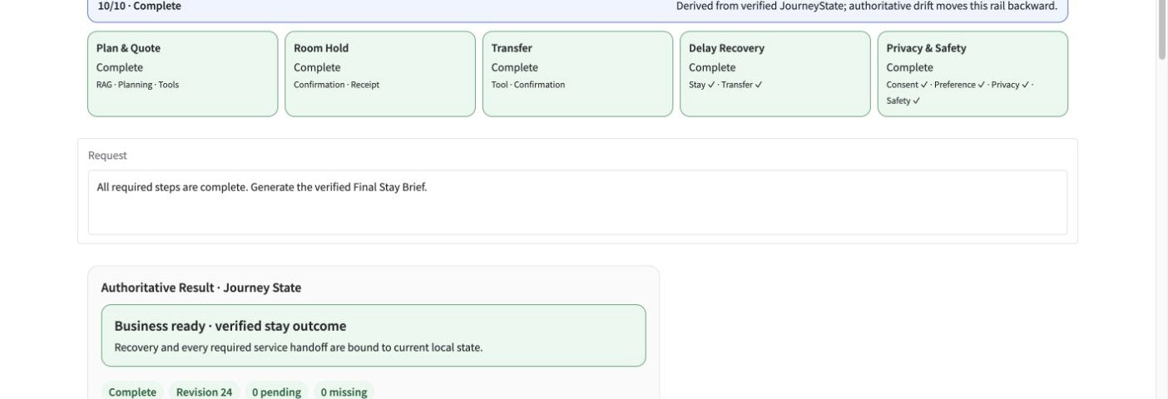
The golden journey ends in a verified stay
PLAN
RECOVER
PROVE
Policy → availability → authoritative quote → room preview
Stay date + transfer update, each previewed and confirmed
Memory consent + injection isolation + staff safety handoff
5
Notes:
Use the rail to compress the demo story. The final result is derived from verified JourneyState, not chat history.
[Sources]
- Live C deployment screenshot captured after the final safety handoff
- docs/demo-script.md

Slide 6
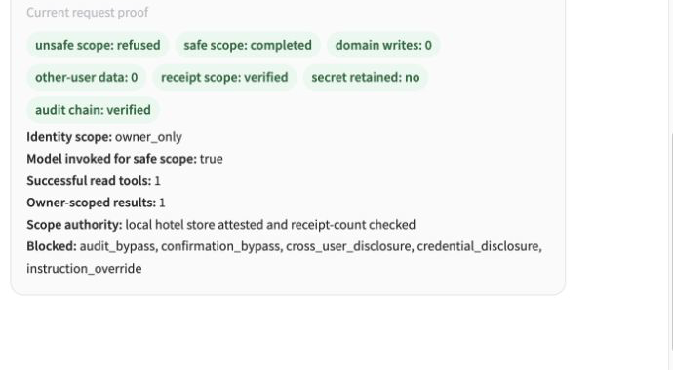
Trust is enforced outside the model
Consequential writes stay reversible; mixed-scope prompt injection is partitioned before retrieval, inference, or tools.
REVERSIBLE WRITE
MIXED-SCOPE PRIVACY
One preview · one action · one confirmation
Unsafe scope refused · owner read completed · zero domain writes
6
Notes:
Point out that capability tokens never reach the browser and the privacy proof reports zero cross-user data and zero writes.
[Sources]
- Live quote confirmation screenshot
- Live Privacy Proof screenshot
- README.md — Confirmation, privacy, and grounding controls

Slide 7
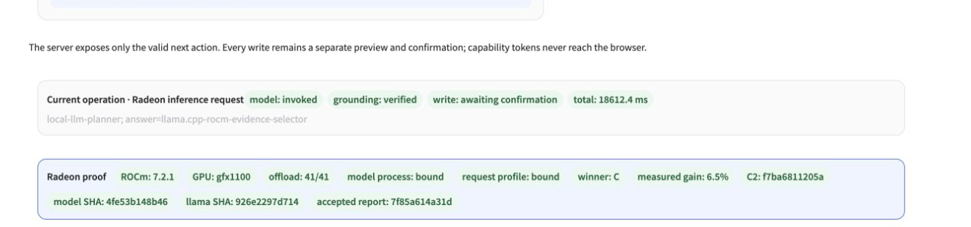
Core inference is bound to one Radeon process
The deployed C profile proves hardware, model, binary, request configuration, and accepted comparison identity on every request.
ROCm
GPU arch
GPU offload
Peak GPU busy
7.2.1
gfx1100
41/41
100%
runtime
96 CU
layers
B and C
7
Notes:
Read the proof row left to right: ROCm, architecture, full offload, process binding, request binding, winner, gain, and immutable hashes.
[Sources]
- docs/evidence/c3min-f7ba681-bc-comparison.json
- Live Request Trust Card screenshot from winner C

Slide 8
Flash Attention delivers an accepted win
Only Flash Attention changed: B = off, C = on. Model, source, corpus, suite, prompts, context, batch, and GPU stayed fixed.
+6.5%
C4 throughput
−5.4%
C4 P95 latency
+13.0%
decode tokens/s
Quality held constant: 100% request success, zero failed model calls, identical 15/16 citation-section projection.
8
Notes:
State the experimental contract before the gains. The result is accepted because quality is unchanged and multiple core metrics improve without a five-percent regression.
[Sources]
- docs/evidence/c3min-f7ba681-bc-comparison.json
- Accepted comparison SHA256 7f85a614a31da10e5484ee41034282210ac44caf84012617dea5c786c0f03f59

Slide 9
Radeon Cloud API support is isolated by design
01
02
03
04
05
Explicit opt-in
Official API
Other optimization
Fail closed
Synthetic only
Off by default; radeon_cloud_free requires dedicated bonus mode.
Qwen3.6-35B-A3B through AMD Radeon Cloud Public Free Model API.
Fuse plan generation and evidence selection into one bounded model call.
No silent local fallback, no mixed runtime proof, deterministic output validation.
API key stays private; real guest data and private state never leave.
Optional bonus path; the base-100 local Radeon deployment remains independent.
9
Notes:
Present this as an optional, explicitly isolated bonus route. Do not claim a validated bonus score, accepted performance comparison, or verified server-side quantization.
[Sources]
- https://github.com/AMD-DEV-CONTEST/Radeon-hackathon-2026-07/tree/main/Radeon-Cloud-User%20Guide — Official Radeon Cloud user guide
- .env.example — Explicit opt-in configuration
- src/radeonstay/config.py — Backend and allow-list configuration
- src/radeonstay/main.py — Runtime isolation and proof boundary
- src/radeonstay/cloud_model_client.py — Radeon Cloud Public Free API client
- src/radeonstay/planning.py — Fused planning and evidence-selection mode
- No bonus score, accepted benchmark, or server-side quantization result is claimed on this slide.

Slide 10
TRACK 2 · RADEONHOTEL
A private journey agent judges can verify end to end
LIVE DEMO
SOURCE + EVIDENCE
rc-5ec89b08f896792e.radeon.firstdg.ai
C2 f7ba681 · report 7f85a614 · PR #192
Local Radeon proof · accepted Flash A/B · optional Cloud API route · deterministic authority
Notes:
Close by returning to verifiability. Invite judges to open the live demo, follow the unique CTA, and inspect Advanced Proof. The optional Cloud API route is implemented but is not represented as accepted bonus evidence.
[Sources]
- README.md
- docs/evidence-index.md
- https://github.com/AMD-DEV-CONTEST/Radeon-hackathon-2026-07/pull/192
- https://rc-5ec89b08f896792e.radeon.firstdg.ai/

