Slide 1
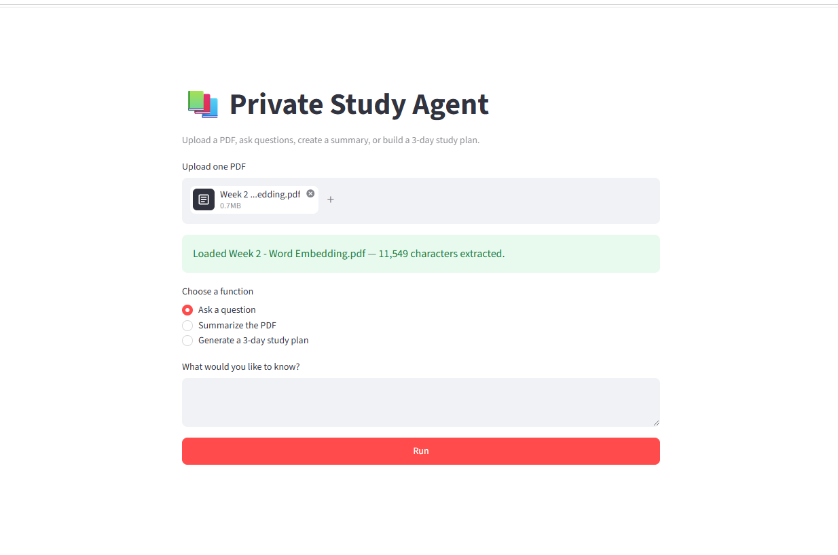
AMD HACKATHON 2026 · TRACK 2
Private Study Agent
An AI-powered PDF learning assistant on AMD Radeon Cloud
Upload one PDF.
Ask, summarize, and plan.
github.com/xmolly929/private-study-agent-amd

Slide 2
PROBLEM & MOTIVATION
Long PDFs slow down focused learning
Students need answers tied to the material—not another generic chatbot.
OUR GOAL
Lightweight,
document-grounded
study support.
01
Find
Important information is buried across long documents.
02
Review
Manual reading and note-making take significant time.
03
Trust
General answers may not be supported by the uploaded PDF.
02

Slide 3
SOLUTION OVERVIEW
One compact workflow turns PDFs into study support
PDF
PyMuPDF
Agent
AMD API
Upload
Extract text
Build task prompt
Generate result
Three focused capabilities
Grounded Q&A
PDF Summary
3-Day Plan
Answers from extracted PDF context
Overview, key ideas, takeaways
Daily topics, activities, goals
Current MVP uses direct document context processing and an OpenAI-compatible shared model API.
03

Slide 4
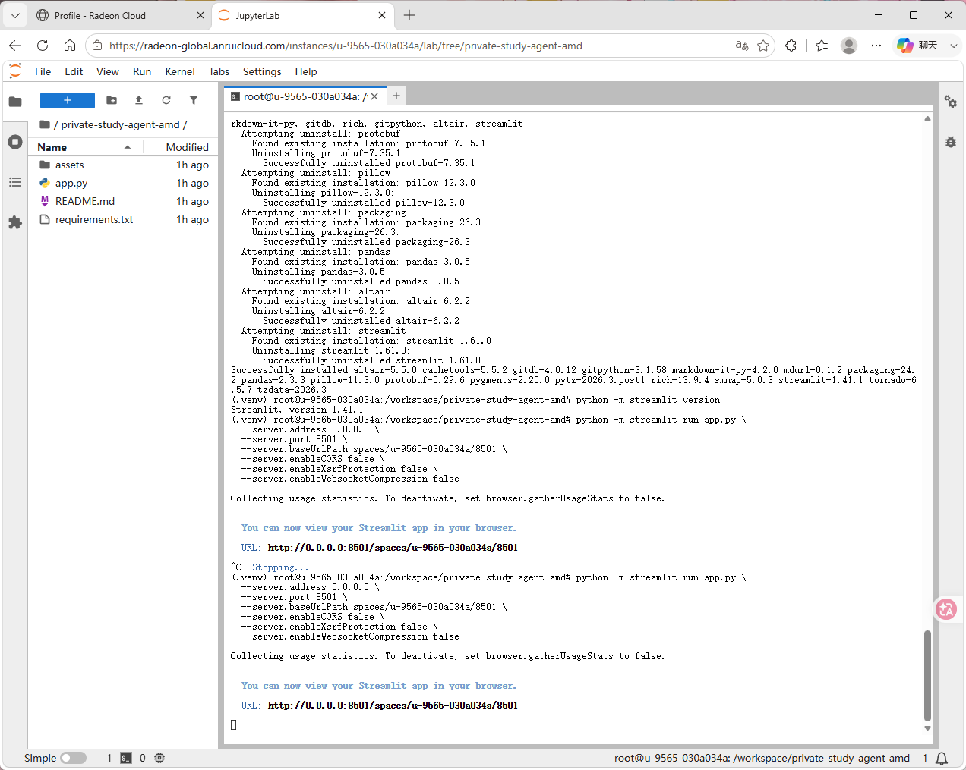
AMD RADEON CLOUD DEPLOYMENT
The application runs and was tested on Radeon Cloud
VERIFIED
Instance created
Dependencies installed
Streamlit launched
Health endpoint returned ok
Agent opened through SSH tunnel
Direct public access was limited by reverse-proxy WebSocket handling. The verified SSH tunnel enabled full browser interaction.
Model generation uses AMD Radeon Cloud's OpenAI-compatible shared API; complete local Radeon GPU inference is not claimed.
04

Slide 5
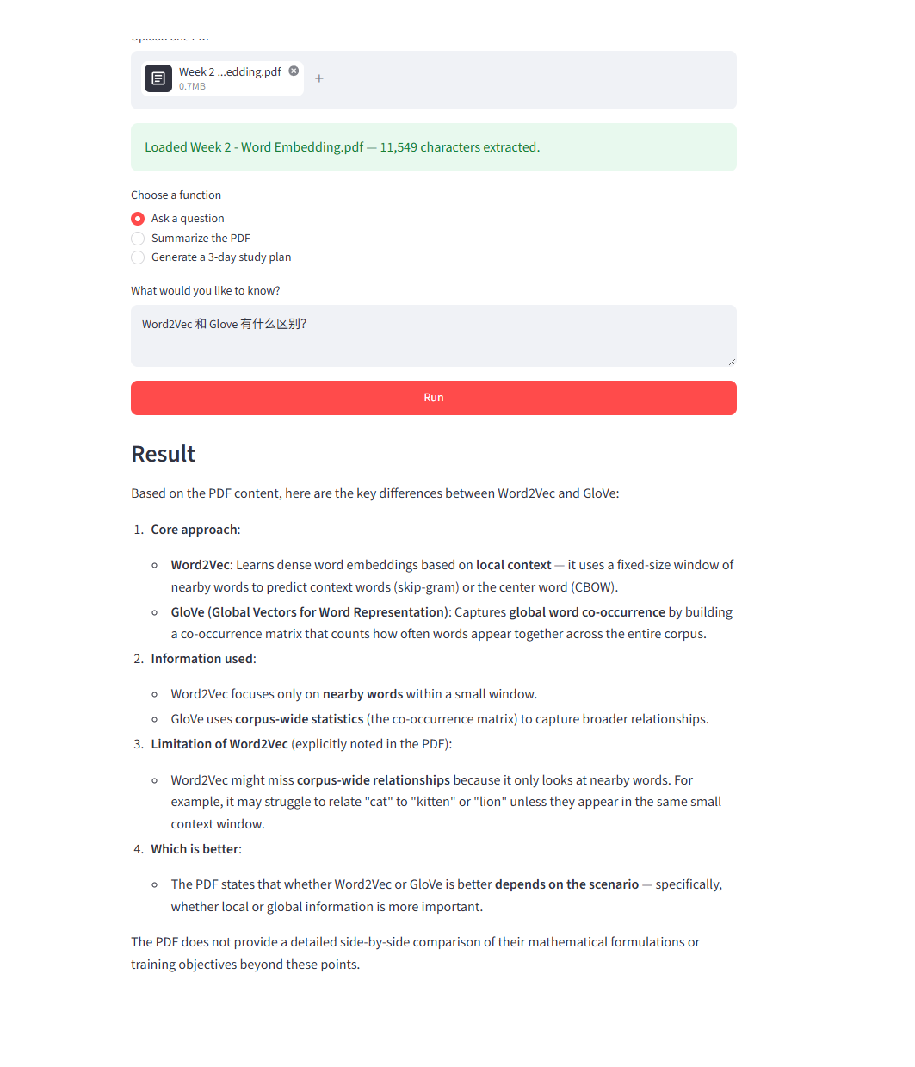
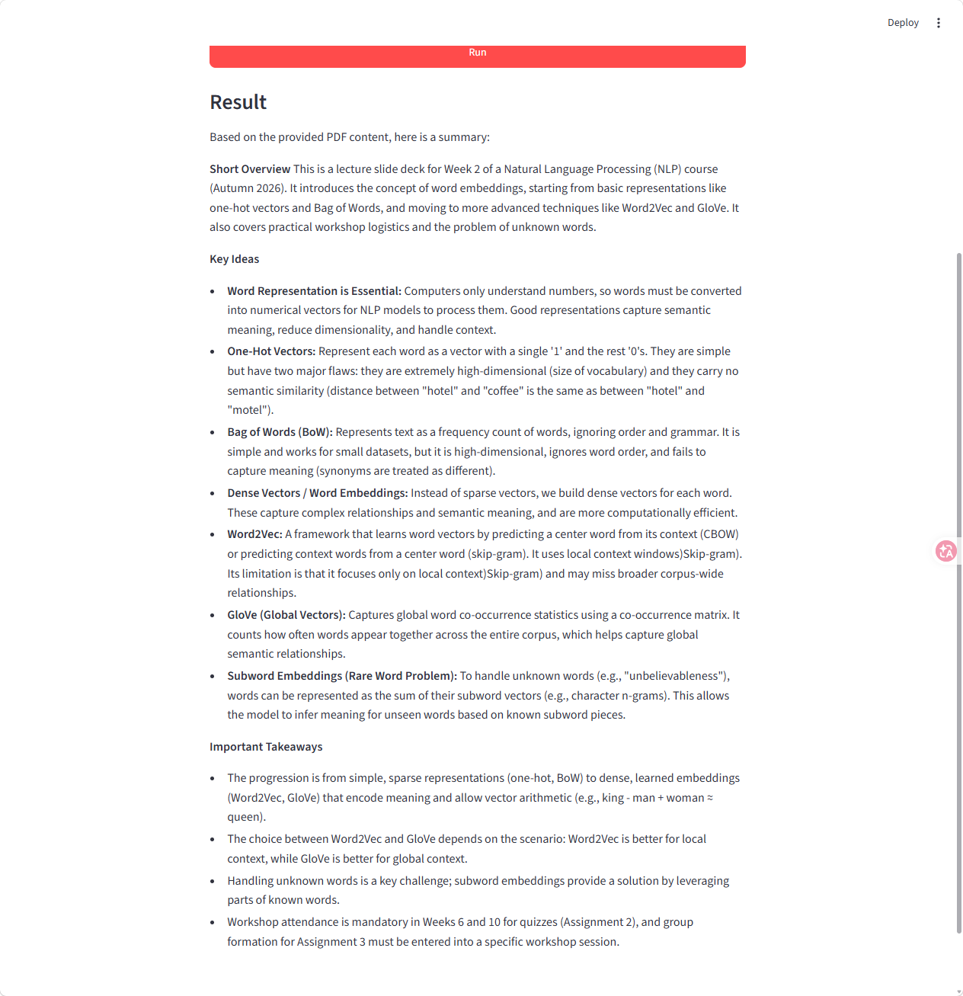
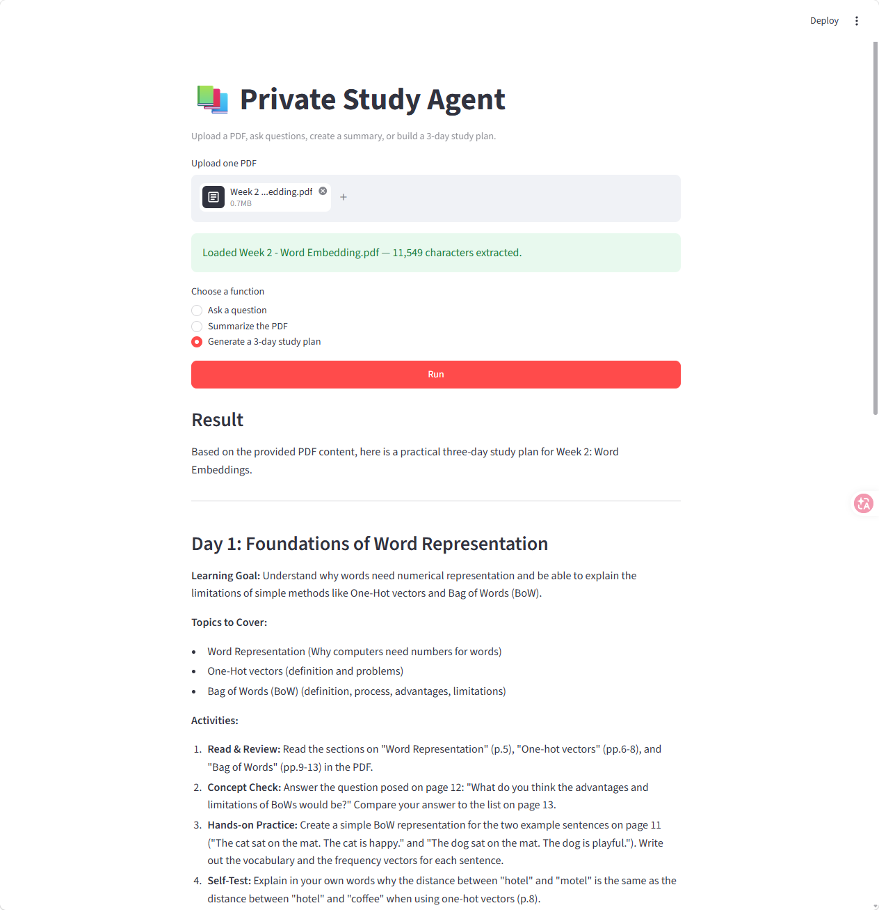
DEMO RESULTS
All three study workflows produced usable results
Grounded Q&A
PDF Summary
3-Day Study Plan
Answers stay tied to the uploaded material.
Structured overview, key ideas, and takeaways.
A practical learning sequence with daily goals.
05

Slide 6
FUTURE WORK
A focused MVP today, with a clear path to deeper privacy
The core workflow is complete: PDF processing, model-backed study assistance, and verified Radeon Cloud deployment.
01
Local serving
02
Better retrieval
Explore ROCm-compatible model deployment
Add RAG and page-level citations
03
Broader inputs
04
Cloud access
Support OCR for scanned PDFs
Reduce reliance on SSH tunneling
Private Study Agent
github.com/xmolly929/private-study-agent-amd
06

