Slide 1

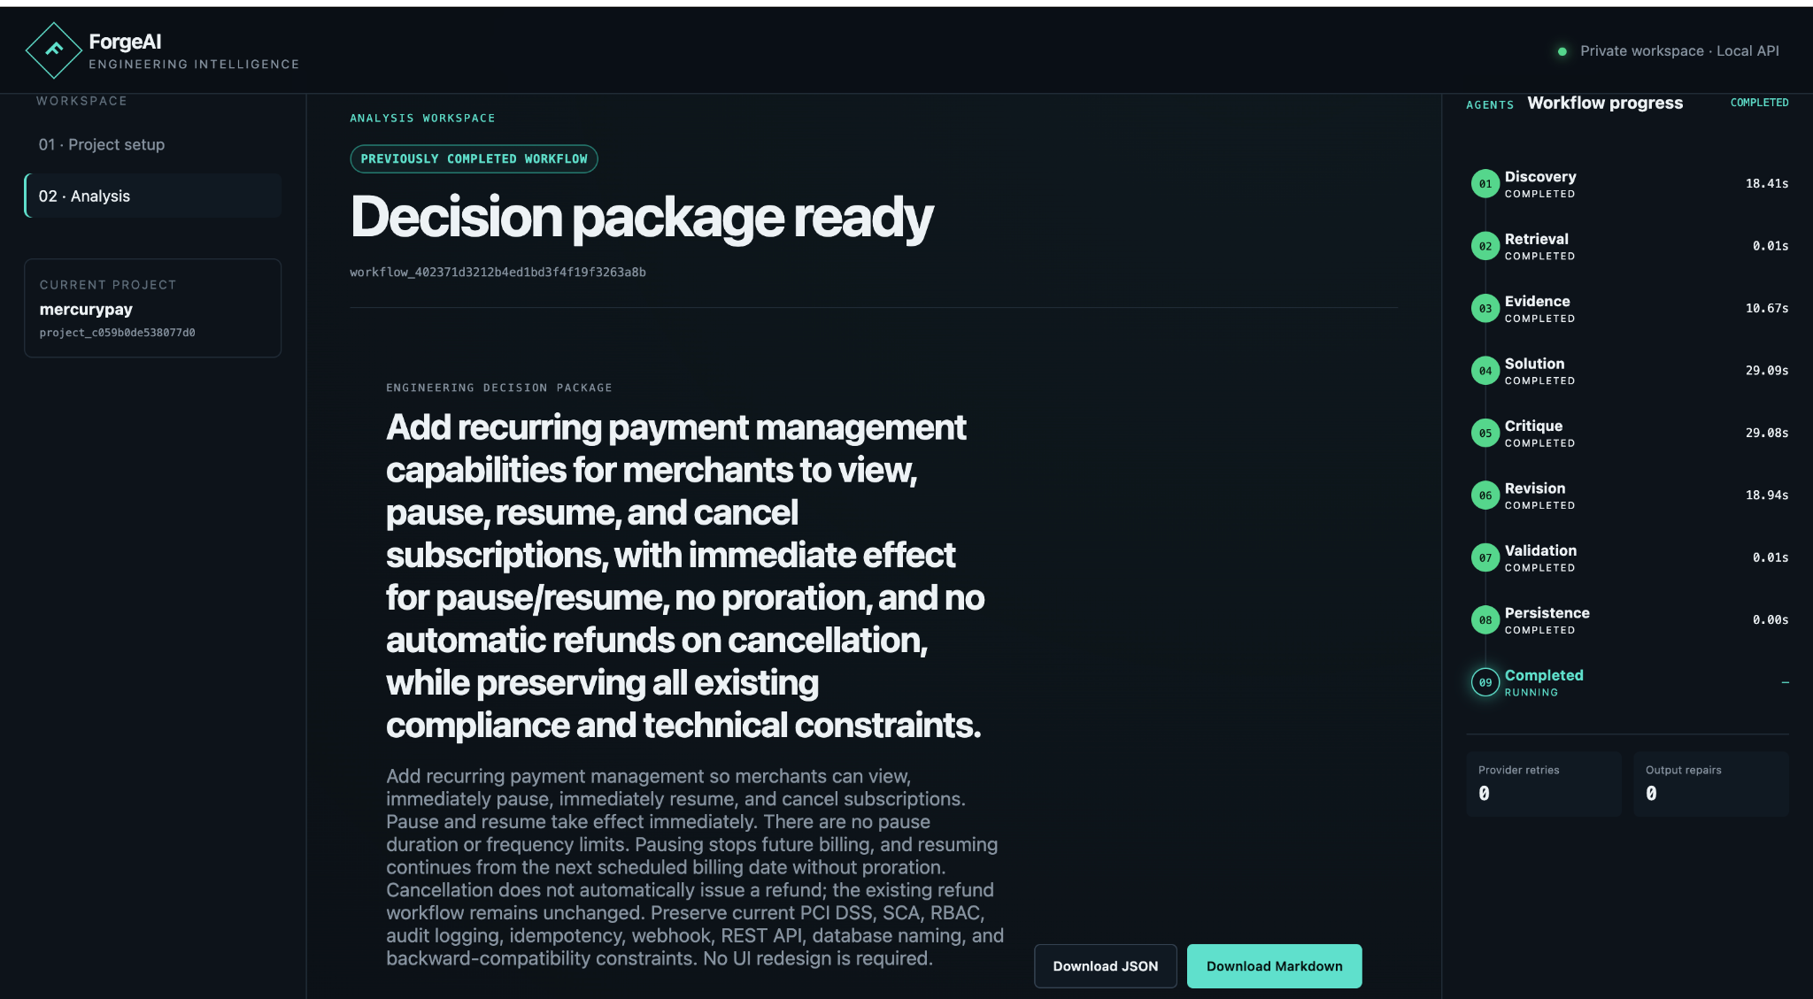
AMD AI DEVMASTER · TRACK 2
ForgeAI
Private, evidence-backed engineering decisions through deterministic multi-agent analysis.
VERIFIED AMD RADEON CLOUD INFERENCE
5
106s
0
bounded reasoning roles
verified AMD workflow
retries / repairs
ABHISHEK HERBERT SAMUEL
SOLO PARTICIPANT
AMD AI DevMaster Hackathon · Track 2
01
Notes:
[Sources]
- Local source deck: ForgeAI_AMD_Track2_Pitch_Deck_v3.pptx
- Local brand source: frontend/src/components/AppShell.tsx and frontend/src/styles/global.css
- Product screenshots: original embedded captures from the source deck
[/Sources]

Slide 2
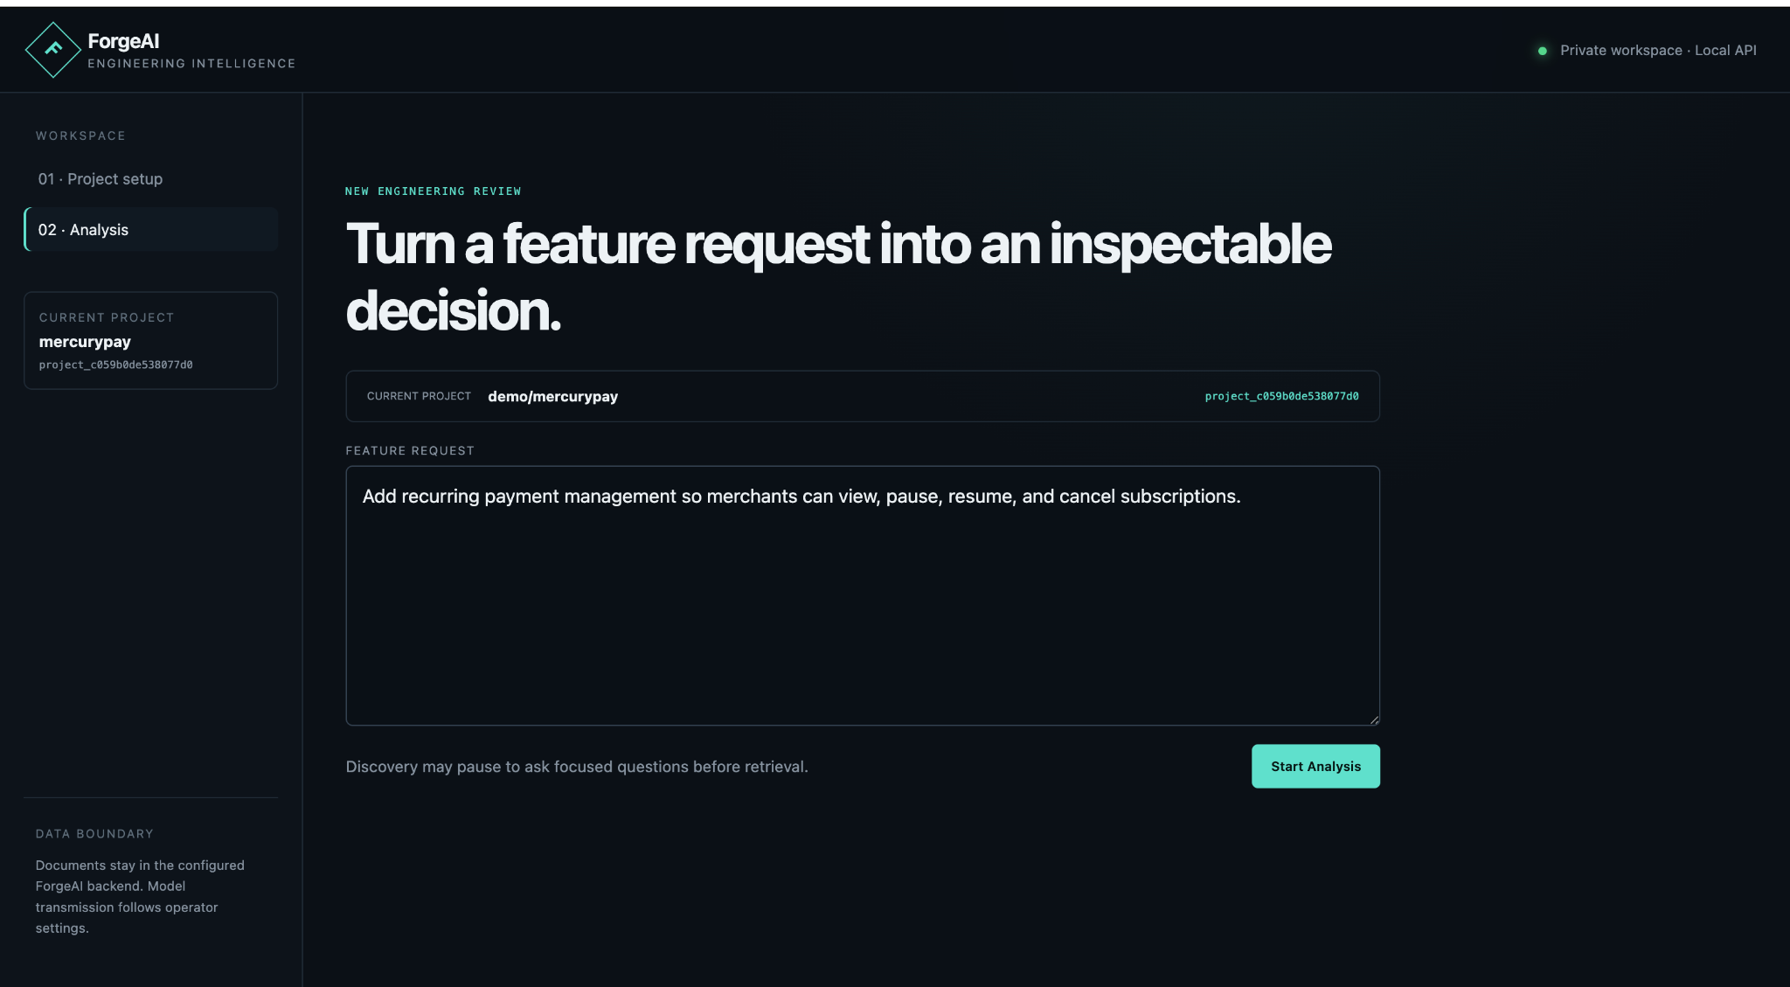
PROBLEM
Engineering review still lives between scattered facts and ambiguous asks.
Feature requests arrive incomplete. Local architecture, compliance constraints, API contracts, and past decisions are scattered. Generic chatbots often produce plausible output without provenance or durable review state.
Ambiguous request
Scattered local knowledge
Different teams implement different interpretations
ADRs, policies and schemas are overlooked
ForgeAI turns the pre-coding decision gap into a bounded, inspectable workflow.
Opaque AI output
Unchallenged proposal
Recommendations cannot be audited
Security and operational risks survive review
AMD AI DevMaster Hackathon · Track 2
02
Notes:
[Sources]
- Local source deck: ForgeAI_AMD_Track2_Pitch_Deck_v3.pptx
- Local brand source: frontend/src/components/AppShell.tsx and frontend/src/styles/global.css
- Product screenshots: original embedded captures from the source deck
[/Sources]

Slide 3
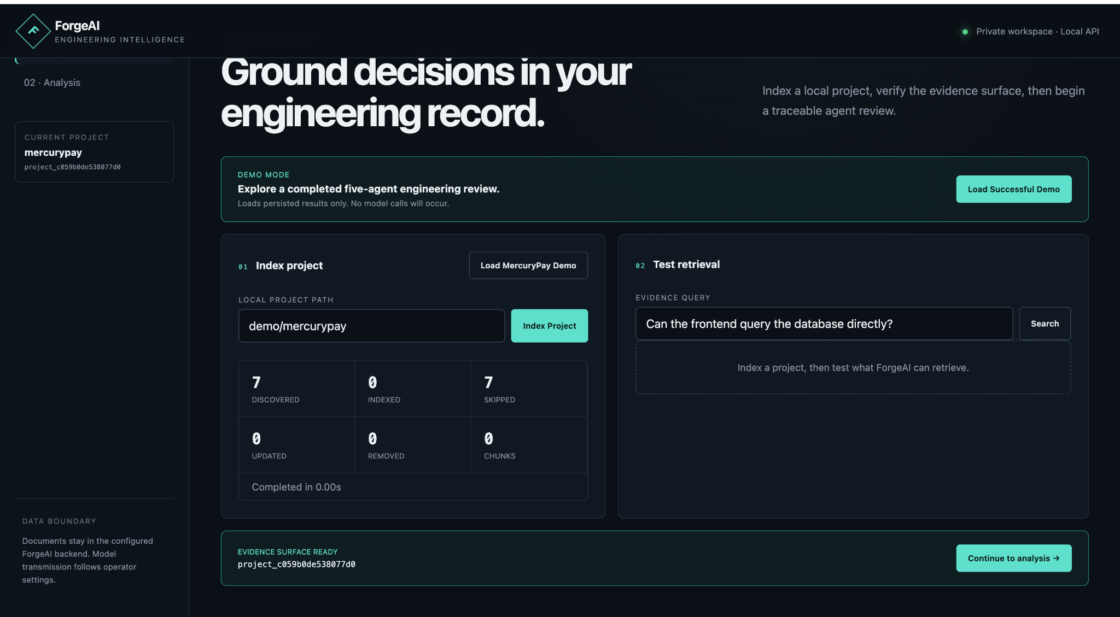
SOLUTION OVERVIEW
Feature request →
Decision package.
A fixed agent workflow produces an artifact that can be reviewed, exported, and revisited.
Request
Local docs
Agents
EDP
Ambiguous feature ask
MercuryPay evidence
Discovery → Revision
Validated decision
JSON
MD
EDP
machine-readable export
human-readable export
decision package
AMD AI DevMaster Hackathon · Track 2
03
Notes:
[Sources]
- Local source deck: ForgeAI_AMD_Track2_Pitch_Deck_v3.pptx
- Local brand source: frontend/src/components/AppShell.tsx and frontend/src/styles/global.css
- Product screenshots: original embedded captures from the source deck
[/Sources]

Slide 4
F
ForgeAI
ENGINEERING INTELLIGENCE
SYSTEM ARCHITECTURE
One engine.
Two transports.
Provider-independent domain invariants
Application-owned transitions and validation
Explicit boundaries: transport code never owns workflow logic.
Adapters for parsing, retrieval, SQLite and inference
Frontend consumes API, never database internals
React UI
FastAPI
Application
Agents
SQLite
AMD API
Setup + workspace
Transport only
Facade + runner
Bounded roles
FTS5 + persistence
OpenAI-compatible
AMD AI DevMaster Hackathon · Track 2
04
Notes:
[Sources]
- Local source deck: ForgeAI_AMD_Track2_Pitch_Deck_v3.pptx
- Local brand source: frontend/src/components/AppShell.tsx and frontend/src/styles/global.css
- Product screenshots: original embedded captures from the source deck
[/Sources]

Slide 5
FIVE-AGENT WORKFLOW
Fixed state machine.
Bounded agents.
Human checkpoint
Discovery pauses before retrieval, asks ordered questions, and resumes without rerunning earlier reasoning.
Discovery
Retrieval
Evidence
Solution
Critique
Revision
Validate
Persist
Clarification pause + resume
Typed input/output contracts
Invalid output cannot advance
Events, timings and provider metadata are persisted
Critic findings receive exactly one Revision disposition
AMD AI DevMaster Hackathon · Track 2
05
Notes:
[Sources]
- Local source deck: ForgeAI_AMD_Track2_Pitch_Deck_v3.pptx
- Local brand source: frontend/src/components/AppShell.tsx and frontend/src/styles/global.css
- Product screenshots: original embedded captures from the source deck
[/Sources]

Slide 6
TRUST ARCHITECTURE
The model chooses.
ForgeAI proves.
Reasoning models are not asked to reproduce hashes, paths, excerpts, line ranges or canonical IDs.
Local files
Chunks + hash
C1, C2, C3
Model selects
Reconstruct
Source of truth
Deterministic
Short labels
Judgment only
Trusted EDP
Trusted public EvidenceOutput
IDs, paths, lines, excerpt and hash copied from retrieval
Model never supplies provenance
Unknown or duplicate labels rejected
Raw model outputs not persisted
AMD AI DevMaster Hackathon · Track 2
06
Notes:
[Sources]
- Local source deck: ForgeAI_AMD_Track2_Pitch_Deck_v3.pptx
- Local brand source: frontend/src/components/AppShell.tsx and frontend/src/styles/global.css
- Product screenshots: original embedded captures from the source deck
[/Sources]

Slide 7
F
ForgeAI
ENGINEERING INTELLIGENCE
AMD INTEGRATION
Verified on AMD
Radeon Cloud.
Disc
18.41s
Evid
10.67s
The successful live workflow used AMD Radeon Cloud’s shared DeepSeek-V4-Flash endpoint through a provider-neutral OpenAI-compatible adapter.
Sol
29.09s
Model
DeepSeek-V4-Flash
Crit
29.08s
Served as
radeon-deepseek/DeepSeek-V4-Flash
Mode
json_object
Rev
18.94s
Timeout
300s
Provider retries
0
106.29s
20,556
10/10
total command latency
model tokens
critic dispositions accepted
AMD AI DevMaster Hackathon · Track 2
07
Notes:
[Sources]
- Local source deck: ForgeAI_AMD_Track2_Pitch_Deck_v3.pptx
- Local brand source: frontend/src/components/AppShell.tsx and frontend/src/styles/global.css
- Product screenshots: original embedded captures from the source deck
[/Sources]

Slide 8
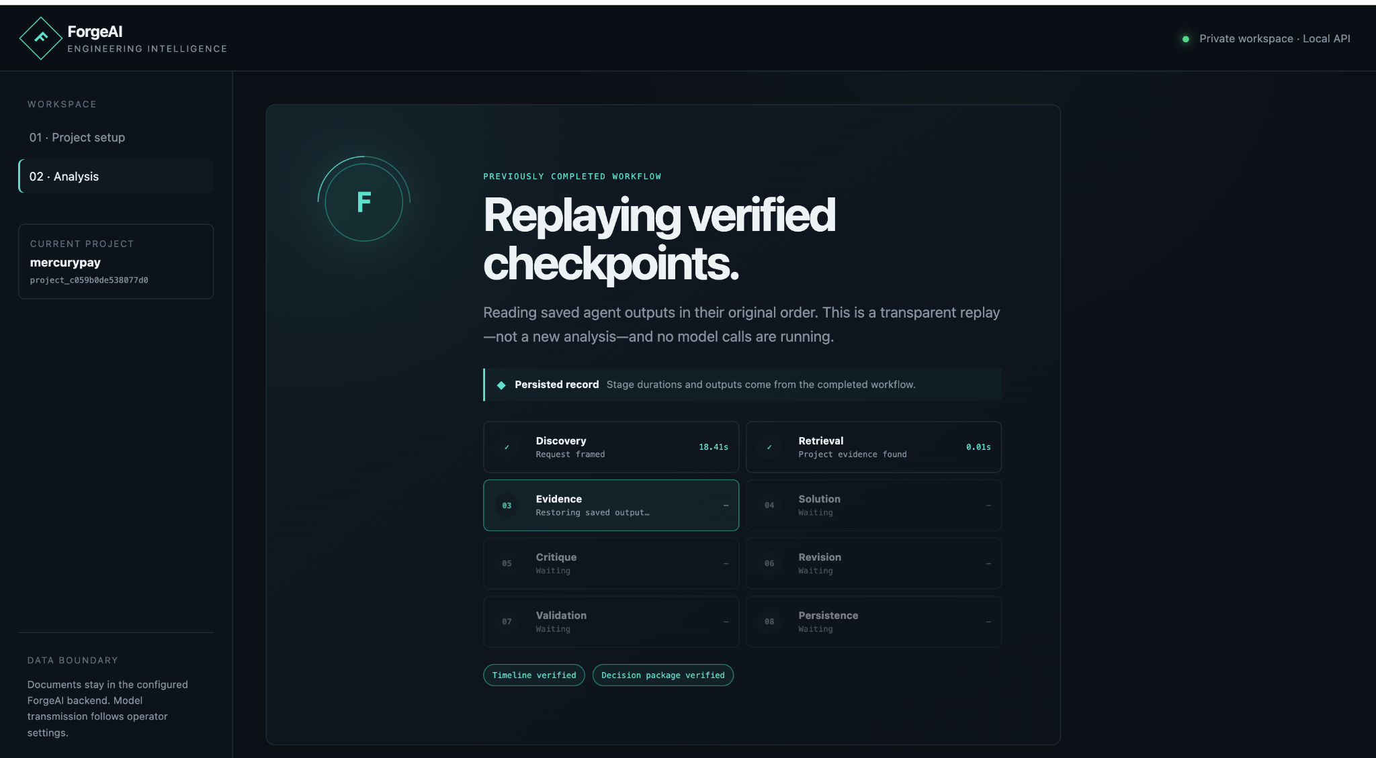
PRODUCT EXPERIENCE
A workspace built for
trust, not theatre.
Live analyses and completed workflow inspection are separated. The demo replay is explicitly labeled and uses persisted outputs only.
Visible stage timings
Safe failure states
JSON + Markdown exports
Accessible controls
AMD AI DevMaster Hackathon · Track 2
08
Notes:
[Sources]
- Local source deck: ForgeAI_AMD_Track2_Pitch_Deck_v3.pptx
- Local brand source: frontend/src/components/AppShell.tsx and frontend/src/styles/global.css
- Product screenshots: original embedded captures from the source deck
[/Sources]

Slide 9
F
ForgeAI
ENGINEERING INTELLIGENCE
ENGINEERING QUALITY
Production discipline inside an MVP.
Failure-safe design
• Exactly one bounded repair
156
16
93%
0
• Sanitized diagnostics only
backend tests passed
frontend tests passed
backend coverage
live output repairs
• No raw provider output persisted
• Invalid model output cannot silently advance
Ruff format/check
MyPy strict typing
Vitest + accessibility assertions
• No model-controlled commands or repo mutation
OpenAPI 3.1 contract
SQLite WAL + migrations
Credential-free mock provider
AMD AI DevMaster Hackathon · Track 2
09
Notes:
[Sources]
- Local source deck: ForgeAI_AMD_Track2_Pitch_Deck_v3.pptx
- Local brand source: frontend/src/components/AppShell.tsx and frontend/src/styles/global.css
- Product screenshots: original embedded captures from the source deck
[/Sources]

Slide 10
ROADMAP
ForgeAI
From verified shared inference to dedicated Radeon deployment.
Engineering intelligence for defensible decisions.
Now
Next
Scale
Local modular monolith + AMD shared DeepSeek API
Dedicated Radeon Cloud vLLM endpoint + ROCm telemetry
Auth, project history, GitHub/Jira, vector retrieval, workers
AMD AI DevMaster Hackathon · Track 2
10
Notes:
[Sources]
- Local source deck: ForgeAI_AMD_Track2_Pitch_Deck_v3.pptx
- Local brand source: frontend/src/components/AppShell.tsx and frontend/src/styles/global.css
- Product screenshots: original embedded captures from the source deck
[/Sources]

