Slide 1
AMD AI DEVMASTER 2026 • TRACK 2
Permission before action.
PrivateOps Agent
A private computer AI with broad supported visibility, deliberate action, exact confirmation, and evidence for every decision.
LangChain Core
vLLM
ROCm + Radeon
BROAD VISIBILITY. DELIBERATE ACTION. EVIDENCE FOR EVERY DECISION.
Notes:
Open with the user's permission insight: useful AI needs access, but access must not become silent control.
[Sources]
- https://github.com/AMD-DEV-CONTEST/Radeon-hackathon-2026-07/blob/main/README.md

Slide 2

THE PERMISSION GAP
02
Giving AI access must not mean giving up control.
If AI is going to take work away from people, it needs permission. PrivateOps makes that permission bounded, visible, and reviewable before action.
See broadly. Act deliberately.
Read-only by default • exact confirmation • blocked exfiltration • local audit
PRIVATEOPS AGENT / TRACK 2
PERMISSION-FIRST • LOCAL • AUDITABLE
Notes:
Show the real dual-mode UI. Local ROCm restores the loopback Qwen defaults without requiring a key; Remote model retains a separate development profile.

Slide 3
FOCUSED SCENARIO
03
One permission kernel, two truthful observation surfaces.
01
02
03
Windows computer
Radeon project
Permission proof
Seven fixed read-only collectors inspect startup, processes, services, tasks, ports, hardware, and security.
Same-instance tools inspect private knowledge, files, tests, submission readiness, GPU, and ROCm state.
Return evidence, plan, tool results, memory, confirmation state, and a redacted audit export.
Whole-computer permission means broad supported observation—not arbitrary admin access
PRIVATEOPS AGENT / TRACK 2
PERMISSION-FIRST • LOCAL • AUDITABLE
Notes:
The official video uses the Radeon project surface. Windows inspection is a separate genuine extension.

Slide 4
AGENT WORKFLOW
04
One request becomes an inspectable execution trace.
1
2
3
Observe + retrieve
Plan + guard
Synthesize + audit
→
→
Fixed tools and 14 bilingual RAG sources return bounded evidence with stable IDs.
Every request is classified safe, exact-confirmation, or blocked before tool execution.
The local Radeon model explains observed results; memory and audit remain inspectable.
REQUEST → EVIDENCE → PLAN → PERMISSION → TOOL → AUDIT ID
PRIVATEOPS AGENT / TRACK 2
PERMISSION-FIRST • LOCAL • AUDITABLE
Notes:
Walk left to right. The differentiator is not another chat UI; it is an observable execution trace.

Slide 5
TRACK 2 COVERAGE
05
All five minimum-capability categories are implemented.
✓
Local RAG
✓
Tool calling
✓
Multi-step planning
14 bilingual sources + stable IDs
Project + Windows StructuredTool
Visible retrieve / inspect / synthesize
✓
Local memory
✓
Permission + privacy
Atomic JSON persistence
Path confinement, tokens, redaction
PRIVATEOPS AGENT / TRACK 2
PERMISSION-FIRST • LOCAL • AUDITABLE
Notes:
The rules require at least two capabilities. PrivateOps deliberately implements all five so functionality and trust reinforce each other.
[Sources]
- https://github.com/AMD-DEV-CONTEST/Radeon-hackathon-2026-07/blob/main/README.md

Slide 6
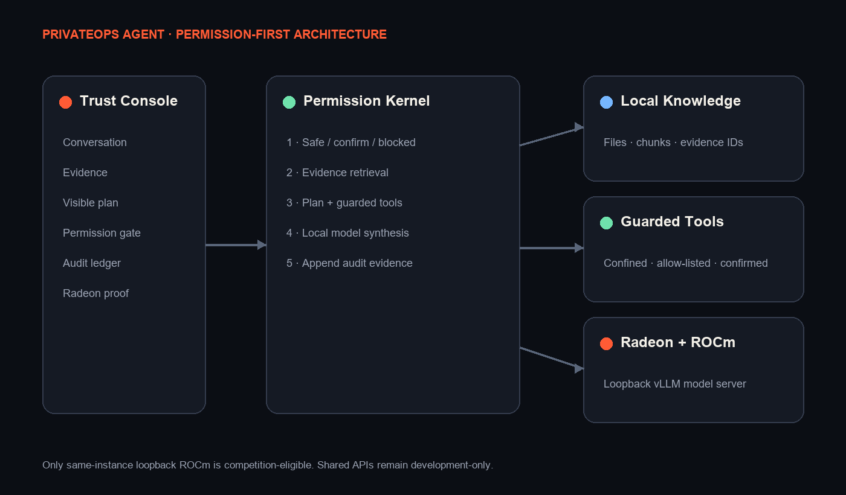
ARCHITECTURE
06
The model proposes; the local control plane decides and records.
Non-negotiable boundaries
LOOPBACK
Core inference never needs a remote API.
WORKSPACE
Tools resolve paths inside one configured root.
NO FALLBACK
ROCm mode fails visibly if local inference fails.
REDACTION
Secrets are removed from audit exports.
PRIVATEOPS AGENT / TRACK 2
PERMISSION-FIRST • LOCAL • AUDITABLE
Notes:
The LLM is only one component. Retrieval, planning, permissions, tools, memory, audit, and evidence recording remain local and inspectable.

Slide 7
RADEON DEPLOYMENT
07
Local ROCm keeps PrivateOps and vLLM on one loopback boundary.
1
2
3
4
Radeon GPU
→
vLLM
→
Qwen2.5 7B
→
PrivateOps
ROCm image
OpenAI-compatible
8,192 context
127.0.0.1 only
Verified capture
gfx1100 • ROCm 7.2.1 • Qwen2.5-7B • 127.0.0.1 only
PRIVATEOPS AGENT / TRACK 2
PERMISSION-FIRST • LOCAL • AUDITABLE
Notes:
The captured instance ran PrivateOps and vLLM together. The UI can switch to a separate Remote model profile, but only Local ROCm uses this same-instance loopback path.
[Sources]
- https://docs.vllm.ai/en/latest/getting_started/quickstart/
- https://huggingface.co/Qwen/Qwen2.5-7B-Instruct
- https://github.com/AMD-DEV-CONTEST/Radeon-hackathon-2026-07/blob/main/Radeon-Cloud-User%20Guide/README.md

Slide 8
OPTIMIZATION + EVIDENCE
08
Performance claims are measured on Radeon—not typed into the deck.
TECHNIQUE
SETTING
WHY IT MATTERS
Direct latency
1,511.072 ms
Measured through the same-instance loopback model endpoint.
Throughput
32.427 tokens/s
Measured from 49 completion tokens; not manually entered.
Complete Agent
18,384.639 ms
Includes RAG, plan, tool, generation, audit, and response assembly.
Context optimization
8,192 / 0.85 / 25
Bounds context, preserves memory headroom, and removes environment noise.
PRIVATEOPS AGENT / TRACK 2
PERMISSION-FIRST • LOCAL • AUDITABLE
Notes:
These values are already captured in immutable machine evidence. No unmeasured speedup, P95, VRAM peak, or concurrency result is claimed.
[Sources]
- https://docs.vllm.ai/en/latest/getting_started/quickstart/

Slide 9
REVIEWER-READY PROOF
09
The submission package is engineered to be checked, not trusted blindly.
5 / 5
102
14
Track capability categories
Local finalization tests
Real bilingual RAG sources
Included evidence
Source + tests • PDF/PPT/poster • verified GPU/runtime/model logs • benchmark JSON/CSV • Agent response + audit
PRIVATEOPS AGENT / TRACK 2
PERMISSION-FIRST • LOCAL • AUDITABLE
Notes:
The Radeon evidence and public demonstration video are complete. Only the official account-bound Fork/PR remains.

Slide 10
PRIVATEOPS AGENT
Broad visibility.
Deliberate action.
A permission-first private computer AI that gives useful access without surrendering control, provenance, or reviewability.
LOCAL RAG • LANGCHAIN TOOLS • VISIBLE PLANS • LOCAL MEMORY • PERMISSION + AUDIT
TRACK 2 / VERIFIED AMD RADEON + ROCm / EVIDENCE FOR EVERY DECISION
Notes:
Close on the differentiator and move directly into the live demonstration.

