Slide 1

RibEye
AMD AI DevMaster Hackathon
Track 1: Multimodal AI
Neural Ninjas

Slide 2
Europe: Radiologist Shortage
In 17 countries in Europe
19% of the radiologists will retire in next 5 years and
45% are over 51 years
EU-REST- https://pmc.ncbi.nlm.nih.gov/articles/PMC11910488/

Slide 3



Europe: Radiologist Shortage
17
countries in Europe
19%
of the radiologists will retire in next 5 years
45%
are already over
the age of 51
EU-REST- https://pmc.ncbi.nlm.nih.gov/articles/PMC11910488/

Slide 4
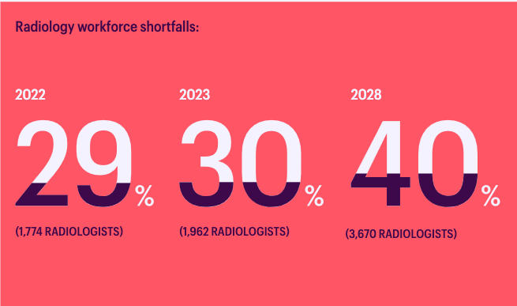
GB: Radiologist Shortage
The Royal College of Radiologists Clinical Radiology - https://www.rcr.ac.uk/media/5befglss/rcr-census-clinical-radiology-workforce-census-2023.pdf

Slide 5

USA: Radiologist Shortage
Relative imbalance between radiology supply and demand will persist without residency growth
Projected US Radiologist Supply, 2025 to 2055, Journal of American College of Radiology https://www.jacr.org/article/S1546-1440(24)00909-8/fulltext

Slide 6

Africa: Radiologist Shortage
Radiography professionals migrate to high-income countries with better-resourced health systems
Challenges and strategies for retaining Africa’s radiography workforce in the continent amidst a competitive global market: Insights from 17 countries https://www.sciencedirect.com/science/article/pii/S1078817425001452

Slide 7
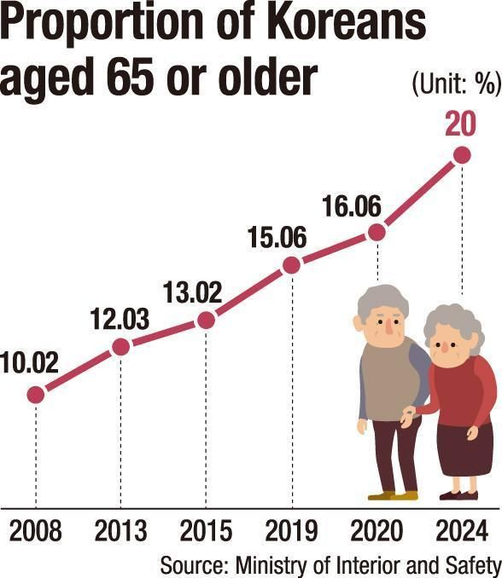
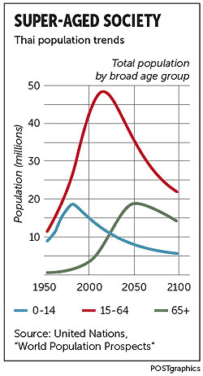
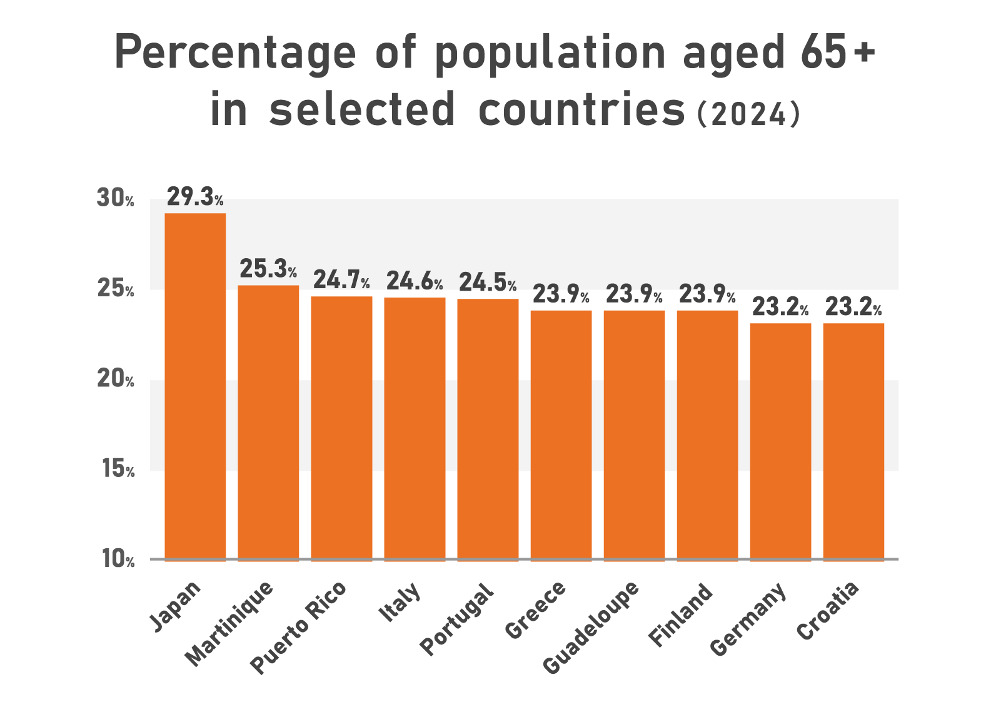
Super Aged Societies:
A Global Phenomenon
Average 20% of population older than 65 years
Bangkok Post - https://www.bangkokpost.com/business/general/667928/super-aged-society-a-broadly-neglected-national-agenda
Nomura Holdings - https://www.nomura.co.jp/fin-wing/column/aging-society_en/
Korean Times - https://www.koreatimes.co.kr/southkorea/society/20241224/korea-becomes-super-aged-society

Slide 8



Radiologists Training & Task
Time-consuming
limited residencies
limited by number of qualified radiologists available to conduct training and examination
The Growing Problem of Radiologist Shortages: Perspectives From Singapore https://pmc.ncbi.nlm.nih.gov/articles/PMC10700991/

Slide 9

Scenario: Emergency Room
Average total waiting time in the emergency department is estimated
210 mins
Measuring and Analyzing Waiting Time Indicators of Patients’ Admitted in Emergency Department: A Case Study - https://pmc.ncbi.nlm.nih.gov/articles/PMC4803980/

Slide 10

Scenario: Emergency Room
Several patients with different issues are admitted to the ER
  People with fall injuries
  People with wounds near the chest
  People with respiratory issues
All waiting to be seen by a radiologist first before being admitted to further, specialized treatment.
Measuring and Analyzing Waiting Time Indicators of Patients’ Admitted in Emergency Department: A Case Study - https://pmc.ncbi.nlm.nih.gov/articles/PMC4803980/

Slide 11
Scenario: Emergency Room with
RibEye
Ad hoc secondary diagnosis
Helps personnel prioritize patients
  based on severity levels
Patients get faster treatment if urgent
  while awaiting the radiologist’s confirmed diagnosis

