Slide 1
An Intro to NLP and Text Analysis
Patrick van Kessel, Senior Data Scientist
Pew Research Center

Slide 2
The role of text in social research

Slide 3
The role of text in social research
Why text?
Free of assumptions
Potential for richer insights relative to closed-format responses
If organic, then data collection costs are often negligible

Slide 4
The role of text in social research
Where do I find it?
Open-ended surveys / focus groups / transcripts / interviews
Social media data (tweets, FB posts, etc.)
Long-form content (articles, notes, logs, etc.)

Slide 5
The role of text in social research
What makes it challenging?
Messy
“Data spaghetti” with little or no structure
Sparse
Low information-to-data ratio (lots of hay, few needles)
Often organic (rather than designed)
Can be naturally generated by people and processes
Often without a research use in mind

Slide 6
Data selection and preparation

Slide 7
Data selection and preparation
Know your objective and subject matter (if needed find subject matter expert)
Get familiar with the data
Don’t make assumptions - know your data, quirks and all

Slide 8
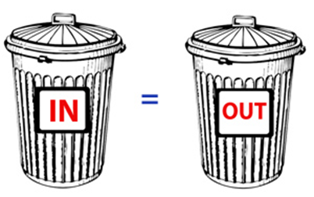
Data selection and preparation
Text Acquisition and Preprepation
Select relevant data (text corpus)
Content
Metadata
Prepare the input file
Determine unit of analysis
Process text to get one document per unit of analysis

Slide 9
(Pre-)Processing
Turning text into data

Slide 10
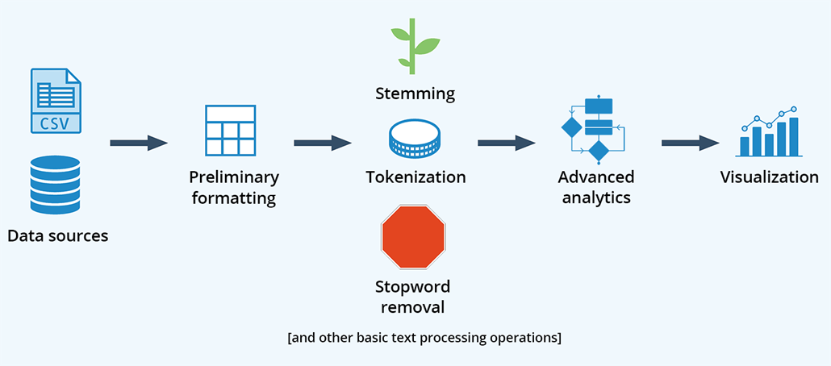
Turning text into data

Slide 11
Turning text into data
How do we sift through text and produce insight?
Might first try searching for keywords
How many times is “analysis” mentioned?
 | Original
1 | Text analysis is fun
2 | I enjoy analyzing text data
3 | Data science often involves text analytics

Slide 12
Turning text into data
How do we sift through text and produce insight?
Might first try searching for keywords
How many times is “analysis” mentioned?
We missed this one
 | Original
1 | Text analysis is fun
2 | I enjoy analyzing text data
3 | Data science often involves text analytics
And this one too

Slide 13
Turning text into data
Variations of words can have the same meaning but look completely different to a computer
 | Original
1 | Text analysis is fun
2 | I enjoy analyzing text data
3 | Data science often involves text analytics

Slide 14
Turning text into data
Regular Expressions
A more sophisticated solution: regular expressions
Syntax for defining string (text) patterns
 | Original
1 | Text analysis is fun
2 | I enjoy analyzing text data
3 | Data science often involves text analytics

Slide 15
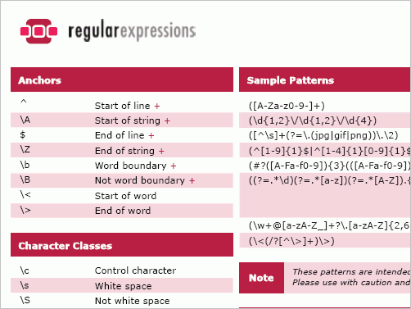
Turning text into data
Regular Expressions
Can use to search text or extract specific chunks
Example use cases:
Extracting dates
Finding URLs
Identifying names/entities
https://regex101.com/
http://www.regexlib.com/

Slide 16
Turning text into data
Regular Expressions
\banaly[a-z]+\b
 | Original
1 | Text analysis is fun
2 | I enjoy analyzing text data
3 | Data science often involves text analytics

Slide 17
Turning text into data
Regular Expressions
Regular expressions can be extremely powerful… ...and terrifyingly complex:
URLS: ((https?:\/\/(www\.)?)?[-a-zA-Z0-9@:%._\+~#=]{2,4096}\.[a-z]{2,6}\b([-a-zA-Z0-9@:%_\+.~#?&//=]*))
DOMAINS: (?:http[s]?\:\/\/)?(?:www(?:s?)\.)?([\w\.\-]+)(?:[\\\/](?:.+))?
MONEY: \$([0-9]{1,3}(?:(?:\,[0-9]{3})+)?(?:\.[0-9]{1,2})?)\s

Slide 18
Turning text into data
Pre-processing
Great, but we can’t write patterns for everything
Words are messy and have a lot of variation
We need to collapse semantically
We need to clean / pre-process
 | Original
1 | Text analysis is fun
2 | I enjoy analyzing text data
3 | Data science often involves text analytics

Slide 19
Turning text into data
Pre-processing
Common first steps:
Spell check / correct
Remove punctuation / expand contractions
can’t -> cannot
they’re -> they_are
doesn’t -> does_not
 | Original | Processed
1 | Text analysis is fun
2 | I enjoy analyzing text data
3 | Data science often involves text analytics

Slide 20
Turning text into data
Pre-processing
Now to collapse words with the same meaning
We do this with stemming or lemmatization
Break words down to their roots
 | Original | Processed
1 | Text analysis is fun
2 | I enjoy analyzing text data
3 | Data science often involves text analytics

Slide 21
Turning text into data
Pre-processing
Stemming is more conservative
There are many different stemmers
Here’s the Porter stemmer (1979)
 | Original | Processed
1 | Text analysis is fun | Text analysi is fun
2 | I enjoy analyzing text data | I enjoy analyz text data
3 | Data science often involves text analytics | Data scienc often involv text analyt

Slide 22
Turning text into data
Pre-processing
Stemming is more conservative
There are many different stemmers
Here’s the Porter stemmer (1979)
 | Original | Processed
1 | Text analysis is fun | Text analysi is fun
2 | I enjoy analyzing text data | I enjoy analyz text data
3 | Data science often involves text analytics | Data scienc often involv text analyt

Slide 23
Turning text into data
Pre-processing
The Lancaster stemmer (1990) is newer and more aggressive
Truncates words a LOT
 | Original | Processed
1 | Text analysis is fun | text analys is fun
2 | I enjoy analyzing text data | I enjoy analys text dat
3 | Data science often involves text analytics | dat sci oft involv text analys

Slide 24
Turning text into data
Pre-processing
Lemmatization uses linguistic relationships and parts of speech to collapse words down to their root form - so you get actual words (“lemma”), not stems
WordNet Lemmatizer
 | Original | Processed
1 | Text analysis is fun | text analysis is fun
2 | I enjoy analyzing text data | I enjoy analyze text data
3 | Data science often involves text analytics | data science often involve text analytics

Slide 25
Turning text into data
Pre-processing
Picking the right method depends on how much you want to preserve nuance or collapse meaning
We’ll stick with Lancaster
 | Original | Processed
1 | Text analysis is fun | text analys is fun
2 | I enjoy analyzing text data | I enjoy analys text dat
3 | Data science often involves text analytics | dat sci oft involv text analys

Slide 26
Turning text into data
Pre-processing
Finally, we need to remove words that don’t hold meaning themselves
These are called “stopwords”
Can expand standard stopword lists with custom words
 | Original | Processed
1 | Text analysis is fun | text analys fun
2 | I enjoy analyzing text data | enjoy analys text dat
3 | Data science often involves text analytics | dat sci oft involv text analys

Slide 27
Turning text into data
Pre-processing
A word of caution: there aren’t any universal rules for making pre-processing decisions
Do what makes sense for your data - but be cautious of the researcher degrees of freedom involved
See: “Assessing the Consequences of Text Pre-processing Decisions” by Matthew J. Denny and Arthur Spirling (2016)

Slide 28
Turning text into data
Tokenization
Now we need to tokenize
Break words apart according to certain rules
Usually breaks on whitespace and punctuation
What’s left are called “tokens”
Single tokens or pairs of two or more tokens are called “ngrams”

Slide 29
Turning text into data
Tokenization
Unigrams
text | analys | fun | enjoy | dat | sci | oft | involv
1 | 1 | 1
1 | 1 |  | 1 | 1
1 | 1 |  |  | 1 | 1 | 1 | 1

Slide 30
Turning text into data
Tokenization
Bigrams
Text analys | 2
Analys fun | 1
Enjoy analys | 1
Analys text | 1
Text dat | 1
Dat sci | 1
Sci oft | 1
Oft involv | 1
Involv text | 1

Slide 31
Turning text into data
Tokenization
If we want to characterize the whole corpus, we can just look at the most frequent words
text | analys | fun | enjoy | dat | sci | oft | involv
1 | 1 | 1
1 | 1 |  | 1 | 1
1 | 1 |  |  | 1 | 1 | 1 | 1
3 | 3 | 1 | 1 | 2 | 1 | 1 | 1

Slide 32
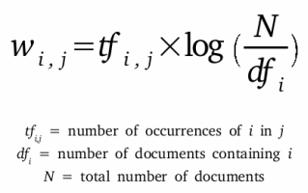
Turning text into data
The Term Frequency Matrix
But what if we want to distinguish documents from each other?
We know these documents are about text analysis
What makes them unique?

Slide 33
Turning text into data
The Term Frequency Matrix
Divide the word frequencies by the number of documents they appear in
Downweight words that are common
Now we’re emphasizing what makes each document unique
text | analys | fun | enjoy | dat | sci | oft | involv
.33 | .33 | 1
.33 | .33 |  | 1 | .5
.33 | .33 |  |  | .5 | 1 | 1 | 1
1 | 1 | 1 | 1 | 1 | 1 | 1 | 1

Slide 34
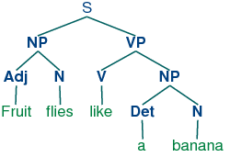

Turning words into numbers
Part-of-Speech Tagging
TF-IDF is often all you need
But sometimes you care about how a word is used
Can use pre-trained part-of-speech (POS) taggers
Can also help with things like negation
“Happy” vs. “NOT happy”

Slide 35
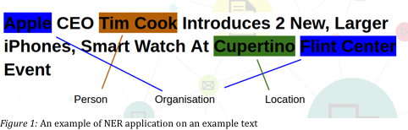
Turning words into numbers
Named Entity Extraction
Might also be interested in people, places, organizations, etc.
Like POS taggers, named entity extractors use trained models

Slide 36
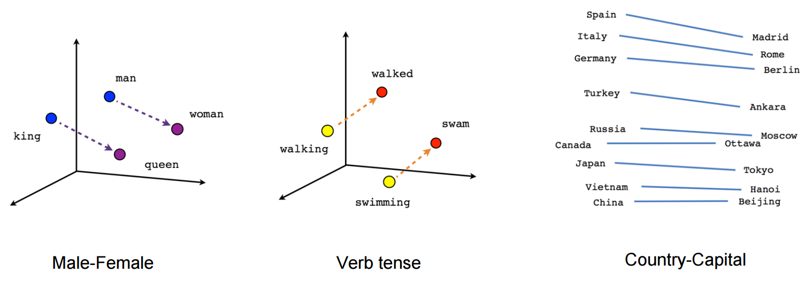
Turning words into numbers
Word2Vec
Other methods can quantify words not by frequency, but by their relation
Word2vec uses a sliding window to read words and learn their relationships; each word gets a vector in N-dimensional space
https://code.google.com/archive/p/word2vec/

Slide 37
Analysis
Finding patterns in text data

Slide 38
Finding patterns in text data
Two types of approaches:
Unsupervised NLP: automated, extracts structure from the data
Clustering
Topic modeling
Mutual information
Supervised NLP: requires training data, learns to predict labels and classes
Classification
Regression

Slide 39
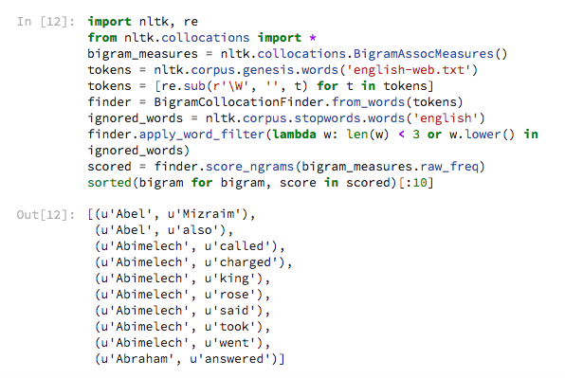
Finding patterns in text data
Unsupervised methods
First up, we might look at words that commonly co-occur
Called “collocations” or “co-occurrences”
Great way to get a quick look at common themes

Slide 40
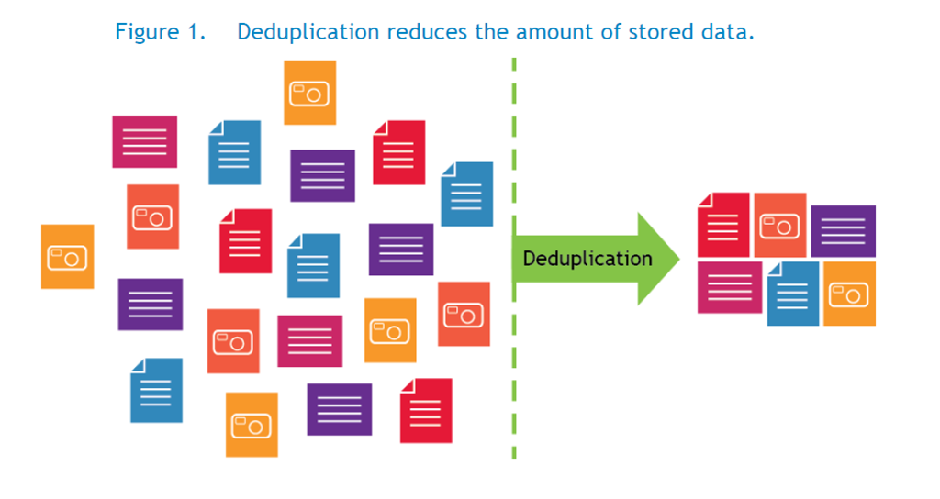
Finding patterns in text data
Unsupervised methods
Might want to compare documents (or words) to one another
Possible applications
Spelling correction
Document deduplication
Measure similarity of language
Politicians’ speeches
Movie reviews
Product descriptions

Slide 41
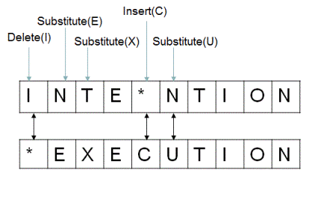
Finding patterns in text data
Unsupervised methods
Levenshtein distance
Compute number of steps needed to turn a word/document into another
Can express as a ratio (percent of word/document that needs to change) to measure similarity

Slide 42
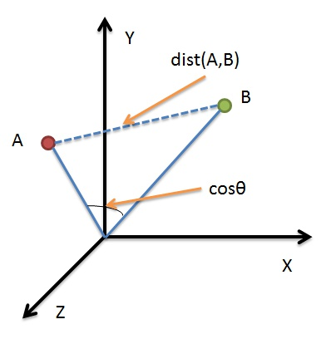
Finding patterns in text data
Unsupervised methods
Cosine similarity
Compute the “angle” between two word vectors
TF-IDF: axes are the weighted frequencies for each word
Word2Vec: axes are the learned dimensions from the model

Slide 43
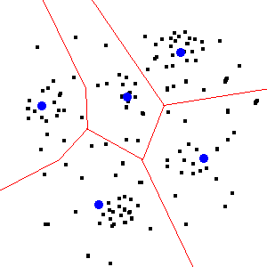
Finding patterns in text data
Unsupervised methods
Clustering
Algorithms that use word vectors (TF-IDF, Word2Vec, etc.) to identify structural groupings between observations (words, documents)
K-Means is a very commonly used one

Slide 44
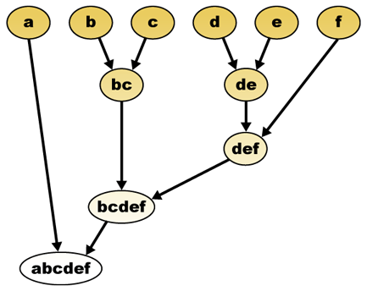
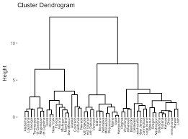
Finding patterns in text data
Unsupervised methods
Hierarchical/agglomerative clustering
Start with all observations, and use a rule to pair them up, and repeat until there’s only one group left

Slide 45
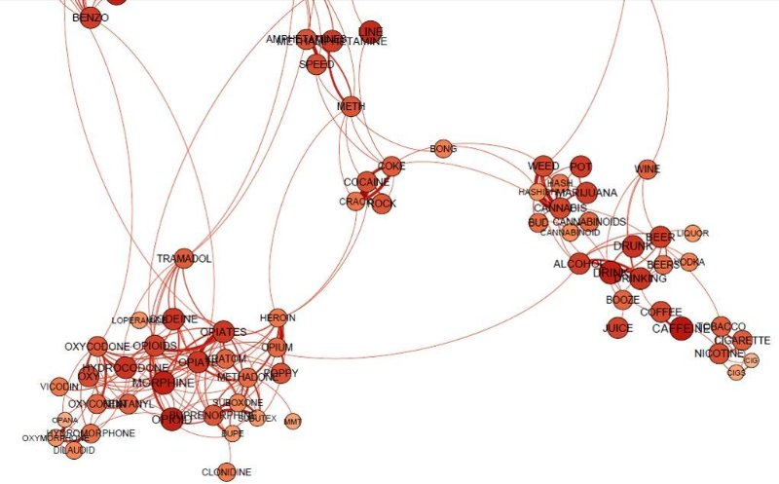
Finding patterns in text data
Unsupervised methods
Network analysis
Can also get creative
After all, we’re just working with columns and numbers
Example: link words together by their strongest correlations

Slide 46
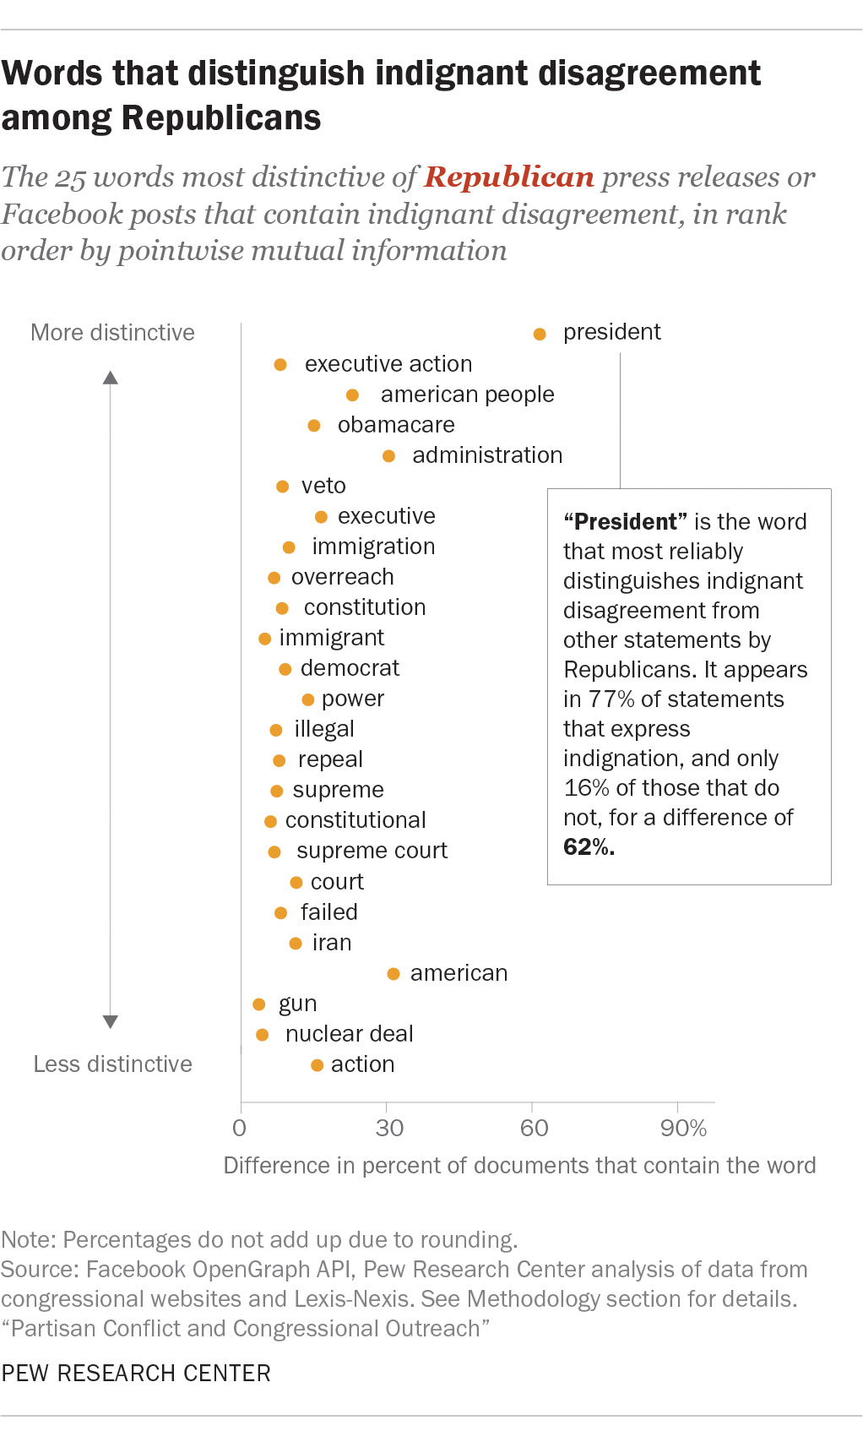
Finding patterns in text data
Unsupervised methods
Pointwise mutual information
Based on information theory
Compares conditional and joint probabilities to measure the likelihood of a word occurring with a category/outcome, beyond random chance

Slide 47
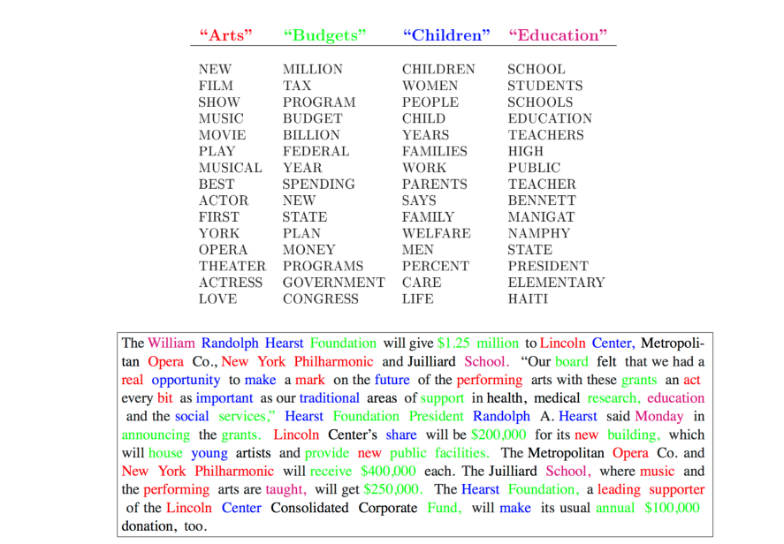
Finding patterns in text data
Unsupervised methods
Topic modeling
Algorithms that characterize documents in terms of topics (groups of words)
Find topics that best fit the data

Slide 48
Finding patterns in text data
Supervised methods
Often we want to categorize documents
Unsupervised methods can help
But often we need to read and label them ourselves
Classification models can take labeled data and learn to make predictions

Slide 49
Finding patterns in text data
Supervised methods
Steps:
Label a sample of documents
Break your sample into two sets: a training sample and a test sample
Train a model on the training sample
Evaluate it on the test sample
Apply it to the full set of documents to make predictions

Slide 50
Finding patterns in text data
Supervised methods
First you need to develop a codebook
Codebook: set of rules for labeling and categorizing documents
The best codebooks have clear rules for hard cases, and lots of examples
Categories should be MECE: mutually exclusive and collectively exhaustive

Slide 51
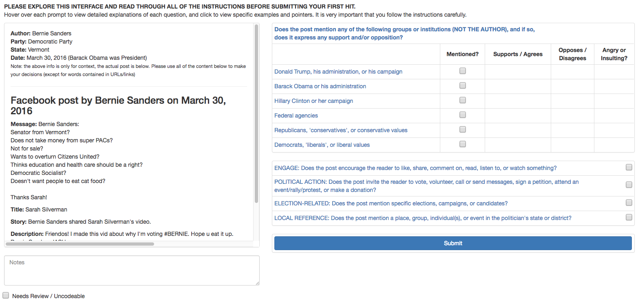

Slide 52
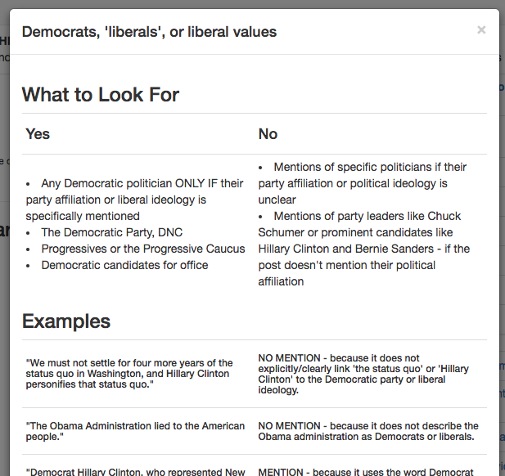
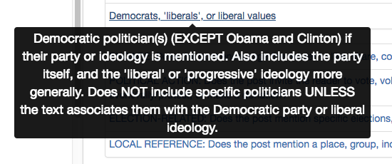
Finding patterns in text data
Supervised methods

Slide 53
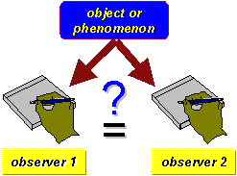
Finding patterns in text data
Supervised methods
Need to validate the codebook by measuring interrater reliability
Makes sure your measures are consistent, objective, and reproducible
Multiple people code the same document

Slide 54
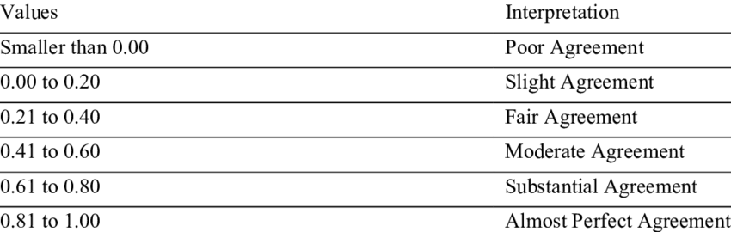
Finding patterns in text data
Supervised methods
Various metrics to test whether their agreement is high enough
Krippendorf’s alpha
Cohen’s kappa
Can also compare coders against a gold standard, if available

Slide 55

Finding patterns in text data
Supervised methods
Mechanical Turk can be a great way to code a lot of documents
Have 5+ Turkers code a large sample of documents
Collapse them together with a rule
Code a subset in-house, and compute reliability

Slide 56
Finding patterns in text data
Supervised methods
Sometimes you’re trying to measure something that’s really rare
Consider oversampling
Example: keyword oversampling
Disproportionately select documents that are more likely to contain your outcomes

Slide 57
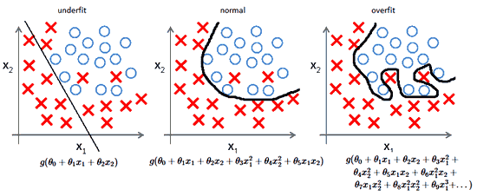
Finding patterns in text data
Supervised methods
After coding, split your sample into two sets (~80/20)
One for training, one for testing
We do this to check for (and avoid) overfitting

Slide 58
Finding patterns in text data
Supervised methods
Next step is called feature extraction or feature selection
Need to extract “features” from the text
TF-IDF
Word2Vec vectors
Can also utilize metadata, if potentially useful

Slide 59
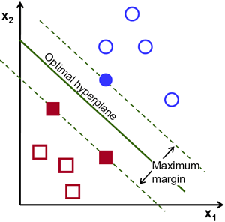
Finding patterns in text data
Supervised methods
Select a classification algorithm
Common choice for text data are support vector machines (SVMs)
Similar to regression, SVMs find the line that best separates two or more groups
Can also use non-linear “kernels” for better fits (radial basis function, etc.)
XGBoost is a newer and very promising algorithm

Slide 60
Finding patterns in text data
Supervised methods
Word of caution: if you oversampled, your weights are probability (survey) weights
Most machine learning implementations assume your weights are frequency weights
Not an issue for predictions - but can produce biased variance estimates if you analyze your training data itself

Slide 61
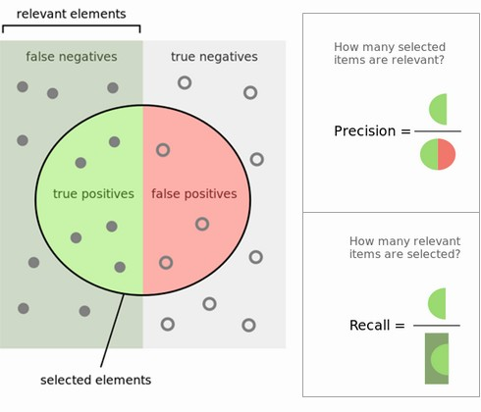
Finding patterns in text data
Supervised methods
Time to evaluate performance
Lots of different metrics, depending on what you care about
Often we care about precision/recall
Precision: did you pick out mostly needles or mostly hay?
Recall: how many needles did you miss?
Other metrics:
Matthew’s correlation coefficient
Brier score
Overall accuracy

Slide 62
Finding patterns in text data
Supervised methods
Doing just one split leaves a lot up to chance
To bootstrap a better estimate of the model’s performance, it’s best to use K-fold cross-validation
Splits your data into train/test sets multiple times and averages the performance metrics
Ensures that you didn’t just get lucky (or unlucky)

Slide 63
Finding patterns in text data
Supervised methods
Model not working well?
You probably need to tune your parameters
You can use a grid search to test out different combinations of model parameters and feature extraction methods
Many software packages can automatically help you pick the best combination to maximize your model’s performance

Slide 64
Finding patterns in text data
Supervised methods
Suggested design:
Large training sample, coded by Turkers
Small evaluation sample, coded by Turkers and in-house experts
Compute IRR between Turk and experts
Train model on training sample, use 5-fold cross-validation
Apply model to evaluation sample, compare results against in-house coders and Turkers

Slide 65
Finding patterns in text data
Supervised methods
Some (but not all) models produce probabilities along with their classifications
Ideally you fit the model using your preferred scoring metric/function
But you can also use post-hoc probability thresholds to adjust your model’s predictions

Slide 66
Tools and Resources

Slide 67

Open-source tools
Python
NLTK, scikit-learn, pandas, numpy, scipy, gensim, spacy, etc
R
https://cran.r-project.org/web/views/NaturalLanguageProcessing.html
Java
Stanford Core NLP + many other useful libraries https://nlp.stanford.edu/software/

Slide 68
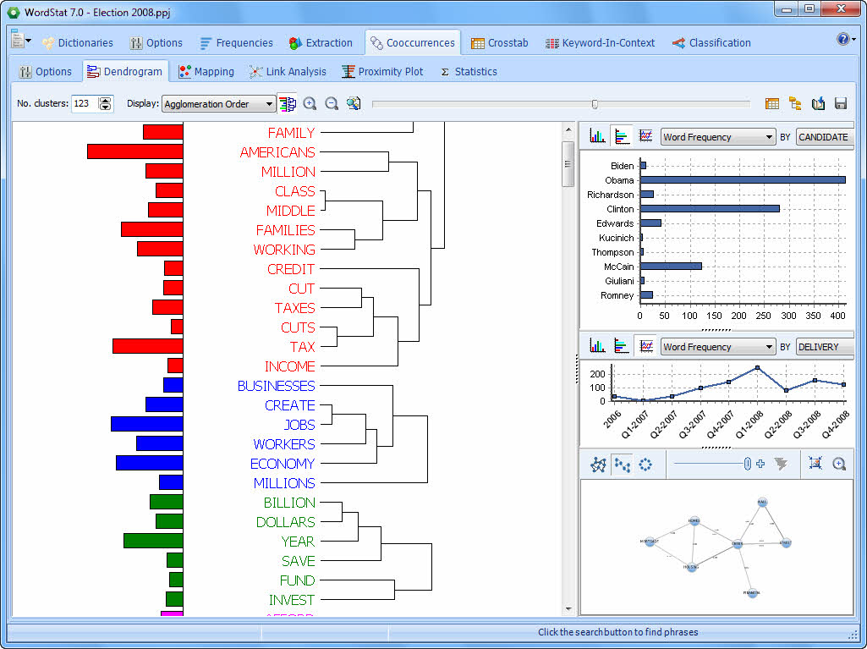
Commercial tools
Cloud-based NLP
Amazon Comprehend
Google Cloud Natural Language
IBM Watson NLU
Software
SPSS Text Modeler
Provalis WordStat

Slide 69
Time for a demo!
Demo notebook:
https://colab.research.google.com/github/patrickvankessel/WorldBank-Text-Analysis-2019/blob/master/Tutorial.ipynb
Feel free to reach out:
pvankessel@pewresearch.org
Special thanks to Michael Jugovich, who helped me put together a lot of this material together for a previous workshop we did at NYAAPOR!

