Slide 1
Data Driven Predictive Maintenance for Aerospace Engines
Anthony Shara, Mohammad Alfeerawi, Nicola Celi, Sebi Torres - Group 5

Slide 2
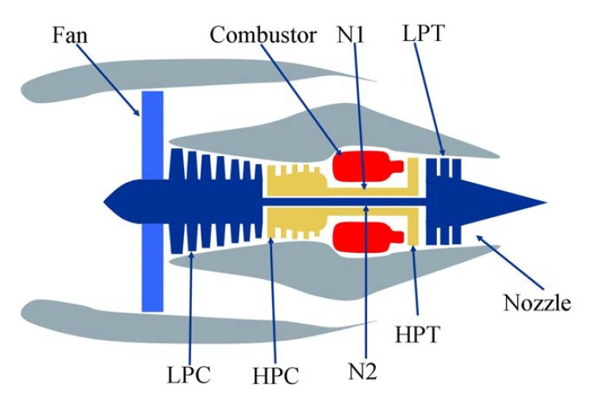
Introduction
Traditional methods for aircraft engine maintenance are time-based approaches which leads to:
Excessive maintenance
Missed opportunities for early intervention
Leveraging machine learning techniques applied to instrumentation data allows for predictive maintenance
Proactive approach to anticipate maintenance and failures
Due to proprietary nature of run-to-failure data, research into this topic is limited
Machine learning techniques can facilitate a shift in the paradigm of maintenance schedules to optimize efficiency and reduce cost
Introduction/
Background
Datasets & Pre-processing
Machine Intelligence / GUI
Results & Lessons Learned

Slide 3
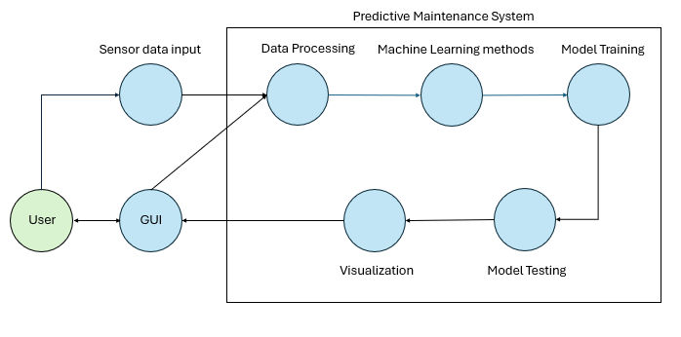
Problem Statement - Overview
Use Case Diagram
The objective is to transform raw operational data into actionable insights, allowing for timely interventions and improving reliability of aircraft systems.
Investigating the applicability of an LSTM or GRU models to learn hidden associations that allow it to accurately predict engine Remaining Usage Life
This research aims to establish a practical foundation for validating the application of machine learning methods for predictive maintenance in engineering.
Introduction/
Background
Datasets & Pre-processing
Machine Intelligence / GUI
Results & Lessons Learned

Slide 4
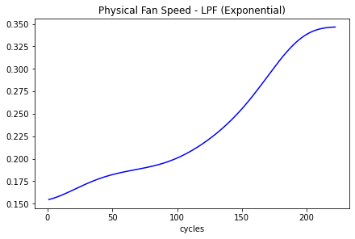
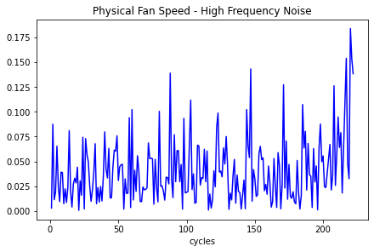
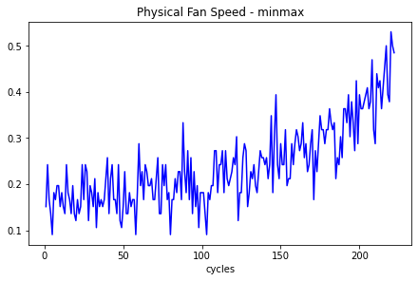
Datasets & Preprocessing
Signal Features
Signal features consists of exponential signal + higher frequency noise.
Goal is to predict RUL from signal features.
Preprocessing needed scale features to a comparable range [0,1] and to focus on the key features (the exponential signal).
Introduction/
Background
Datasets & Pre-processing
Machine Intelligence / GUI
Results & Lessons Learned

Slide 5
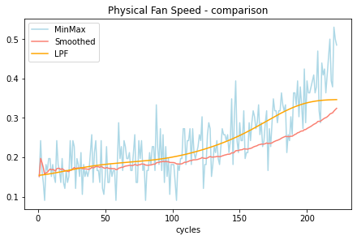
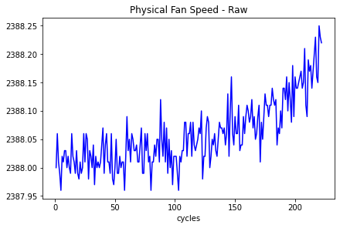

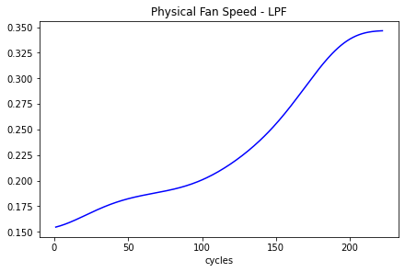
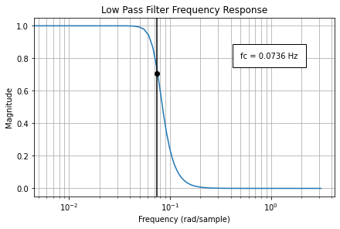
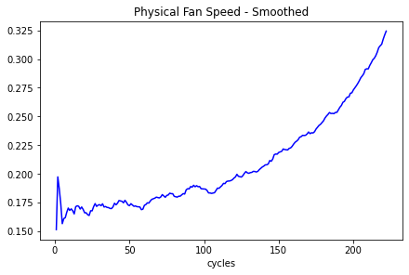
Datasets & Preprocessing
Raw Data
Apply MinMax scaling to scale signal features to a comparable range
Smoothened data to remove unwanted noise
Apply LPF to filter out high frequency noise
Introduction/
Background
Datasets & Pre-processing
Machine Intelligence / GUI
Results & Lessons Learned

Slide 6
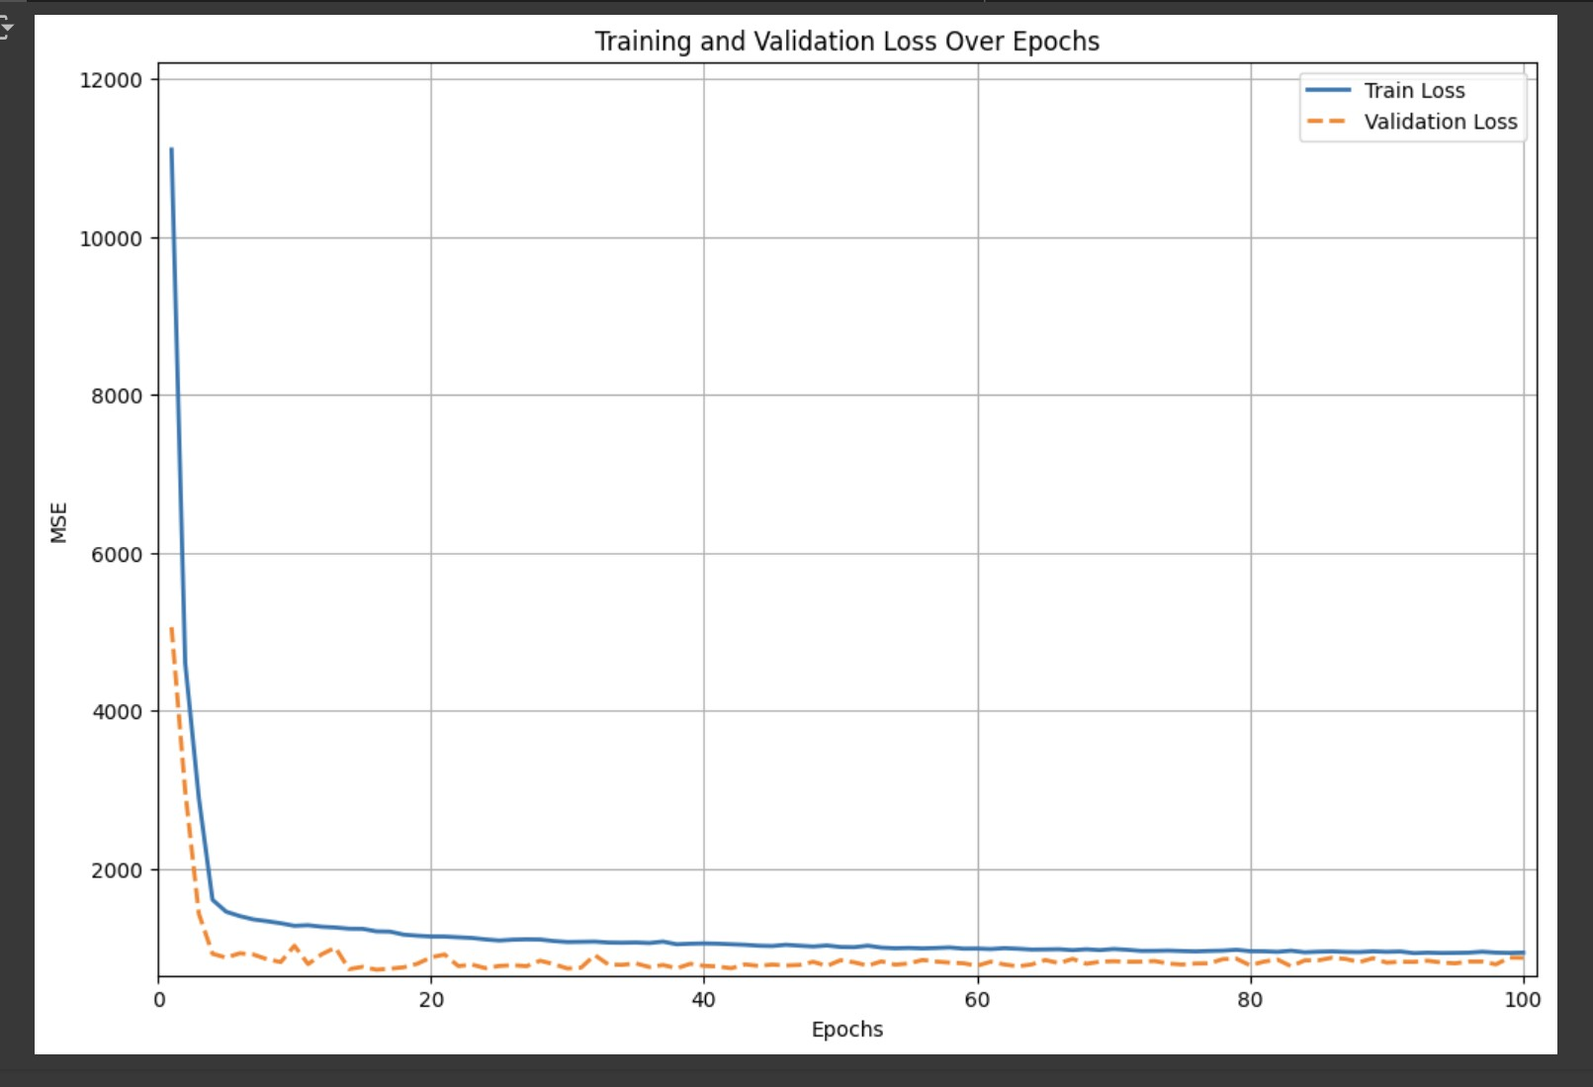
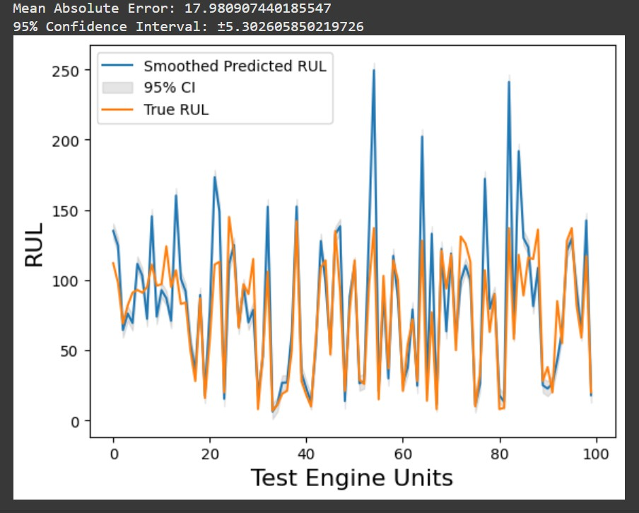
Machine Intelligence & Methods
Desired Intelligent Behaviors of the System: 1. Accurate Prediction of Remaining Useful Life (RUL):
Analyzes multivariate time-series data to predict component lifespan.
Models include LSTMs and GRUs, trained for high accuracy across diverse conditions.
Result: Model showed high degree of accuracy with MAE of ~18 Cycles and 95% Confidence Interval of ~5.3 (Dataset FD001) 2. Adaptability Across Operational Conditions:
Trained on multiple data sets (FD001, FD002, FD003, FD004) which alter altitudes, Mach numbers, and for each engine unit throttle settings.
Robust preprocessing and data augmentation enhance real-world applicability.
Result: A singular model trained on wide range of operational settings became computational cumbersome and inaccurate. Treating operational settings as hyperparameters allows for lighter weight and more accurate models.
Introduction/
Background
Datasets & Pre-processing
Machine Intelligence / GUI
Results & Lessons Learned

Slide 7
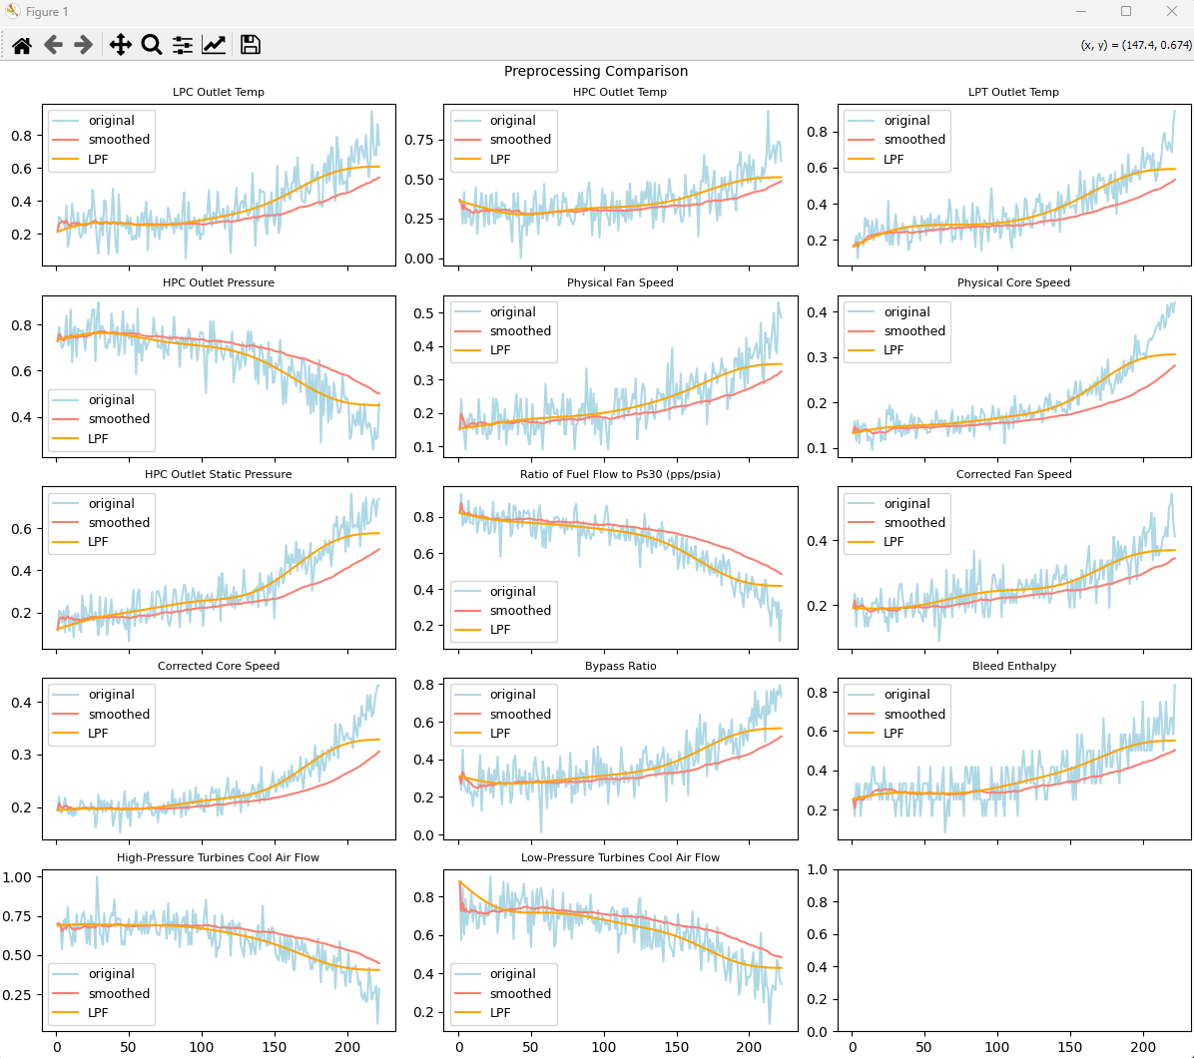
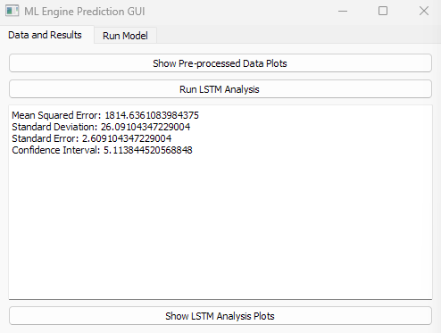
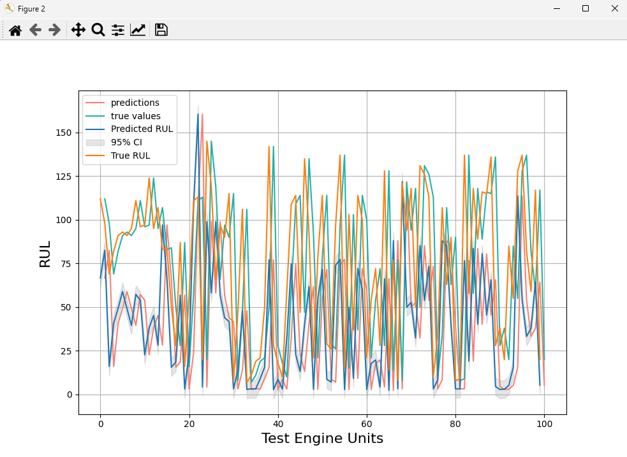
Graphical User Interface
Streamlines the processes of data visualization and model training
Consists of two tabs
Data & Results:
Perform pre-processing and display plots
Run analyses and display error / loss values
Show results in plot form
Run Model:
Adjust hyperparameters
Train Model (w/progress bar)
Choose where to export model as .pth file
Final design developed from scratch in Python using PyQT without QT Designer
Directly integrates with models and datasets
Introduction/
Background
Datasets & Pre-processing
Machine Intelligence / GUI
Results & Lessons Learned

Slide 8
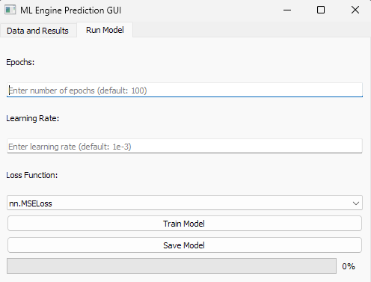
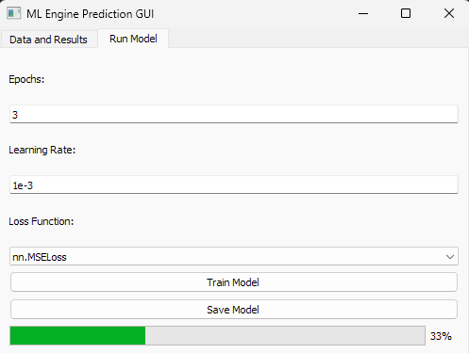
Graphical User Interface
Streamlines the processes of data visualization and model training
Consists of two tabs
Data & Results:
Perform pre-processing and display plots
Run analyses and display error / loss values
Show results in plot form
Run Model:
Adjust hyperparameters
Train Model (w/progress bar)
Choose where to export model as .pth file
Final design developed from scratch in Python using PyQT without QT Designer
Directly integrates with models and datasets
Introduction/
Background
Datasets & Pre-processing
Machine Intelligence / GUI
Results & Lessons Learned

Slide 9
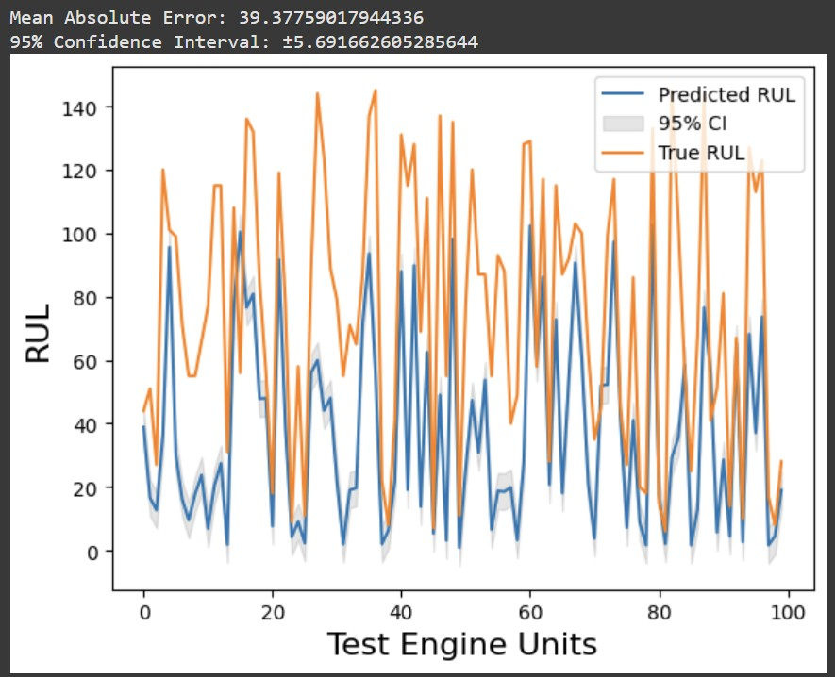
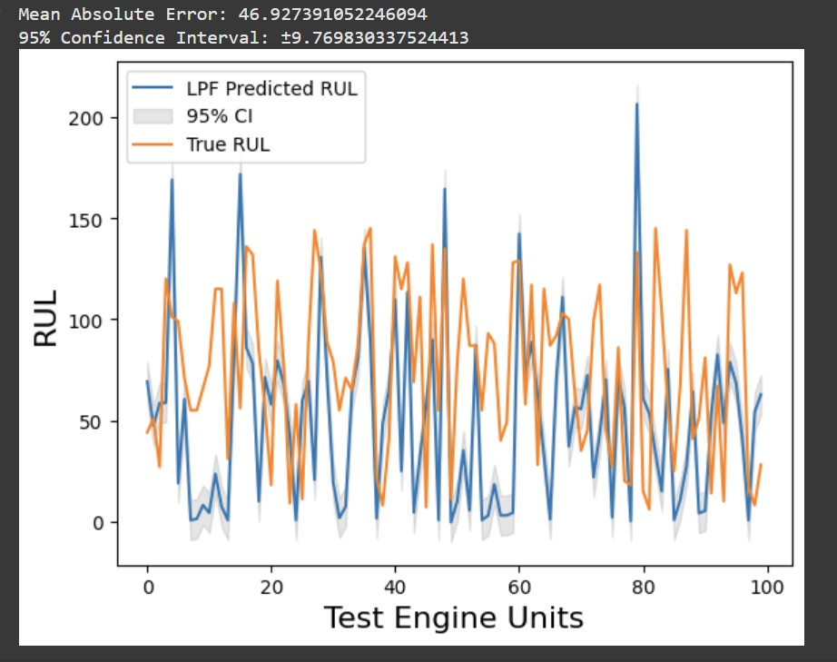
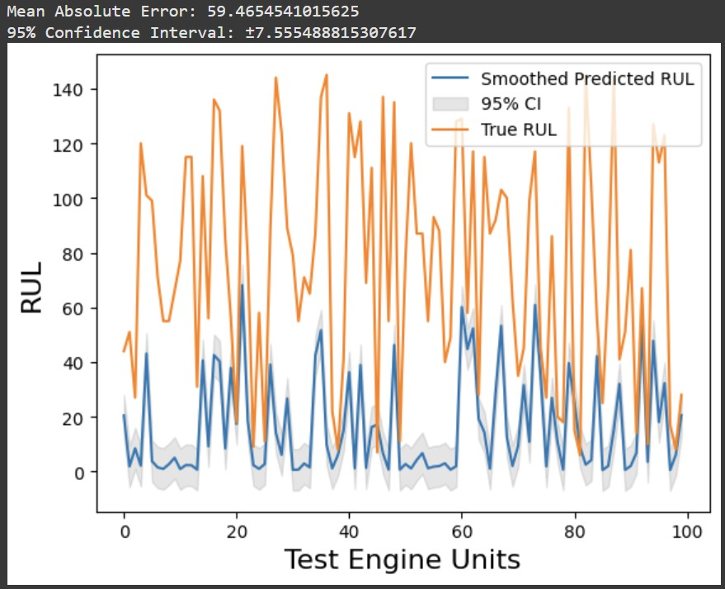
System Testing Evaluation
Evaluated model adaptability across operational conditions:
Models Trained on FD001 dataset:
Sea-level conditions with one fault mode (HPC degradation).
Used varying preprocessing: unsmoothed, smoothed, and low-pass filtered (LPF).
Tested models on FD003 dataset:
Sea-level conditions with two fault modes (HPC degradation and fan degradation).
Analyzed model performance in generalizing to datasets with additional fault modes.
Demonstrated some level of maintained accuracy but not to the same degree as validation set from FD001.
Shows the need for multiple models tailored to specific operational conditions to achieve highest level of accuracy.
UNSMOOTHED FD001 MODEL - FD003 Unsmoothed Data
LPF FD001 MODEL - FD003 LPF Data
SMOOTHED FD001 MODEL - FD003 Smoothed Data
Introduction/
Background
Datasets & Pre-processing
Machine Intelligence / GUI
Results & Lessons Learned

Slide 10
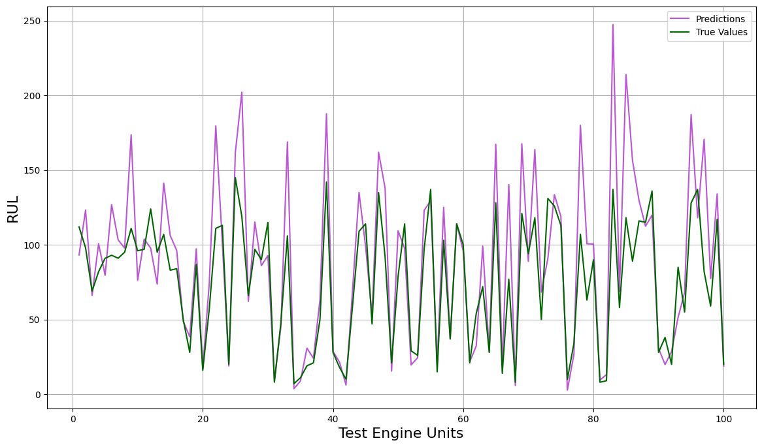
Future Work - GRU Model
The framework for a Gated Recurrent Model (GRU) was created and tested on with the unsmoothed data for future research
Simpler structure than LSTM, allowing for faster runtimes and better efficiency for larger datasets
Found to be achieving lower loss values than LSTM for the unsmoothed data:
LSTM: Avg Train Loss: 653.38 Val Loss: 780.58
GRU: Avg Train Loss: 828.48 Val Loss: 813.45
Runtime marginally better (on order of a couple minutes), dataset not large enough to matter
Introduction/
Background
Datasets & Pre-processing
Machine Intelligence / GUI
Results & Lessons Learned

Slide 11
Conclusions
Both machine learning methods successfully learned from the training set and made RUL predictions
LSTM and GRU ended up only having marginal differences in run time and accuracy
GRU was less accurate but ran slightly faster
Conceptually proved the potential application of ML in predictive maintenance for engineering applications
Further work can be further developed to enhance current model
Multiple models tailored to specific operational conditions.
Lessons Learned
Aim to reduce computational cost while maintaining model accuracy
GUI development should start during the initial phases of system development and continue to evolve as the model develops
Collaborating in one shared space like github from the start would have been more time efficient
Data handling is critical for development of a RNN type model.
Signal filtering parameters such as LPF cutoff frequency should be tuned per signal variable and are not one-size-fits-all
Introduction/
Background
Datasets & Pre-processing
Machine Intelligence / GUI
Results & Lessons Learned

Slide 12
Appendices
Appendix A - Git Repository
https://github.com/AME505-Group-5/Engine_Predictive_Maintenance_Project
Appendix B - Google Colab
https://colab.research.google.com/drive/1zo4-VFkkQWz9BQUup_ucSPGptmHWrnVZ#scrollTo=O6L6i4vJ0cVX
Introduction/
Background
Datasets & Pre-processing
Machine Intelligence / GUI
Results & Lessons Learned

