Slide 1
Sales & Category Performance Analysis
Insights from Sample Superstore Dataset

Slide 2
Business Goal
Objective:
- Identify top-performing products and sales trends
- Optimize inventory and marketing focus

Slide 3
PROCESS in POWER BI
Import and Load the data
Transform the data
Make the first column a header
Change datatype
Do apply filters if necessary
Replace null values
Close and apply

Slide 4
Overall Sales by Product
Insights:
- Canon imageCLASS 2200 significantly outperforms all other products
- Sales are heavily skewed toward a few top products
Implications:
- Focus marketing and inventory on high performers
- Promote mid-tier products to increase revenue

Slide 5
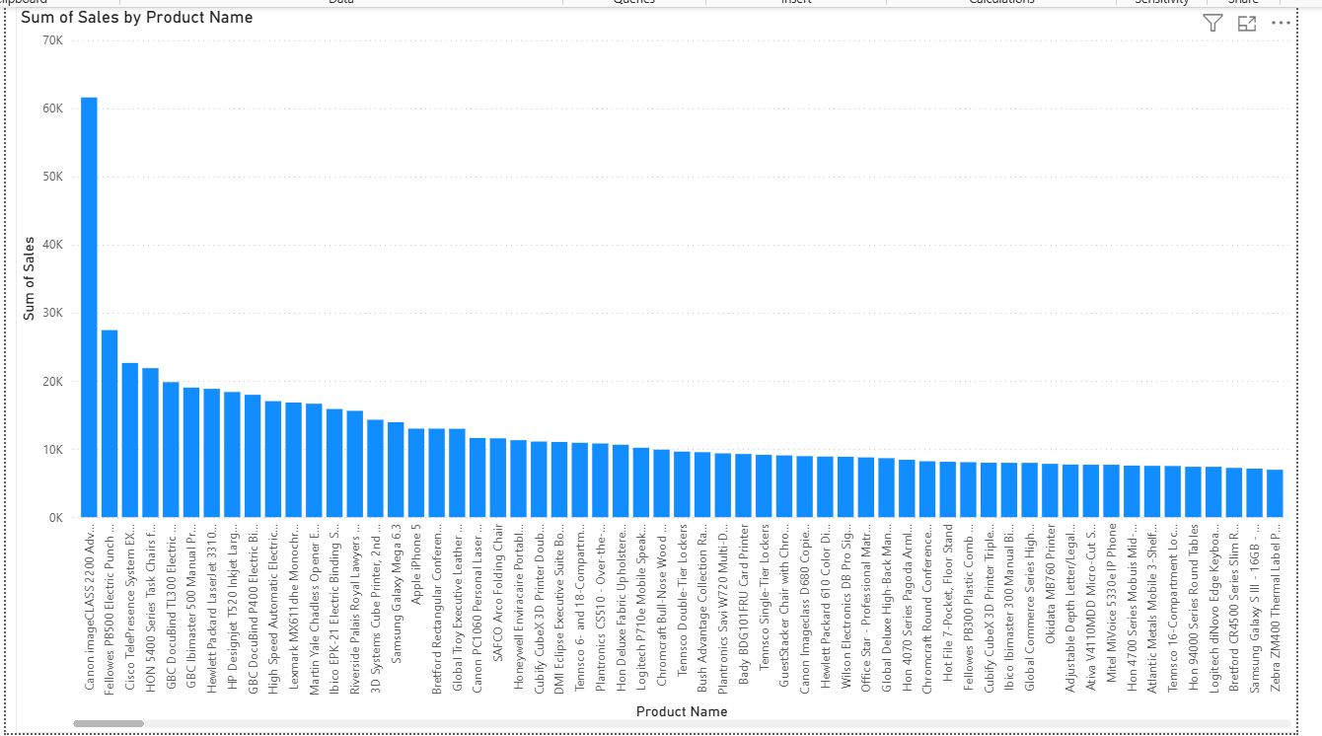

Slide 6
Quantity Sold by Category
Insights:
- Office Supplies lead in volume sold
- Technology and Furniture have lower quantities despite potential high value
Implications:
- High volume doesn't always mean high profit
- Reassess category strategies based on margins

Slide 7
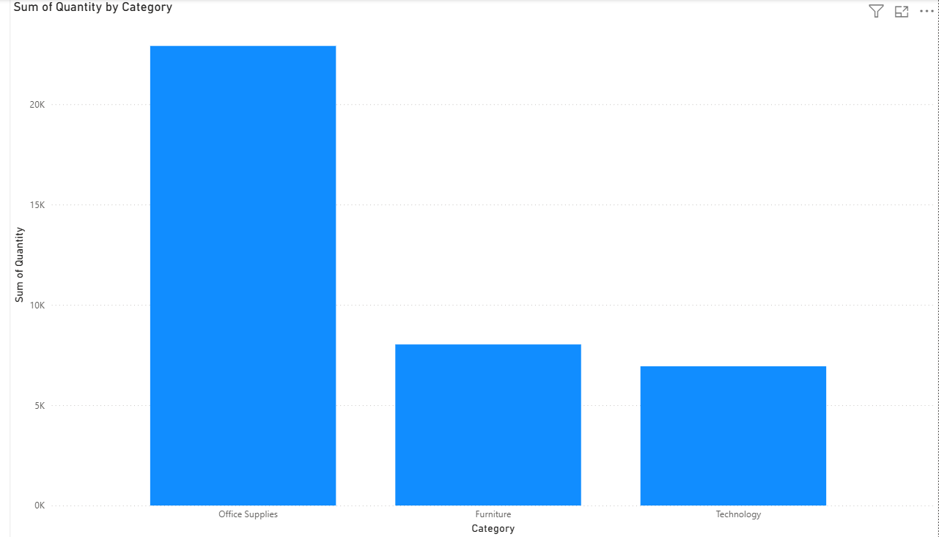

Slide 8
Profit Gained By region
Insights:
West region leads with the profit gained
Central region holds the last in profit and shows that the products are not sold that much
Implications:
Focus on advertising based on region
Giving discount may boost the profit

Slide 9
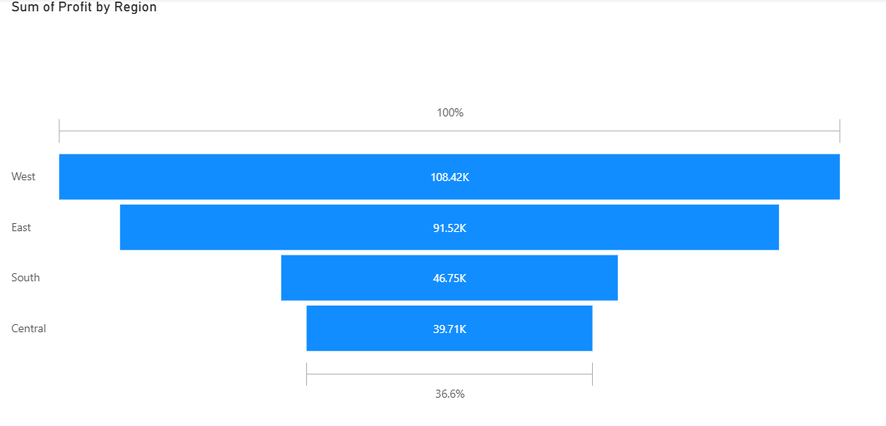

Slide 10
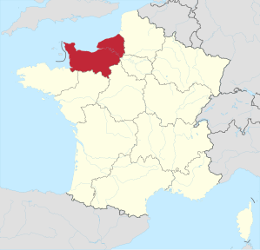
Key Takeaways
🏆 Canon imageCLASS 2200 is the top sales performer product
📦 Office Supplies dominate in quantity
West Region shows more profit in sales
🎯 Opportunity to grow underperforming categories with targeted marketing

Slide 11
Recommendations
- Maintain inventory for high-selling products
- Analyze category profitability in detail
- Use bundles or discounts for mid-tier products

