Slide 1
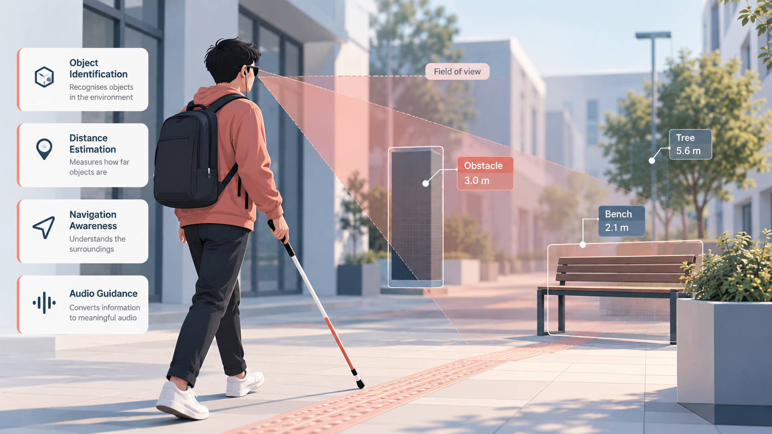

PROJECT PRESENTATION
Echo Vision
An AI-powered assistive perception system for
visually impaired individuals
Unity-based digital twin approach
Nandeesh S · Monesh D · Madhan S
Department of CSE (AI & ML)
Sri Sairam Engineering College
Notes:
1

Slide 2
Introduction
Echo Vision is an AI-powered assistive perception concept that aims to help visually impaired individuals understand their surroundings through intelligent environmental sensing and meaningful information delivery.
The system will combine virtual environment simulation, computer vision concepts and spatial perception to turn raw environmental information into clear guidance.
Development follows a Unity-based digital twin approach. Perception capabilities will first be designed and refined in a virtual environment, before any physical hardware is introduced.
02
Notes:
2

Slide 3
Problem Statement
Visually impaired individuals find it difficult to identify objects along their path, to judge how far obstacles are, and to move through unfamiliar places without assistance. Conventional mobility aids support physical navigation, but offer limited contextual information about what lies ahead.
Obstacle awareness
Distance awareness
Environmental understanding
Unfamiliar environments
Problem definition. To develop an intelligent assistive perception system that interprets environmental information and provides meaningful feedback to visually impaired individuals.
03
Notes:
3

Slide 4
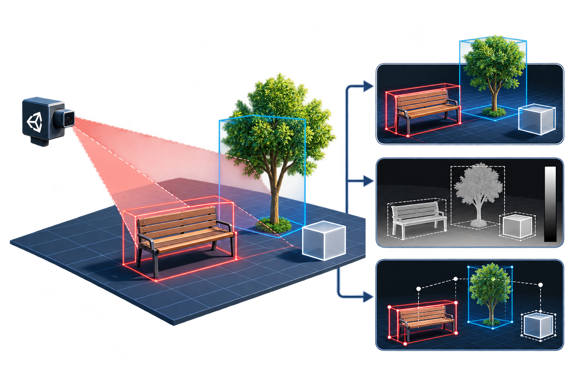
Objectives
01
Build a Unity-based digital twin of
real-world surroundings
02
Establish a virtual camera-based capture
system
03
Detect ground surfaces and potential
obstacles
04
Identify objects and estimate their
distances
05
Develop a structured environmental
perception pipeline
06
Lay the foundation for audio guidance
and hardware integration
04
Notes:
4

Slide 5
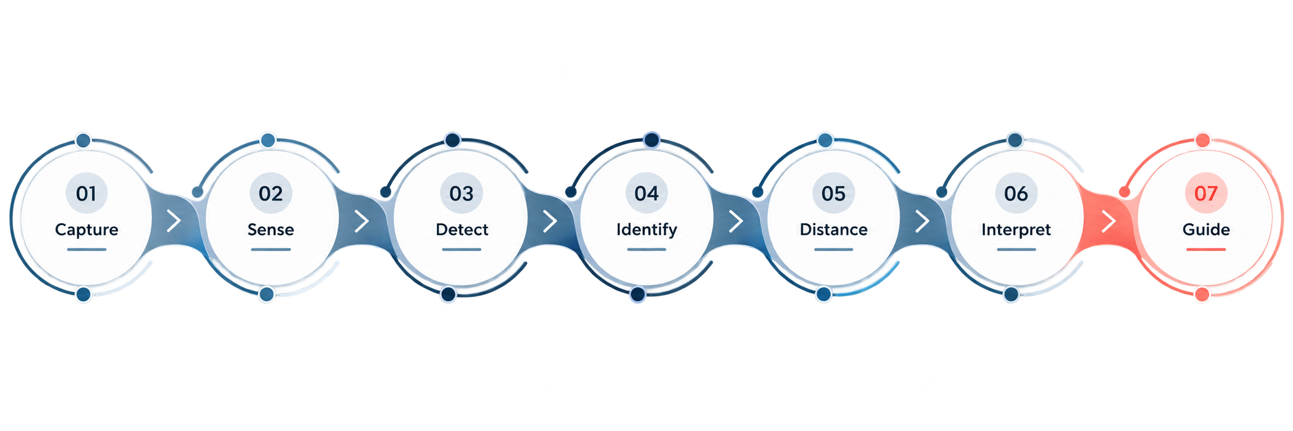
Proposed Solution
Echo Vision proposes an integrated pipeline that captures the surrounding environment, analyses it, and converts the result into understandable guidance. A virtual camera will observe the Unity scene, and a custom perception component will process what it sees.
05
Notes:
5

Slide 6
Digital Twin Methodology
A digital twin is a virtual representation of a physical environment that can be modelled, observed and evaluated.
Field of view
Unity will serve as this virtual environment, giving the perception pipeline controlled, repeatable scenes with flexible object placement and less early dependence on hardware.
Structure
Obstacle
3.0 m
Virtual camera
ECHO VISION | OBSTACLE | Distance: 3.0 m
Concept illustration
06
Notes:
6

Slide 7
System Architecture
LAYER 01
LAYER 02
LAYER 03
Environmental layer
Capture layer
Virtual sensing layer
Represents the virtual surroundings: ground surfaces, structures, obstacles and scene objects.
Captures the rendered environment through the virtual camera feed, ECHO_VISION_CameraFeed (256 × 256).
ECHO_VISION_RangeSensor acquires the rendered output and runs the scanning logic.
LAYER 04
LAYER 05
LAYER 06
Perception layer
Information layer
Assistive output layer
Ground detection, obstacle detection, object identification and distance estimation.
Organises perception results into structured information for higher-level functions.
Translates environmental information into understandable audio guidance.
07
Notes:
7

Slide 8
Perception Workflow
The Unity camera will render the virtual scene into a 256 × 256 camera feed. A custom sensing component, ECHO_VISION_RangeSensor, will acquire each rendered frame through the RenderPipelineManager.endCamera event and run the scanning logic.
For every detection, the system will report what was found, whether it is ground or an obstacle, which object it belongs to, and its estimated distance.
PLANNED OUTPUT FORMAT
PLANNED AUDIO GUIDANCE
ECHO VISION | GROUND | Distance
ECHO VISION | OBSTACLE | Object | Distance
Obstacle ahead, about three metres
08
Notes:
8

Slide 9
Technology Stack
Unity 3D
C#
Unity Camera
Virtual environment and digital twin
Sensing and perception programming
Environmental image capture
Rendering pipeline
Computer vision and AI
Audio technology
Camera-feed acquisition
Environmental interpretation
Assistive information delivery
09
Notes:
9

Slide 10
Expected Impact
Echo Vision is intended to contribute to accessibility and assistive technology by giving users meaningful information about nearby objects, obstacles and spatial conditions.
01
02
03
04
Independence
Awareness
Confidence
Inclusion
Informed movement
Spatial understanding
Less uncertainty
Accessible technology
10
Notes:
10

Slide 11
Development Roadmap
The project will progress through six phases, moving from a simulated environment towards validation in real-world conditions.
PHASE 01
PHASE 02
PHASE 03
Digital twin environment
Environmental perception
Contextual understanding
Develop and organise the virtual environment for assistive perception.
Refine ground and obstacle detection, object identification and distance estimation.
Interpret multiple environmental elements together, in context.
PHASE 04
PHASE 05
PHASE 06
Audio guidance
Hardware integration
Real-world validation
Develop an audio feedback approach for perception information.
Explore integration with suitable physical sensing and computing components.
Evaluate reliability, usability and effectiveness in real environments.
11
Notes:
11

Slide 12
Conclusion
Echo Vision sets out to turn environmental information into meaningful guidance for visually impaired individuals. By developing perception in a Unity-based digital twin first, the project creates a controlled foundation for sensing, detection and distance estimation.
Audio guidance and physical hardware integration will then build on this tested foundation.
Helping people experience their surroundings beyond what their eyes can see.
12
Notes:
13

Slide 13
Thank You
Nandeesh S · Monesh D · Madhan S
Echo Vision | Sri Sairam Engineering College
Notes:
14

