Slide 1
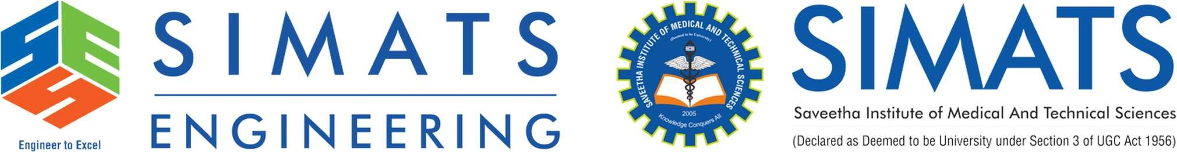
Morphological Analysis for Indian
Languages
NATURAL LANGUAGE PROCESSING –DSA0308
G.PALLAVI
192472203
AV.AMEYA
192472036

Slide 2
Introduction
Morphological processing is an important part of Natural Language Processing (NLP).
It studies the internal structure and formation of words.
It identifies root words, prefixes, suffixes, and grammatical features.
Indian languages such as Tamil, Hindi, and Telugu have complex word-formation rules.
A single root word can produce many forms by adding suffixes.
Morphological processing helps computers understand tense, gender, number, and case.

Slide 3
BASIC CONCEPTS
Morpheme: The smallest meaningful part of a word.
Root Word: The main part of a word that carries its basic meaning.
Prefix: A part added before a root word.
Suffix: A part added after a root word to change its meaning or grammar.
Inflection: Changing a word form to show tense, number, gender, or case
Examples:
Unhappy = Un + Happy
Playing = Play + ing
Cats = Cat + s.

Slide 4
3. Language-specific challenges
Language | Major challenge | Possible solution
Tamil | Complex suffix combinations and stem changes | Suffix analysis and language-specific rules
Hindi | Gender, number, case, and agreement variations | Grammar rules and contextual models
Telugu | Long suffix sequences and agglutination | Root extraction and morphological segmentation

Slide 5
Common techniques used
Rule-based approach: Uses predefined grammar and word-formation rules.
Statistical approach: Learns word patterns from annotated language data.
Machine learning: Uses trained models to predict roots and grammatical features.
Deep learning: Uses neural networks and transformer models to understand context.
Hybrid approach: Combines linguistic rules with machine learning for better accuracy.

Slide 6
Proposed workflow
Input text in Tamil, Hindi, or Telugu
Text normalization
Morphological segmentation
Root word and grammatical feature identification
Output: root, suffixes, tense, number, and case where applicable

Slide 7
Applications
Machine translation between Indian languages.
Search engines that recognize different forms of the same word.
Spell-checking and grammar correction.
Speech recognition and voice assistants.
Sentiment analysis of social media content.
Information retrieval from regional-language documents.

Slide 8
Conclusion
Morphological processing helps computers understand word structure.
Tamil, Hindi, and Telugu have complex word-formation rules.
Grammar and spelling variations are major challenges.
Rule-based methods and machine learning help solve these problems.
It improves NLP applications such as translation, speech recognition, and text analysis.

Slide 9
FUTURE SCOPE
AI Improvement: Develop more accurate AI models for Indian languages.
Better Translation: Improve translation between Tamil, Hindi, Telugu, and English.
Voice Assistants: Build smarter voice assistants that understand regional languages.
More Datasets: Create more language datasets for better processing.
Real-World Applications: Use morphological processing in education, healthcare, and communication systems.

Slide 10
References
Jurafsky, D., and Martin, J. H. Speech and Language Processing.
Bharati, A., Chaitanya, V., and Sangal, R. Natural Language Processing: A Paninian Perspective, 1995.
Manning, C. D., and Schütze, H. Foundations of Statistical Natural Language Processing, 1999.
Richard Sproat. Morphology and Computation, 1992.
Research papers on morphological analysis of Tamil, Hindi, and Telugu in Natural Language Processing (NLP).

Slide 11


