Slide 1
Support tool for visualisation of undergraduate module information in EEE
Andrew Fagan & Dr. Graeme West

Slide 2
Aims
Web based system for managing undergraduate module information
Improve access to MDF information at year and course level
Improve management of MDF information

Slide 3
Key Functions
Database structure based on MDF template, with additional fields/tables which might be useful
Bulk pre-populated with existing MDF descriptors (45 UG classes).
Front end to allow MDF details to be updated
Function to autogenerate MDF document as pdf/web
Easier to maintain and use than existing MDF
Once the info is in the database, there is no need to duplicate
Additional views (assessment schedule, module prerequisites, Rudimentary staff to module association)

Slide 4
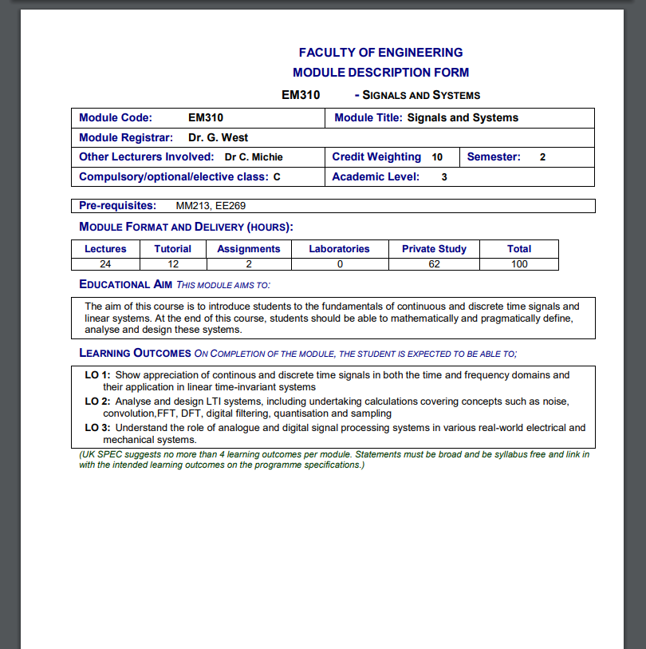
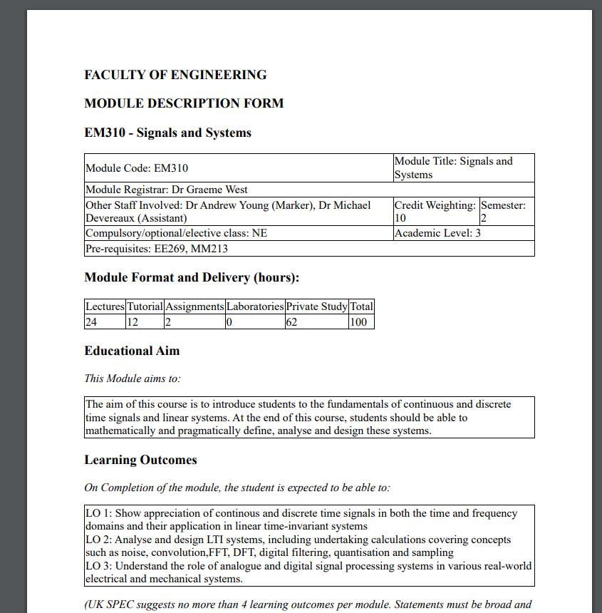
Sample MDF – Old Vs New
We can easily pull all the same data back out, and it can look however we want.
Colour and other aesthetics are easy to change.

Slide 5
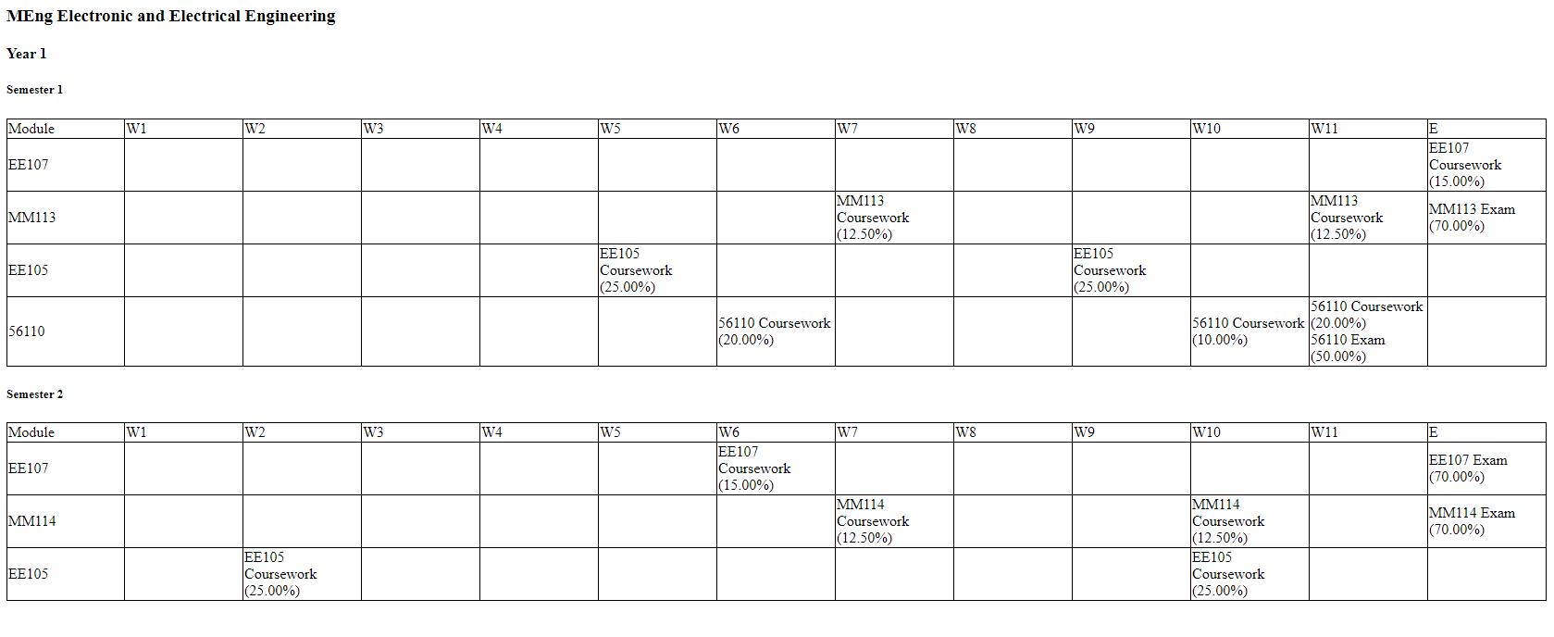
Examination Timeline View
A new view made possible by the database representation. Shows each semester broken
down into 11 week + Exam period timelines with all deadlines represented

Slide 6
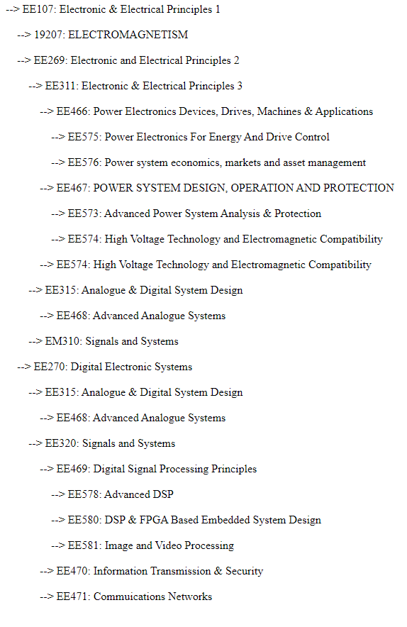
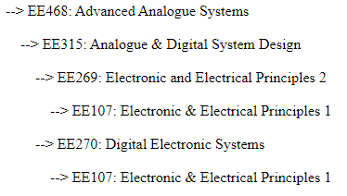
Class Dependency View
We can also span the data to
automatically derive classes which follow on from or require one another.
Shown here are all classes which require EE107 (→) and all classes which are required for EE468 (↓).
Note the repetition: classes are represented under several parents. This is deliberate, to show all requirements of each class in the tree, and is easy to change for other views.

Slide 7
Example: Staff workload
System already supports named staff members and class – staff relationships.
We know the total number of lecture, tutorial and lab hours for a single student from the existing MDFs. By accounting for either class size or number of lab/tutorial groups, it would be easy to calculate the total number of staff hours required of a given module.
This could also allow staff to see their total teaching commitment at any given time.

Slide 8
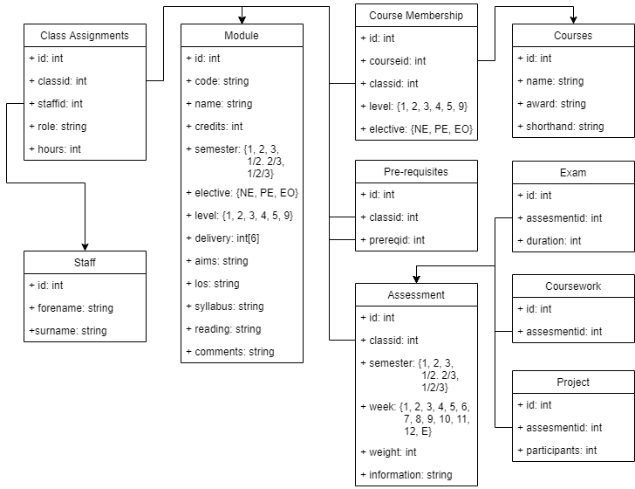
Database Schema
Notes:
Pros: Highly normalised, extremely robust, modifiable and extensible.
Cons: Slow access due to distributed nature

Slide 9
Sample MDF – Old Vs New
We can easily pull all the same data back out, and it can look however we want.
Colour and other aesthetics are easy to change.

Slide 10
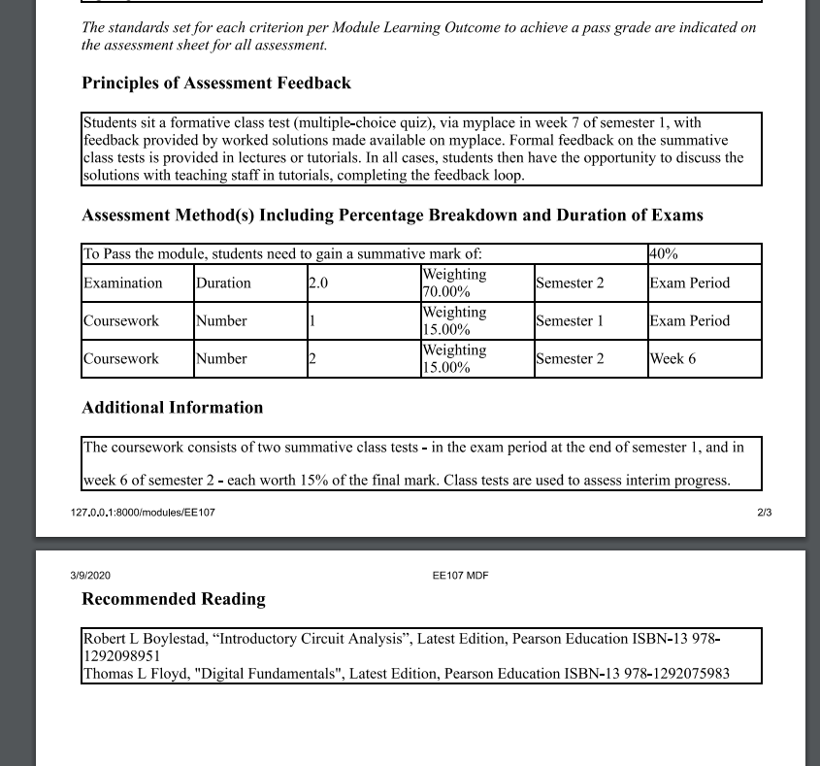
Sample MDF – Old Vs New
We can easily pull all the same data back out, and it can look however we want.
Colour and other aesthetics are easy to change.

Slide 11
Extensibility
Decoupling -> easy addition of new features.
Simple data structures -> can create new views and span the DB in many ways
Highly normalised DB -> changes can be made painlessly, and additional data sources can be brought in with little or no updating.
Example: Could connect to existing DBs of staff, or classes easily to combine data into meaningful views

Slide 12


