Slide 1
Support tool for visualisation of undergraduate module information in EEE
Andrew Fagan & Dr. Graeme West

Slide 2
What we’ve done
SQL database backend storing data on modules, courses and staff
Generating MDFs back from DB
Django Based Web App frontend for modifying DB and viewing useful information
Very much a prototype, should be integrated with Pegasus/Intranet/etc for real use.

Slide 3
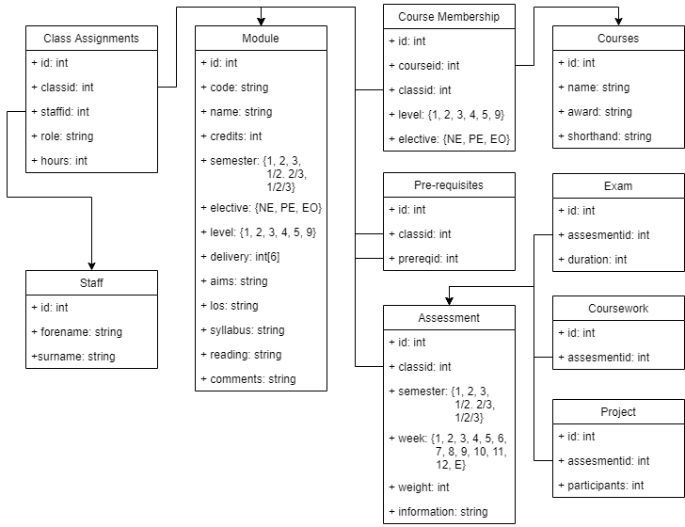
Database Design
Notes:
Pros: Highly normalised, extremely robust, modifiable and extensible.
Cons: Slow access due to distributed nature

Slide 4
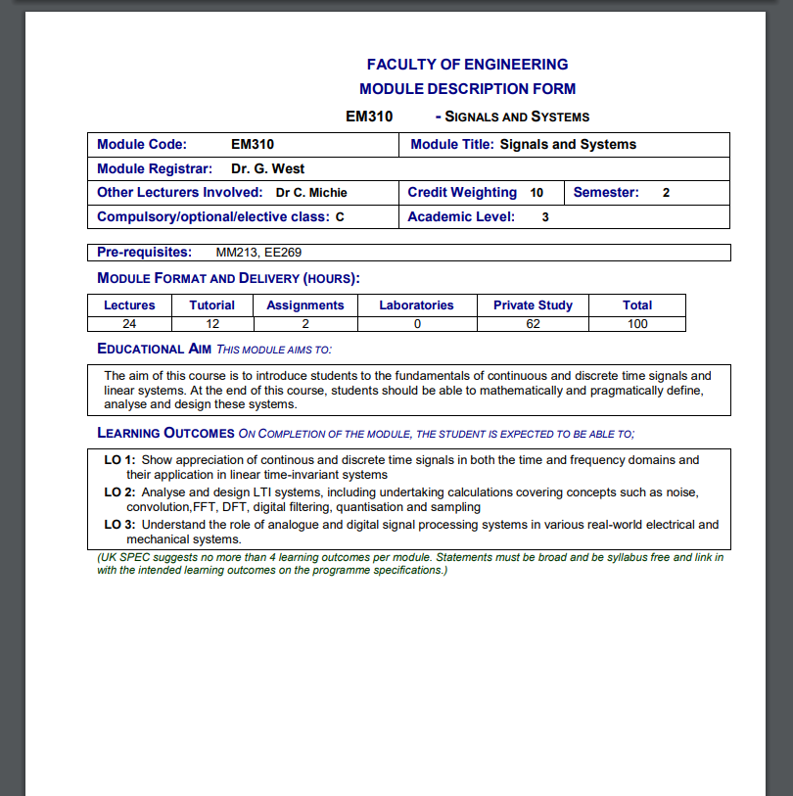
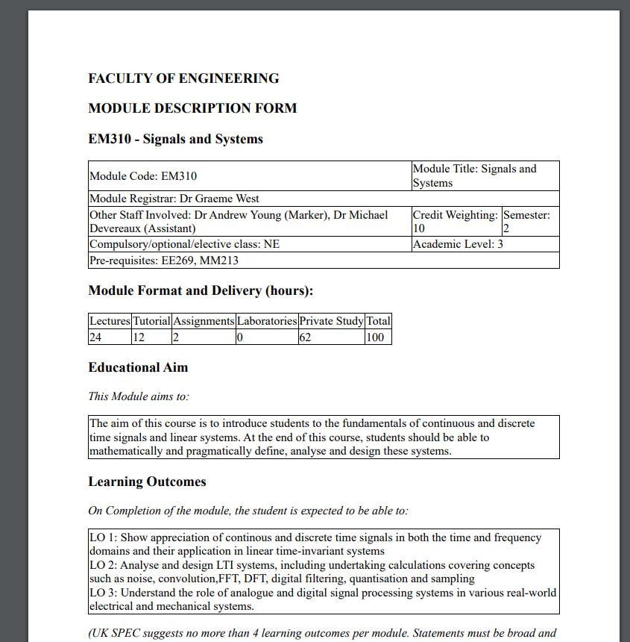
Sample MDF – Old Vs New
We can easily pull all the same data back out, and it can look however we want.
Colour and other aesthetics are easy to change.

Slide 5


