Slide 1
Support tool for visualisation of undergraduate module information in EEE
Andrew Fagan & Dr. Graeme West

Slide 2
Aims
Web based system for managing undergraduate module information
Improve access to MDF information at year and course level
Improve management of MDF information

Slide 3
Key Functions
Database structure based on MDF template, with additional fields/tables which might be useful
Bulk pre-populated with existing MDF descriptors (45 UG classes).
Front end to allow MDF details to be updated
Function to autogenerate MDF document as pdf/web
Easier to maintain and use than existing MDF
Once the info is in the database, there is no need to duplicate
Additional views (assessment schedule, module prerequisites, Rudimentary staff to module association)

Slide 4
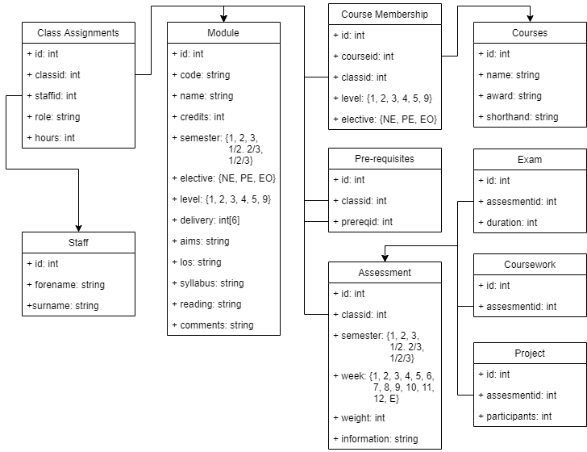
Database Schema
Notes:
Pros: Highly normalised, extremely robust, modifiable and extensible.
Cons: Slow access due to distributed nature

Slide 5
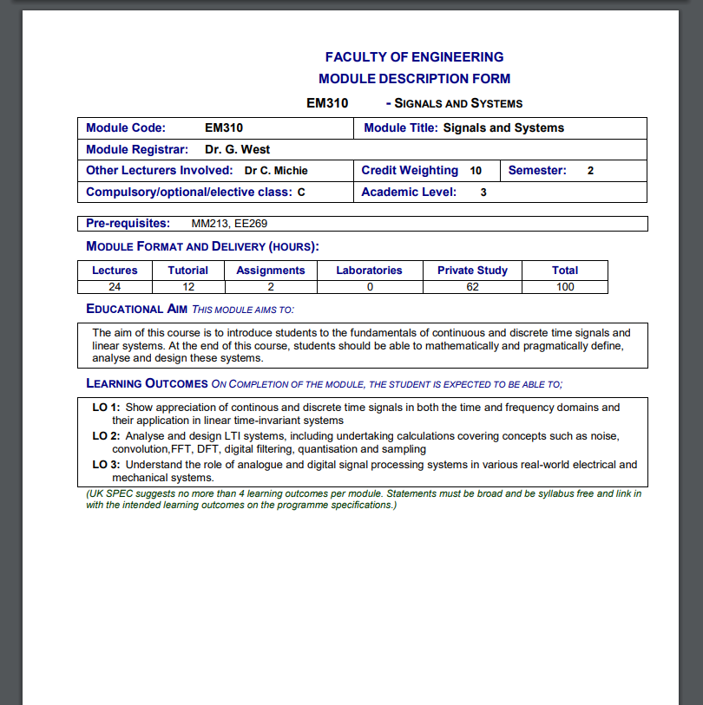
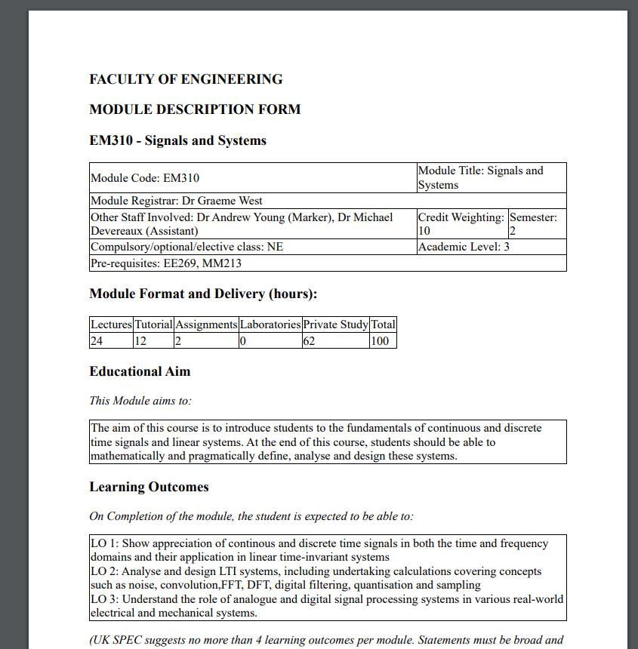
Sample MDF – Old Vs New
We can easily pull all the same data back out, and it can look however we want.
Colour and other aesthetics are easy to change.

Slide 6


