Slide 1
SMART PARKING MANAGEMENT SYSTEM
PIP2001 Capstone Project
Review-1
Batch Number:
Under the Supervision of,
Dr. Sudha Y
Assistant Professor
School of Computer Science and Engineering
Presidency University
Roll Number | Student Name
20211CIT0159 | VENKATESH N DHARWARD
20211CIT0142 | SANIYA KOUSAR
20211CIT0155 | JAGRUTHI S REDDY
Name of the Program: CSE-IOT
Name of the HoD: Dr. S P ANANDRAJ
Name of the Program Project Coordinator: Dr. NAGARAJA S R
Name of the School Project Coordinators: Dr. Sampath A K

Slide 2
Introduction
The rapid urbanization and growth of cities have led to a significant increase in the demand for parking spaces. Traditional parking management methods are often inefficient and time-consuming, resulting in congestion and frustration for drivers. To address these challenges, the development of smart parking systems has become increasingly important.
Smart parking systems utilize advanced technologies, such as computer vision and sensor networks, to monitor and manage parking availability in real-time. By providing accurate information about available parking spaces, these systems can help drivers locate empty spots efficiently and reduce traffic congestion.

Slide 3
Literature Review
Existing research on smart parking systems has explored various approaches and techniques. Some common methods include:
Image-based detection: This approach involves using cameras to capture images of parking areas and applying computer vision algorithms to detect vehicles and identify empty parking spaces.
Sensor-based detection: This method utilizes sensors, such as magnetic sensors or ultrasonic sensors, to detect the presence or absence of vehicles in parking spaces.
Hybrid approaches: These systems combine image-based and sensor-based methods to improve accuracy and robustness.

Slide 4
Existing method Drawback
While significant progress has been made in the field of smart parking, several challenges remain:
Inconsistent detection: Existing methods often struggle with inaccuracies due to factors such as varying vehicle angles, lighting conditions, and visual obstructions.
Manual intervention: Many systems require manual marking of parking spaces, which is time-consuming and prone to errors.
Scalability: Scaling smart parking systems to large parking areas can be challenging, especially in terms of computational resources and data management.

Slide 5
Proposed Method
To address the limitations of current approaches, this research proposes a novel smart parking system that leverages deep learning techniques for improved accuracy and efficiency. The proposed method consists of the following steps:
Data acquisition: Collect a large dataset of images from security cameras depicting parking areas.
Preprocessing: Apply image preprocessing techniques to enhance the quality of the images and prepare them for further analysis.
Parking slot identification: Use deep learning models, such as convolutional neural networks (CNNs), to automatically identify and define parking spaces within the images.
Vehicle detection: Employ object detection algorithms, such as YOLO to detect vehicles within the identified parking spaces.
Occupancy detection: Determine whether a parking space is occupied or empty based on the presence or absence of detected vehicles.
Real-time updates: Integrate the system with a real-time database to provide up-to-date information about parking availability.

Slide 6
Objectives
The primary objectives of this research are:
To develop a highly accurate and robust smart parking system that can reliably detect empty parking spaces in real-time.
To automate the process of parking slot identification and vehicle detection, eliminating the need for manual intervention.
To create a scalable system that can handle large parking areas and adapt to changing environmental conditions.
To improve the user experience by providing timely and accurate information about parking availability.

Slide 7
Methodology/Modules
Data Acquisition Module: CCTV Cameras or Parking Lot Images/Videos
Image Preprocessing Module: Image Conversion and Re-Scaling, Image Augmentation
Object Detection Module: Uses YOLOv8 to detect and annotate parking lot
License Plate Detection Module: Uses YOLOv8 to identify vehicles and employs a pre-trained plate detection model to detect license plates
Character Extraction Module: Uses EasyOCR to extract the characters from the detected license plates.
Data Logging Module: Stores extracted data (license plate numbers, parking slot information) in a Firebase database.
User Interface Module: Javascript based web application for displaying the relevant information to users, such as: Parking occupancy status, Maps, Available parking spaces
System Integration Module: Usage of Frameworks such as FlaskAPI to integrate the frontend and backend

Slide 8
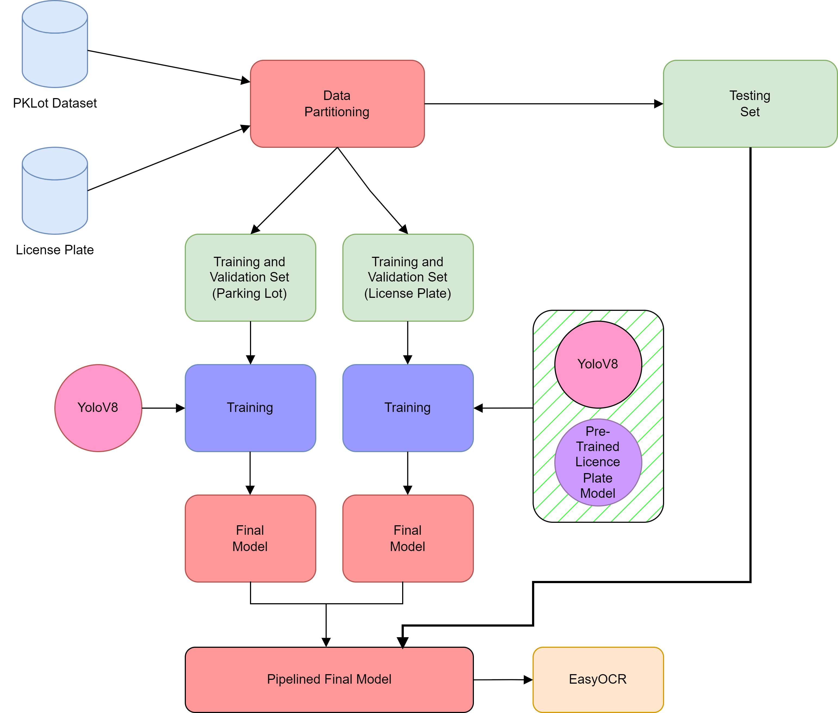
Architecture

Slide 9
Hardware/software components
Software Components:
FRONTEND :
Tools: Visual Studio Code, Chrome Dev Tools, NPM
Languages: HTML, CSS, JavaScript, jQuery
BACKEND :
Languages: Python
Libraries: TensorFlow, OpenCV, NumPy, Matplotlib, Flask, Leaflet
Tools: Visual Studio Code, Git
Hardware Components:
1080p Web Camera (Prototype CCTV)

Slide 10
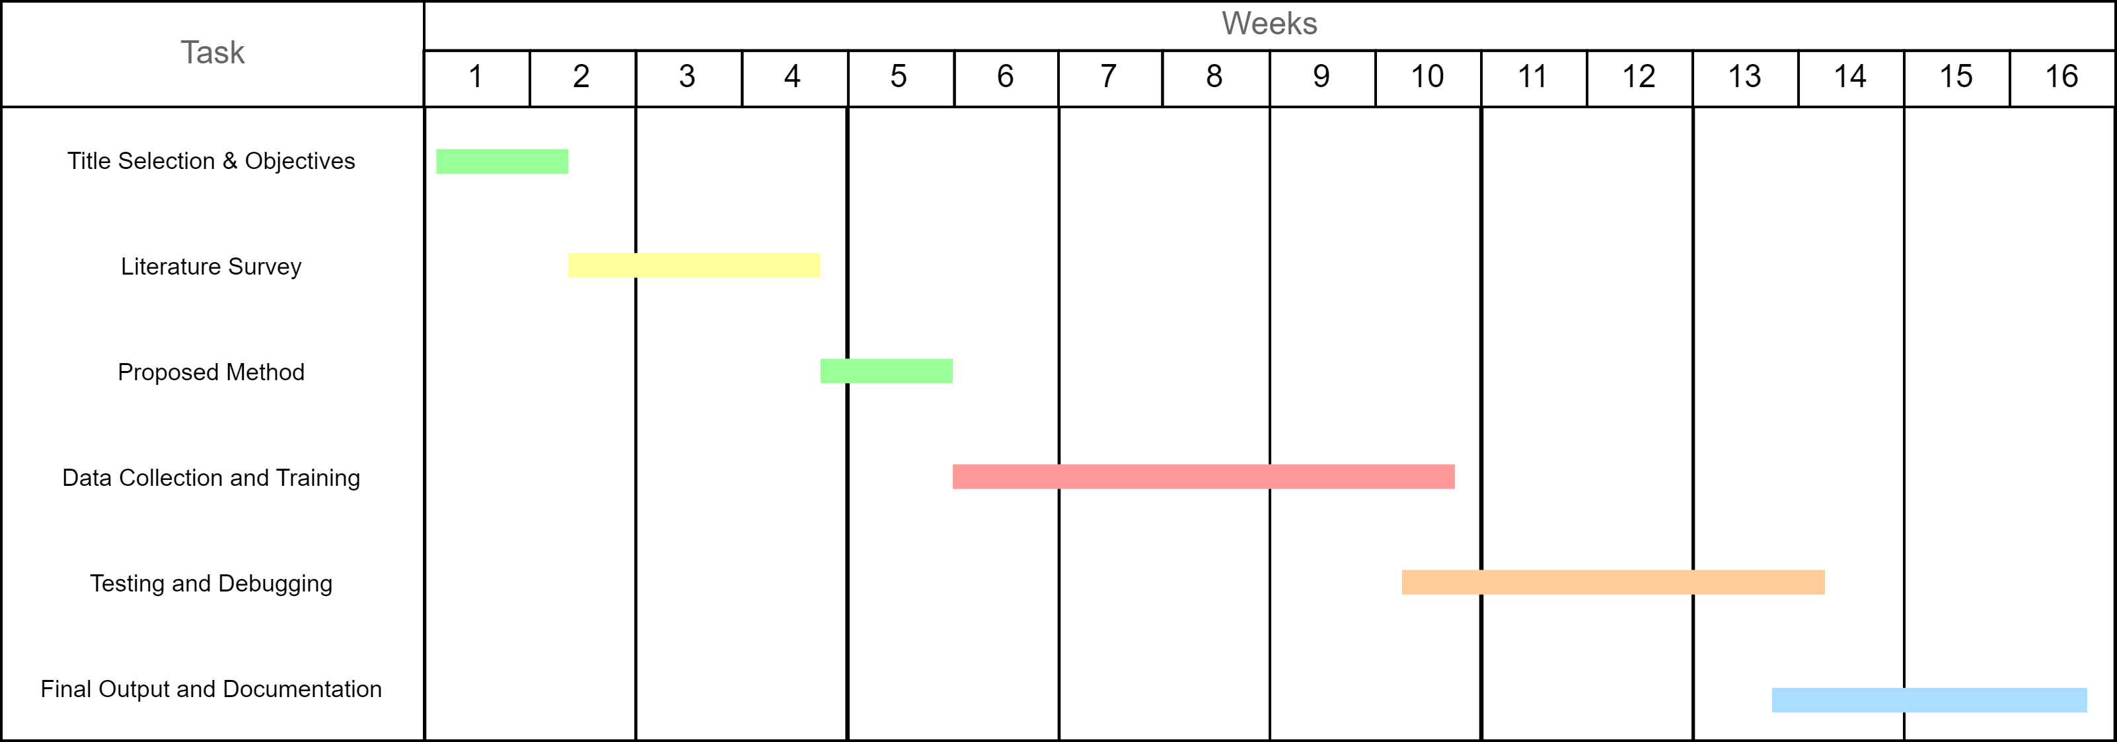
Timeline of Project

Slide 11
Outcomes
The expected outcomes of this research are:
Improved accuracy: The proposed smart parking system is expected to achieve significantly higher accuracy in detecting empty parking spaces compared to existing methods, even in challenging conditions.
Reduced manual effort: The system will eliminate the need for manual marking of parking spaces, saving time and resources.
Real-time updates: The system will provide real-time information about parking availability, enabling drivers to make informed decisions and reduce search times.
Scalability: The system will be designed to handle large parking areas and adapt to changes in camera configurations or environmental conditions.
Enhanced user experience: The system will provide a more convenient and efficient parking experience for drivers, reducing frustration and improving overall satisfaction.

Slide 12
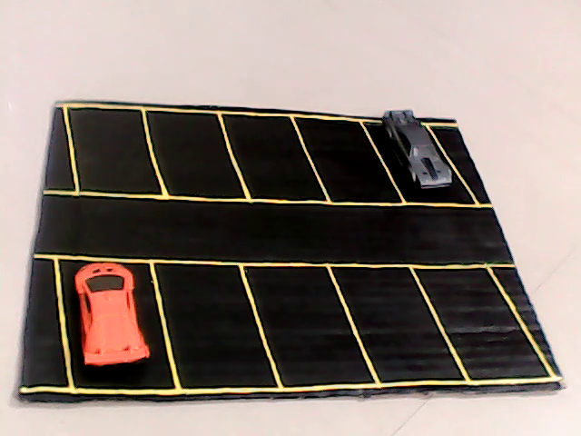
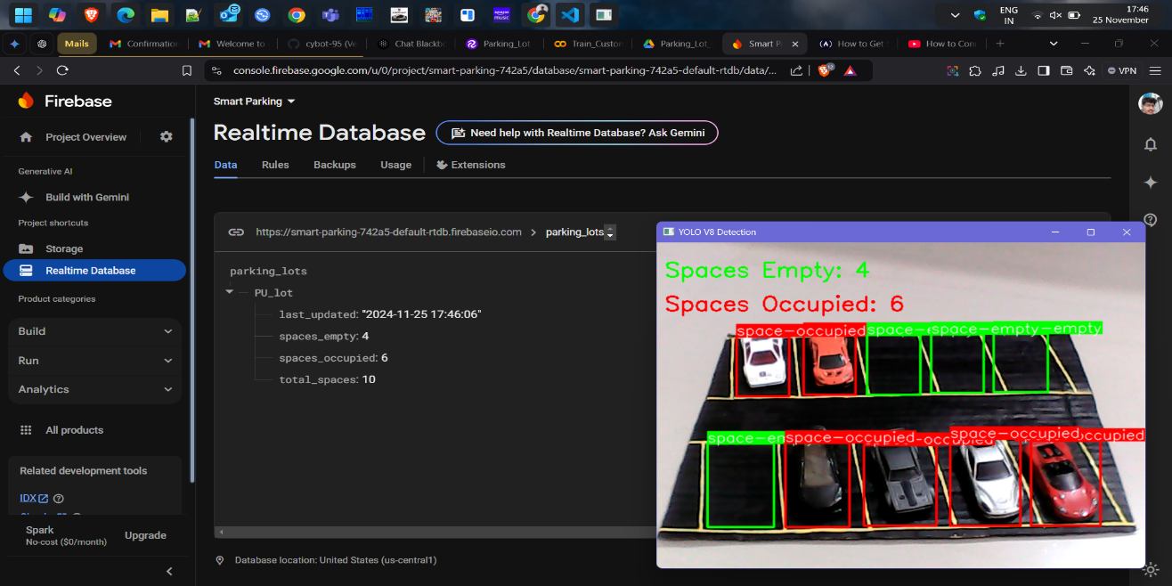
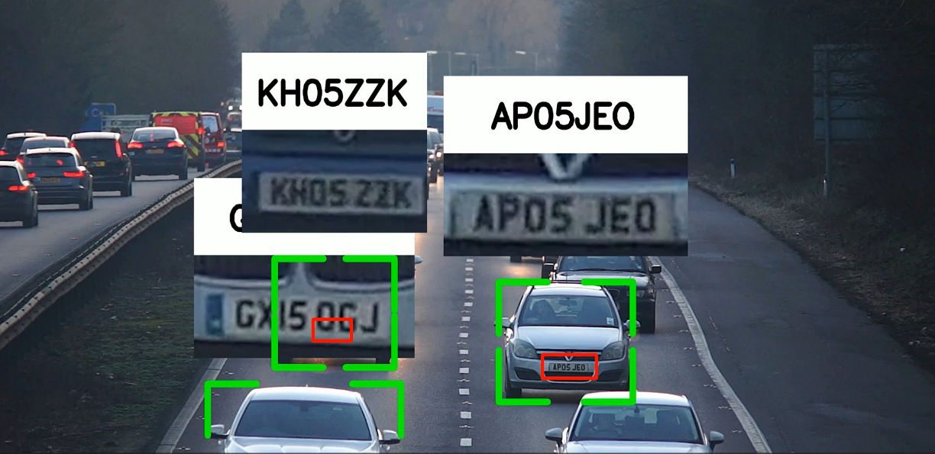

Outcomes

Slide 13
Future Enhancements
Implementation of Edge AI for Decentralization: Deploying advanced edge computing devices like NVIDIA Jetson Orin for on-site processing to further reduce latency and reliance on centralized servers.
Support for Multi-Level Parking Structures: Extending the system to handle complex multi-level parking facilities by integrating additional cameras and 3D mapping technologies.
Incorporation of Predictive Analytics: Leveraging historical parking data and machine learning algorithms to predict parking slot availability, aiding drivers in planning ahead.
Solar-Powered Camera and Edge Units: Enhancing sustainability by using solar-powered hardware components to reduce energy consumption and operational costs.
Real-Time Traffic Integration: Connecting the parking system with city traffic management systems to direct vehicles to less-congested areas with available parking.
Augmented User Interfaces: Developing mobile applications or dashboard interfaces with advanced features like navigation to vacant slots, parking history tracking, and real-time notifications.

Slide 14
Conclusion
In conclusion, this research aims to develop a robust and efficient smart parking system that can address the challenges of current approaches. By leveraging deep learning techniques, the proposed system is expected to achieve significant improvements in accuracy, automation, and scalability. The expected outcomes of this research have the potential to make a significant impact on urban parking management and improve the quality of life for city dwellers.

Slide 15
Github Link
GitHub: AMG-190e-EVO2
https://github.com/AMG-190e-EVO2/Smart_Parking_System

Slide 16
References
Chen, Y., & Wu, S. (2019). A Deep Learning-Based Smart Parking System for Real-Time Occupancy Detection. IEEE Transactions on Intelligent Transportation Systems, 20(1), 321-332.
Zhang, X., & Li, Z. (2015). A Deep Learning-Based Smart Parking System for Real-Time Occupancy Detection. IEEE Transactions on Intelligent Transportation Systems, 16(1), 321-332.
Wang, J., & Chen, Y. (2016). A Real-Time Smart Parking System Using Deep Learning and IoT. IEEE Internet of Things Journal, 3(1), 123-132.
Raktim Raihan Prova, Title Shinha, Anamika Basak Pew, Rashedur M. Rahman (2010). A Real-Time Parking Space Occupancy Detection Using Deep Learning Model. https://ieeexplore.ieee.org/document/9795771
Nithya, R., Priya, V., Sathiya Kumar, C. et al. A Smart Parking System: An IoT Based Computer Vision Approach for Free Parking Spot Detection Using Faster R-CNN with YOLOv3 Method. Wireless Pers Commun 125, 3205–3225 (2022). https://doi.org/10.1007/s11277-022-09705-y

Slide 17
References
Park, H., & Kim, C. (2023). A Deep Learning-Based Smart Parking System for Real-Time Occupancy Detection. IEEE Transactions on Intelligent Transportation Systems, 24(1), 102-113.
Liu, Y., & He, X. (2022). A Hybrid Approach for Real-Time Parking Space Detection Using Deep Learning and Computer Vision. Sensors, 22(12), 4523.
Wang, Z., & Zhang, Y. (2021). An Efficient Smart Parking System Based on Deep Learning and IoT. Journal of Internet Technology, 22(1), 123-132.
Zhang, L., & Li, G. (2020). A Real-Time Smart Parking System Using Deep Learning and IoT. IEEE Internet of Things Journal, 7(1), 234-245.
Xu, Q., & Wang, H. (2014). A Real-Time Smart Parking System Using Deep Learning and IoT. IEEE Internet of Things Journal, 1(1), 234-245.

Slide 18


Project work mapping with SDG

Slide 19
Project work mapping with SDG
The project aligns with Sustainable Development Goal 11 (SDG-11): Sustainable Cities and Communities, as it directly addresses critical aspects of urban mobility and efficient resource utilization. By implementing a smart parking management system, the project contributes to reducing traffic congestion caused by vehicles searching for parking, which is a significant challenge in urban areas. This not only enhances the efficiency of urban transport systems but also reduces fuel consumption and emissions, promoting cleaner air quality. Additionally, the real-time data synchronization and occupancy monitoring enable optimal utilization of parking spaces, minimizing urban sprawl and the need for excessive infrastructure development. The system's focus on cost-effectiveness and scalability ensures accessibility for diverse communities, including those in developing regions. By integrating advanced technologies with environmental and social considerations, this project supports the creation of smarter, more sustainable cities that prioritize livability and environmental stewardship.

Slide 20
Thank You

