Slide 1
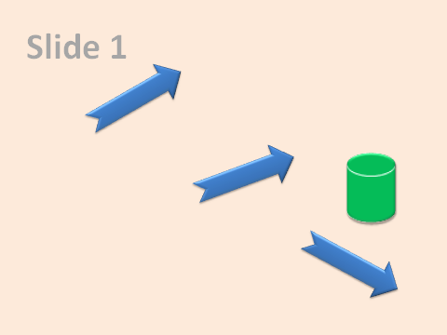
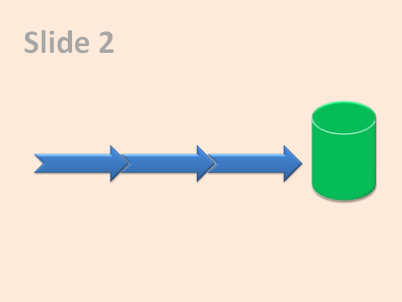

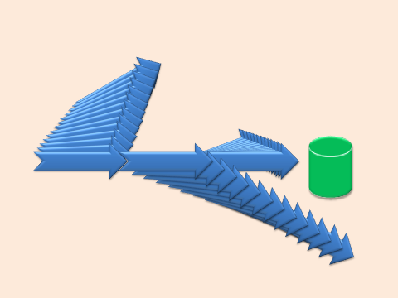
The easiest way to animate shapes in PowerPoint slides
Let’s say you want to animate shapes in slide 1 to end up as they are in slide 2
Select slide 1 and click ‘Add animation slide’
A new slide containing the required animations is added automatically .
Get the free PowerPointLabs plugin from http://PowerPointLabs.info

Slide 2
Slide 1

Slide 4
Slide 2

Slide 5
