Slide 1
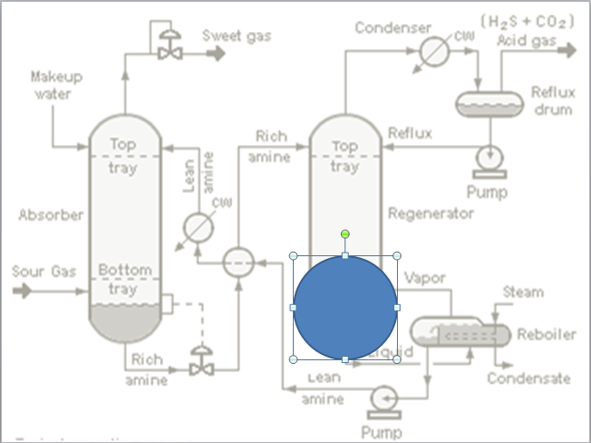
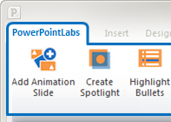
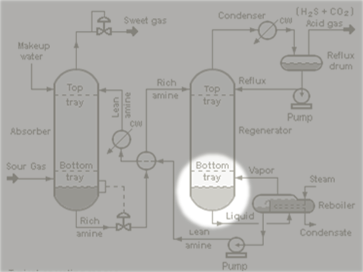
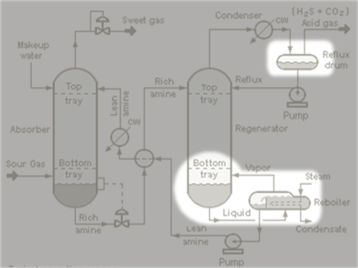
The easiest way to create a spotlight effect in your PowerPoint slides
Draw a shape to mark the area to be highlighted, and click ‘Create Spotlight’
Here’s the generated effect
Works on multiple shapes too
Get the free PowerPointLabs plugin from http://PowerPointLabs.info

Slide 2
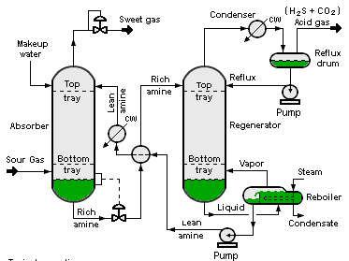

Slide 3


Slide 5


Slide 6
