Slide 1
Examples for Positions Lab

Slide 2

Align to point
Visuals
Visuals
Structure
Structure
Message
Message

Slide 3



Align to point
1/2
1/2

Slide 4




Slide 5
Align using visual edges
PowerPoint
PowerPointLabs

Slide 6
Vertical adjoin
ANALYSIS
DESIGN
IMPLEMENTATION
TESTING
Horizontal adjoin + align
ANALYSIS
DESIGN
IMPLEMENTATION
TESTING

Slide 7


ANALYSIS
DESIGN
ANALYSIS
DESIGN
IMPLEMENTATION
IMPLEMENTATION
TESTING
Horizontal adjoin + align
TESTING
ANALYSIS
TESTING
IMPLEMENTATION
ANALYSIS
DESIGN
IMPLEMENTATION
TESTING
DESIGN

Slide 8
Fruits
Protein
Protein
Fruits
Fats
Vegetables

Slide 9
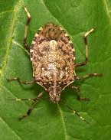
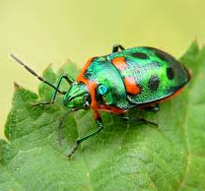


Horizontal distribute, equalize width between objects
Distribute between 1st and 2nd objects.
LAUNCH
TESTING
IMPLEMENTATION
DESIGN
ANALYSIS

Slide 10


Slide 12

1
1
2
1
2
3
4

Slide 13

Overlapping Objects
2
1
2
1
Overlapping Objects
3

Slide 14

LAUNCH
TESTING
IMPLEMENTATION
DESIGN
ANALYSIS
LAUNCH
TESTING
IMPLEMENTATION
DESIGN
ANALYSIS

Slide 15
Shape Edges
Vs
Shape Centers

Slide 16

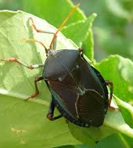


Grid, equalize space between edges

Slide 17
3
4
1
5
8
2
6
7

Slide 18
Left + Right
Within First and Second
Top + Bottom

Slide 19
Left
Center
Right
Top
Center
Bottom

Slide 20

Grid, equalize space between object centers
Male
Female
N/A
Canada
USA
Mexico

Slide 21
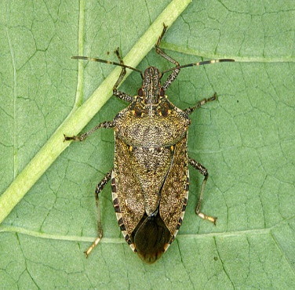

Swap

Slide 22
Cyclic Swap
Team F 19
Team F 19
Team A 15
Team B 17
Team C 15
Team A 15
Team D 13
Team C 15
Team B 11
Team D 13

Slide 23
Cyclic Swap by clicking order
Team C 16
Team B 20
Team D 13
Team F 19
Team A 15
Team C 16
Team F 19
Team A 15
Team B 20
Team D 13

Slide 24

Swap anchor point

Slide 25
Repack

Slide 26

Clear
Clear
Consistent
Current
Consistent
Complete
Concise
Current
5 C’s
5 C’s
Overlapping Objects
Concise
Complete

Slide 27
Point away/towards object
Primary cause 1
Secondary causes
Primary cause 2
Primary cause 3

Slide 28

Rotate around object
Horizontal move
A
B
A
B

Slide 29

Snap horizontal

Slide 30

Snap away

